Slide 1
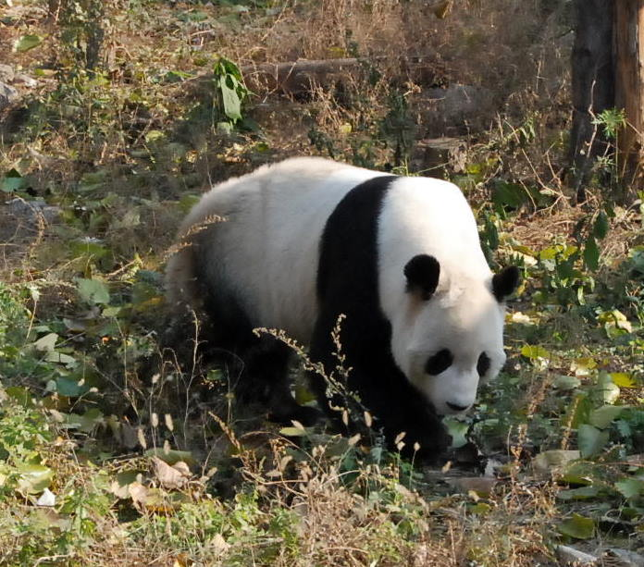
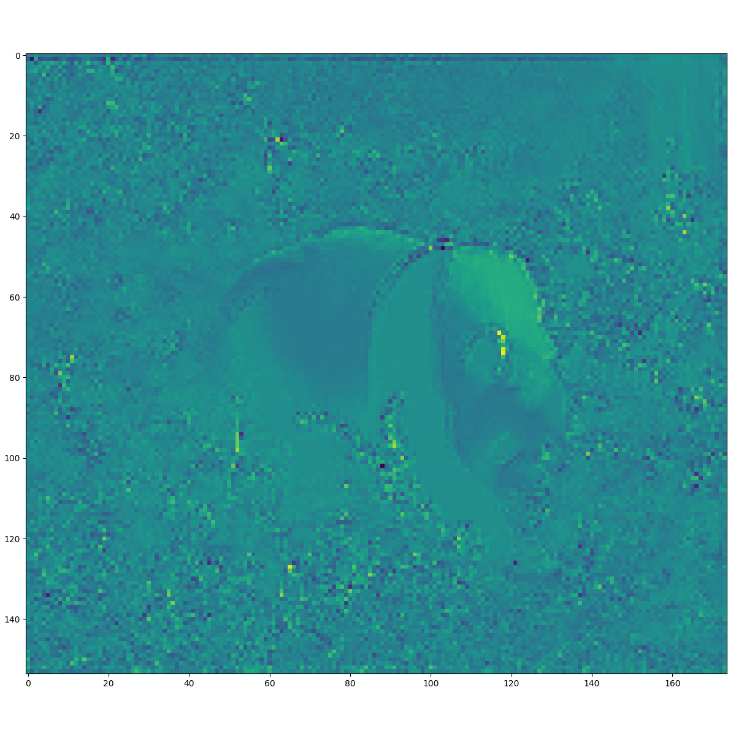

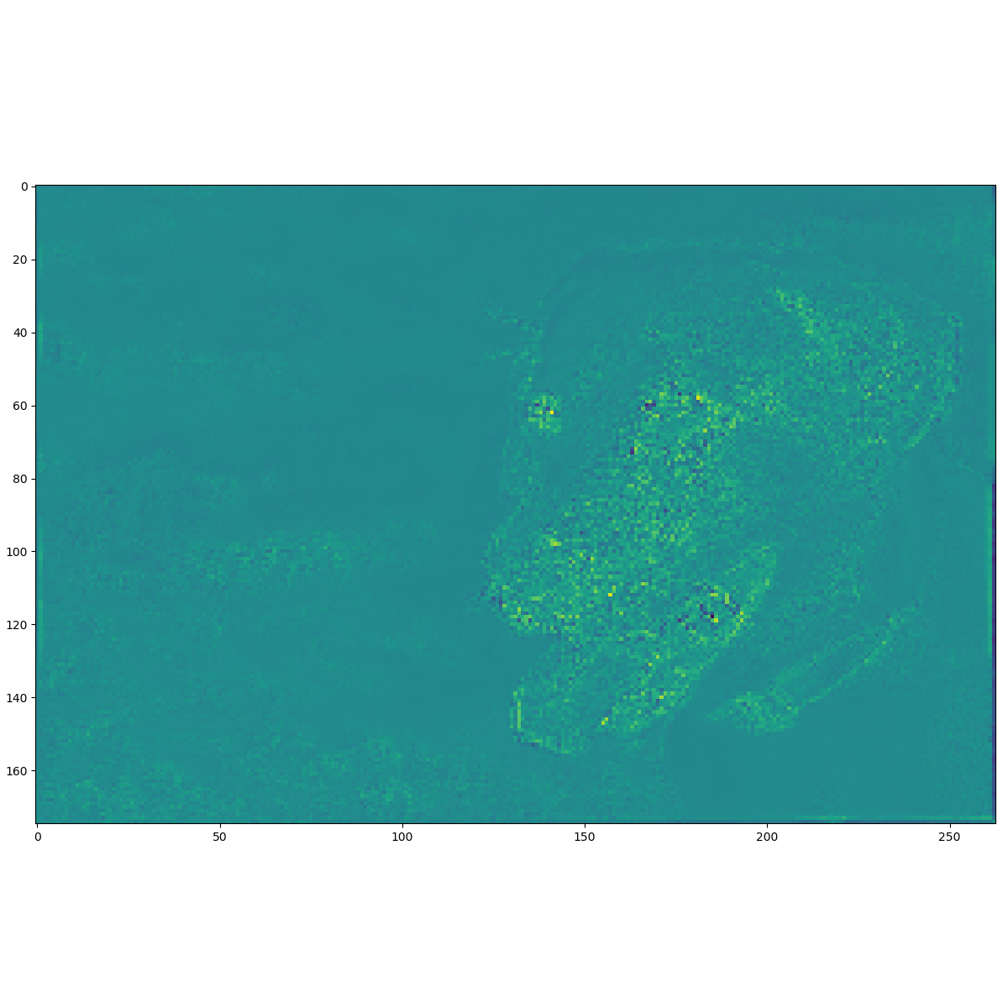
EfficientNet-B0 Endponit 2
EfficientNet-B0 Endponit 3

Slide 2
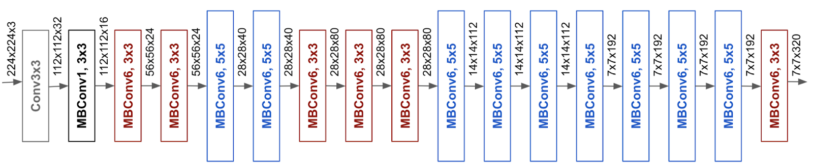
block1a_project_bn
block2b_project_bn
block3b_project_bn
block4b_project_bn
block4b_drop
block4c_project_bn
block4c_drop
code gives 14 x 14 x 80
block5c_project_bn
block5c_drop
block6d_project_bn
block7a_project_bn
Bottle Neck

