Slide 1

Week 1: Python
Data Science Bootcamp
Fall’ 23
Instructor: Kartik Jindgar

Slide 2
About the bootcamp
We will start from scratch!
It is okay if you can’t program in Python

Slide 3
About the bootcamp
We have an action-packed agenda!
Week 1
Week 2
Week 3
Week 4
Python
SQL
Numpy & Pandas
Data Visualization

Slide 4
About the bootcamp
We have an action-packed agenda!
Week 5
Week 6
Week 7
Week 8
ML
ML
ML
Project Presentation

Slide 5
Resources
Review the syllabus!
Join the SLACK community – Perfect place to ask your questions and discuss interesting problems!
Visit the GitHub page to access ppts and jupyter notebooks discussed in each section
You can email us at datasciencebootcamp@nyu.edu

Slide 6
Agenda
Why Python ?
Datatypes
Control Statements
Loops
Functions
Object Oriented Programming

Slide 7
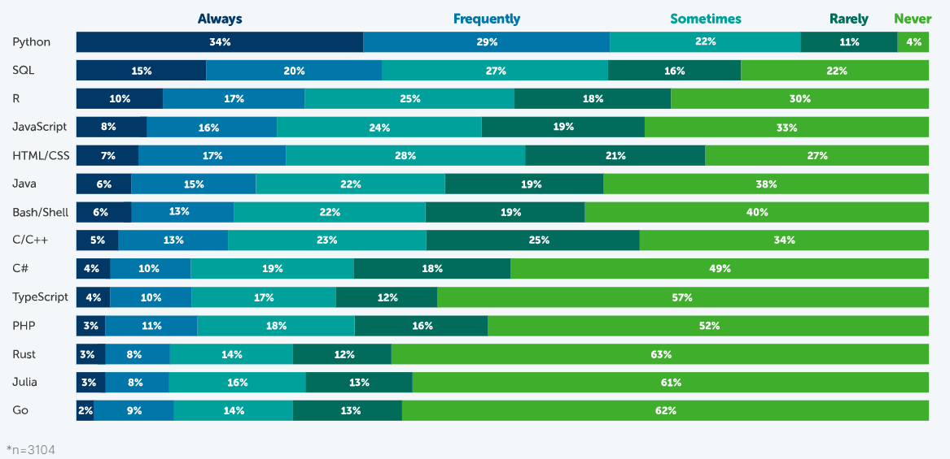
Why python ?
For data scientists, researchers, students, and professionals worldwide, Python is becoming an increasingly popular programming language.
63% or respondents frequently used Python
Source: Anaconda Report 2021

Slide 8
Why python?
EASY to read, learn and write
Its HIGHLY PRODUCTIVE – Much more concise and requires less time, effort and lines of code to perform the same operations
Its slow but Development Speed >> Execution Speed
Big Community – Rich set of standard libraries and frameworks for several purposes

Slide 9
Hands on exercise
https://github.com/kartikjindgar/NYU-DataScience-BootCamp-Fall23/blob/main/Week1/DataScienceBootcamp_Week1_Section1.ipynb

Slide 10
QnA

