Slide 1
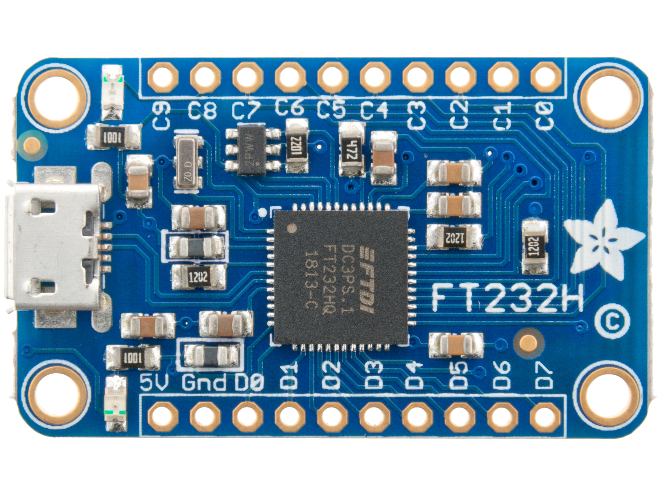
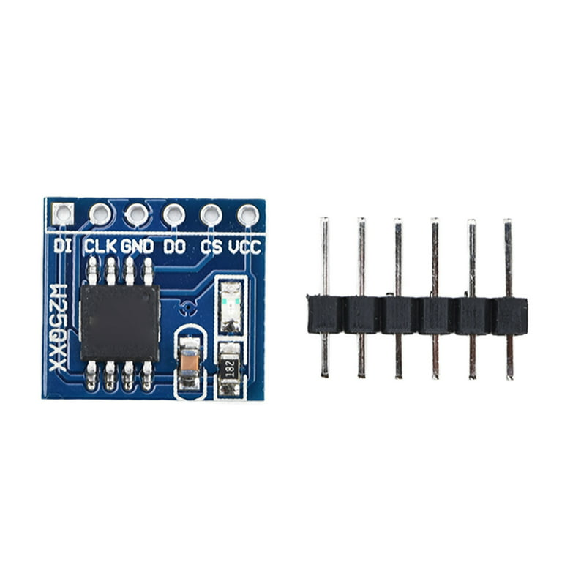
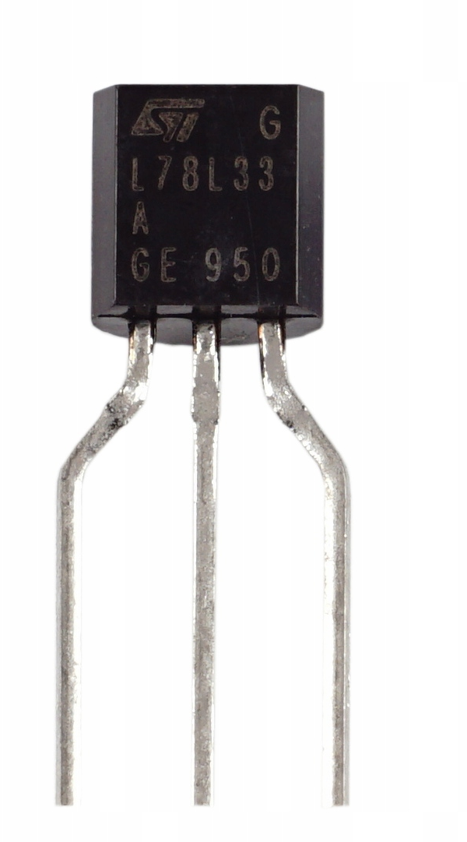
FT232H Breakout Board
L78L33
SPI FLASH
3.3V
CS
MISO
GND
CLK
3.3V
5 V
GND
MOSI
5 V
CLK
CS
MOSI
GND
MISO

Slide 2
FT232H Breakout Board
L78L33
SPI FLASH
3.3V
CS
MISO
CS
MISO
GND
MOSI
3.3V
5 V
CLK
CLK
GND
GND
MOSI
5 V

