Slide 1
ETL Pipeline for Brand Sentiment Analysis
Automated ETL pipeline for brand sentiment analysis from news articles using MongoDB, Neo4j, and an interactive Flask dashboard for visualizing results.

Slide 2
Business Problem
Business Problem
Marketing agencies need to evaluate potential brand partners for their clients by assessing brand reputation which in many case is associated with brand sentiment and association. However, manually tracking online mentions and sentiment across various sources is time-consuming and inefficient especially when it must be done across different forms of information platforms (I.e : audio, short videos, long videos , images, texts)
Proposed Solution
This project aims to build an automated ETL pipeline that crawls NYT historical articles, extracts brand mentions and associates adjectives across a panoply of news website to assess their reputation and alignment for potential collaborations.The rationale for this is that news are read by consumers directly on social media and potential customers look into few words about brands to make economic decisions
Objectives
Continuously monitor online sentiments and key topics for Nike(eg: festivals, sport events)
Identify emerging market trend in the sport apparel industry
Detect shift in Nike’s brand perception
Benchmark Nike against competitors like Puma, Adidas, Lululemon

Slide 3
Data Source & Procurement
Primary Data Source: NYT Article Datafile https://www.kaggle.com/datasets/tumanovalexander/nyt-articles-data
Endpoint: download nyt_data.parquet file directly from Kaggle and access the data locally
Authentication: None needed to access the Kaggle dataset
Query Parameters: Query parameters are not used during the upload process. Filtering and data selection happen after the entire file has been loaded into MongoDB
Response Data: Raw data Included fields like title, excerpt, year
Storage Plan: Data is initially stored in MongoDB for flexible document-based storage

Slide 4







Design Choices & Functionality for Selected Technologies
To efficiently assess brand reputation by automating the extraction and analysis of brand mentions, we have selected a combination of MongoDB, Neo4j, and Flask. These technologies are critical for data extraction, storage, relationship modeling, and retrieval.
MongoDB – NoSQL Database for Data Aggregation
The brand analysis pipeline involved loading and indexing news data in MongoDB, specifically tagging brand mentions. Subsequent steps included detailed analysis of 'Nike' (sentiment, co-occurrence, temporal trends), comparative visualizations with 'Asics' and other brands, and final data structuring in MongoDB and a DataFrame for reporting.
Neo4j – Graph Database for Relationship Modeling
Applied three Neo4j queries process data from a CSV file to create or update Brand and Keyword nodes (lowercase) based on specific keyword lists, establishing MENTIONED_WITH relationships for 'young', 'new', and 'athletic', TRENDING_WITH relationships for 'young' and 'musical', and ASSOCIATED_WITH relationships for 'good' and 'athletic'.
Flask – API for Data Retrieval and Streaming
The Flask application is providing a web interface to explore the relationship between the listed athletic and apparel brands (Adidas, Asics, Hoka, Lululemon, New Balance, Nike, Puma, Reebok, Under Armour) and the adjectives used to describe them, specifically as found within NYT article dataset.
Other Technologies:

Slide 5



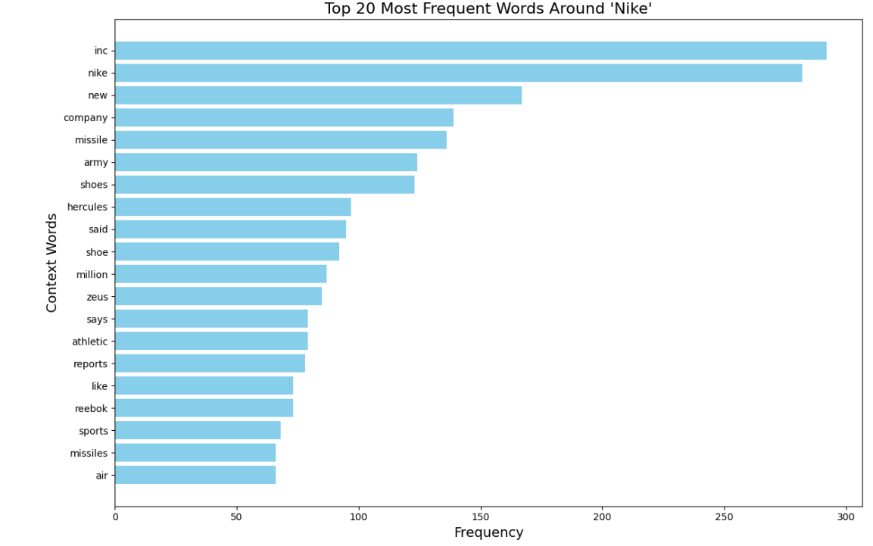
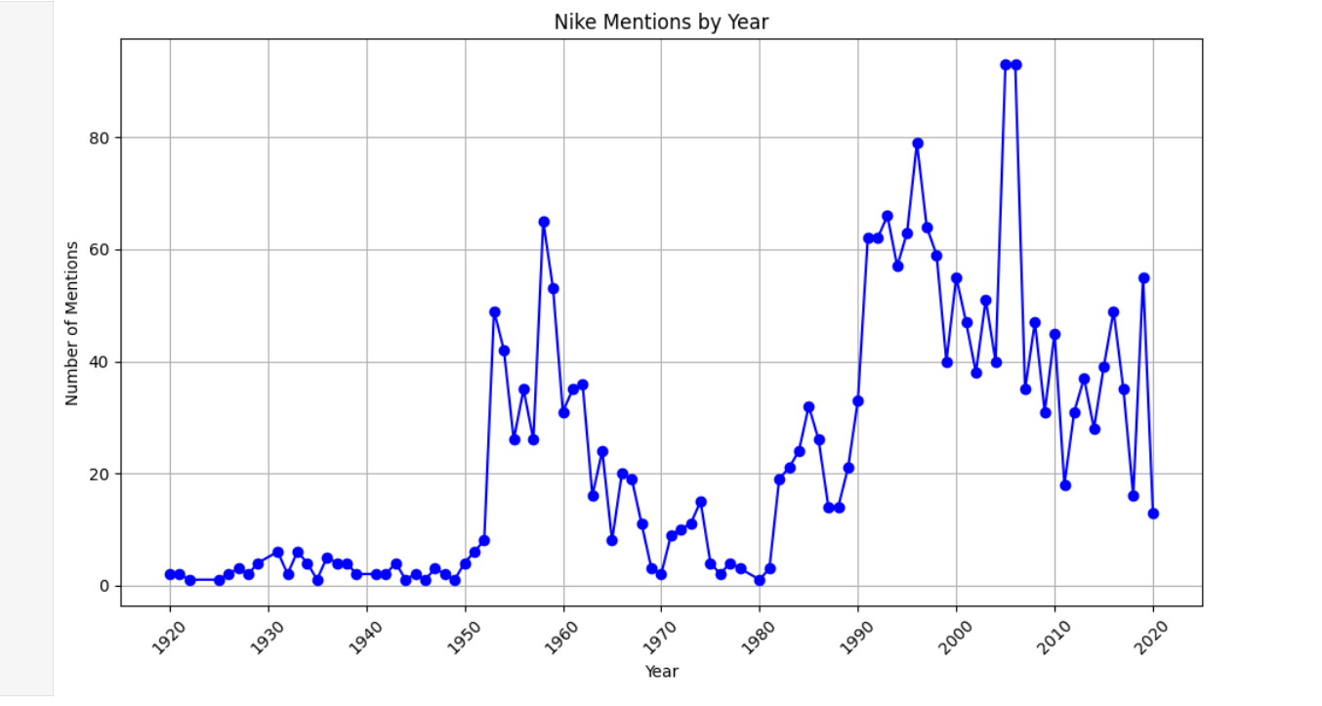
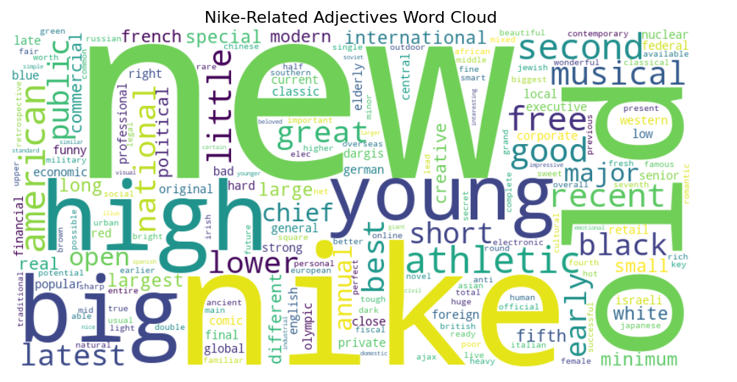
MongoDB
6.Export final Data for Neo4j analysis
2.Clean Data
1.Read Data
3.connect to MongoDB, create database & collection
4.Insert data into MongoDB as dictionaries
2.93 GB
unstructured news articles
7.Final Data for Flask web output.
5. Analysis Performed using Database in MongoDB
Brand Tagging: Search for brand mentions, create a new 'brand' column.
Indexing: Create an index on the 'brand' column for faster querying.
Tokenization: Tokenize articles, remove stopwords, extract frequent tokens per brand.
Adjective Extraction: Identify frequent adjectives, add to each article's data.
Nike Analysis: Detailed sentiment and content analysis on Nike articles.

Slide 6
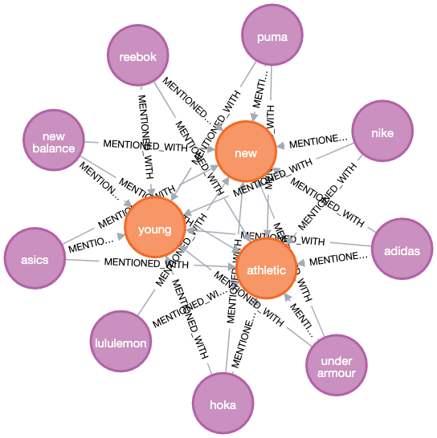
Neo4j
Visualizes how brands are positioned through language
Reveals gaps and strengths in brand messaging
Confirms Nike’s strong positioning
Highlights competitor blind spots Nike can exploit

Slide 7
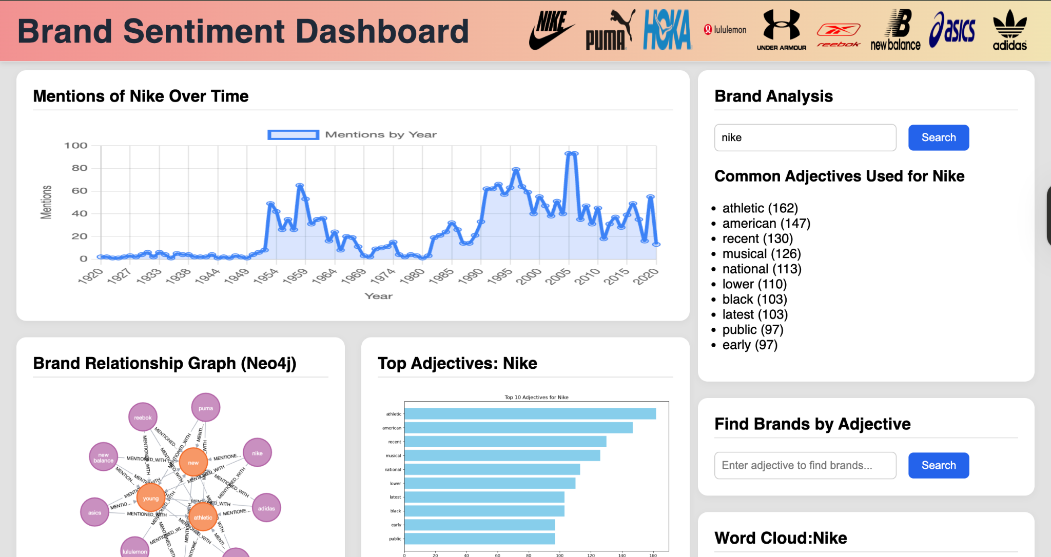
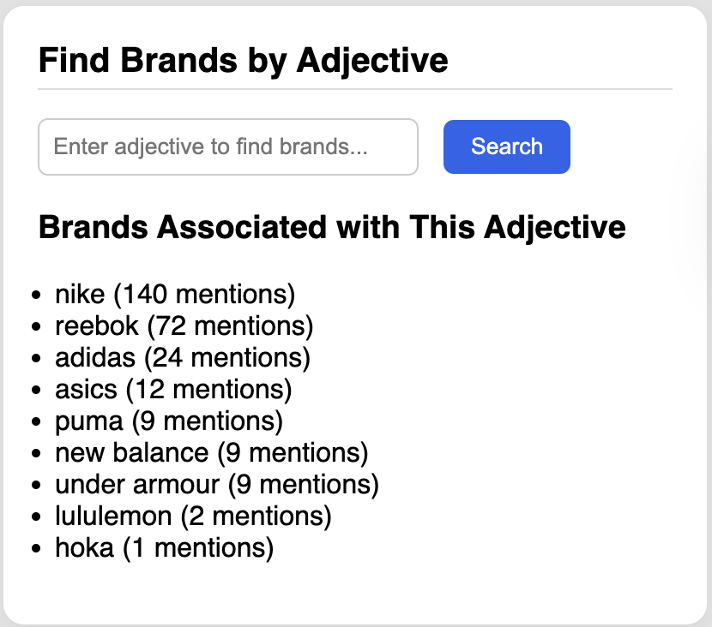
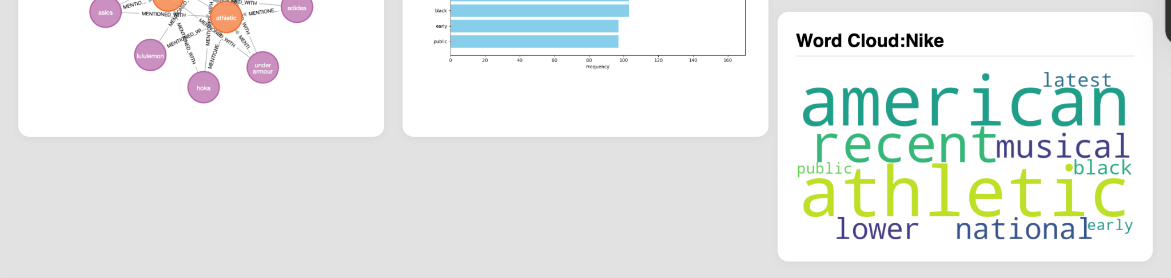
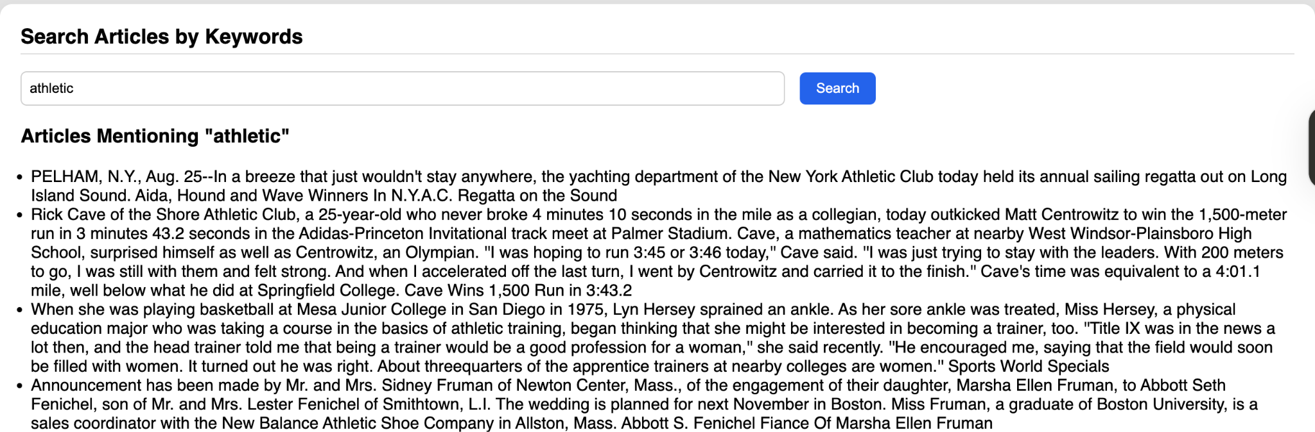
Flask

Slide 8
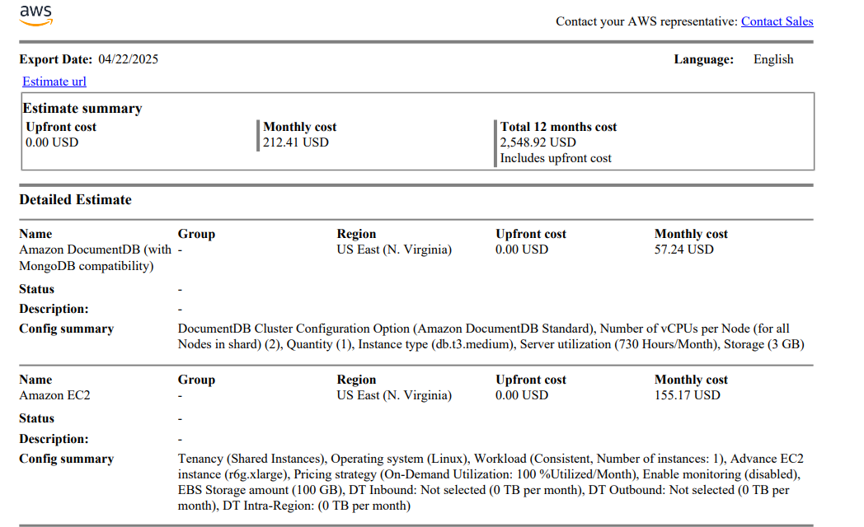
Licensing, Scalability, Cost and Data Quality
Cost Estimate
Scaling: Incorporating additional news datasources and running additional analysis if an organization were to execute
.
MongoDB- Necessary to scale up by increasing resources of the server. Improve optimization by utilizing explain() to analyze query performance.
Neoj4- Purchasing enterprise edition to allow for clustering spreading the data and query load across multiple servers. Improve optimization by utilizing PROFILE to analyze query execution plans.
Flask- lightweight and well-suited for horizontal scaling running multiple instances behind a load balancer.
Data Quality:
Assess completeness of dataset for missing values
Checking the date range of articles and identifying any out of range dates and removing them.
Checking the keyword appear in the text.
Licensing (increases cost):
MongoDB Atlas- fully managed cloud database service and licensing is part of the service subscription where cost is based on usage.
Neo4j Enterprise Edition- commercial license that offers enhanced scalability, high availability, security features, and enterprise support.
Data- NewsAPI Business: $449 month/$5,388 year allows for commercial projects, 250,000 requests/month
Notes:
Other considerations- licensing of data and personnel to manage analysis
Overall Monthly Estimate: Our current estimated monthly cost for the outlined infrastructure is $212.41 USD.
Amazon DocumentDB (MongoDB Compatible):
The estimated monthly cost for our managed DocumentDB service is $57.24 USD.
This covers a standard tier instance (db.t3.medium with 2 vCPUs) running continuously with 3 GB of storage.
Amazon EC2 Instance:
The estimated monthly cost for our advanced EC2 instance (r6g.xlarge) is $155.17 USD.
This instance is configured for consistent workload, running on-demand at full utilization, with 100 GB of EBS storage.

Slide 9
Conclusion
Successfully built an end-to-end automated ETL pipeline to analyze brand mentions in NYT and related news articles by using MongoDB, Neo4j and lastly a Flask-based API/interface for our end- user end interaction with the data in real-time. Product’s main function is surfacing brand reputation signals from unstructured data which showcases its relevance for marketers and ,enables real-time brand reputation assessment to support collaboration decision, strategic partnerships and sponsorships.
Recommendations for real life data management practices:
Ethical Use with Data Governance Lead / AI Ethics Officer:
Implement transparency guidelines and bias detection structure to ensure that the data provides a fair representation, especially when analyzing sensitive or polarizing brand coverage.
Schedule Regular Data Refresh with Data Engineer / DevOps Engineer:
Automate the ETL pipeline with appropriate softwares (ex:Airflow ,Cron jobs) to ensure data freshness and maintain an up-to-date reputation assessment.
Expand Data Sources with Data Engineer / Web Scraping Specialist
Enlarge the crawler to pull from diverse and high-authority media sources to improve data coverage and reduce likelihood of source bias that may occur in analyzing blogs, social media, news articles.

Slide 10
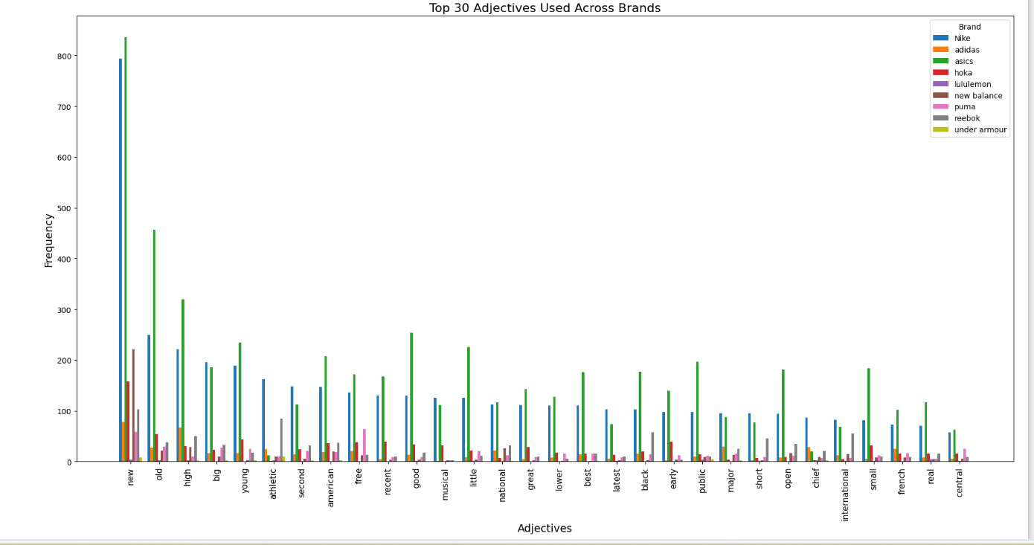
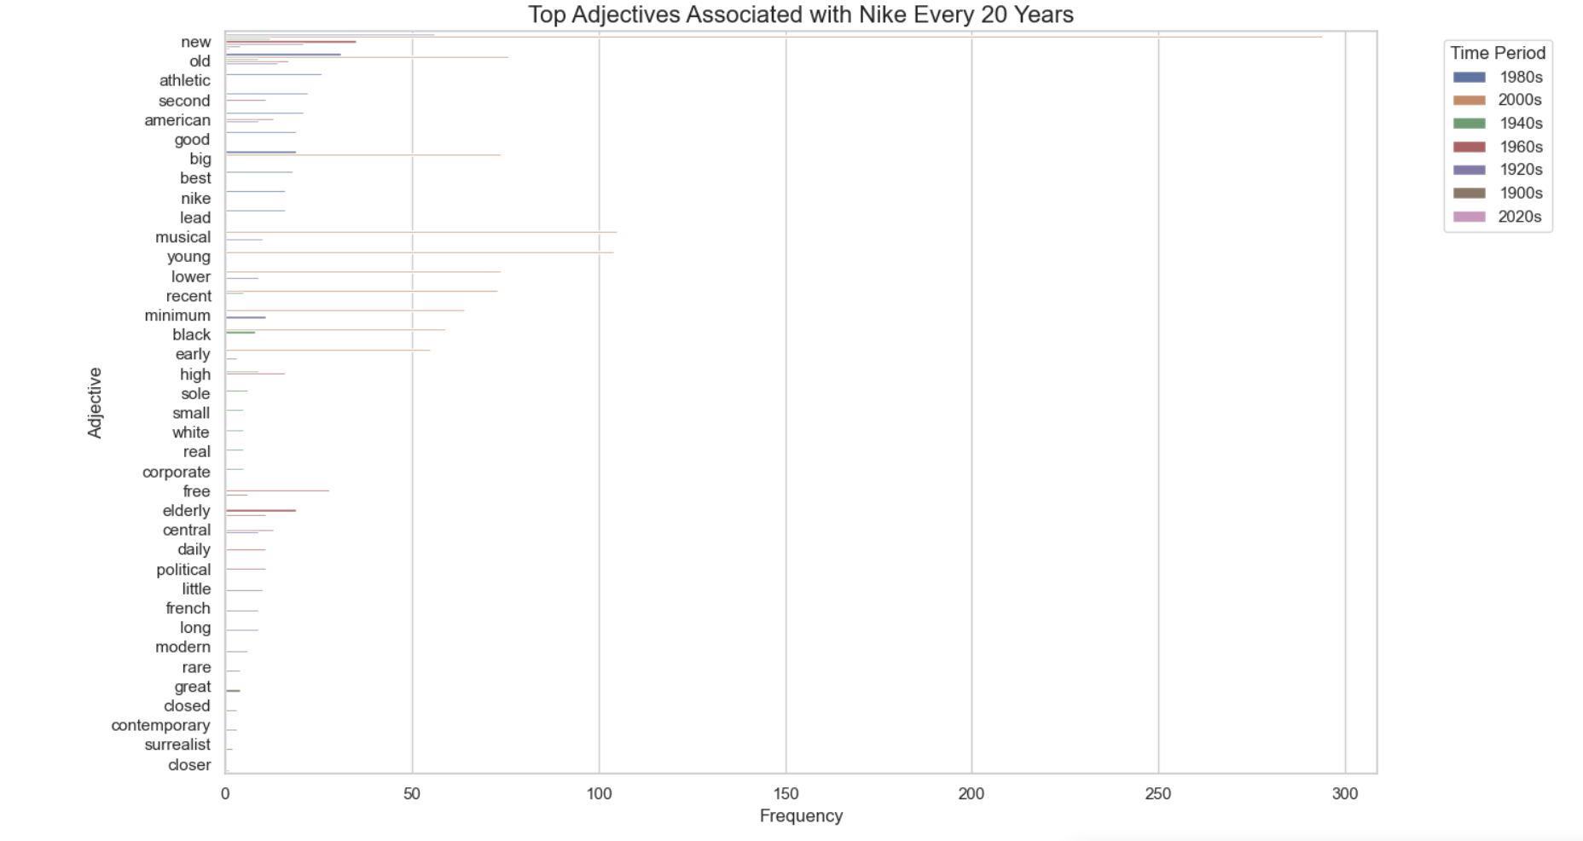
To remove

