Slide 1

IT PBL Cryptography Subject Teacher- Shweta Tiwaskar Ma’am
Div:C
Batch:C1
Sr no. | Name | Roll no. | GR no.
1 | Pratiksha Andhare | 223003 | 22110793
2 | Siddhant Ankar | 223004 | 22110700
3 | Prasad Bhosale | 223011 | 22110876

Slide 2
INTRODUCTION
Cryptography is a technique to achieve confidentiality of messages. The term has a specific meaning in Greek: “secret writing”. Nowadays, however, the privacy of individuals and organizations is provided through cryptography at a high level, making sure that information sent is secure in a way that the authorized receiver can access this information
Everyone needs communication to express their feelings or opinion or for information passing. Normal people will communicate by speaking and deaf and dumb people by using sign language. Morse code is a type of sign language which is very useful for secret communication and this type of communication is important in army, navy, and air force departments why because in those departments there is so much sensitive information which shouldn't be reviled to others and that information should not be understandable by others. So, they prefer a separate way of communication, which is called the Morse Code

Slide 3
ABSTRACT
Cryptography is the practice of secure communication in the presence of third parties. It involves various techniques for encoding and decoding information to protect it from unauthorized access.
One such technique is the use of Morse code, a system of dots and dashes that represent letters and numbers. Morse code was developed in the early 19th century and is still used today in various applications, including aviation and amateur radio communication.
The use of cryptography and Morse code is crucial in many fields, including military operations, financial transactions, and data privacy. This abstract provides a brief overview of these important topics and their significance in modern communication.

Slide 4
Tkinter
Tkinter is the Python interface to the Tk GUI toolkit shipped with Python
It is the standard GUI library for Python.
Python when combined with Tkinter provides a fast and easy way to create GUI applications.
It provides a powerful object-oriented interface to the Tk GUI toolkit.

Slide 5
Base64
Base64 is a group of similar binary-to-text encoding schemes that represent binary data in an ASCII string format by translating it into a radix-64 representation. The term Base64 originates from a specific MIME content transfer encoding.
Base64 encoding schemes are commonly used when there is a need to encode binary data that needs to be stored and transferred over media that are designed to deal with ASCII. This is to ensure that the data remain intact without modification during transport. Base64 is commonly used in a number of applications including email via MIME, and storing complex data in XML.
One common application of Base64 encoding on the web is to encode binary data so it can be included in a data.

Slide 6
Algorithm:-
Import the necessary libraries – base64 and Tinker.
Take the choice from user cryptography or morse code.
If cryptography, then take the input as a message and password if password is wrong end, else take choice encrypt or decrypt.
if encrypt convert the message in encoded form the display the value.
if decrypt decode the data using base64 and display the actual value.
If morse code take the user input text as message take the choice Eng-morse or morse-Eng .
If Eng-morse convert the message into morse code with the help of morse dict.
If morse-Eng convert the message into real message with the help of morse dict.
end

Slide 7
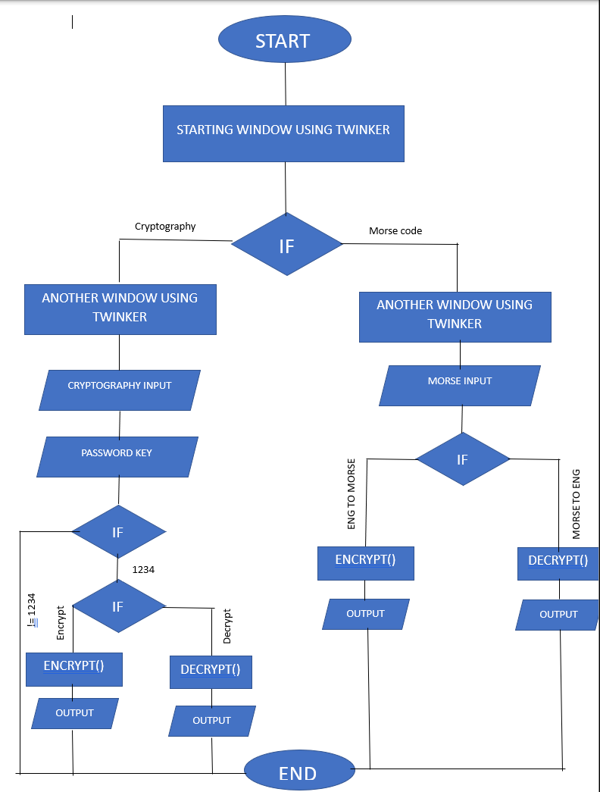
FlowChart:-

Slide 8
Encrypt Function:-
CRYPTOGRAPHY: In cryptography we import a base64 library to make use of its encoding and decoding feature. when the function is called the input text is converted into encrypted code with the help of a base64 library. And return the encrypted value.
MORSE CODE : In morse code we declare a dictionary in which we map the morse value with the key and when the function is called we take the input text and take letter/digit one by one and with the help of those key we form the whole morse code and store it in cipher. And return the cipher.

Slide 9
Decrypt Function:-
CRYPTOGRAPHY: In cryptography we import a base64 library to make use of its encoding and decoding feature. when the function is called we take the input value and decrypt it with the help of a base64 library. And return the original value.
MORSE CODE: In morse code we declare a dictionary in which we map the morse value with the key and when the function is called we take the input text and with help of the values we find the key of those values and form the real message and store it in decipher. And return the decipher, and display it.

Slide 10
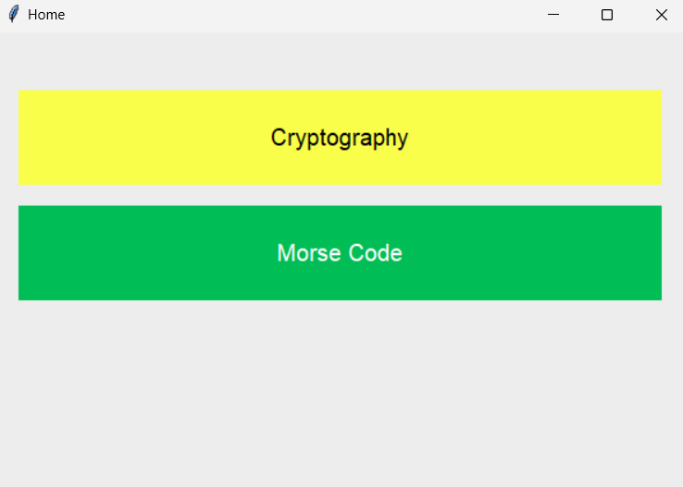
Output:

Slide 11
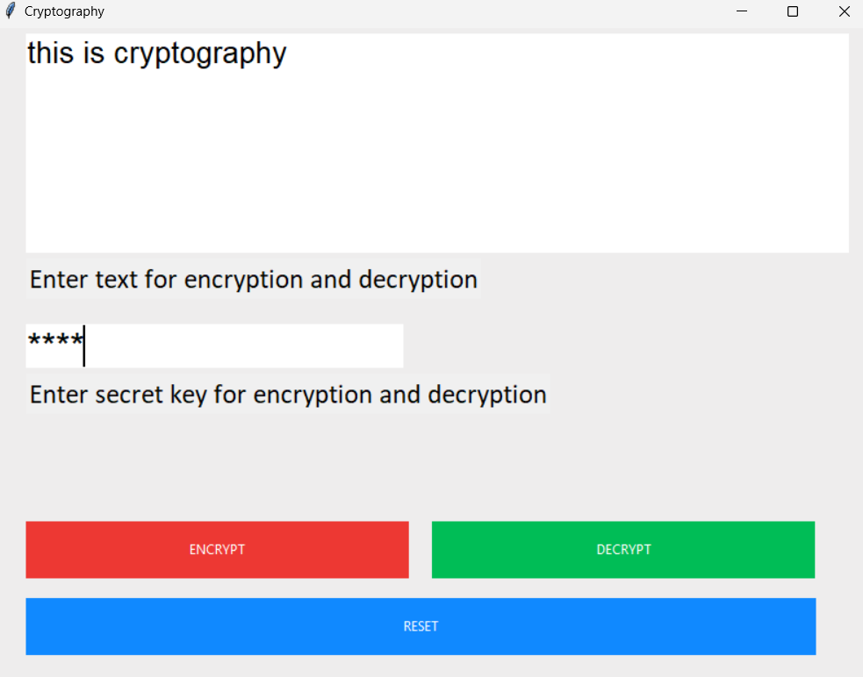
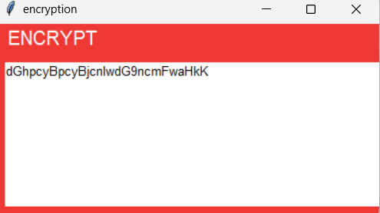

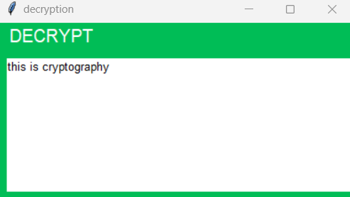
Output:
CRYPTOGRAPHY

Slide 12
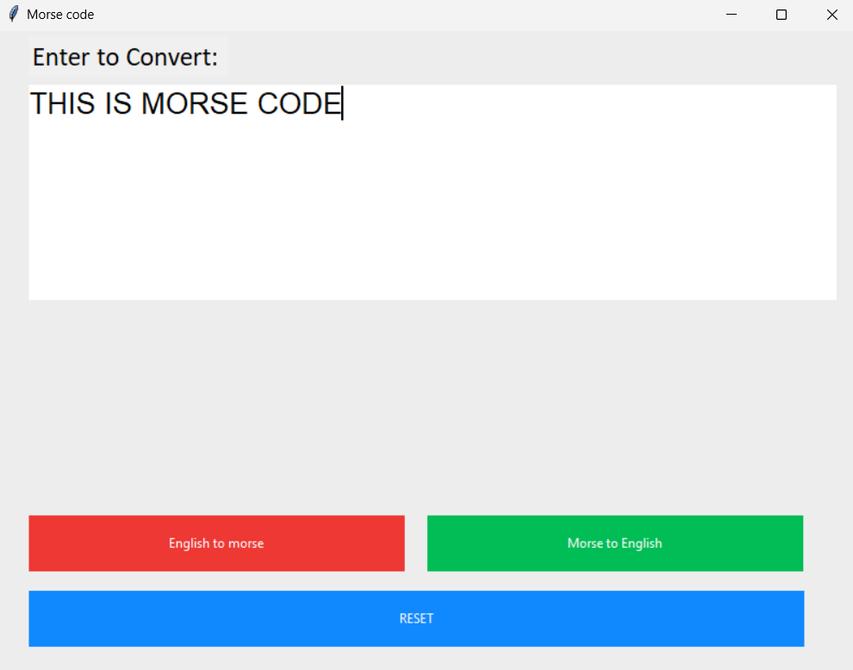
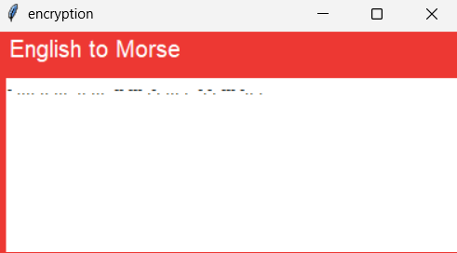
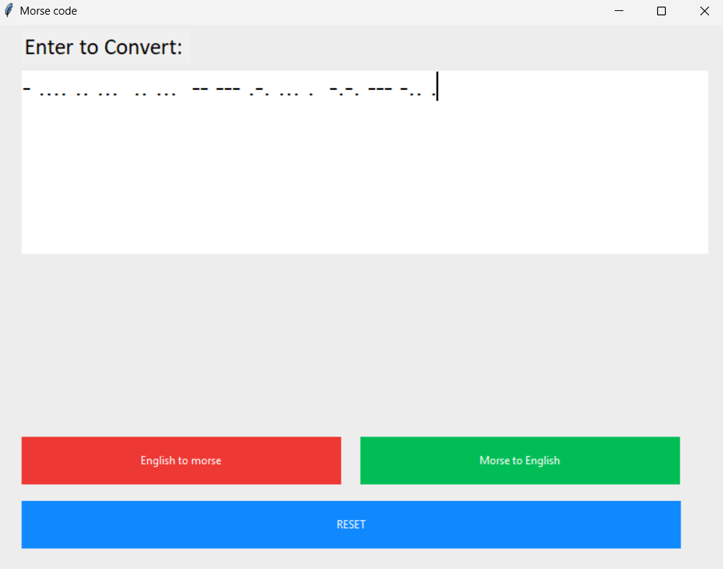
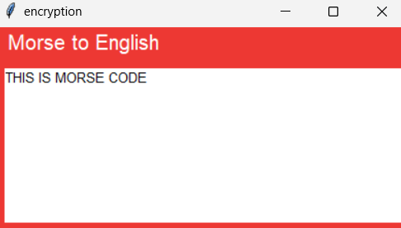
Output:
MORSE CODE

Slide 13
Conclusion:
Cryptography is all about securing communication from unauthorized access or modification, and using Morse code as a way to transmit the encrypted message adds another layer of security. Cryptography has the important purpose of providing reliable, strong, and robust network and data security. Cryptography provides features like security, simplicity, versality, accessibility.
Morse code is a relatively simple communication method that can be easily learned and used by anyone, including those without technical expertise. Morse code can be used in a variety of situations, from sending secret messages in wartime to communicating with others in noisy or low-light environments. This makes it a versatile tool for communication and encryption. whereas our system has resolved the complicated issues and added predictive power to it. But the only flaw in the proposed system is that the time limit is associated with dots and dashes. So, in the future, we can improve the model by removing the time limits and implementing advanced machine learning algorithms such as Neural Networks. This model could also be extended to words and sentences and even for paragraphs.

Slide 14
References:
https://developer.mozilla.org/en-US/docs/Glossary/Base64
https://www.geeksforgeeks.org/cryptography-and-its-types/
https://www.researchgate.net/publication/352040167_An_Approach_for_Morse_Code_Translation_from_Eye_Blinks_Using_Tree_Based_Machine_Learning_Algorithms_and_OpenCV
https://www.researchgate.net/publication/334418542_A_Review_Paper_on_Cryptography

Slide 15
THANK YOU!

