Slide 1
Diabetes 130-US hospitals for years 1999-2008
Davide Capacchione
Big Data project

Slide 2
Introduction
The problem : Despite high-quality evidence showing improved clinical outcomes for diabetic patients in hospitals who receive various preventive and therapeutic interventions, many patients do not receive them. This can be partially attributed to arbitrary diabetes management in hospital environments, which fail to attend to glycemic control.
Failure to provide proper diabetes care not only increases the managing costs for the hospitals (as the patients are readmitted) but also impacts the morbidity and mortality of the patients, who may face complications associated with diabetes.
The goal is to determine the early readmission of the patient within 30 days of discharge.

Slide 3
Dataset
The dataset represents ten years (1999-2008) of clinical care at 130 US hospitals and integrated delivery networks. Each row concerns hospital records of patients diagnosed with diabetes, who underwent laboratory, medications, and stayed up to 14 days.
Over 50 features representing patient and hospital outcomes satisfying the following criteria:
It is an inpatient encounter (a hospital admission).
It is a diabetic encounter.
The length of staying was at least 1 day and at most 14 days
Laboratory tests were performed during the encounter.
Medications were administered during the encounter.

Slide 4
The task
This problem will be approached as a classification task to predict the label column readmitted having 3 distinct values:
‘>30’ : patient readmitted after 30 days or more discharge
‘<30’ : patient readmitted within 30 days after discharge
‘NO’ : patient not readmitted after discharge
Reference to the paper Impact of HbA1c Measurement on Hospital Readmission Rates: Analysis of 70,000 Clinical Database Patient Records for detailed description of the attributes.

Slide 5


Experimental setting
Physical Machine
Windows 11 (64-bit)
Intel Core i7-8750H CPU @ 2.20 GHz
6 cores
16 GB RAM
Virtual Machine
Linux Ubuntu (64-bit)
8 GB RAM
4 virtual processors
2.2 GHz max processor speed
System
Hadoop pseudo-distributed (v. 3.2.0)
YARN
Pyspark programming API (v. 3.2.1)

Slide 6
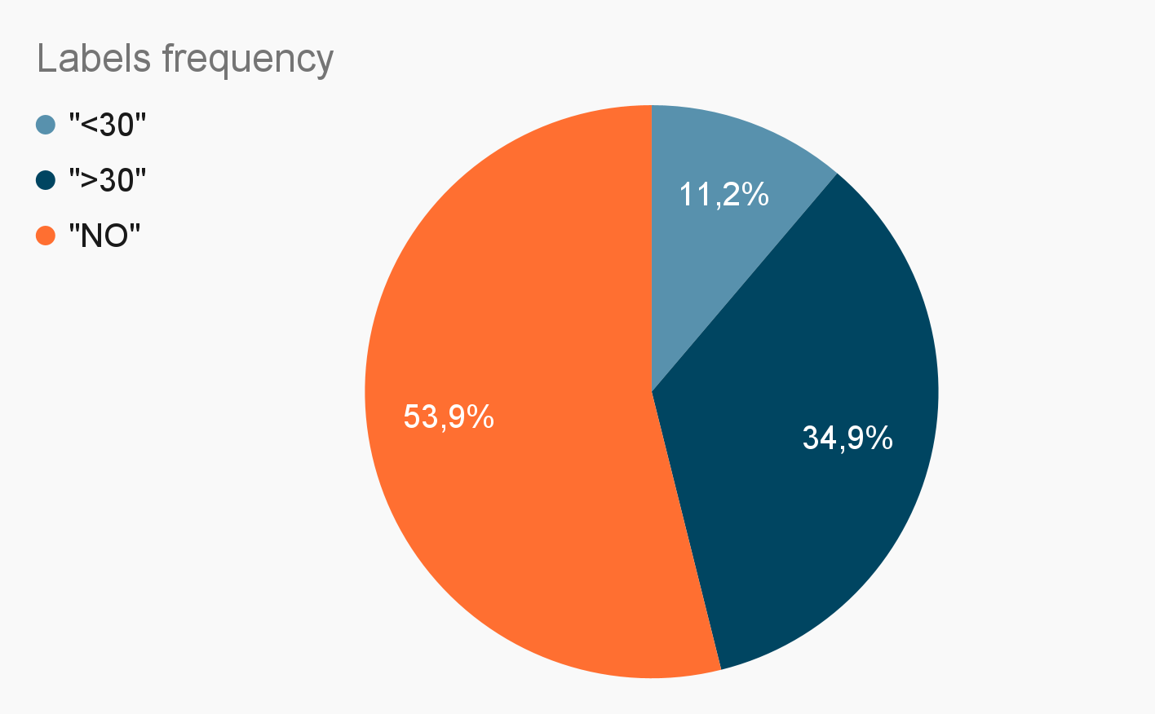
1. Data exploration
47 features
101766 instances
71518 patients
missing values present
unbalanced class label
Feature type : Categorical/Integer

Slide 7
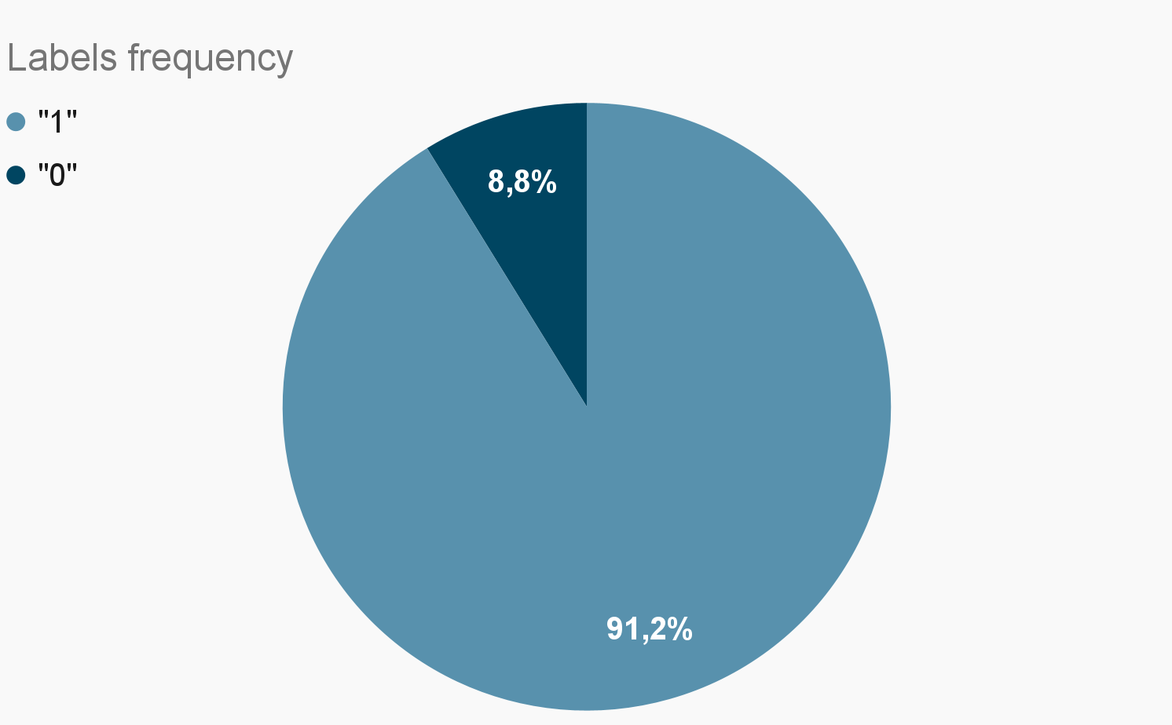
2. Pre-processing
Missing values
Drop null value rows for columns gender and race .
Drop columns having more than 40% of missing values: weight, payer_code, medical_specialty .
Feature selection
Drop single value columns: examide, citoglipton, glimepiride-pioglitazione .
Drop rows of already visited patients to avoid bias.
Drop columns: encounter_id, patient_nbr .
Feat. transformation
Labels aggregation, switch to a Binary classification problem (focus on positives):
“>30”, “NO” 0
“<30” 1
StringIndexer to all categorical columns (37 columns transformed).

Slide 8
Resampling: Problem
Resampling techniques have been used in order to account for class unbalance (towards the negatives in this case).
Main issue: dealing with resampling of health-related datasets is a delicate situation because of a rare occurrence of certain pathologies or clinical conditions:
Overfitting
Noise
Loss of diversity of minorities
Oversampling
Undersampling
Loss of potentially valuable information

Slide 9
Resampling: Solution
Combining undersampling and oversampling at a moderate level enables us to benefit from both the techniques while mitigating their potential drawbacks.
SMOTE oversampling
Generates new synthetic samples of minority class similar to the original ones.
Sampling= 0.5 k_neigbors=5
Random undersampling
Removing instances from the majority class to balance class distribution in a dataset.
Ratio = 2 ( 1:2 )
from imblearn.over_sampling import SMOTE
# use SMOTE oversampling
smote = SMOTE(sampling_strategy=0.5,k_neighbors=5, random_state=random_state)
# Apply SMOTE
X_resampled, y_resampled =smote.fit_resample(X,y)
df_resampled = X_resampled.join(y_resampled)
def resample(base_features,ratio,class_field,base_class):
pos = base_features.filter(col(class_field)==base_class)
neg = base_features.filter(col(class_field)!=base_class)
total_pos = pos.count()
total_neg = neg.count()
fraction=float(total_pos*ratio)/float(total_neg)
sampled = neg.sample(False,fraction)
return sampled.union(pos)
df_resampled = resample(df_resampled,ratio = 2,class_field = labelCol,base_class = 1)

Slide 10
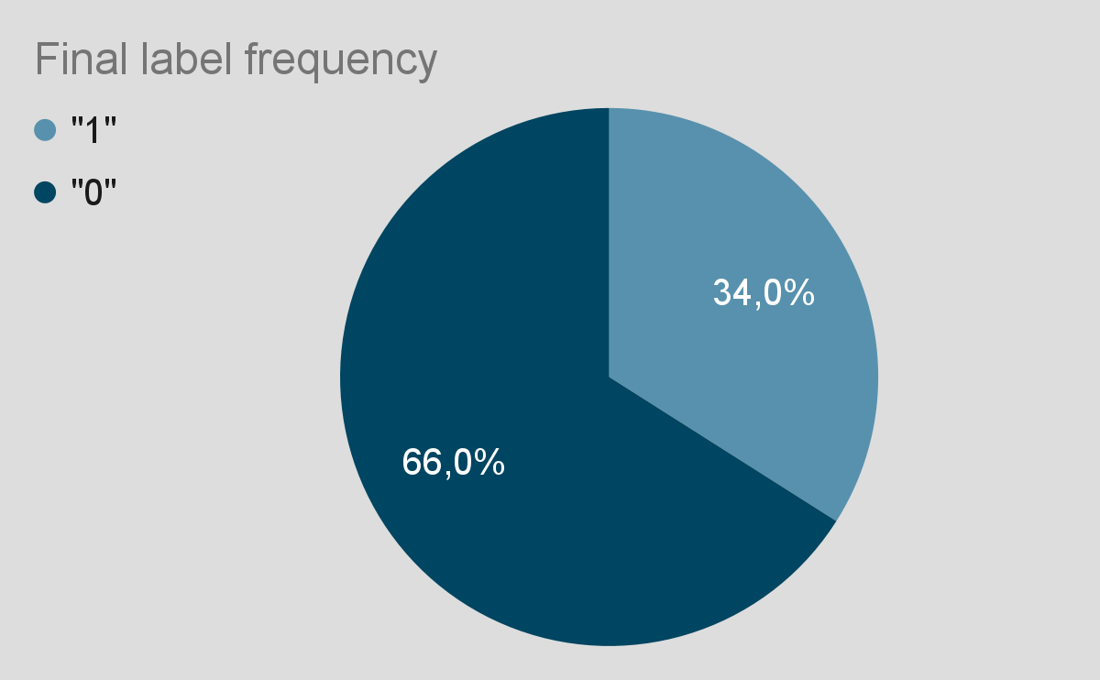
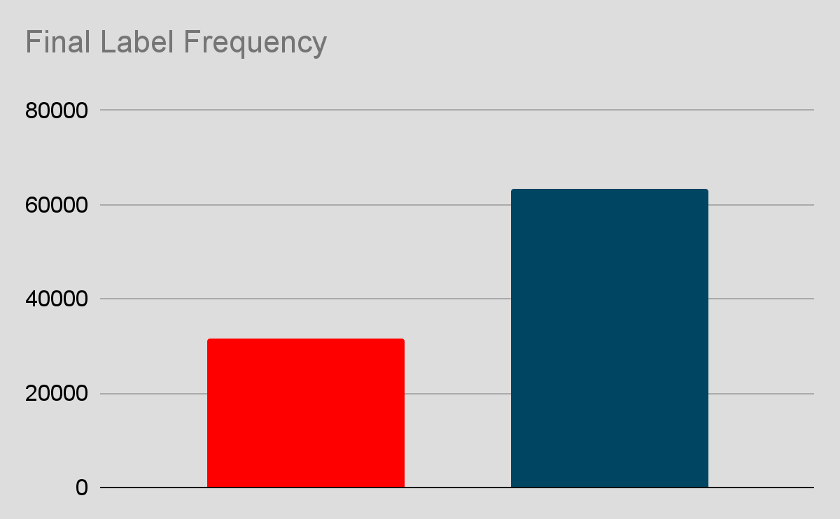
Resampling: Result
In this way we rebalanced the class labels to be respectively:
0 : 66% of the total
1 : 33% of the total
We chose to apply this ratio as we aim to keep the occurrence of the readmission within 30 days as a rarer event compared to the others.
Moreover, the choice of the parameters
led to better results experimentally speaking.
Number of instances: 95125

Slide 11
Data statistics
 | admission_type_id | discharge_disposition_id | admission_source_id
count | 95125 | 95125 | 95125
mean | 2.0492 | 3.5112 | 5.655
stddev | 1.478 | 5.23155 | 4.1752
min | 1 | 1 | 1
max | 8 | 28 | 25
readmitted
95125
0.3333
0.4714
0
1
…
Statistics not very insightful because of features being ids or codes (mostly converted from categorical).
Number of instances increased after sampling.

Slide 12
3.Models
Logistic Regression | lr = LogisticRegression(featuresCol=featuresCol, labelCol=labelCol, maxIter=10)
Polynomial Regression | plr = PolynomialLogisticRegression(featuresCol = featuresCol,labelCol=labelCol)
Decision Tree | dt = DecisionTreeClassifier(featuresCol=featuresCol, labelCol=labelCol)
Random Forest | rf = RandomForestClassifier(featuresCol=featuresCol, labelCol=labelCol, numTrees=100, seed=random_state)
Gradient Boost | gbt = GBTClassifier(featuresCol=featuresCol, labelCol=labelCol, maxIter=10, seed=random_state)
SVM | svm = LinearSVC(featuresCol=featuresCol, labelCol=labelCol)
Naive Bayes | nb = NaiveBayes(featuresCol=featuresCol, labelCol=labelCol)
Perceptron | nn = MultilayerPerceptronClassifier(featuresCol=featuresCol, labelCol=labelCol, layers=[len(cols), len(cols), 2])

Slide 13
4.Results - no resampling
 | Accuracy | F1_score | Precision | Recall
Logistic Regression | 0.614 | 0.004 | 0.267 | 0.002
Polynomial Regression | 0.589 | 0.021 | 0.216 | 0.011
Decision Tree | 0.476 | 0.01 | 0.333 | 0.005
Random Forest | 0.632 | 0.0 | 0.0 | 0.0
Gradient Boost | 0.653 | 0.008 | 0.389 | 0.004
SVM | 0.492 | 0.0 | 0.0 | 0.0
Naive Bayes | 0.433 | 0.148 | 0.154 | 0.143
Perceptron | 0.605 | 0.002 | 0.999 | 0.001

Slide 14
4.Results - resampling
 | Accuracy | F1_score | Precision | Recall
Logistic Regression | 0.621 | 0.031 | 0.407 | 0.016
Polynomial Regression | 0.805 | 0.495 | 0.93 | 0.338
Decision Tree | 0.713 | 0.768 | 0.999 | 0.624
Random Forest | 0.886 | 0.683 | 1.0 | 0.519
Gradient Boost | 0.893 | 0.831 | 1.0 | 0.712
SVM | 0.566 | 0.0 | 0.0 | 0.0
Naive Bayes | 0.656 | 0.322 | 0.413 | 0.265
Perceptron | 0.63 | 0.153 | 0.507 | 0.09

Slide 15
Discussion
Applying resampling leads to a drastic improvement of the results.
GradientBoost and RandomForest classifiers outperform other models in term of accuracy and F1_score, probably due to their robustness to overfitting and capabilities of handling non-linear relationships. The last one tends to make more errors in predicting the minority class, as evidenced by the lower recall score.
Accordingly, LogisticRegression and LinearPerceptron classifiers perform poorly because only suitable for linear application.
The dataset is relatively small in term of number of instances and cannot fully take advantage of Hadoop.

Slide 16
Future improvements
Applying PCA to consider the features that are more relevant for classification. This facilitates a rapid identification of key parameters for patient monitoring.
Experiment with a wider range of parameters for the machine learning models to explore diverse configurations and potentially improve overall performance.
Improve the pre-processing step.
Execute the software on a bigger cluster of physical machines rather than utilizing a pseudo-distributed environment to fully exploit Hadoop potential.
Try to collect more data to expand the dataset with more recent patient information in order to improve models’ performances.

Slide 17
Thanks for your attention!

