Slide 1
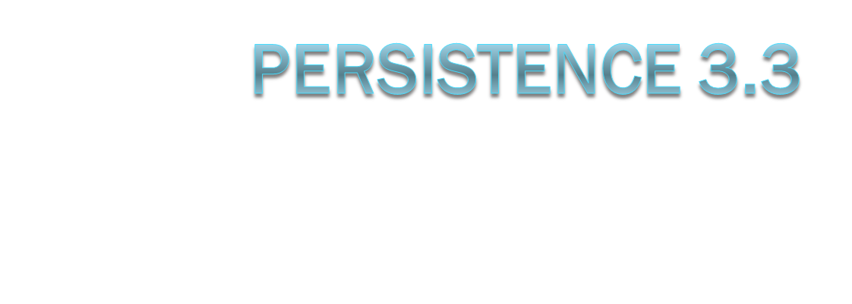
HeuristicLab

Slide 2
Motivation
less memory pressure
  no DOM
  single pass
  linear process
less developer effort
  no interfaces to implement
modularity & flexibility
  not specific to XML
  not specific to any interface (i.e. [Storable])

Slide 3
Components
driver: serializer (deserializer)
  traversal of object graph
  object graph → tree/stream
object analysis
  composite serializer
back end: generator (parser)
  primitive serializer
  serial object information → file/db

Slide 4

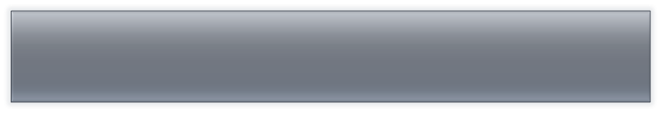

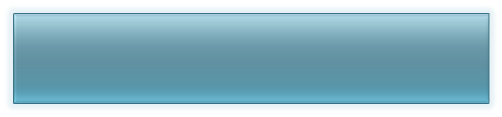
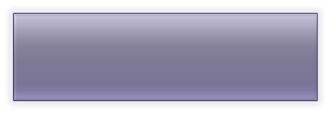

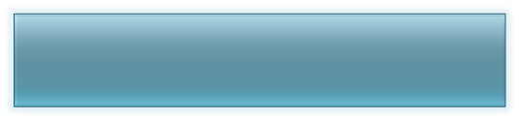


Overview
serialization
live objects
deserialization
serializer / deserializer
composites
serialization tokens
generator / parser
primitives
persisted objects

Slide 5

Example
<composite 1>
<composite 2>
<primitive 3/>
<composite 4>
<reference 3/>
<primitive 5/>
<composite 6>
<reference 1/>
<reference 4/>
<composite 7>
<reference 4/>
<reference 5/>
</composite>
</composite>
</composite>
</composite>
</composite>
1
2
3
4
5
6
7

Slide 6






Composite Serializers
2
2
3
4
3
4
2
extract or compose from
  sub-objects
  meta information
decide whether they are applicable

Slide 7

Primitive Serializers
<primitive 3>
3
</primitive>
3
transform between
  in-memory object
  serial format (e.g. XML text)
fixed mapping between formatter ⬄ type

Slide 8
Configuration
specific to output format (e.g. XML)
contain
  composite serializer (in order)
  primitive serializer
included in type cache
persistent (ConfigurationService)
default configuration through reflection

Slide 9


Use
std. data types are handled
new classes can use StorableSerializer
  add [Storable] attribute to fields or properties
public class IntWrapper {
[Storable]
private int Value;
[Storable]
public string Name {
get; private set;
}
...
}
[EmptyStorableClass]
public class NonSerialized {
private int TransientValue;
...
}
public class Empty { }

Slide 10

Advanced Use
custom serialization through property
load old version: Name=, DefaultValue=
public class TimeTest {
public DateTime lastLoadTime;
[Storable(Name="Time", DefaultValue=DateTime.Now)]
private DateTime lastLoadTimePersistence {
get { return lastLoadTime; }
set { lastLoadTime = DateTime.Now; }
}
}

Slide 11
Hacking
ZIP File
data.xml contains serial object graph
  Tags: COMPOSITE, PRIMITIVE, REFERENCE, NULL
  Attributes: name, id, typeId, ref
typecache.xml contains mapping of
  typeId to
  AssemblyQualifiedName
  serializer

Slide 12
Extension & Customization
more efficient serialization through new custom serializers (e.g. compact array)
introduce new format by replacing generator and parser
  e.g. DebugString
replace [Storable] mechainsm
  disable StorableSerializer
  add new generic composite serializers

Slide 13

IPrimitiveSerializer Example
[EmptyStorableClass]
public class String2XmlFormatter :
PrimitiveSerializerBase<string, XmlString> {
public override XmlString Format(string s) {
return new XmlString(s);
}
public override string Parse(XmlString x) {
return new x.Data;
}
}

Slide 14

ICompositeSerializer Example
[EmptyStorableClass]
public class EnumerableDecomposer : ICompositeSerializer {
public int Priority { get { return 100; } }
public bool CanSerialize(Type type) {
return type.GetInterface(typeof(IEnumerable).FullName) != null;
}
public IEnumerable<Tag> CreateMetaInfo(object o) { return new Tag[] { }; }
public IEnumerable<Tag> Decompose(object obj) {
foreach (object o in (IEnumerable)obj) {
yield return new Tag(o);
}
}
public object CreateInstance(Type type, IEnumerable<Tag> metaInfo) {
return Activator.CreateInstance(type, true);
}
public void Populate(object instance, IEnumerable<Tag> tags, Type type) {
foreach (var tag in tags )
type.GetMethod("Add").Invoke(instance, new[] { tag.Value });
}
}

Slide 15

ICompositeSerializer Example
[EmptyStorableClass]
public class EnumDecomposer : ICompositeSerializer {
public int Priority { get { return 100; } }
public bool CanSerialize(Type type) {
return type as Enum != null;
}
public IEnumerable<Tag> CreateMetaInfo(object obj) {
yield return new Tag(Enum.Format(obj.GetType(), obj, "G"));
}
public IEnumerable<Tag> Decompose(object obj) { return new Tag[] { }; }
public object CreateInstance(Type t, IEnumerable<Tag> metaInfo) {
IEnumerator<Tag> it = metaInfo.GetEnumerator();
it.MoveNext();
return Enum.Parse(t, (string)it.Current.Value);
}
public void Populate(object instance, IEnumerable<Tag> elements, Type t) {}
}

Slide 16
Versioning
full version information is stored
fall back to compatible version
  same major & minor version number
  newer build & revision
possibility of independent archives
  contain all required assemblies
    serialized types
    used serializers

Slide 17
Next Steps
conversion
  replace Populate/GetXML() → [Storable]
rebuild engines
test

