Slide 1
CS 169
Software Engineering
Armando Fox
Fall 2010
Notes:
earliest ever lecture prep! aug 4
follow along download slides

Slide 2
Today...
This overview—filmed in front of a live audience
  Provocative opening remarks
  Why SaaS? What’s different about this course?
  Administrivia
Introduce course staff
Guest speaker: Prof. Dave Patterson on:
  cloud computing
  the future of software: mobile client + cloud
  the RAD Lab and a programming contest
  why it’s a waste of time to multitask during lecture
Q&A with Prof. Fox, via Skype

Slide 3
Good code should be generously commented.

Slide 4
Good code should be self-documenting
Programs must be written for people to read, and only incidentally for machines to execute.-- Abelson & Sussman, Structure and Interpretation of Computer Programs
input = "documenting"
result = []
for x in l:
for y in l:
if sorted(input) == sorted(x+y):
result.append(x+y)

Slide 5
Programs must be written for people to read, and only incidentally for machines to execute.-- Abelson & Sussman, Structure and Interpretation of Computer Programs
input = "documenting"
anagrams = []
for word in word_list:
for other_word in word_list:
if sorted(input) == sorted(first_word+second_word):
anagrams.append(first_word + second_word)

Slide 6
After writing some code, you should write thorough tests for it.

Slide 7
Tests Come First
When debugging broken code, you’re trying to “isolate” the badness by trial & error
Can be hard if you have to get past lots of stuff “around” the broken spot
Solution: write tests first, then write code to pass test => code guaranteed to be testable
This semester, you will write tests & love it

Slide 8
Once code is running and tested, you’re done with that code (until new functionality is needed)

Slide 9
Code is like Prose
First draft is effective but ugly
Writing primarily for others, not for yourself
Bad writing is painful to read
Won’t be perfect on first draft – but recognize that it IS a first draft
Code aesthetics will be part of evaluation—not just “does it run”
Notes:
comments on blogs are a good example

Slide 10

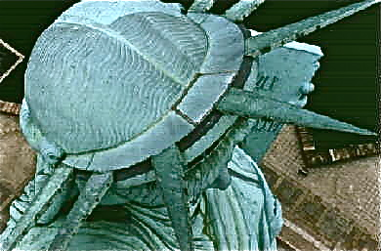

Slide 11

“Capstone programming courses considered harmful”
(Keith Wright, CACM, 4/2010)
“...it is a disservice [to CS seniors] to delude them into thinking they can create a ‘real world’ app in a semester course project.”

Slide 12
Real(istic) Projects
Design, develop and deploy a Software-as-a-Service (SaaS) app of your choice
Use same tools used by production sites
Your projects will work
They’ll be deployed on public cloud, with public invited to project demos
Many projects will likely continue life beyond the course

Slide 13

Effective Craftsmen Learn to Use Good Tools
“It was working yesterday”
“My coworker overwrote my changes”
“I deleted it by accident”
“My hard drive crashed”
✖
✔

Slide 14
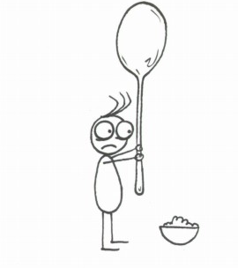

✔
✖

Slide 15
Notes:
Use good tools to avoid needless pain

Slide 16
Why SaaS?

Slide 17
Software as a Service (SaaS)
Software delivered over the Internet as a hosted service, rather than installed on individual users’ computers
  Run customer database on MS Access => Salesforce
  Email Word files around => Google Docs
  StreetAtlas USA => Google Maps
  Quicken => Mint.com
  Buy backup disks => Amazon S3
  Buy servers => cloud computing

Slide 18
Why SaaS is exciting:
“2 people can affect millions”
Web apps deployable instantly to millions of users
  eBay: long weekend, 1 person (Pierre Omidyar)
  Inktomi (first cluster-based search engine): Cal, 2 persons (Prof. Eric Brewer, Paul Gauthier)
  Google (@Stanford) by 2 persons (Larry & Sergey)
  First graphical Web browser on handheld: Cal grad student team including yours truly (1998)
App platforms + social computing make it easier to reach millions of users with powerful apps
  Google Maps API
  Facebook plug-in (“canvas”) apps

Slide 19
Course Goals
Understand new challenges, opportunities, and open problems of SaaS relative to SWS (shrink-wrapped software)
Take a SaaS project from conception to public deployment
  Server side: Ruby on Rails
  Client side: HTML, CSS, AJAX
  Deploy using cloud computing
Can be “connected” app (eg Facebook ) or smartphone app (using HTML/AJAX/CSS)

Slide 20
Prereqs & course format
4 units, letter grade(see homepage for breakdown)
These are real prereqs: CS61[ABC] or equivalents
Format
  Before lecture: reading, and sometimes online self-test
  In lecture: put reading in context
  After lecture: homeworks/labs for hands-on practice
2 midterms
Required team project
  Design a Web app of your choice in 1-pizza teams
  Deploy to “production ISP” (Amazon EC2 or Heroku)
  Outsiders invited (VC’s, etc) to final demos
  Many projects have continued after the class
Notes:
functional programming, map/filter, higher-order programming

Slide 21
Lecture & “Section”
Lecture: concepts, some examples
  0:35 topic 1 + 0:05 Facebook/IM/email break
  0:35 topic 2 + 0:05 One Cool Thing
  A few high-profile guest speakers
Section == GSI office hours
  Occasionally, prepared material
Office hours & locations on homepage
  Instructor & GSI office hours: concept/HW help
  Staffed lab hours (TBA): programming help and hackfests

Slide 22
Homeworks
Some done on your own, others in pairs
Due Thursdays BEFORE class (see Syllabus)
  50% credit up to 48 hours late, 0% thereafter
  ALL homeworks used in calculating grade
First few can be done on your own computer
  Mac OS 10.4 or later, Windows 2000 or later, most Linux distros; see “courseware” on home page
  Contact Lab Staff if you’d rather not use your own computer (no “course accounts”)
Later HW’s and Project will be deployed using cloud computing (details TBA)

Slide 23
Meet the staff
GSIs
  Shoaib Kamil
  Kristal Curtis
Lab staff
  Allen Chen
  Amber Feng
  Karl He
  Brandon Liu
  Sunil Pedapudi

Slide 24
Evolution of SaaS
1990: NCSA Mosaic & HTTP 0.9 (Tim Berners-Lee et al., at CERN)

Slide 25
Evolution of SaaS
1995: Web 1.0 “Content is King”, basic e-commerce (Netscape)
1997: “Services are King” (Web-based email, search engines, eBay, photo sharing...)

Slide 26
Evolution of SaaS 2000-2009
1999: Platform as Service (SalesForce)
2000: Web 2.0 (rich AJAXy UI’s, social computing)
~2003: Service-oriented Architecture (Google Maps, Amazon S3, Mashups, ...)
2008: pay-as-you-go public cloud computing (Amazon Elastic Compute Cloud)
...So what’s different about developing SaaS?

Slide 27
Develop, Assess, Deploy, Operate
What | SWS | SaaS
incorporating new functionality | use libraries | call other services (service-oriented architecture, mashups)
GUI | Cocoa, Windows, X11, Java/Swing, Tk, ... | Browser is the GUI: DHTML/HTML5, CSS, JavaScript
Test cycle | Throw code over the wall to “QA” | Test-first & behavior-driven development, delivering code to customer
Deployment | Press CD’s, distribute through retailers | Deploy on “instant cluster” using public cloud computing
Performance | Single-machine performance key | Single-machine performance nearly irrelevant if can scale out
relationship to end user | 100% of resources of a single, usually wimpy, machine | <0.01% of resources of world’s largest supercomputers

Slide 28
Develop, Assess, Deploy, Operate (cont.)
What | SWS | SaaS
# clients (users) | 1-10s | millions
# servers | 1 | 10s-1000s
distribution | “install wizard” must support many variants of OS, HW, etc. | centrally installed, vendor has ~100% control over single OS/HW configuration
releases (bug fixes, new features) | once or twice a year | once a week
scalability | 1 user on a PC | “spike” can occur anytime (e.g. Michael Jackson’s death; Animoto)
security/threat model | user’s data on her PC is her problem | user’s data is your problem, and the world is full of evil forces
reliability/uptime | app crashes => users file bug reports | site crashes => front page of NY Times
Notes:
ebay: 300 features/qtr, 100K new LOC every 2 weeks

Slide 29
Lead story in NY Times business section
eBay stock down >10% that day

Slide 30


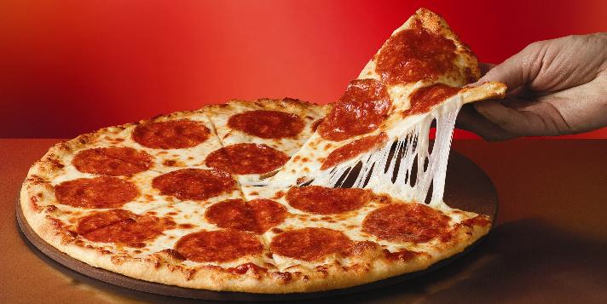



New models of software development
Waterfall: Static Handoff Model, N groups
Large teams, yearly releases
Process: Support
DADO Evolution, 1 group
1-pizza team, bi-weekly releases (iterations)
Develop
Develop
Assess
Assess
Deploy
Deploy
Operate
Operate

Slide 31
Major topics & tools
Software architecture & design patterns
Test-first development
Behavior-driven design
Agile, iteration-based project management
Version management & collaboration
Deploying & operating SaaS
Rails
RSpec
Cucumber
PivotalTracker
Git & Github
Amazon EC2, Heroku

Slide 32
Pre-FAQs
I already know {php,perl,java}...can I use that for the SaaS code?
Can I write a mobile phone app instead?
Can I work on a project solo?
Can I work in a larger team (e.g. 6-8 ppl)?
I already have my own website/vanity URL, can I deploy there instead of EC2/Heroku?
Can my app plug into/work with Facebook, Google Maps, etc.?

Slide 33
Prof. Dave Patterson will discuss...
The datacenter is the server
  Most “interesting” apps have a datacenter component
  “Google scale” == each user request uses 1000’s of machines for a fraction of a second
  Cloud computing brings datacenter scale within the reach of anyone with a credit card
The mobile phone is the client
  More than 50% of world’s population has cell phone
  Nearly continuous connectivity (at a variety of speeds)
  AJAX, HTML5 allow phone browser to support sophisticated apps with rich GUI

Slide 34
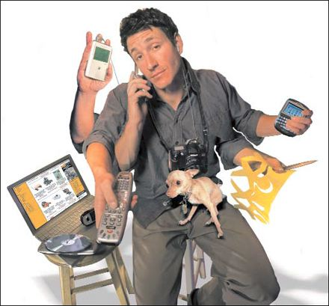
And also...
http://www.columbia.edu/itc/sipa/nelson/newmediadev08/multi-tasking.html

