Slide 1
SaaS Technology Stack

Slide 2
What are our goals?
Write good code
  ...10x more quickly
  ...10x fewer LOC (lines of code)
  ...runs 10x faster
Write beautiful code
  writers start from paragraphs, work their way up to novels
  we will start from functions, work up to SaaS
Write SaaS: how is it different from SWS?

Slide 3

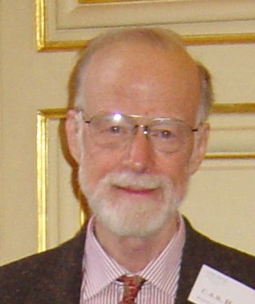
Thoughts on good code
“It’s easier to optimize correct code
than to correct optimized code”
Josh Bloch, Chief Java Architect, Google
“There are 2 ways to design software.
One way is to make it so simple
that there’s obviously no deficiencies.
The other way is to make it so complicated
that there’s no obvious deficiencies.”
Sir Charles Anthony Richard (“Tony”) Hoare,
inventor of Quicksort and of the null reference

Slide 4
SaaS is More to Learn
Everything from conventional/SWS
  algorithm choice, SW architecture, testing, ...
Plus new development & deployment models
Plus working knowledge of many areas outside “core” SW engineering
  networking, databases, security, distributed systems, high availability, cloud computing, ...
  Goal: know what you don’t know and how to fill in the gaps yourself
  Non-goal: become expert in all of the above

Slide 5
In this episode
What are the logical “building blocks” & key technologies behind SaaS?
How do they fit together?
How do these correspond to the evolution from “Web 1.0” to “Web 2.0”?
Non-goal: design & implementation details of underlying protocols (TCP/IP, DNS, routing, etc.)

Slide 6

Web at 100,000 feet
The web is a client/server architecture
It is fundamentally request/reply oriented
What’s this mean? Is it still true in Web 2.0?
Web browser
2.
Web site
A series of tubes
1.
DNS server

Slide 7
Internetwork Routing In Just 2 Slides
Everyone promises to speak IP, the Internet Protocol
  Each machine (“host”) gets a unique host number (IP address)
IP addresses: four numbers separated by dots, each number is between 0-255
  Example: 128.32.67.107
  In binary: 10000000 . 00100000 . 01000111 . 01101011
Addresses are grouped into subnets
  The subnet number is the leftmost part of the IP address
  Exact number of bits depends on size of subnet
You address a packet to a particular IP address
  If the machine with that IP address is on the same subnet as you, you’re done: broadcast it on the wire
Subnet number
Host number

Slide 8
Internetwork Routing
Different subnets are connected by gateway machines
  gateway has multiple IP addresses: one on each subnet that it’s connected to
  also called “multi-homed”
A machine’s route table tells it which gateway(s) can route to which subnet(s)
For esoteric reasons, some subnets are unroutable
  127.0.0.1 aka localhost
  10.0.0.*, 192.168.*.*, some others

Slide 9
Bytes are sent via TCP/IP
IP – the Internet Protocol, the “narrow waist” of the Internet
  hardware- & platform-independent protocol that describes the headers of a packet, its payload, etc. at the byte level
  any hardware that wants to carry IP traffic must define a way to encapsulate it
  physical network interface associates to an IP address through user configuration or DHCP (Dynamic Host Configuration Protocol)
  demo: ifconfig
UDP—best-effort “user datagram protocol” wrapped around IP
TCP (Transmission Control Protocol) makes IP “reliable”
  detect “dropped” packets, data arriving out of order, transmission errors, slow networks, etc., and respond appropriately
  communicators’ view: bi-directional “pipe” where the bytes you put in magically emerge in same order at other side

Slide 10
TCP (& UDP) Ports & Mechanics
TCP & UDP connections have associated port numbers
  from 0–65535, to allow multiple connections per machine
  connection = <protocol, source IP, source port, dest IP, dest port>
  demo: netstat –n –p tcp
By convention, certain port numbers “reserved” for particular services: TCP 80=HTTP, TCP 22=ssh, ...
Typical TCP-based server flow:
  “listen” for incoming connection on a port (how to handle multiple simultaneous connections on same port?)
  usually make assumptions about application protocol of incoming request based on port number or other convention
  bidirectional data exchange until either party closes connection
  mechanics of TCP protocol handled by operating system’s communication abstraction (e.g. socket in Unix-like systems)

Slide 11
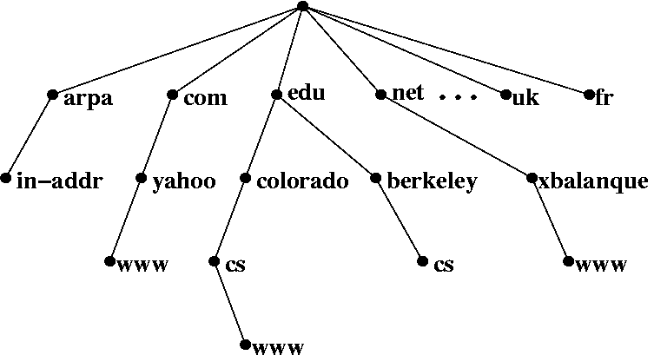
The Domain Name System (DNS)—1982
IP addresses are hard to remember, so we use names
  cs.berkeley.edu, www.google.com, ftp.research.ibm.com
First “word”: host name
Last “word”: top-level domain (TLD)
  originally .edu, .com, .net, .gov, .mil, .org; now also country domains (.ca, .ru, etc.) and new top-levels (.info, .biz, etc.)
  Intermediate parts are intra-organization subdomains
  Adopted in 1982 after switching from “flat” namespace
DNS server (or nameserver) machines listen on UDP port 53
  maps names to IP addresses within its domain or subdomain

Slide 12
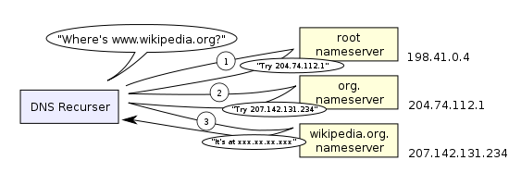

DNS (slightly simplified)
DNS protocol defines format of DNS request (“tell me the IP address corresponding to this name”) and reply, using UDP
Namespace and topology of servers both hierarchical
Most searches start with “nearby” nameserver
If server can’t resolve a name, ask root
  Nameservers exchange information with their parents to stay up-to-date
Homer’s ISP

Slide 13
Key concepts so far
Request/reply, client/server architecture
IP address
port number
DNS lookup
localhost

Slide 14
Hypertext Transfer Protocol
an ASCII-based request/reply protocol for transferring hypertext information around
  ASCII-based == ?
  Protocol == ?
convention: HTTP servers listen on TCP port 80
client therefore sends HTTP request to that port
  a handful of request methods, of which GET & POST are most common
  request includes a uniform resource identifier (URI) that specifies what content is to be transferred
  additional headers specify extra info regarding the transfer request

Slide 15
URI format
scheme, host, port, resource, parameters, fragment
http://search.com:80/img/search/file?t=banana&client=firefox#p2
Demo: nc (netcat) & telnet

Slide 16
Web (HTTP) Server
Piece of software that listens for TCP connections on port 80 (and maybe others)
  TCP port 443 used for HTTPS...more on that later
Expects to receive HTTP requests
Major players then & now...
  NCSA httpd (original HTTP server, now obsolete)
  Apache (open source, powers ~60% of Web sites, descended from “a patchy httpd”)
  Internet Information Server (Microsoft)
  AOLserver (now open source)
  Smaller players: thin, nginx, Tomcat (Java-based)...

Slide 17
Web browser
Retrieves content from web server(s)
  renders content & mediates user interaction with it
  formerly simple; now quite sophisticated because of JavaScript (topic coming soon...)
Milestones in browser history...
  NCSA Mosaic, first graphical & integrated browser
  Netscape Navigator, commercial version
  Microsoft Internet Explorer (orig. Spyglass)
  Mozilla Firefox, open source progeny of Netscape
  Other players: Safari (Apple), Chrome (Google), Opera, Lynx...

Slide 18
Review so far
Type a URI into web browser
  browser resolves hostname to IP address using DNS
  sends an HTTP request to specified TCP port (default=80)
  request headers tell server about us
Await reply from server
  status tells what happened
  response headers tell us what to expect
  response body is the actual resource

Slide 19
Dynamic content generation
In the Elder Days, most web pages were (collections of) plain old files
But most interesting Web 1.0/e-commerce sites actually run a program to generate the “page”
Originally: templates with embedded code “snippets”
Eventually, code became “tail that wagged the dog” and moved out of the Web server

Slide 20
Sites that are really programs (SaaS)
So you want to run a program (vs. serving a file)
how do you:
  identify program?
  “map” URI to correct program & function?
  pass arguments?
  invoke program on server?
  [optional] handle persistent storage?
  handle errors?
  package output back to user?
mysql
Filesystem
or database
Ruby
interp.
your app
CGI
apache
firefox
Notes:
HTTP stateless: IP addr? cookies? sessions in DB? other?
(why would you consider a specialized store?)

Slide 21
Common Gateway Interface
Common gateway interface (cgi): allows Web server to run a program
  Server (eg Apache) configuration file maps certain URI’s to application names
  Application is run, gets handed HTTP request including headers
http://www.foo.com/search?term=rabbit&show=10&page=1
  App generates proper HTTP response
  (recall response == HTTP headers + body: HTML? an image? some JavaScript?)
Most major Web servers now have modules that allow long-running CGI programs
Filesystem
or database
mysql
your app
Ruby
interp.
fork+exec
apache
firefox
Various frameworks have evolved to capture common structure
  locus of control (“who owns main()”): server is “always listening”
  dispatching logic (what program/function corresponds to some URI)
  environment in which application runs
  facilities for “rendering” results to client (HTML templating, XML generation...)

Slide 22
Cookies
Observation: HTTP is stateless
Early Web 1.0 problem: how to guide a user “through” a flow of pages?
  why not use IP address to identify returning user?
Where to keep this info about the session?
  Fat URL’s: embed as URL parameters
  Hidden form fields (on pages with forms)
  Quickly superseded by cookies
Notes:
why not IP: DHCP; NAT; cant identify user when on different machine; breaks for public/shared computer

Slide 23
How cookies work
If browser has ever visited this server, it may have a cookie given to it by server
  Encoded as an HTTP header
  Data is arbitrary (up to 4KB long) and interpretation is up to the server
Browser automatically passes appropriate cookie back to server on each request
Server may include new cookie value with any response
Demo: get cookie from google.com

Slide 24
Uses of cookies
Most sites quickly realized that the per-user state could be used for lots of things:
  customization (“My Yahoo”)
  click tracking/flow tracking
  authentication (logged in or not)
  Which of these could be implemented on the client side? Which ones shouldn’t be and why?
A golden rule: don’t trust the client

Slide 25
Frameworks
Support for more languages: Apache modules (mod_perl, mod_php, ...)
Support for common idioms like sessions
  Cookie management
  virtual connection to a DB
Support for efficiency: FastCGI
  avoid spawning a new process per request...why?
Early systems “embed” code directly into HTML templates (PHP, ASP, JSP)

Slide 26
Summary: Web 1.0 SaaS
Browser requests web resource (URI) using HTTP
  certain URI’s cause a program to be run, rather than a static file to be fetched
  URI can encode “arguments” to the program
  in case of HTML forms submitted with POST, “arguments” can also come from the form fields
Cookies allow server to track client
  Browser automatically passes cookie to server on each request
  Server may change cookie on each response
  Typical usage: cookie includes a handle to server-side information about this user
  That’s why some sites don’t work if cookies are completely disabled
Frameworks make these abstractions convenient for programmers to use without sweating the details

Slide 27
Administrivia
Waiting list...
Newsgroup: cs169 on CSUA server (see inst.eecs for instructions)....check soon for:
  suggestions on additional resources, tutorials, cheatsheet etc
  Staffed lab hours SurveyMonkey poll
Setup guide and other useful handouts—now linked from course homepage
  Example files used in lecture will be at
  git://github.com/armandofox/ucb-cs169.git
Ruby Meetups, third Tuesday, 6:30 pm in Woz
Webcast.berkeley.edu, iTunes U, etc.
HW0 out today, due Thursday 11:59pm
HW1 out later this week, due Next Thursday

