Slide 1
Final Project
Data analysis of Chocolate Bar
Yuxin Ou
Qiunian Li

Slide 2
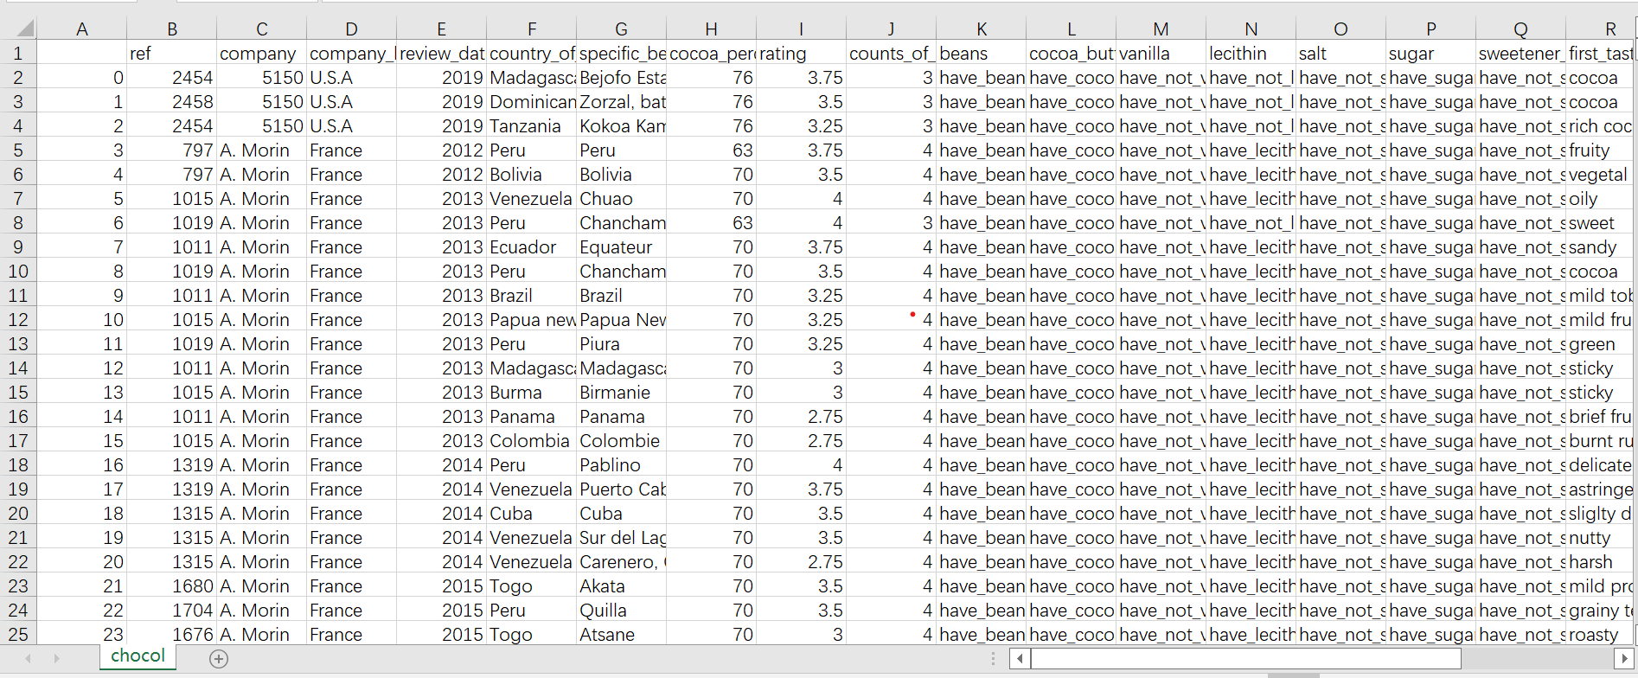
The Dataset we selected

Slide 3
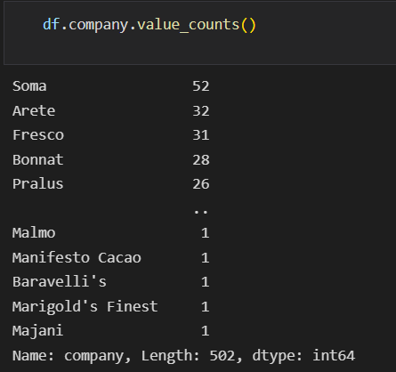
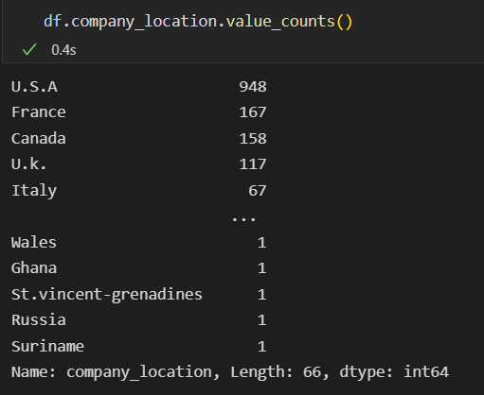
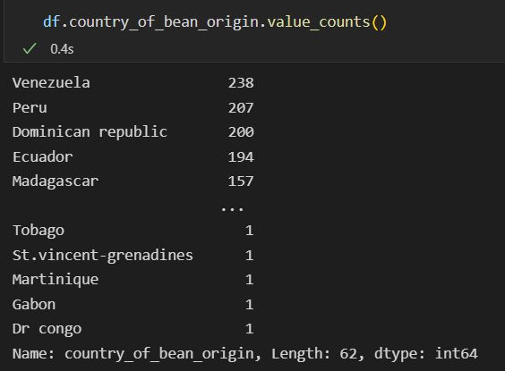
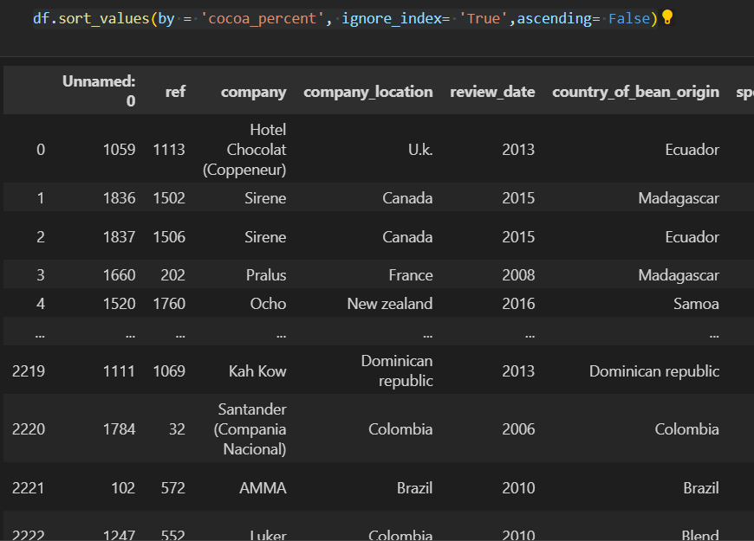
The dataset has 502 companies.
Those companies locations are in 66 companies.
The countries of bean origin are 62.
Sort values by cocoa percent

Slide 4
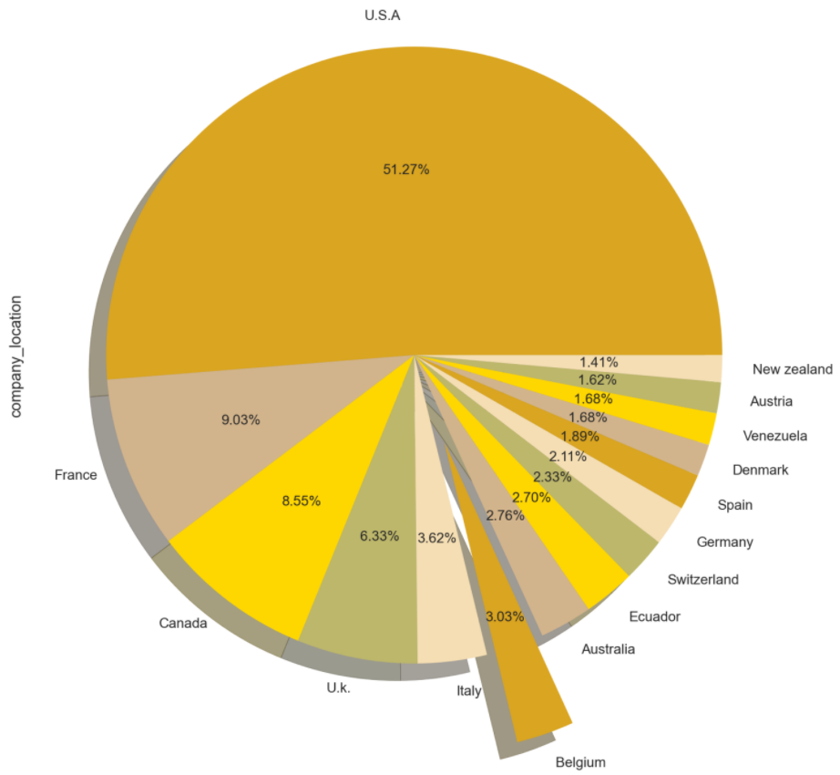
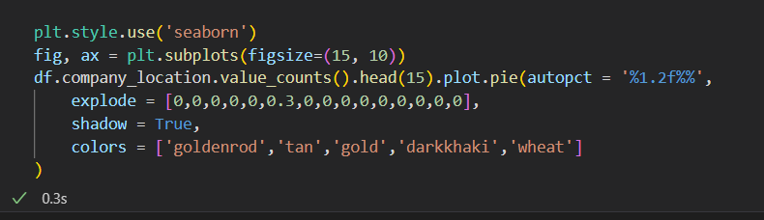
The pie chart and code of chocolate company location

Slide 5
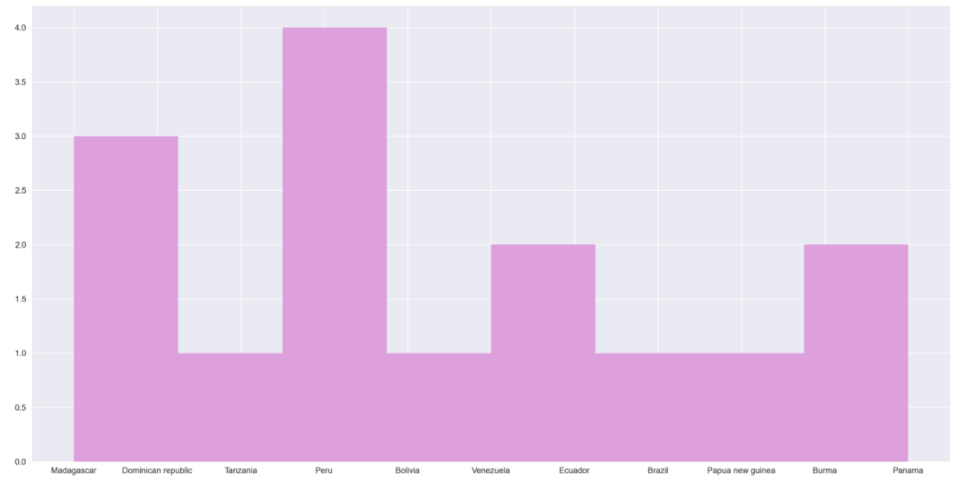


The histogram of
Country of
bean origin

Slide 6
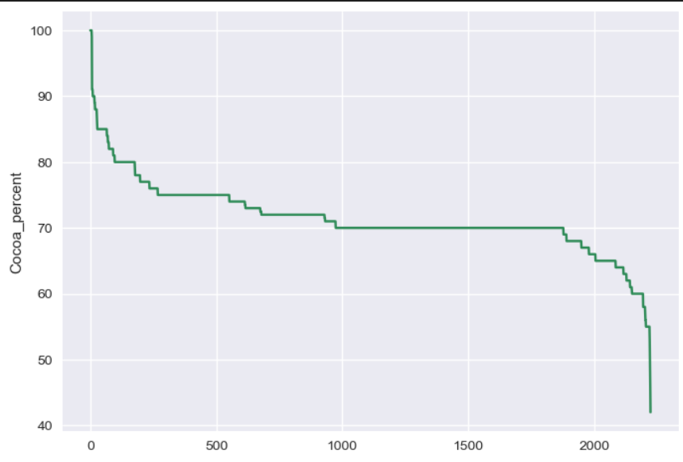
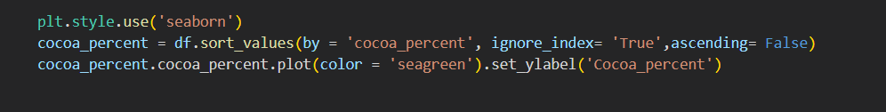
The Line Chart of
the Cocoa percent

Slide 7
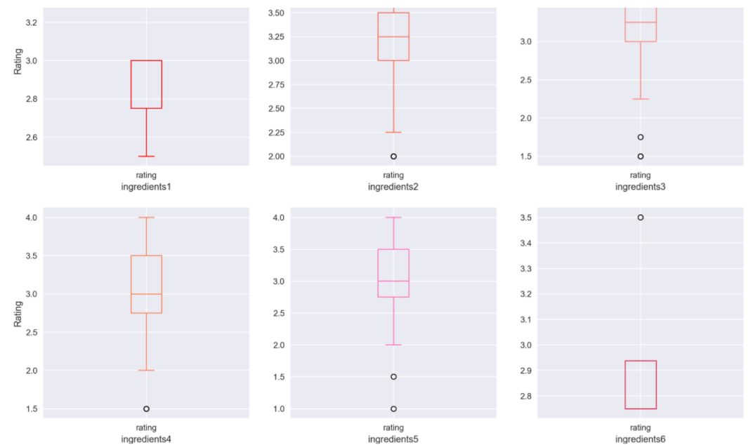
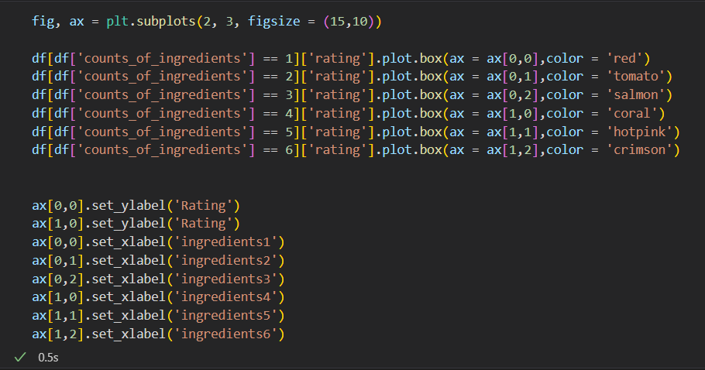
The relationship of
the mount of ingredients
and rating of cocoa

Slide 8
The Discovery of data analysis:
More than half of the world’s chocolate companies are in the U.S.A, which means the United States is the largest producer of chocolate.
Venezuela and Peru are the largest producer of cocoa beans.
Most chocolate products on the market have a concentration of around 70 cocoa percent.
When chocolate contains too many or too few ingredients, it doesn’t have a high concentration of cocoa.

Slide 9

THANK YOU

