Slide 1

Development Plan 2024

Slide 2
HMM’s Goals
Help People
Raising Money
Donations
Sales
Raising Awareness
Partnerships / Sponsors
What do we want to do?
How do we do that?
What methods do we have to do that?
Grassroots Activity
Programmes
Events
What does that look like
Online
In Person
Addons
Merch
Auctions
Raffles
Ball
Santa Splash
Snowdon
Advertising
'Franchising' HMM activity across Defence
MH Awareness Days (Sponsored)
Everyday Activity

Slide 3
HMM’s Needs
Help People + Ourselves
Raising Money for ourselves
Donations
Sales
Raising Awareness of ourselves
Partnerships / Sponsors
What do we want to do?
How do we do that?
What methods do we have to do that?
Grassroots Activity
Programmes
Events
What does that look like
Online
In Person
Addons
Merch
Auctions
Raffles
Ball
Santa Splash
Snowdon
Advertising
'Franchising' HMM activity across Defence
MH Awareness Days (Sponsored)
Everyday Activity

Slide 4
HMM’s Needs
Help People + Ourselves
Raising Money for ourselves
Donations
Sales
Raising Awareness of ourselves
Partnerships / Sponsors
What do we want to do?
How do we do that?
What methods do we have to do that?
Grassroots Activity
Programmes
Events
What does that look like
Online
In Person
Addons
Merch
Auctions
Raffles
Ball
Santa Splash
Snowdon
Advertising
'Franchising' HMM activity across Defence
MH Awareness Days (Sponsored)
Everyday Activity

Slide 5
HMM’s Needs
Help Ourselves
Raising Awareness of ourselves
Partnerships / Sponsors
What do we want to do?
How do we do that?
What methods do we have to do that?
Grassroots Activity
Programmes

Slide 6
Raising Awareness
Raising awareness of a company involves strategic planning and execution to ensure that its brand, products, or services are visible and well-regarded by its target audience.
Define Your Target Audience: Understand who your ideal customers are and what channels they use to gather information. Tailor your awareness efforts to resonate with their needs, interests, and preferences.
Craft a Compelling Brand Story: Develop a clear and authentic narrative that communicates your company's mission, values, and unique selling proposition. Your story should evoke emotion and create a memorable impression on your audience.
Consistent Branding: Ensure consistency in your branding elements such as logo, colours, typography, and messaging across all communication channels. Consistency builds recognition and reinforces your brand identity in the minds of consumers.
Utilize Multiple Channels: Employ a mix of online and offline channels to reach your target audience effectively. This may include social media platforms, website content, email marketing, advertising, public relations, events, and community engagement initiatives.
Content Marketing: Create valuable and relevant content that educates, entertains, or inspires your audience. Content marketing can help establish your company as a thought leader in your industry and attract organic traffic to your website or social media profiles.
Engage with Your Audience: Foster two-way communication with your audience by actively engaging with them on social media, responding to comments and messages, and soliciting feedback. Building a relationship with your audience can increase brand loyalty and advocacy.
Collaborate with Influencers: Partner with influencers or industry experts who have a significant following and credibility among your target audience. Their endorsement can amplify your brand's reach and credibility, especially on social media platforms.
Monitor and Measure Performance: Regularly monitor the performance of your awareness campaigns using key performance indicators (KPIs) such as website traffic, social media engagement, brand mentions, and customer sentiment. Use these insights to refine your strategies and optimize future campaigns.
Differentiate Yourself: Identify what sets your company apart from competitors and highlight those unique attributes in your messaging and branding. Differentiation can help you stand out in a crowded marketplace and capture the attention of potential customers.
Be Authentic and Transparent: Build trust with your audience by being transparent about your company values, business practices, and product offerings. Authenticity breeds loyalty and encourages customers to advocate for your brand.

Slide 7
So What?
Raising awareness of a company involves strategic planning and execution to ensure that its brand, products, or services are visible and well-regarded by its target audience.
Define Your Target Audience: Understand who your ideal customers are and what channels they use to gather information. Tailor your awareness efforts to resonate with their needs, interests, and preferences.
Craft a Compelling Brand Story: Develop a clear and authentic narrative that communicates your company's mission, values, and unique selling proposition. Your story should evoke emotion and create a memorable impression on your audience.
Consistent Branding: Ensure consistency in your branding elements such as logo, colours, typography, and messaging across all communication channels. Consistency builds recognition and reinforces your brand identity in the minds of consumers.
Utilize Multiple Channels: Employ a mix of online and offline channels to reach your target audience effectively. This may include social media platforms, website content, email marketing, advertising, public relations, events, and community engagement initiatives.
Content Marketing: Create valuable and relevant content that educates, entertains, or inspires your audience. Content marketing can help establish your company as a thought leader in your industry and attract organic traffic to your website or social media profiles.
Engage with Your Audience: Foster two-way communication with your audience by actively engaging with them on social media, responding to comments and messages, and soliciting feedback. Building a relationship with your audience can increase brand loyalty and advocacy.
Collaborate with Influencers: Partner with influencers or industry experts who have a significant following and credibility among your target audience. Their endorsement can amplify your brand's reach and credibility, especially on social media platforms.
Monitor and Measure Performance: Regularly monitor the performance of your awareness campaigns using key performance indicators (KPIs) such as website traffic, social media engagement, brand mentions, and customer sentiment. Use these insights to refine your strategies and optimize future campaigns.
Differentiate Yourself: Identify what sets your company apart from competitors and highlight those unique attributes in your messaging and branding. Differentiation can help you stand out in a crowded marketplace and capture the attention of potential customers.
Be Authentic and Transparent: Build trust with your audience by being transparent about your company values, business practices, and product offerings. Authenticity breeds loyalty and encourages customers to advocate for your brand.

Slide 8
Work-strands with the Marketing Firm
Evolution of brand:
Logo / Colour scheme
Market Analysis
Brand Identity & Story to differentiate ourselves
Awareness Campaigns
Theming of events

Slide 9
So What?
Raising awareness of a company involves strategic planning and execution to ensure that its brand, products, or services are visible and well-regarded by its target audience.
Define Your Target Audience: Understand who your ideal customers are and what channels they use to gather information. Tailor your awareness efforts to resonate with their needs, interests, and preferences.
Craft a Compelling Brand Story: Develop a clear and authentic narrative that communicates your company's mission, values, and unique selling proposition. Your story should evoke emotion and create a memorable impression on your audience.
Consistent Branding: Ensure consistency in your branding elements such as logo, colours, typography, and messaging across all communication channels. Consistency builds recognition and reinforces your brand identity in the minds of consumers.
Utilize Multiple Channels: Employ a mix of online and offline channels to reach your target audience effectively. This may include social media platforms, website content, email marketing, advertising, public relations, events, and community engagement initiatives.
Content Marketing: Create valuable and relevant content that educates, entertains, or inspires your audience. Content marketing can help establish your company as a thought leader in your industry and attract organic traffic to your website or social media profiles.
Engage with Your Audience: Foster two-way communication with your audience by actively engaging with them on social media, responding to comments and messages, and soliciting feedback. Building a relationship with your audience can increase brand loyalty and advocacy.
Collaborate with Influencers: Partner with influencers or industry experts who have a significant following and credibility among your target audience. Their endorsement can amplify your brand's reach and credibility, especially on social media platforms.
Monitor and Measure Performance: Regularly monitor the performance of your awareness campaigns using key performance indicators (KPIs) such as website traffic, social media engagement, brand mentions, and customer sentiment. Use these insights to refine your strategies and optimize future campaigns.
Differentiate Yourself: Identify what sets your company apart from competitors and highlight those unique attributes in your messaging and branding. Differentiation can help you stand out in a crowded marketplace and capture the attention of potential customers.
Be Authentic and Transparent: Build trust with your audience by being transparent about your company values, business practices, and product offerings. Authenticity breeds loyalty and encourages customers to advocate for your brand.

Slide 10
Crediblity
Domain / Online Identity Procured:
https://www.healingmilitaryminds.com/
https://www.healingmilitaryminds.co.uk/
Circa £60pa to maintain
Website – Placeholder design active now. Central access point to our events and workspace
Hosted at zero cost*
Email and Shared Cloud Workspace
Uses Microsoft 365 ecosystem.
Currently on single licence 1 month trial, but £5pm per licence from Jun.

Slide 11
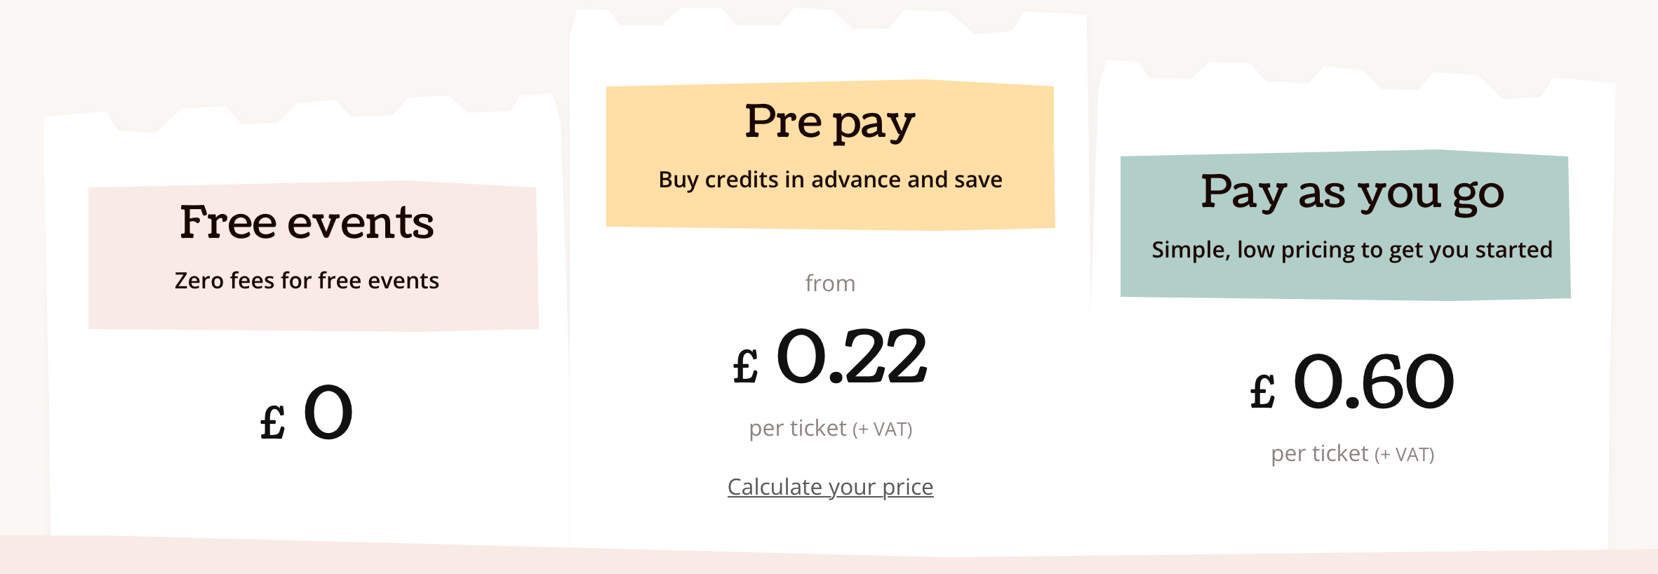
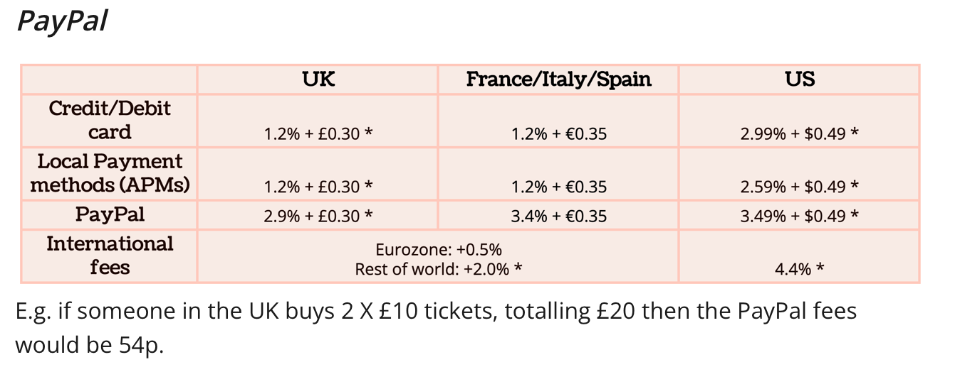
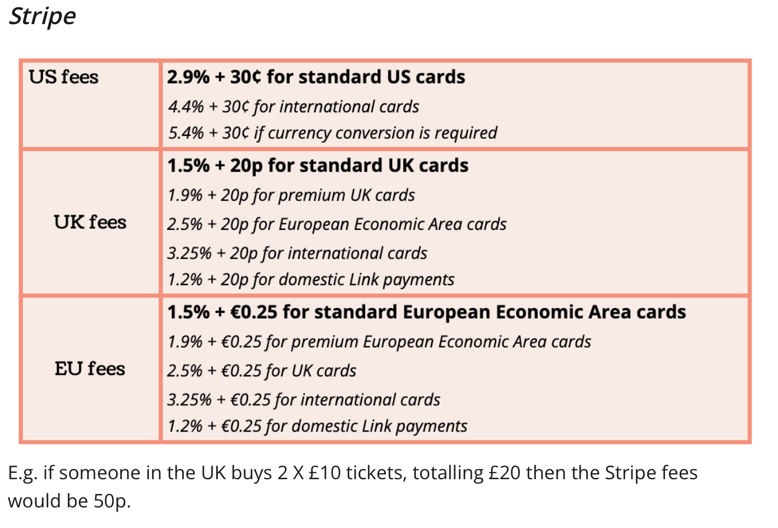
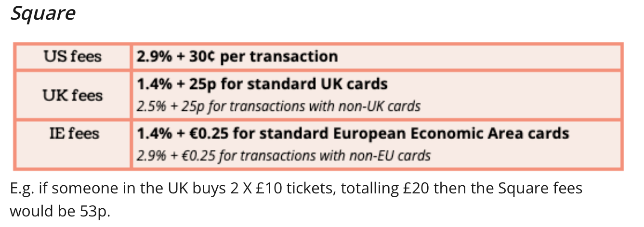
Ticket tailor

Slide 12
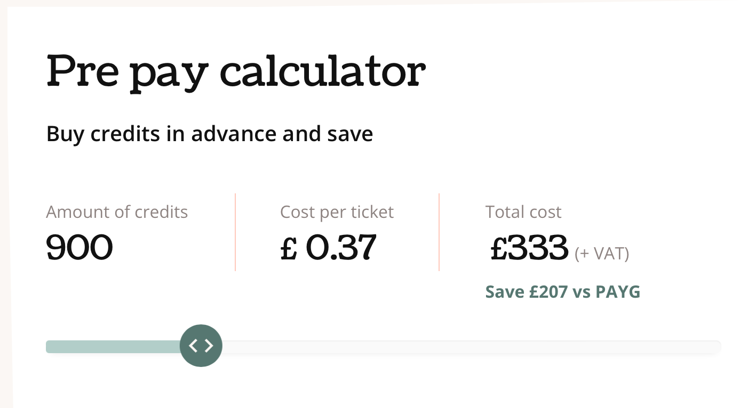
Worked Example
Event Management Costs: £399.60 (inc VAT)
450 tickets @ 1x credit per ticket sale &
1x credit per seating plan entry. = +89p per ticket
Payment Processing Costs: £663.75
(450 tickets @ £85) * (1.5% + 20p) = £1.48 per ticket
Total Costs: £1063.35
= +£2.37 / £85.37 per ticket

Slide 13
Further Work
Discussion with legal about registering as a charitable company.
Credibility / Legitimacy
Lower Running Costs
A major stage in growth.

Slide 14
Pitfalls
Losing the ‘local heroes’ vibe
Being too corporate
Focusing too much on growth
Good ideas club
Overwhelming with bureaucracy instead of just doing the job
New guy syndrome

Slide 15
Stuff I need
POCs for all our accounts
Social Media
Comms
Apps
Breakdown of how things are being run, and some hard truths about pain points
Volunteers willing to get involved in wider HMM activity in addition to individual projects
A chance and some mercy.

