Slide 1
NeuroHEALIS A Neurosurgical Health Information System for Integration of Clinical Research and Clinical Care
Athanassios Hatzis, PhD
Health Informatics Consultant/Analyst
Email : hatzis@neuro.gr
Notes:
Good afternoon ladies and gentlemen, I am very pleased to be with all of you today. This presentation of mine was decided the very last moment, it is out of the formally announced conference program and therefore you may hopefully consider it is as a pleasant surprise. Today I would like to share with you an illuminating experience I had the past three years working as a health informatics manager in the department of neurosurgery, University of Athens, at Evangelismos General Hospital

Slide 2
Presenter Background Info
Education
BSc CS – MSc AI – PhD Speech Technology
R&D Assistive Technology (10 Years)
SpandH Group, CS Dept, Univ.Sheffield
HIT Manager (3 Years)
Neurosurgery Department, Univ. of Athens
Evangelismos General Hospital
13 Years Experience with Clinicians and Medical Applications
Notes:
Before we take off and cruise with the speed of sound at 10000 feet I would like to introduce a bit myself as I have recently joined your fascinating scientific community. My MSc, PhD and two funded projects I participated in UK are in the field of Assistive Technology (Alternative/Augmentative Communication). Today I count 13 years of collective experience working CLOSELY with clinicians and development of medical applications for such users.

Slide 3
Medical Staff – The Driving Force
Head of Dept. Prof. Damianos Sakas
CIS (Functional Disorders) – Clinical Research
Resident M. Themistokleous (Parkinson)
Resident V. Konofaou (Spasticity)
Resident L. Stavrinou (Dystonia)
Assistant Prof. George Stranjalis
EMR – Clinical Care
Assistant Prof. Stylianos Gatzonis
EPILEPSY (EPILDA, BIOSIM-NTUA)
Clinical Research and Clinical Care
Notes:
Three persons, all senior medical staff members, were the key players and the driving force for the application of CIT in their department. Please notice the different priorities and needs they have, the first one in clinical research, the second one in clinical Care, and the third one in both but only in EPILEPSY.

Slide 4
Lesson 1 – Communication Issues
Main obstacles
Low priority of IT issues
Lack of coordination and organisation
Lack of communication
Lack of planning and clear objectives
Main reasons
Contradictory priorities and needs
Overloaded appointment schedule
OR heavy schedule
Notes:
Lack of coordination, organization, planning, communication regarding the IT issues between senior staff members despite the monthly and annual reports produced by the IT manager can really make the balance of working relationship a circus exercise. Main reasons for that were the many appointments with patients and vendors, the many surgical operations per month, and conflicts between the different priorities and needs.

Slide 5
IT Local Network Bridge The Gap
Dispersed locations
Site 1 outside the Hospital Network
The Hellenic Neurosurgical Research Centre
Site 2 inside hospital without Network
The Neurosurgery Clinic
The Operating Room
The Lecture Amphitheater
Site 1,2 NOT LINKED
Network planning was underestimated
Notes:
To get an even better picture of the challenging startup situation faced you may also consider the big gap between the two main sites, the clinic inside the hospital and the research center outside the hospital as well as other dispersed locations.

Slide 6
IT Infrastructure Solution
In the Beginning (2006)
Site 1, LAN (1 Server, 12 PCs, ADSL)
Site 2, 9 Standalone PCs, ISDN
Site 1, Site 2 Do not communicate
Today (2009)
Site 1 (2 LANs, 1 Local – 1 Webhosting)
Site 2, 15 PCs on MLS VPN LAN
3 ADSL Lines (2 MLS VPN, 1 Web VPN)
Secure Access/Linking inside/outside
Notes:
This slide presents the progress made to overcome the networking obstacle. Today thanks to computer network technology clinicians are able to access securely clinical databases and the electronic medical record from their home, offices, operation room, amphitheater, the epilepsy unit and the research center.

Slide 7
Lesson 2 – Networking Issues
Clinicians - Misunderstanding
Network Security Policy issues
Database Availability-Access issues
No plan and budget for the cost of Networking solutions
Hospital Management – Indifference
Act “independently”, feasible solution
Private/Departmental Funding
Informal permission to proceed
Notes:
Neither clinicians were educated to understand difficult computer networking issues and how critical the topic is for the availability and access of databases nor there was any interest from the hospital side to alleviate the problem. In this case the only chance to make progress was to get an informal permission from the hospital IT to operate an independent computer network, and then you know you are alone !

Slide 8
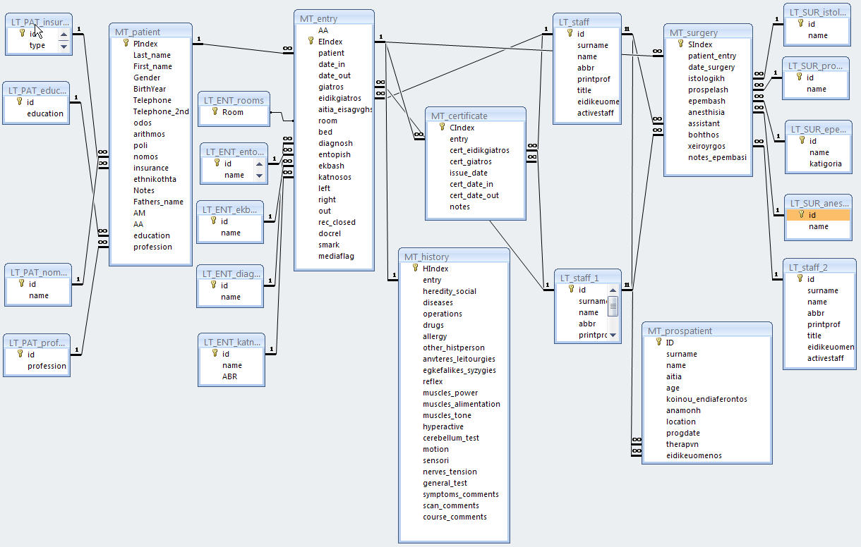
EMR – Phase 1 (ER Diagram)
Notes:
The database development started naturally with the analysis, design and development of patient EMR record. The slide presents the three main entities (patient, admission and operation) with one to many relationships between them and the lookup tables.

Slide 9
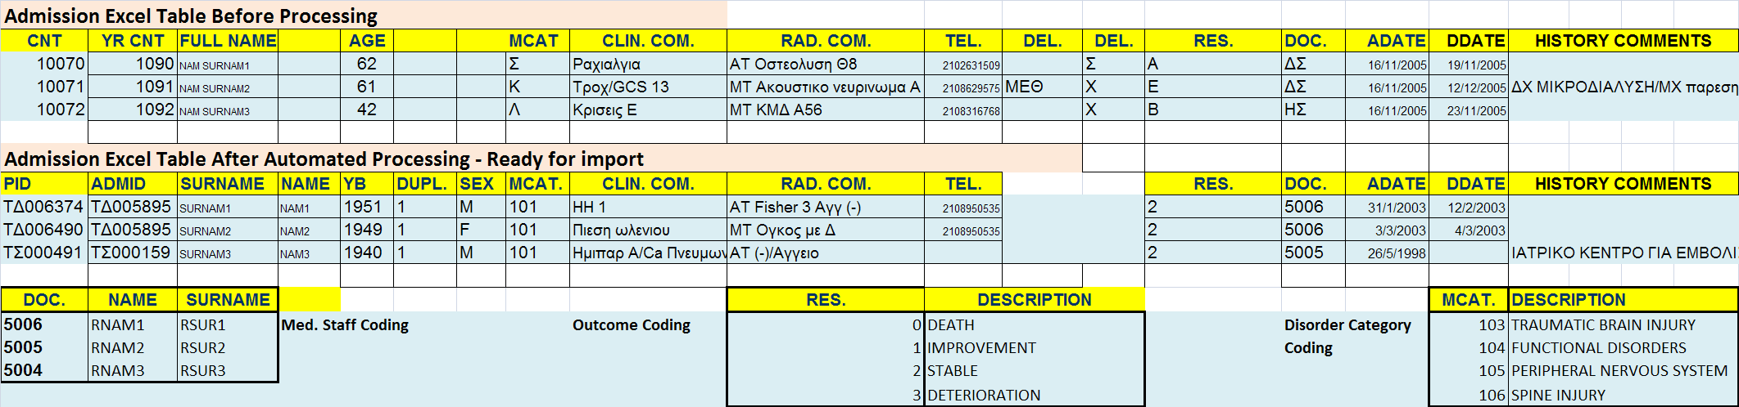
EMR Phase 2 – Migration
Notes:
Migration, another unforeseen painful and tedious task that it took almost 5 Person Months to code the solution, process the data, and check/verify the results. Data was duplicated, inconsistent, separated in two unlinked excel spreadsheets one for the admissions and one for the operations and coding of many fields was custom and incomplete.

Slide 10
Lesson 3 – Migration Issues
Another underestimated task
Cost
Time
Many stacked/stumbled over
Residents, Medical Associates
Other Non-IT Experts
A small IT company
Be patient… keep waiting… (1998-2006)
Notes:
There were many efforts to implement EMR on this clinic but all of them had to solve the migration problem for the existing data.
In other situations, cost and time stopped the project at this stage.

Slide 11
EMR Phase 3 - Implementation
Data Forms
View/Entry Purpose
Catalogues
View/Searching/Filtering Purpose
Reports
Patients IN, Discharge Certificate, etc…
Digital Media Record
Linking with the Patient Record
Storage/Retrieval Purpose
Notes:
Finally the first completed version was ready in 3 Persons Months. There were over 40 bug fix releases and upgrades of the first version in two years. This slide presents the content of the electronic medical record composed of forms, catalogues, reports and digital media

Slide 12
EMR Phase 3 – Data Forms Free Text, Selection Input Methods
Admission Form
Demographic, Admission Data
EMR Form in three sections
1) Patient – 2) Admissions – 3) Operations
History Record
Physical Examination
Radiology Comments
Clinical Course
Discharge Certificate
Surgical Operation Form
Notes:
There were two main input methods, free text and selection from non-universal coded options. The main EMR form is a sub-form (operations) inside a sub-form (admissions) inside a form (patient). A picture worth a thousand words

Slide 13
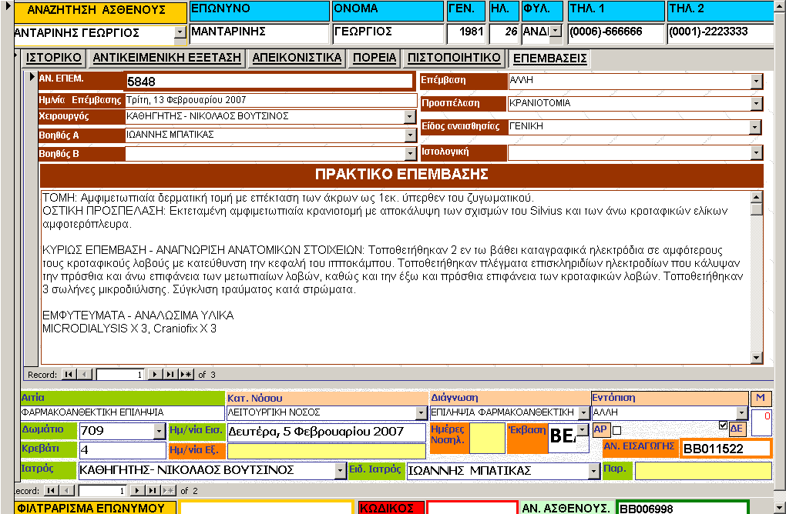
EMR Phase 3 – EMR Form
Notes:
You may see the searching field at the top left corner, the demographic data in blue and the admission data on the lower part under the operation form. You can easily navigate on previous admissions and previous operations with the navigation control at the bottom of each form. A single record can be locked/Unlocked for editing with a code input in the red field but it cannot be locked from viewing

Slide 14
EMR Phase 3 – Catalogues
Pending data (open/closed admissions)
Patients IN Catalogue
All Patients Catalogue
All Admissions Catalogue
All Operations Catalogue
Histology Completion Catalogue
Notes:
Catalogue is the second most important visual presentation tool for the user. There are catalogues for patient IN, for all the patients, for admissions, for operations and for the completion of histology. See a few examples

Slide 15
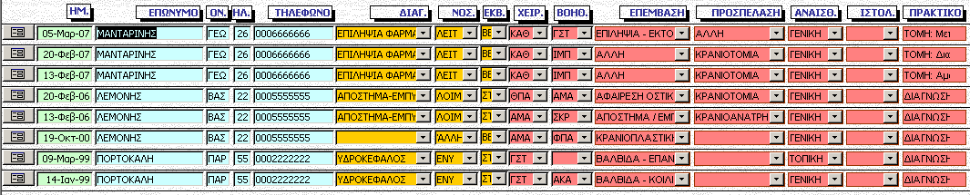
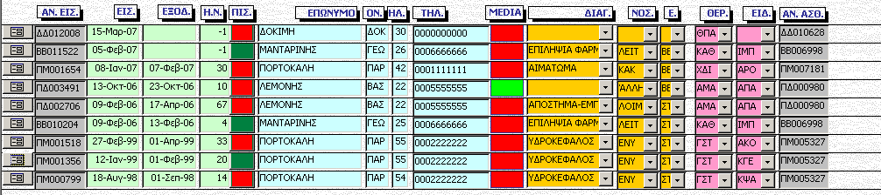
EMR Phase 3 – Examples
Notes:
The top catalogue shows all necessary fields for sorting, searching, and filtering data for the surgical operations of the clinic. Same is true for the catalogue on the second lower half where it presents data from admissions. There are also two warning visual indicators representing a binary field. One is used for discharge certificate completion and the other is used for digital media presence indicator

Slide 16
EMR Phase 3 – Query/Reports
Notes:
This slide shows a typical example of a report based on a query that selects and displays all data from all the operations of a specific neurosurgeon.

Slide 17
EMR Phase 3 – Daily Reports
Discharge Certificate
Patients IN List
Notes:
In this slide we have the discharge certificate report and the patients IN list that are used on a daily basis. Nowadays in many health providers one can find doctors that are using word templates to complete these manually. Even in that case searching can be tedious to locate and retrieve the content of the correct discharge certificate and there is waste of time to complete the Patients IN list every day.

Slide 18
EMR – Phase 3 DIGITAL MEDIA RECORD
Contents
Photos of the radiology film
Photos from the surgical operation
Video-Clips from surgical operation
Histology scanned documents
Patient Folder Implementation
-KM12000 (inside folder….)
090215-KM14567-SURGERY (folder)
080925-KM12345-HISTOLOGY (folder)
Notes:
Medical exams, other documents, videos and photos that are not part of the clinical EMR are attached as separate files inside coded folders. This slide shows different types of digital data that neurosurgeons are interested in.

Slide 19
CIS Phase 4 - Clinical Research Neurosurgical Databases
Spasticity, Parkinson, Dystonia
EPILEPSY (Already Implemented)
Data Completion Method
Resident completes a printed form
Secretary fills the data in a digital form
Periodic Use vs. Daily Use
Clinical Research vs. Clinical Practice
It is often not easy to distinguish
Notes:
The next phase after the successful completion of the EMR and the continuous use from the staff was to deal with other clinical information systems that are special to neurosurgery domain. Development lasted for two years and a lot of effort was put on the spasticity database, unfortunately there is not time to discuss the other two.

Slide 20
CIS Phase 4 – Spasticity DB
Spasticity is a chronic disorder
Surgical treatment with an
Implanted Pump – Control Device
Data Forms
Extra Patient Related Fields
General Comments
Clinical Evaluation Tests
Clinical Course
Operations and Pump tuning
Notes:
A few words about spasticity, it is a chronic disorder and if it is decided to proceed with surgical treatment an electronic pump is implanted and controlled by a device. Data forms contain extra information and the most important of these are evaluation tests and pump tuning.

Slide 21
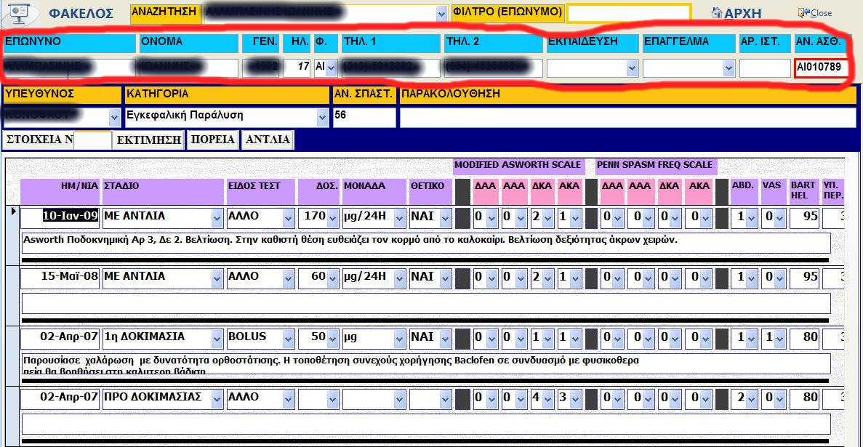
CIS Phase 4 – Evaluation Form
Notes:
In this slide the circled red section is linked to the EMR and the demographic data are not duplicated. You may also see some of the measurements taken at a specific evaluation stage, with a specific type of test, such as the dose and the two scales used for measurements.

Slide 22
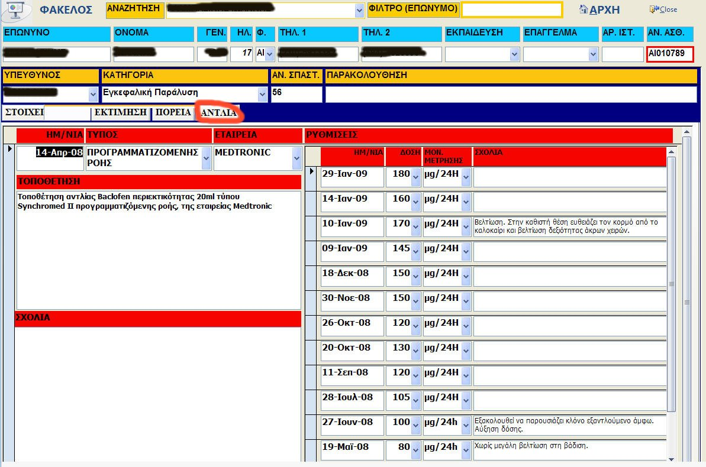
CIS Phase 4 Operations/Pumps Tuning
Notes:
In this slide the operations/pump tuning is selected (red circle). One can view all the dates that the patient came to the health provider for a tuning together with the dose and comments. The left part shows also the surgical operations fields.

Slide 23
CIS Phase 4 – Linking with EMR
EMR tables were linked on this separate database
Demographic Data
Admission Data
Surgical Operation Data
Notes:
The linking with EMR is achieved by linking the necessary database tables on a separate database file. Common groups of data that are shared between the two information systems are demographic, admission and surgical operation.

Slide 24
CIS Phase 5 – Continuity of Care
The continuity of care problem cycle
Patients with chronic disorders may
get in different clinics
see different doctors
stay at home and get slowly worse
get seriously ill, go into hospitals
Discharged and….. Cycle begins again
Follow-up monitoring plan in the clinic
Notes:
The continuity of care problem is most evident in the chronic disorder cases such as spasticity. In many cases, medical staff in one clinic have no clue to what happened to a specific patient and it is patient’s responsibility to get in touch and inform the doctor about his present situation. In our case the patient must keep somewhere written all the adjustments of the pump and the measurements from the evaluation. A CIS can be most beneficial with a follow-up monitoring plan.

Slide 25
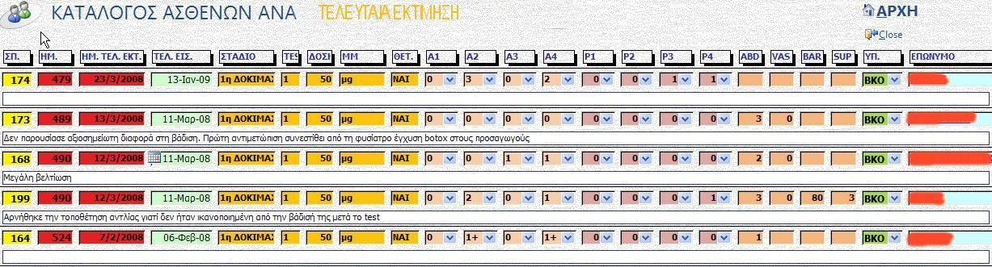
CIS Phase 5 Follow-up Monitoring
Notes:
Notice in this slide how many days have past since the last visit of the patient in the clinic (2nd column). His medical record has not been updated for more than a year. Is he visiting another clinic/doctor, is he seriously ill, are the data lost, are they kept somewhere else? The resident responsible for this database (the column before the last) has to investigate the cases and inform the senior medical staff.

Slide 26
Phase 6 – Database Security
Reports are given only with consent form signed by senior medical staff
Physical location of CIS backend in the research center server
Physical location of EMR backend in the clinic/hospital
Restrict user network remote access for CIS from the clinic
Frontend password protected execution
Notes:
Backend database files are located on shared folders and special permissions are given to the network users on that folder.
The EMR frontend opens with a single password but application users cannot modify old data unless they unlock the record and in that case it is viewed by the medical supervisor. No user but the administrator has a direct access to the backend and frontend.

Slide 27
Lesson to learn – Security Issues
Consent forms signed by the medical staff for exporting data created conflicts among the staff members
Everyone wants to export data without permission, without authorization
DB administrator is exposed to dangerous situations because of uncontrolled release of sensitive data
Notes:
Once the medical staff realize they can harvest the data collected they demand exportation, reports and statistics. It is extremely difficult to impose a security policy if it is not agreed among the medical staff. If nobody cares, database administrator should care because he is responsible for the release of data.

Slide 28
What about IT Staff Support
Hospital IT staff – 4 Persons
not involved with departmental network
Departmental IT staff – 0 Persons !!!
LANs Support
Web Sites-Email Support
Database Administration
OR Teleconference/Recording Support
Outsourcing for IT special needs
IT Management, R&D – 1 Person
Notes:
With no involvement from the hospital and no other IT staff employed in three years the Health IT manager becomes technician, administrator, developer, researcher, etc. Inevitably one man show cannot lasted for ever and this one lasted for almost four three years.

Slide 29
What about other staff
Departmental Secretaries
2P Read Access, 1P (R/W All DBs)
Nursing Staff
Not Involved
Other Departments
Not Involved
Notes:
One secretary was used to chase completion of medical records (especially discharge certificates and digital media). She was also entering data from printed forms or manuscripts. The other two departmental secretaries were only viewing the EMR patient data. There was no nursing staff involved with the databases and both EMR and CIS in the neurosurgery department were isolated from the rest of hospital HIS. Recently an additional workstation was added at residents’ office to order laboratory exams from Hospital LIS.

Slide 30
Future Plans
Hellenic EMR Open Source
Portable, Working Off-line
Web or wireless Synchronization
A freeware version of the front end
Participation on a Thematic Network on Neurodegenerative Disorders
Participation on certification authority
IT education, consultation services
Notes:
At last but not least my vision for the EMR in Greece, a coordinated effort to accomplish EMR as an open source project. This EMR version has to be portable and the user will be able to work off-line and synchronize his records from the web or with a wireless connection. A basic frontend application will be given for free. I would also appreciate your interest and help to continue this pilot project on the continuous care of neurodegenerative disorders. Finally I am interested in participating in the Hellenic certification authority panel.

Slide 31
Thank You
Enjoy Samos
Enjoy Greece
Enjoy Life
Send me a smile ;-)

