Slide 1
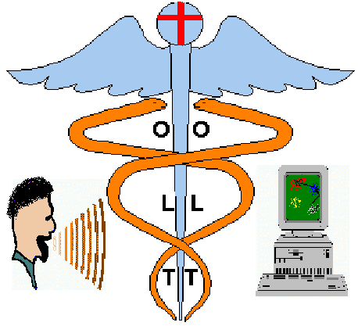
Introduction
What is OLT ?
OLT is a computer-based speech acoustics visualisation method that provides audio-visual feedback of articulatory gestures using interactive phonetic displays.
Notes:
1
OLT is a computer based system that analyses the speech input through a microphone and relates the acoustic features with visual animation on a two dimensional phonetic map.

Slide 2
Practical Auditory - Articulatory Phonetics Teaching
Teaching Phonetics vs Learning Phonetics
Experts Clients
Linguists Linguistics students and others
Phoneticians - Phonologists Phonetics students and others
Speech Therapists Speech therapy students and patients
Language Instructors Foreign language learners
Common Principal Aim
Relate the acoustics of the speech sounds to the speech production mechanisms that occur in normal or abnormal speech.
Notes:
2
Traditional methods of teaching auditory phonetics vary according to what is the purpose of learning auditory phonetics.
Nevertheless they all have a common principal aim.
Relate the acoustics of the speech sounds to the speech production mechanisms that occur in normal or abnormal speech.
An effective and simple method of teaching articulatory phonetics to non-expert people is needed.
Undoubtly if one can teach articulatory phonetics to speech therapy patients and foreign language speakers the task would be much easier to be repeated in students trained to become phoneticians or linguists.
Traditional methods are based on imitation of the speech chain

Slide 3
Instrumental Techniques in Studying Phonetics
Auditory Phonetics
Speech Perception
Auditory qualities
Articulatory Phonetics Acoustic Phonetics
Speech Production Speech Transmission
Place, Manner Pitch, Loudness, Quality
Electropalatograpy, Electromagnetic Articulography Spectrography
Ultrasound, Magnetic Resonance Imaging.
Optico-Acoustic Phonetics
Visual Feedback
Visual Qualities
Formants Vowel Chart, Optical Logo-Therapy.
Create phonetic maps.
Distinguish contrastive
feature of articulators
Notes:
2
The speech chain includes three distinctive speech processes
(Speech production - Speech Transmission - Speech perception)
The corresponding main properties of each one are
(Place, manner - Pitch, Loudness, Quality - Auditory qualities)
Problem here lies on the mystery area of speech perception and particularly the relation it has with the speech production mechanisms. How the acoustics of a sound are related through auditory mechanisms with the speech production. How is this relationship represented internally and where the brain stores those specific information.
What is the effect on speech production if there is poor speech perception (deaf persons)
if a certain phonetic contrast that appears in a foreign language (ex : she vs see, for Greeks and lice vs rice for Japaneese) doesn’t exist in the native language of the foreigner speaker. How that effects the pronunciation of the foreigner speaker.
Therefore we should enhance the auditory queues with appropriate visual feedback.

Slide 4
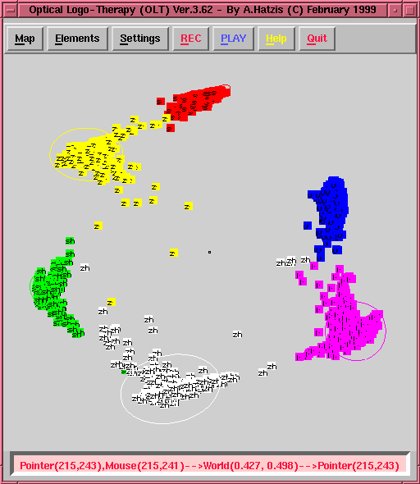
Optical Logo-Therapy (OLT)
Create phoneme maps
  Decide what contrasting phonemes you want to display on your map and where they should go.
  Collect and label the speech data, perform a cepstral analysis and create two random sets for training and testing.
  Decide what are going to be the fixed 2D target positions on the map corresponding to the cepstral means for each phoneme class.
  Train a neural-network to map all the acoustic vectors of a specific phoneme class onto the 2D targets.
Distinguish contrastive feature of articulators
  Relates the direction connecting two phonemes with a feature contrast of the articulators (tongue, lips, jaw, vocal folds).
Notes:
4

Slide 5
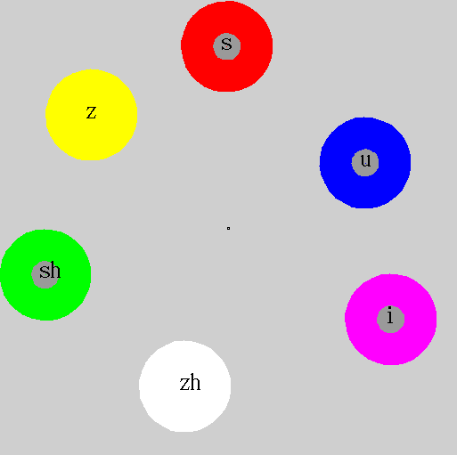
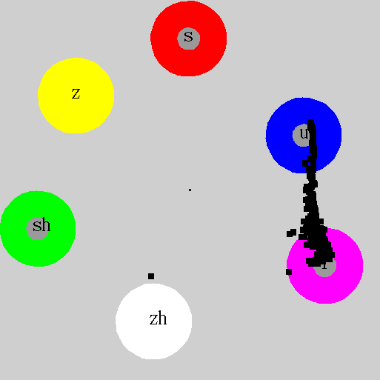
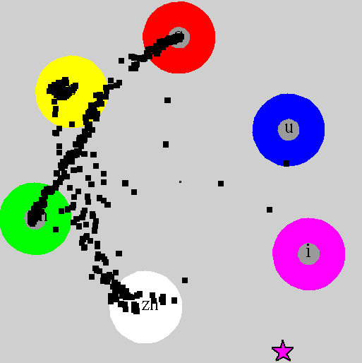
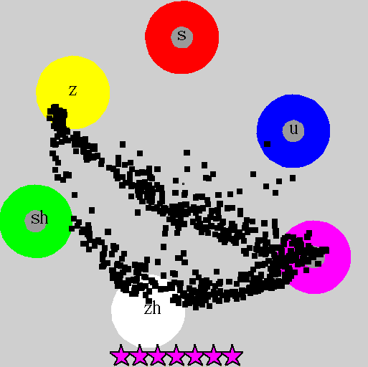
Speech Training on Sibilant Fricatives
Adults Map
Lip Rounding
Tongue Retraction
Stricture
Notes:
6
Clockwise direction
Adults map
Lip rounding,
Stricture,
Tongue retraction.

Slide 6
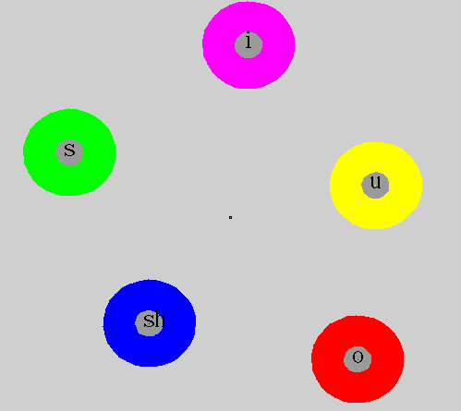
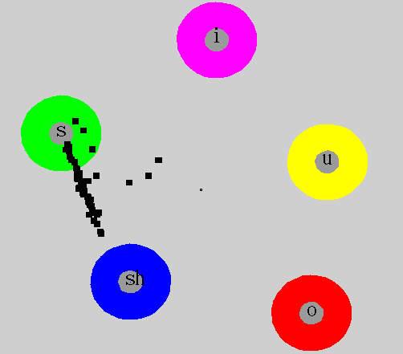
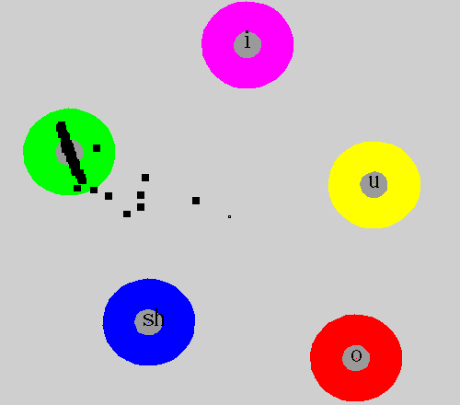
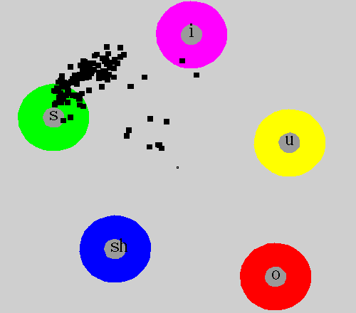
Speech Therapy on Sibilant Fricatives
Normal Children’s Map
Palatalised /s/
(abnormal sound)
Normal /s/ (lower insissors)
Normal /s/
(alveolar ridge)
Notes:
Clockwise direction
Normal Children’s Map
Palatalised /s/ (abnormal sound)
Normal /s/ with tip of the tongue behind the lower insissors.
Normal /s/ with the blade of the tongue raised towards the alveolar ridge.

Slide 7
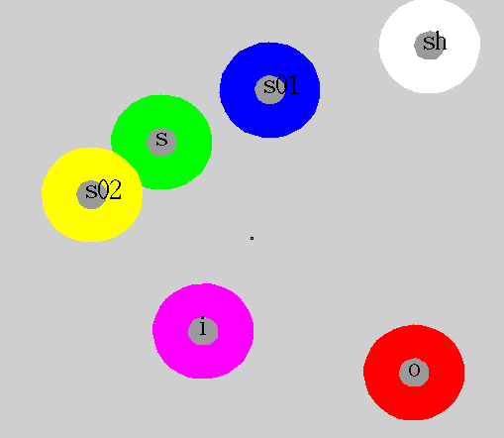

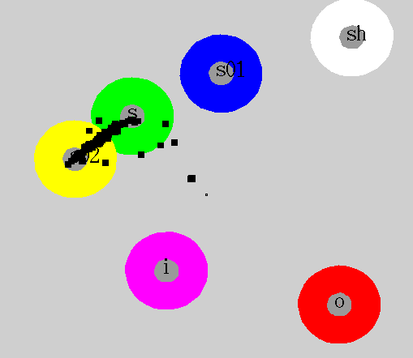
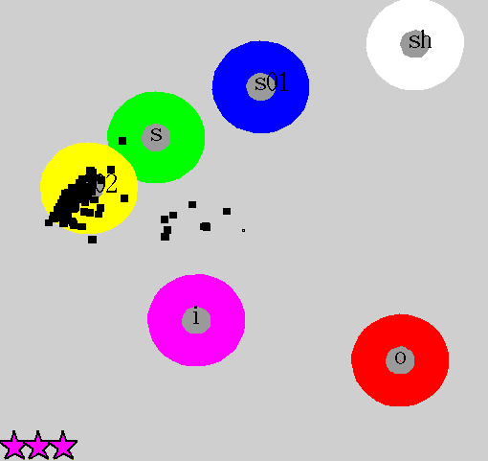
Speech Therapy on Personalised Maps
Personalised Children’s Map
Palatalised /s/
(abnormal sound)
Normal /s/ (lower insissors)
Normal /s/
(alveolar ridge)
Notes:
6
Clockwise direction
Personalised children map
(Good production are with yellow)
(Bad productions are with blue)
Palatalised /s/ (abnormal sound)
Normal /s/ with tip of the tongue behind the lower insissors.
Normal /s/ with the blade of the tongue raised towards the alveolar ridge.

Slide 9
Conclusions
We have demonstrated a technique that aims to visualise the relationship that exists between the different articulatory gestures and the acoustics of a certain speech production.
It creates visual contrast between different articulatory gestures and provides also audio-visual monitoring of how one can go from a certain articulatory configuration to a different one by varying properties of the articulators.
Future Plans
Complete the OLT toolkit by :
  Designing better and more descriptive phonetic maps.
  Development of a library of pre-prepared maps for speech training according to the case.
  Easy building of personalised maps.

