Slide 1




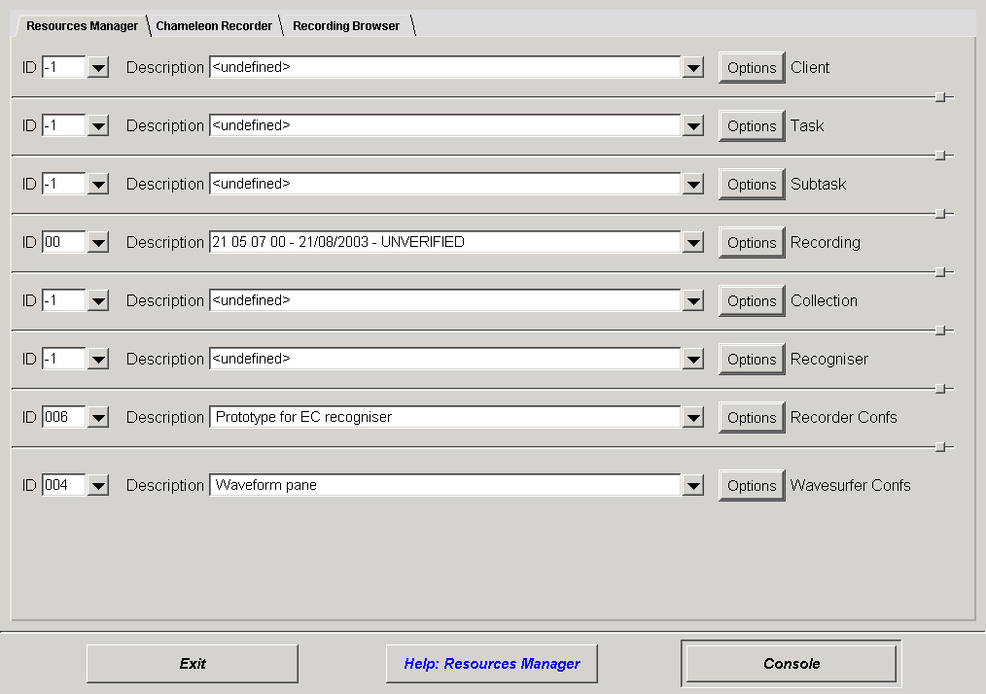
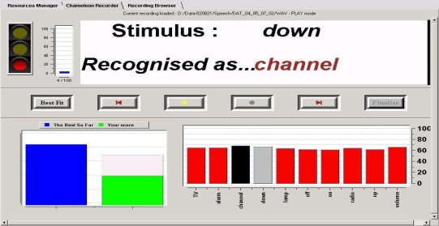
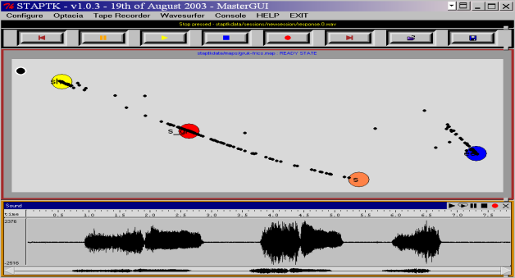
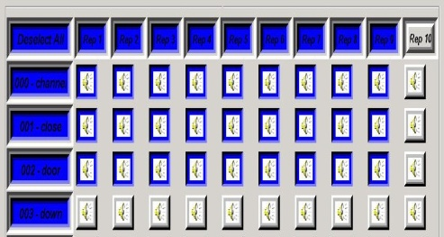
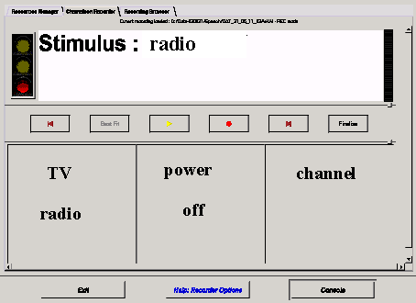
An Integrated Toolkit Deploying Speech Technology for Computer Based Speech Training with Application to Dysarthric Speakers
Athanassios Hatzis∗, Phil Green∗, James Carmichael∗, Stuart Cunningham+, Rebecca Palmer°, Mark Parker°, and Peter O’Neill+
∗ Department of Computer Science and ° Institute of General Practice and Primary Care University of Sheffield, + Barnsley District General Hospital NHS Trust, Barnsley
Clinicians
Phoneticians
Students
Articulatory Variability = insertions, deletions, substitutions, prolongations + speech characteristics (e.g. frication, aspiration, voicing, intonation, nasality)
How do we measure ? What do we compare ?
Sound Level
Clients
Users
Programmers
Acoustic Signal
Target Models
Speech Training
Instructors
Segment Level
Environmental Conditions + Recording Equipment
Higher level (Tcl/Tk)
Coding
Graphical User Interfaces
Low level (C/C++)
Configurability
Word Level
STAPTK Speech Technology Applications Toolkit
Articulatory Consistency = Frequency of occurring productions Intra-Model Variation
Articulatory Confusability = Inter-model distinction
Intelligibility = Comparison with the NORM model
Sentence Level
Interoperability HTK – Wavesurfer
Open Architecture
Portability/Compatibility
STARDUST (http://www.dcs.shef.ac.uk/~pdg/stardust)
Project Aims (2000–2003)
Characteristics of Dysarthric Speech
Confusability matrix : Inter and intra word model confusability can be visualised as a matrix. For greater visual impact, we use colour-coding to depict a range of values.
OLP (http://www.xanthi.ilsp.gr/olp) Project Related Aims (2001-2004)
Improve consistency of severely dysarthric speakers
Use training sessions to procure data for automatic speech recognition
Build small vocabulary speaker dependent recognisers
Use the recognisers in assistive technology
Fluency problems
Limited phonetic contrast
Large deviation from normal
Inconsistent production
Improve intelligibility of mild dysarthric speakers
Use OPTACIA maps for training at the sound, segment level
Use recognisers for training at the word level
Low
Confusability
High
Confusability
Management of Resources (Clients, Therapists, Stimuli, Recordings, Results, Tasks, Tools, Tools Configurations). The database hides the details of files and folders from the naïve user.
Chameleon Recorder (Appearance of the graphical user interface changes according to the task e.g. transcribe, record, recognise, train)
TV
Alarm
Lamp
Chan
On
Off
Up
Down
Radio
Vol
TV Alarm Lamp Chan. On Off Up Down Radio Vol
Optico-Acoustic-Articulography (OPTACIA) Real-time audio-visual feedback. OPTACIA is an alternative way to visualise speech and can relate articulatory movement with the acoustics of a speech production on a two-dimensional map.
Recording Browser (Fast access of recorded utterances, Create speech data collections, Auditory comparison)
Table : Confusability matrix for a normal speaker and a 10-word vocabulary.
Chameleon Recorder (Top : Training consistency– Bottom : Environmental device control)
Results
Caption : A map with targets for the Greek /s/ sound, the English /S/ and /s/ sounds and the vowel /ee/ is displayed on the top panel. The speech waveform of utterances [/s/ - /ee/] and [/S/ - /ee/] is displayed on the bottom panel. The map and the time-domain visualisations are synchronised so that the black dots on the map represent 10msec acoustic frames of the speech signal.
Toolkit Website : www.dcs.shef.ac.uk/spandh/projects/staptk
Figure : The trend of mean log-probability recognition scores over several training sessions for two clients.
Acknowledgements
STARDUST project is funded by UK Department of Health New and Emerging Application of Technology (NEAT) programme. OLP project is funded by the European Commission, Fifth Framework Program, Quality of Life and Management of Living Resources.

