Slide 1
History of Vowel Charts
Vowel charts date back to the 19th century.
Melville Bell – Phonetic quality of vowels is derived from the position and height of tongue constriction
Daniel Jones – The cardinal vowels quadrilateral which is still in use today !

Slide 2
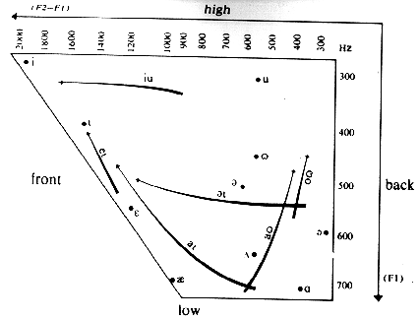
Vowel Chart Quadrilateral
Vowel chart of F1 (vertical) vs F2-F1 (horizontal). (Ladefoged)

Slide 3
Vowel Chart Problems
Frontness and Height specify acoustic dimensions
Cardinal vowels, pure vowels because of their stable auditory quality, have not been adequately described in terms of their corresponding stable articulatory configuration.
Only two of them /i/ and // have lingual descriptions and the rest were defined according to the number of auditorily equidistant steps between /i/ and //

Slide 4
Vowel Chart Problems
Vowel charts used in computer based speech training aids are often based on formant frequencies. Front-back corresponds to F2-F1 and high-low to F1.
  Algorithms for formants extraction
  Consonants
  Misarticulated sounds
  Secondary articulation, e.g. nasality

Slide 5
Optico-Acoustic Articulography OPTACIA
attempt to relate articulatory configurations to acoustics to 2D fixed positions.
Related to EMA, EPG, but less invasive, more flexible, and cost effective.
Inspired from Kohonen’s SOM and the work of Zahorian and Venkat.
How it works…

Slide 6
Optacia Mapping
ANN
2D fixed positions
Acoustic vector representation
Reference Gestures Cardinals

Slide 7
Optacia Mapping
A small movement of the articulators , hence a small difference in the acoustics, results in a mapping close to the fixed 2D points defined for the cardinals.
The 2D area between the cardinals of the map is related to the articulatory continuum between gestures.
Movement of the articulators from one gesture to another results in moving along a 2D direction from one cardinal to another.

Slide 8
Optacia Experiments
Experiment with 4 cardinals
  Lingual mapping and the gliding test
Experiment with 5 cardinals
  Lip rounding of //
  Nasalisation of /i/
  Rhotacisation of /ae/
  Pharyngealisation of /i/

Slide 9
Optacia Experiments
Experiment with ten cardinals
  Diphthongs
  Consonantal production of /z/
  CVC transitions
  Utterances

Slide 10
Summary
Optacia visualises the relationship between the auditory qualities of the sounds we produce and the movement of the articulators
Attempt to escape from the traditional abstract notion of the phoneme target with auditory qualities to that of gestures with articulatory description
Enhancement of the classic vowel chart
Flexible layout of sounds

Slide 11
Further Investigation
Use a different acoustic vector
Think about how to use different parameters of visual modality to portray the varying properties of the articulators
Study the relationship between vocal tract area, acoustics, and positions on the map.
Find how one can move the articulators to glide from one gesture to another

