Slide 1
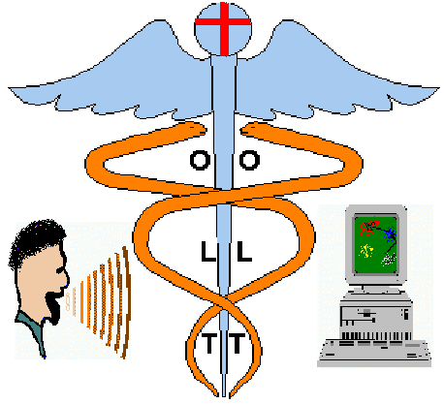
Introduction
What is OLT ?
OLT is a Computer Based Speech Training system (CBST) for the visualisation of articulation using both connectionist and speech technology techniques.
Notes:
1

Slide 2
State of the Art in (CBST)
Research on (CBST) systems started 15 years ago.
The majority of the systems provided feedback on a single acoustic dimension of speech such as, pitch, volume(amplitude,duration,onset), rhythm, intonation, articulation, or on a single acoustic property, such as s-sh frication, vowels articulation, e.t.c.
Physiological methods vs Acoustic analysis
Electropalatography (EPG) Video Voice
Electrolaryngography (ELG) Indiana Speech Training Aid (ISTRA)
Glossometry The Visual Speech Apparatus (VSA)
The Dynamic Orometer IBM Speech Viewer
HARP
Visual Speech Trajectories (Kohonen SOM - Visual Ear - VAHISOM - OLT)
Notes:
2

Slide 3
Computer Based Speech Training systems (CBST)
Critical aspects
The kind of feedback
Evaluation of speech production
Guidelines for error correction
Training curriculum
(Phone - Utterance - Continuous speech)
Adjustable training targets
Specialised to particular speech disorders and client’s physiology
Motivation. Enjoy the speech drills.
OLT design aspects
Real time visual animated feedback
Qualitative and quantitative results
Speaker comparison and trial error correction
Simultaneous phone and utterance training
Build maps based on best user training performance
Specialised phonetic maps
Simple games, e.g. a moving object that follows the target trajectories on the map.
Notes:
2

Slide 4
Preparation of Speech Training Data
Segmentation and labelling
  Manual procedures have been used for the current experiments.
  Mel Frequency Cepstral Coefficients (MFCC) together with overall energy are taken every 10 msec on an analysis window of 20 msec.
  Appropriate phone categories are selected for the special case of the speech disordered person.
  Equal number of samples is taken for each one of the phone categories.
Notes:
3

Slide 5
Creating an OLT Phonetic Map
Three Stages
Learning Vector Quantisation (LVQ)
  LVQ algorithms [Kohonen et. all] are used to model the subset of phonetic space with a sufficient number of 9D reference vectors.
Sammon mapping
  A non-linear projection is then applied to reduce the 9D reference vectors to points in a 2D space.
Multi Layer Perceptron mapping (MLP)
  Finally an MLP neural network is trained using the backpropagation algorithm to learn the nonlinear relationship between 9D space patterns and 2D ones.
Notes:
4

Slide 6
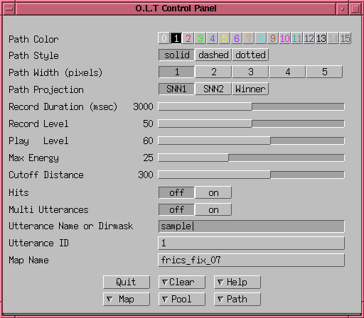
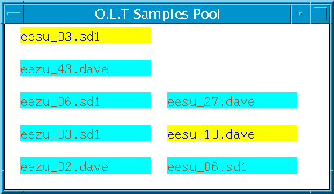
OLT - User Interface
Three Main Windows
OLT - Control panel
  Control path display attributes.
  Control map projection.
  Control speech recording and playback.
  Control the creation, selection and loading of maps and utterances.
OLT - Samples pool
  On line selection of pre-recorded utterances for comparison with user
OLT - Main map area (Slide 4)
  Recording and playback
  Speech evaluation tools
Notes:
5

Slide 7
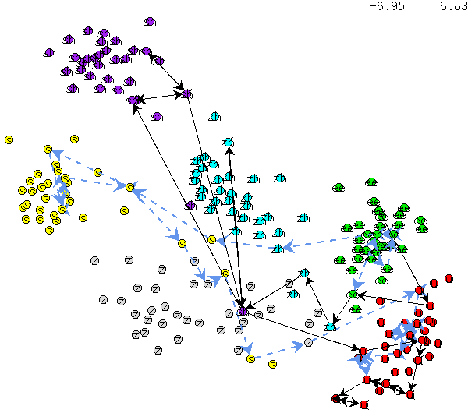

Adults Sibilant Fricatives Experiment
  Map Construction
Training data from 4 and testing data from 2 normal speakers, all male and English adults.
44 utterances of fixed context of the form /ee X u/ where X is /s,sh,z,zh/.
Map Comparison
A speech impaired subject, also male and English adult was selected for comparison . He articulates all of the target sibilant fricatives laterally, rather than centrally.
The picture on the right shows normal (blue dashed line) and abnormal (black solid line) trajectories for the utterance /ee s u/.
Notes:
6

Slide 8
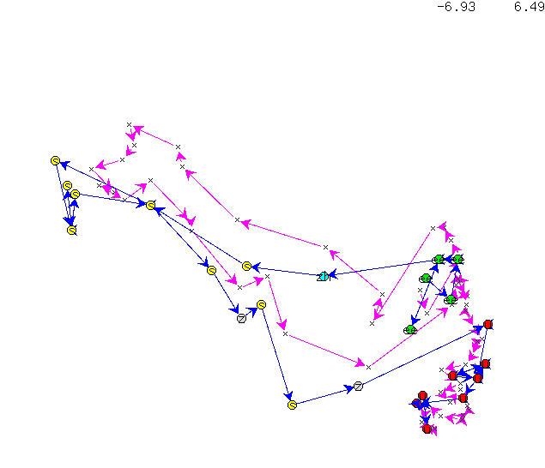
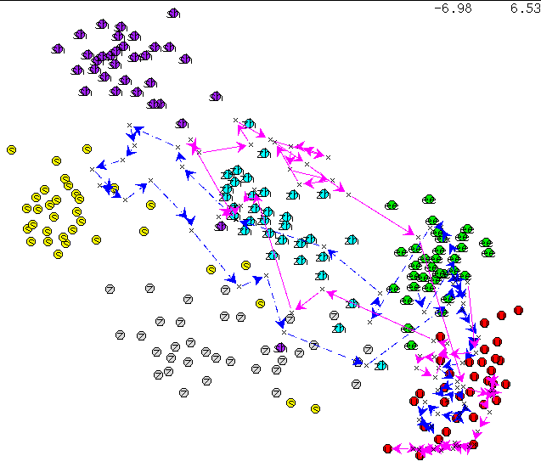
MLP-Mapping vs Kohonen’s-Mapping
Normal trajectories of the utterance, /ee s u/ for MLP mapping, pink line with crosses, and Kohonen’s mapping, blue line with circles.
Normal trajectory, blue dashed line, vs abnormal trajectory, pink solid line, for the utterance /ee s u/ with MLP mapping.
Notes:
7

Slide 9
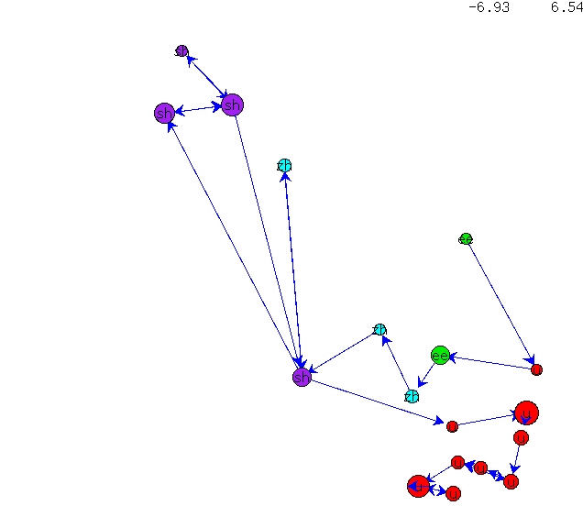
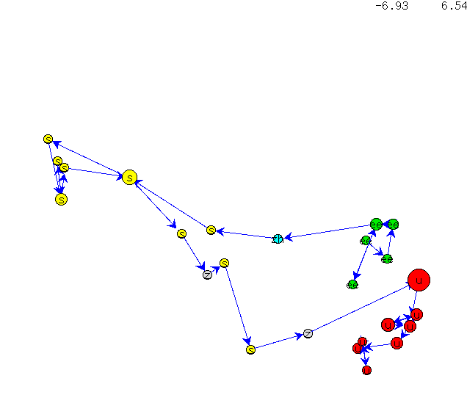
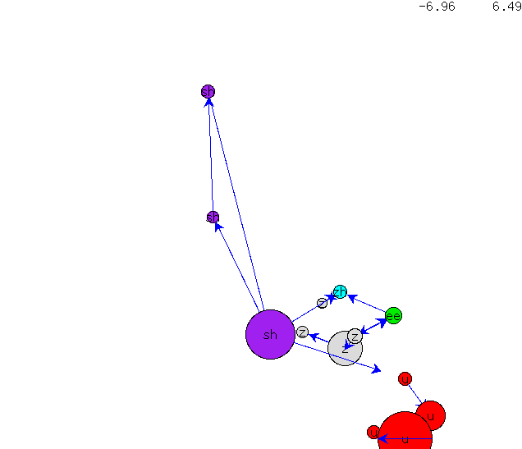
Kohonen’s-Mapping Trajectories
Abnormal trajectory of /ee s u/ with normal rate of speech.
Normal trajectory of /ee s u/ with normal rate of speech.
Abnormal trajectory of /ee s u/ with slow rate of speech.
Notes:
8

Slide 10
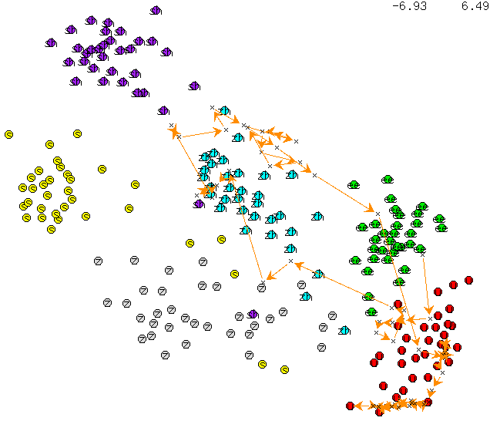
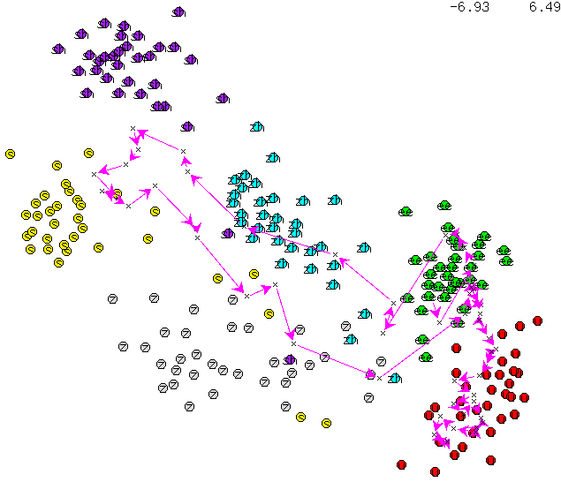
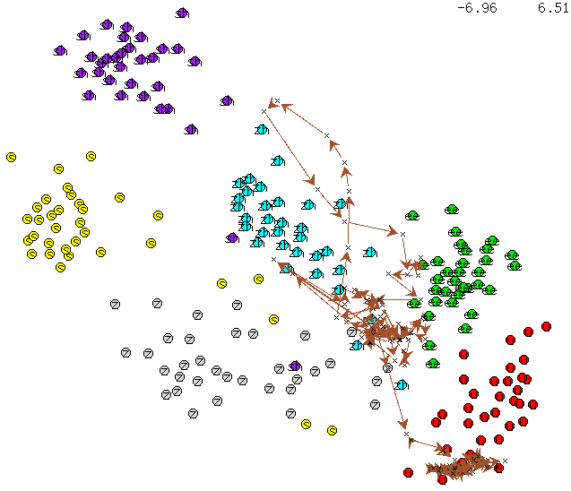
MLP-Mapping Trajectories
Abnormal trajectory of /ee s u/ with normal rate of speech.
Normal trajectory of /ee s u/ with normal rate of speech.
Abnormal trajectory of /ee s u/ with slow rate of speech.
Notes:
9

Slide 11
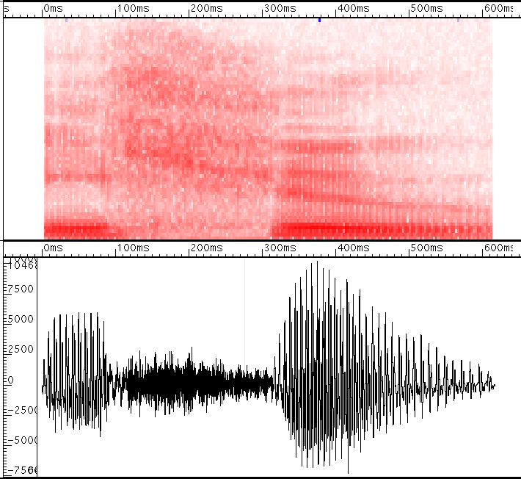
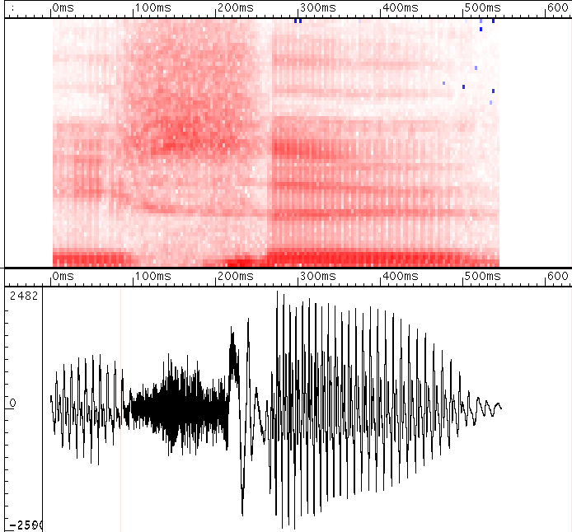
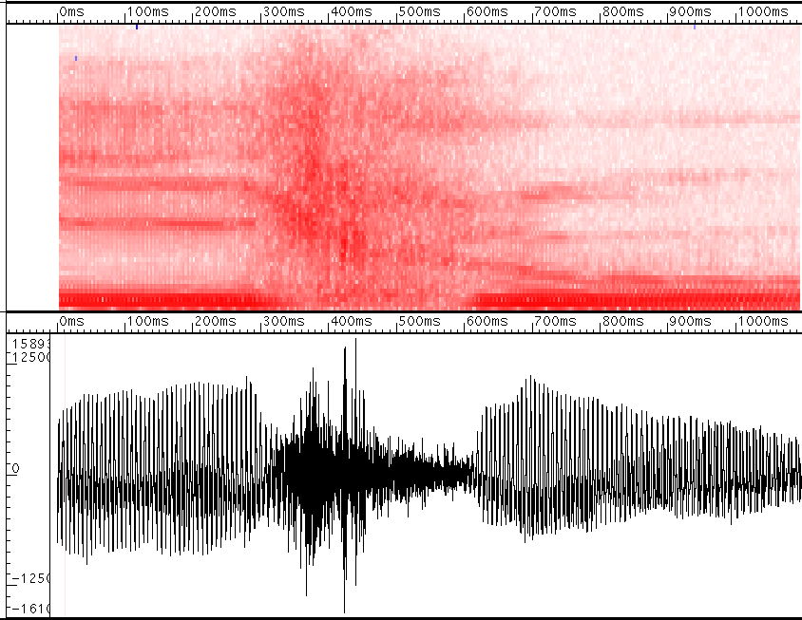
Time-Frequency Domain Comparison
Abnormal /ee s u/ with normal rate of speech.
Normal /ee s u/ with normal rate of speech.
Abnormal /ee s u/ with slow rate of speech.

Slide 12
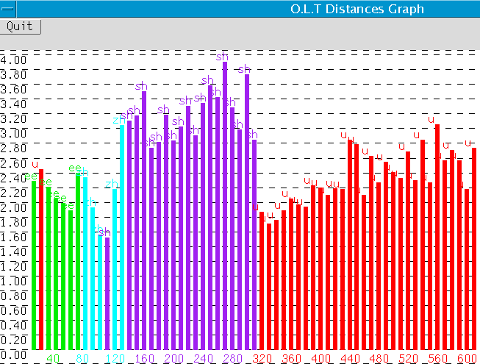
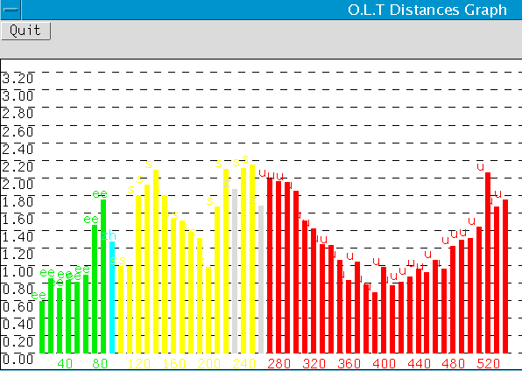
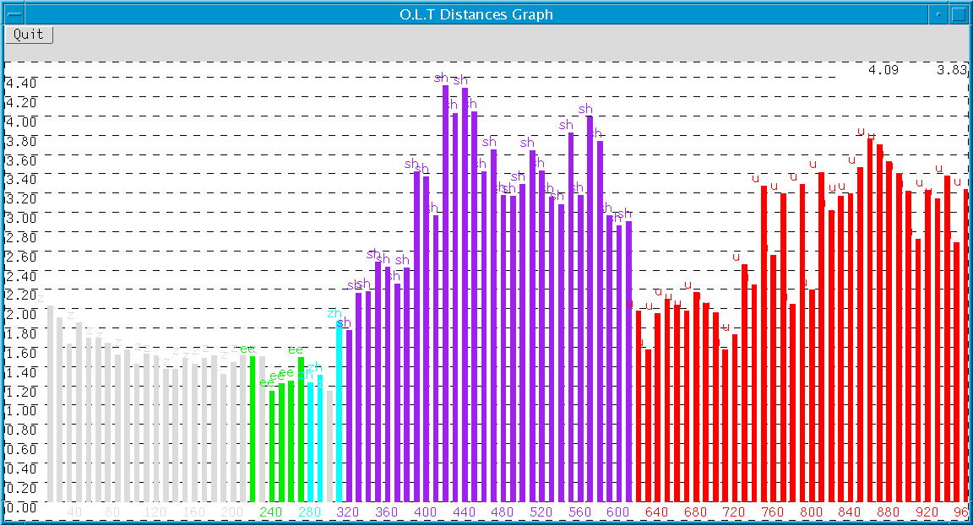
OLT Distances Comparison
Abnormal /ee s u/ with normal rate of speech.
Normal /ee s u/ with normal rate of speech.
Abnormal /ee s u/ with slow rate of speech.

Slide 13
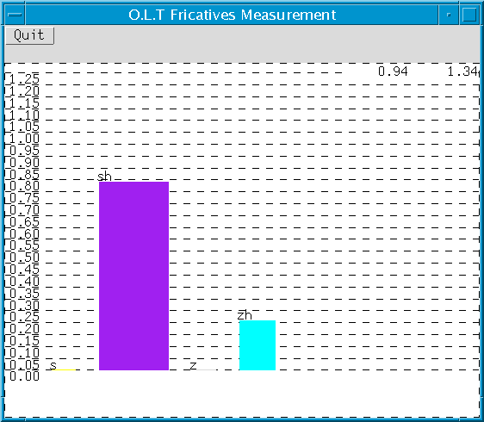
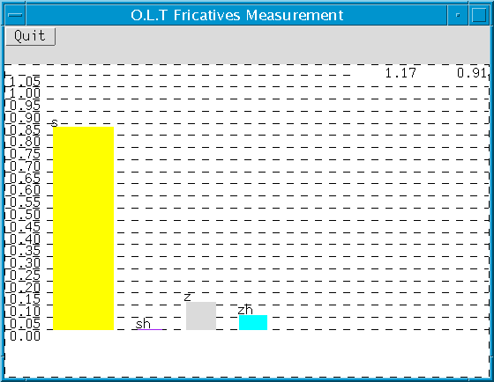
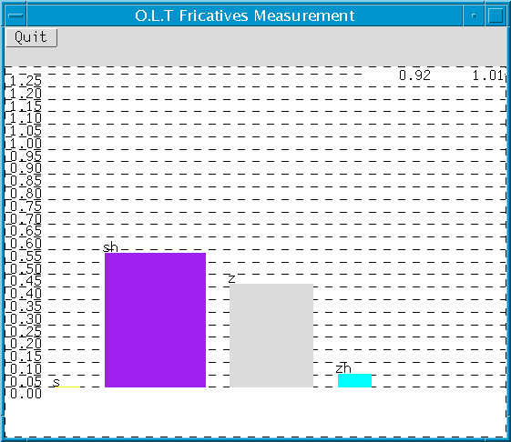
Fricative Quality Comparison
Abnormal /ee s u/ with normal rate of speech.
Normal /ee s u/ with normal rate of speech.
Abnormal /ee s u/ with slow rate of speech.
Notes:
12

Slide 14
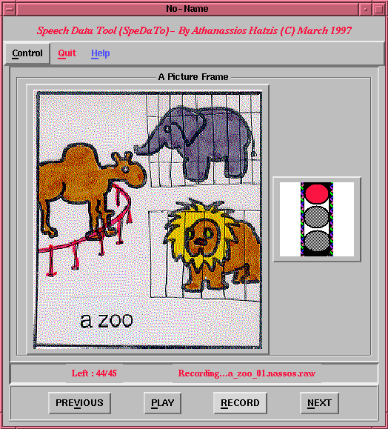
Children Sibilant Fricatives Experiment
  Speech Data Collection
A special program was built to help with the recordings of the children.
We recorded in total 18 normal children and each subject repeated a list of words (a sea, a zee, a sheep, a saw, a shore, a zorr, a zoo, a shoe, a suit) 5 times. In addition the subjects recorded isolated sounds.
Map Comparison
A seven years old girl with misarticulated sibilant fricatives, was compared with one of the normal female speakers. She produced target alveolar and post-alveolar fricatives with lateral rather than central friction.
Notes:
6

Slide 15
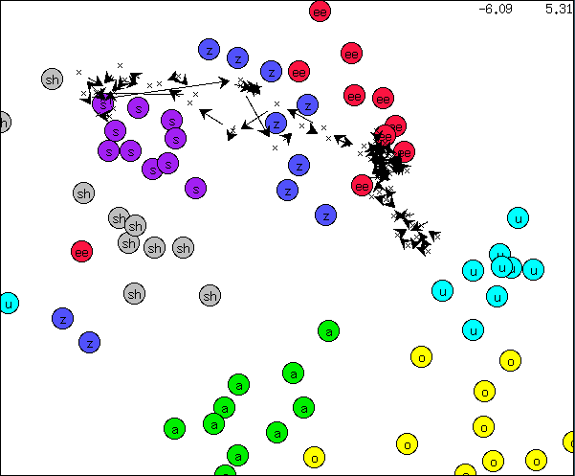
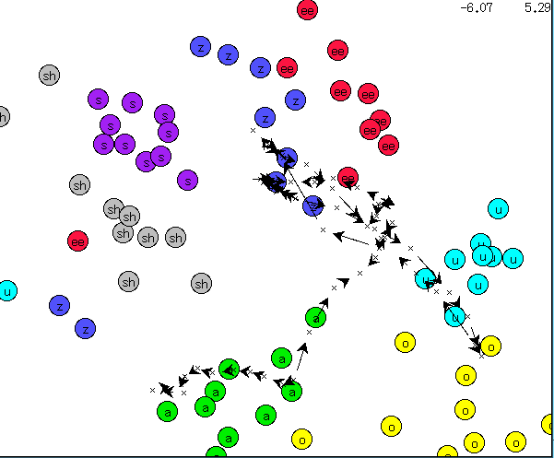
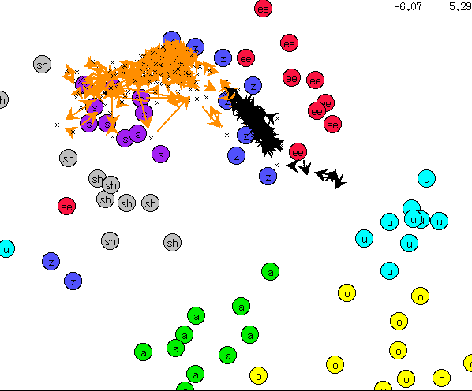
Normal Child vs Abnormal Child
Abnormal speech trajectory of the utterance “a zoo”
Normal speech trajectory of the utterance “a zoo”
Normal (black) vs Abnormal (orange) trajectory of the isolated sound of phoneme /z/
Notes:
8

Slide 16
Conclusions
We have demonstrated the creation of a real time visual feedback in the form of a trajectory in a 2D ‘phonetic space’
The speech-impaired subjects show clear abnormalities in speech-impaired vowel-fricative-vowel trajectories which are consistent with their ‘lateralising’ problem
With OLT, the child or adult can be asked not only to produce sounds which are problematic for them, but also sounds which are easy for them. Thus it guarantees them some positive visual feedback, even in the initial stages of therapy.
Clients were clearly motivated by OLT to experiment according to the clinician’s instructions and were able to relate the results of different articulatory configurations to the visual feedback they received.

Slide 17
Future Plans
Implementation of various techniques using Neural Networks for dimensionality reduction and classification for the creation of better phonetic maps.
Real time simple animated games based on the ‘phonetic map’.
Development of a library of pre-prepared maps for common problems in speech therapy and for different subject groups..
Easy building of a map by selecting phone categories from an appropriate phone database.
Build personalised phonetic maps based on the speech disorder and potential improvement of the subject.

