Slide 1
AS.280.347 Class 1.2
Look at data displays!
Review of logistic regression

Slide 2
Module 1: Smoking and risk of disease
Question 1.1 (Q1.1): How does the risk of disease compare for smokers and otherwise similar non-smokers?
Question 1.2 (Q1.2): Does the contribution of smoking to the risk of disease vary by sex or SES?
To address each question, we want:
a data display
a statistical analysis
We will answer these questions using data from the National Medical Expenditures Survey (NMES)

Slide 3
Module 1: Smoking and risk of disease
Question 1.1 (Q1.1): How does the risk of disease compare for smokers and otherwise similar non-smokers?
Question 1.2 (Q1.2): Does the contribution of smoking to the risk of disease vary by sex or SES?
smoking status
disease status
sex, age, SES, etc
smoking status
disease status
sex, SES

Slide 4
Today’s agenda
Group discussion and critiques of NMES data displays to address Q1.1:
How does the risk of disease compare for smokers and otherwise similar non-smokers?
Plans to improve displays
Review of logistic regression

Slide 5
Questions for discussion
What are the characteristics of effective displays?
How can the current displays that address Q1.1 be improved?
How can the process of working together be improved?
What statistical analysis will effectively use the NMES data to address Q1.1?
Multivariable logistic regression
Propensity scores (next week)
What displays and statistical analysis will address Question 1.2 (Q1.2):
Does the contribution of smoking to the risk of disease vary by sex or SES?

Slide 6
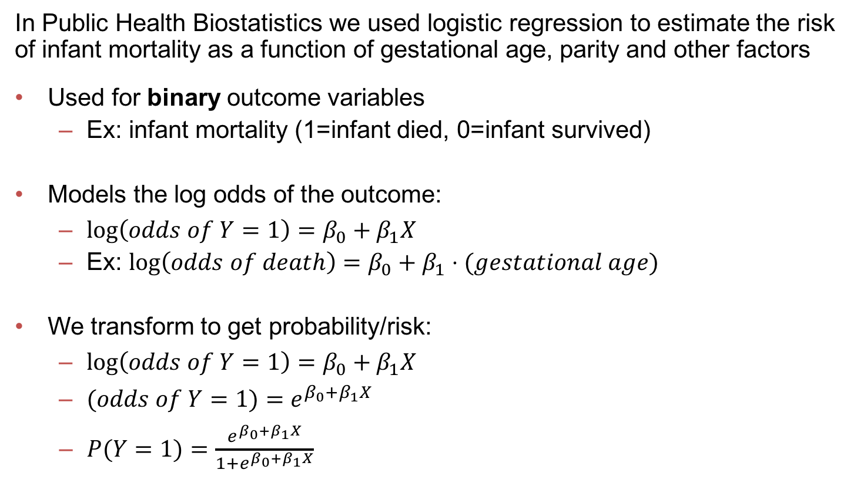
Review of logistic regression
In Public Health Biostatistics we used logistic regression to estimate the risk of infant mortality as a function of gestational age, parity and other factors
Used for binary outcome variables
Ex: infant mortality (1=infant died, 0=infant survived)
Models the log odds of the outcome:
$\log\left(odds of Y=1\right)=β_{0}+β_{1}X$
Ex: $\log\left(odds of death\right)=β_{0}+β_{1}⋅(gestational age)$
We transform to get probability/risk:
$\log\left(odds of Y=1\right)=β_{0}+β_{1}X$
$(odds of Y=1)=e^{β_{0}+β_{1}X}$
$P(Y=1)=\frac{e^{β_{0}+β_{1}X}}{1+e^{β_{0}+β_{1}X}}$

Slide 7
Review of logistic regression
Is the mortality risk (or odds) higher for twins than singleton births?
Odds of death for twins: 71/187 = .38
Odds of death for singletons: 526/8899 = .059
Odds ratio of death for twins as compared to singletons:
OR = (odds for twins)/(odds for sing) = (71/187)/(526/8899) = 6.42
Log odds ratio: log_{e}(OR) = log(6.42) =1.86
 | Singleton | Twin | Total
Survived | 8899 | 187 | 9086
Died | 526 | 71 | 597
Total | 9425 | 258 | 9683

Slide 8
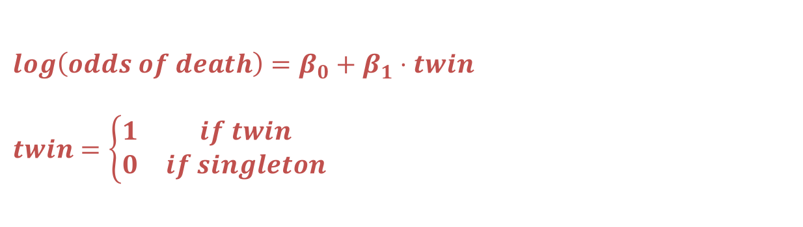
Review of logistic regression
$$log\left(odds of death\right)=β_{0}+β_{1}⋅twin$$
$$twin=\left\{\begin{matrix}1 & if twin \\ 0 & if singleton\end{matrix}\right.$$
> model1 = glm(death ~ twins, family=binomial(link="logit”))
> summary(model1)
Coefficients:
Estimate Std. Error z value Pr(>|z|)
(Intercept) -2.82839 0.04487 -63.03 <2e-16 ***
twins 1.85996 0.14644 12.70 <2e-16 ***
---
Null deviance: 4483.1 on 9682 degrees of freedom
Residual deviance: 4361.6 on 9681 degrees of freedom
AIC: 4365.6
Number of Fisher Scoring iterations: 5

Slide 9


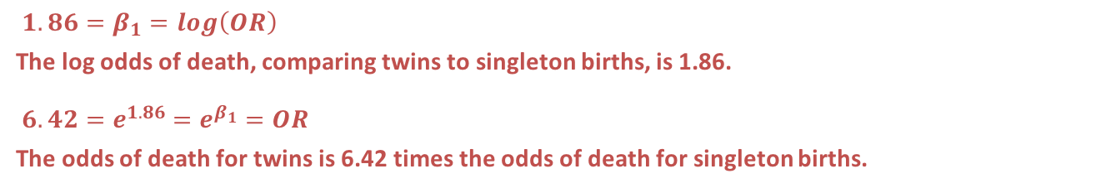
Review of logistic regression
> model1 = glm(death ~ twins, family=binomial(link="logit”))
> summary(model1)
Coefficients:
Estimate Std. Error z value Pr(>|z|)
(Intercept) -2.82839 0.04487 -63.03 <2e-16 ***
twins 1.85996 0.14644 12.70 <2e-16 ***
---
Null deviance: 4483.1 on 9682 degrees of freedom
Residual deviance: 4361.6 on 9681 degrees of freedom
AIC: 4365.6
Number of Fisher Scoring iterations: 5
test
statistic
$$β$$
$$SE(β)$$
p-value
${1.86=β}_{1}=log\left(OR\right)$
The log odds of death, comparing twins to singleton births, is 1.86.
$6.42=e^{1.86}=e^{β_{1}}=OR$
The odds of death for twins is 6.42 times the odds of death for singleton births.

Slide 10
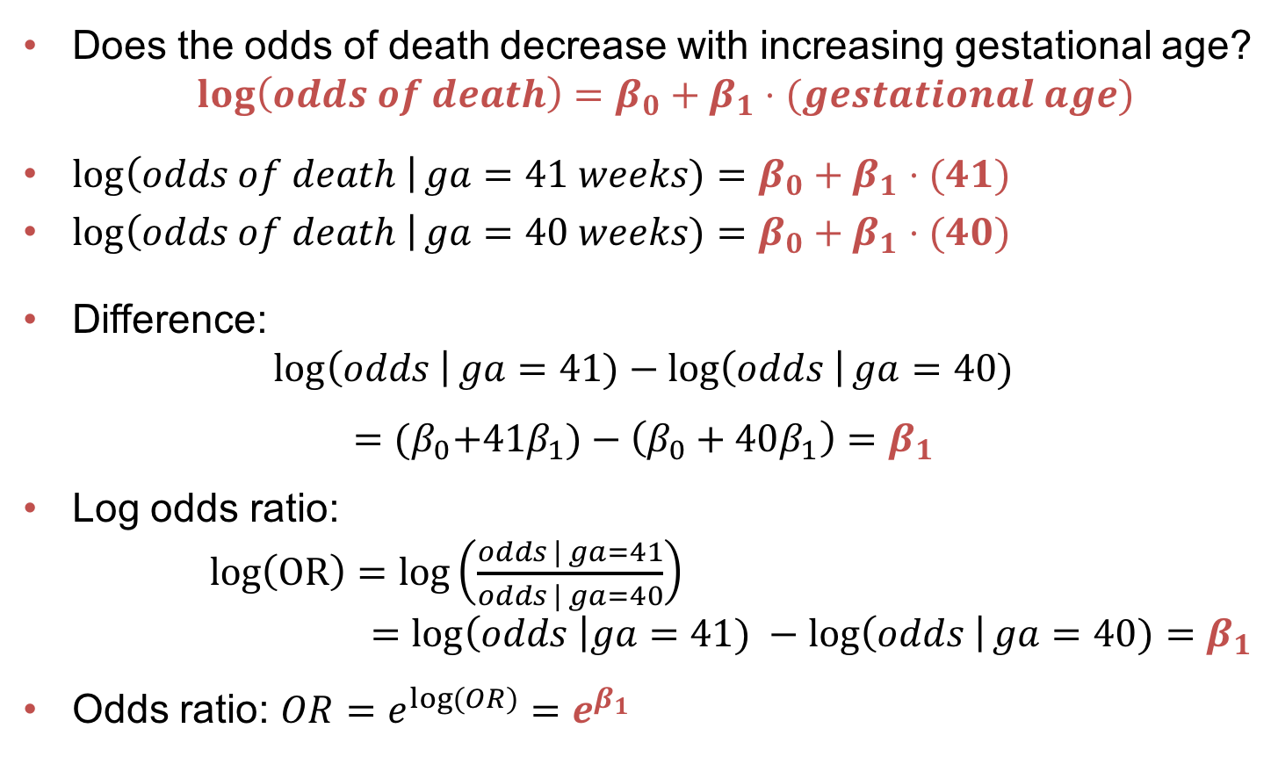
Review of logistic regression
Does the odds of death decrease with increasing gestational age?
$\log\left(odds of death\right)=β_{0}+β_{1}⋅(gestational age)$
$\log\left(odds of death \right|ga=41 weeks)=β_{0}+β_{1}⋅(41)$
$\log\left(odds of death \right|ga=40 weeks)=β_{0}+β_{1}⋅(40)$
Difference:
$$\log\left(odds \right|ga=41)−\log\left(odds \right|ga=40)$$
$$={(β}_{0}+41β_{1})−\left(β_{0}+40β_{1}\right)=β_{1}$$
Log odds ratio:
$log\left(OR\right)=log\left(\frac{odds | ga=41}{odds | ga=40}\right)$
$=log\left(odds \right|ga=41) −\log\left(odds \right|ga=40)=β_{1}$
Odds ratio: $OR=e^{\log\left(OR\right)}=e^{β_{1}}$

Slide 11
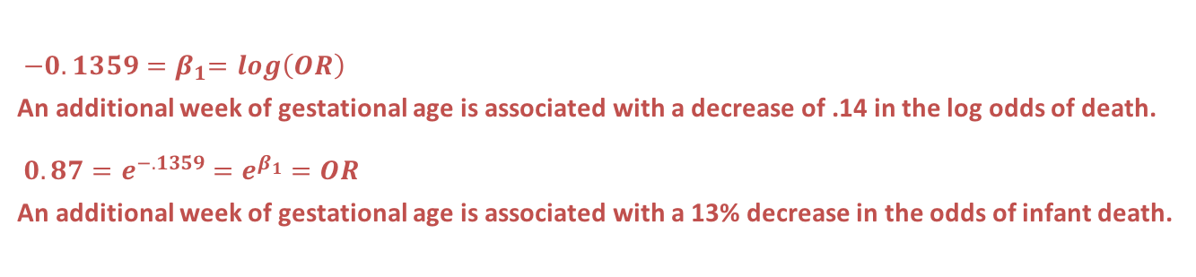
Review of logistic regression
> model2 = glm(death ~ gestage, family=binomial(link="logit”))
> summary(model2)
Coefficients:
Estimate Std. Error z value Pr(>|z|)
(Intercept) 2.3274 0.3943 5.902 3.59e-09 ***
gestage -0.1359 0.0108 -12.584 < 2e-16 ***
Null deviance: 4483.1 on 9682 degrees of freedom
Residual deviance: 4328.0 on 9681 degrees of freedom
AIC: 4332
$$β$$
$${−0.1359=β}_{1}=log\left(OR\right)$$
An additional week of gestational age is associated with a decrease of .14 in the log odds of death.
$$0.87=e^{−.1359}=e^{β_{1}}=OR$$
An additional week of gestational age is associated with a 13% decrease in the odds of infant death.

Slide 12
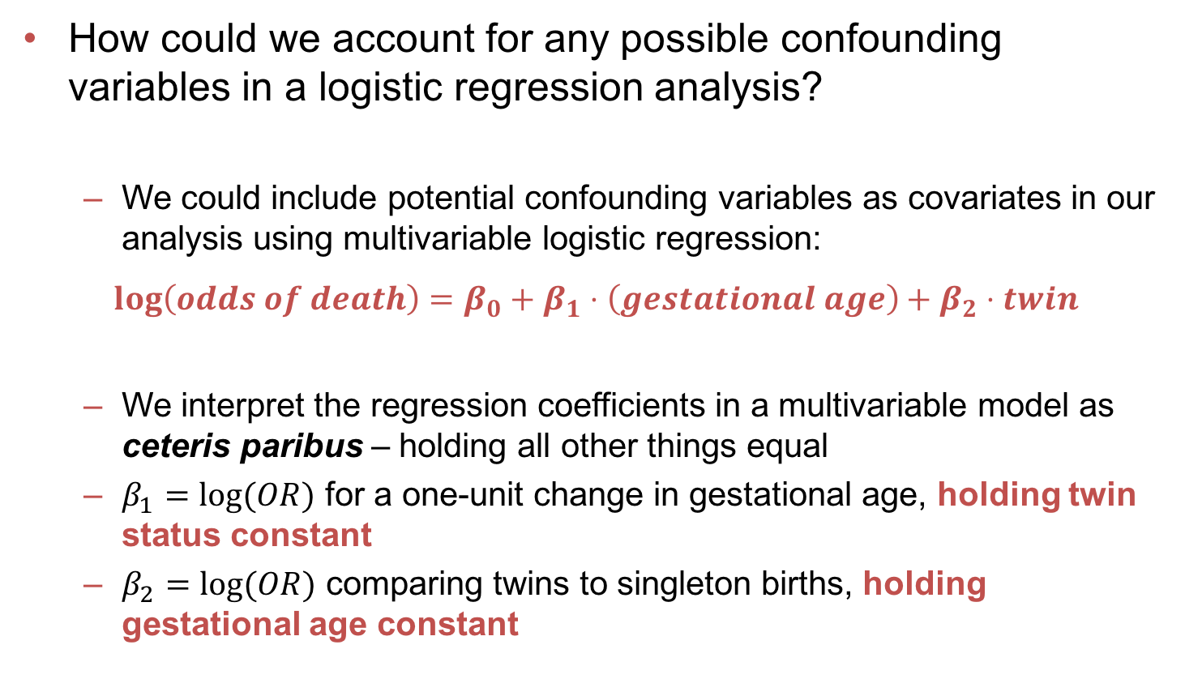
Review of logistic regression
How could we account for any possible confounding variables in a logistic regression analysis?
We could include potential confounding variables as covariates in our analysis using multivariable logistic regression:
$$\log\left(odds of death\right)=β_{0}+β_{1}⋅\left(gestational age\right)+β_{2}⋅twin$$
We interpret the regression coefficients in a multivariable model as ceteris paribus – holding all other things equal
$β_{1}=log⁡(OR)$ for a one-unit change in gestational age, holding twin status constant
$β_{2}=log⁡(OR)$ comparing twins to singleton births, holding gestational age constant

Slide 13
Assignment 1.2
Q1.1: How does the risk of disease compare for smokers and otherwise similar non-smokers?
Improve your data display to answer this question.
Fit a logistic regression model to answer this question. Interpret your coefficients and significance tests to answer the question: what does this model say about Q1.1?
Work together in groups!
Submit your display in R markdown through Blackboard by Sunday @ midnight.
Consider completing any/all of these available DataCamp modules:
Introduction to R
Reporting with R Markdown: Authoring R Markdown Reports
Reporting with R Markdown: Embedding Code
Reporting with R Markdown: Compiling Reports
Introduction to the Tidyverse
Next week in class we will again start with presentations/critiques of your displays.

