Slide 1
AS.280.347 Class 1.4
Look at interpretations of logistic regressions and propensity score results
Effect modification

Slide 2
Module 1: Smoking and risk of disease
Question 1.1 (Q1.1): How does the risk of disease compare for smokers and otherwise similar non-smokers?
Question 1.2 (Q1.2): Does the contribution of smoking to the risk of disease vary by sex or SES?
To address each question, we want:
a data display
a statistical analysis
We will answer these questions using data from the National Medical Expenditures Survey (NMES)

Slide 3
Interpreting propensity score results
Propensity scores based on age and sex:
propModel<-glm(eversmk ~ age + female, data=nmes.data,
family=binomial(link="logit"))
predLogOdds<-predict(propModel)
predProb<-exp(predLogOdds)/(1+exp(predLogOdds))
probCutoffs<-quantile(predProb, probs=c(0,0.2, 0.4, 0.6, 0.8, 1))
probQuintiles<-cut(predProb, probCutoffs, include.lowest = TRUE)
Relationship between disease and smoking, adjusted for propensity score quintile:
glmOut<-glm(mscd ~ eversmk + probQuintiles, data=nmes.data,
family=binomial(link="logit"))
summary(glmOut)

Slide 4
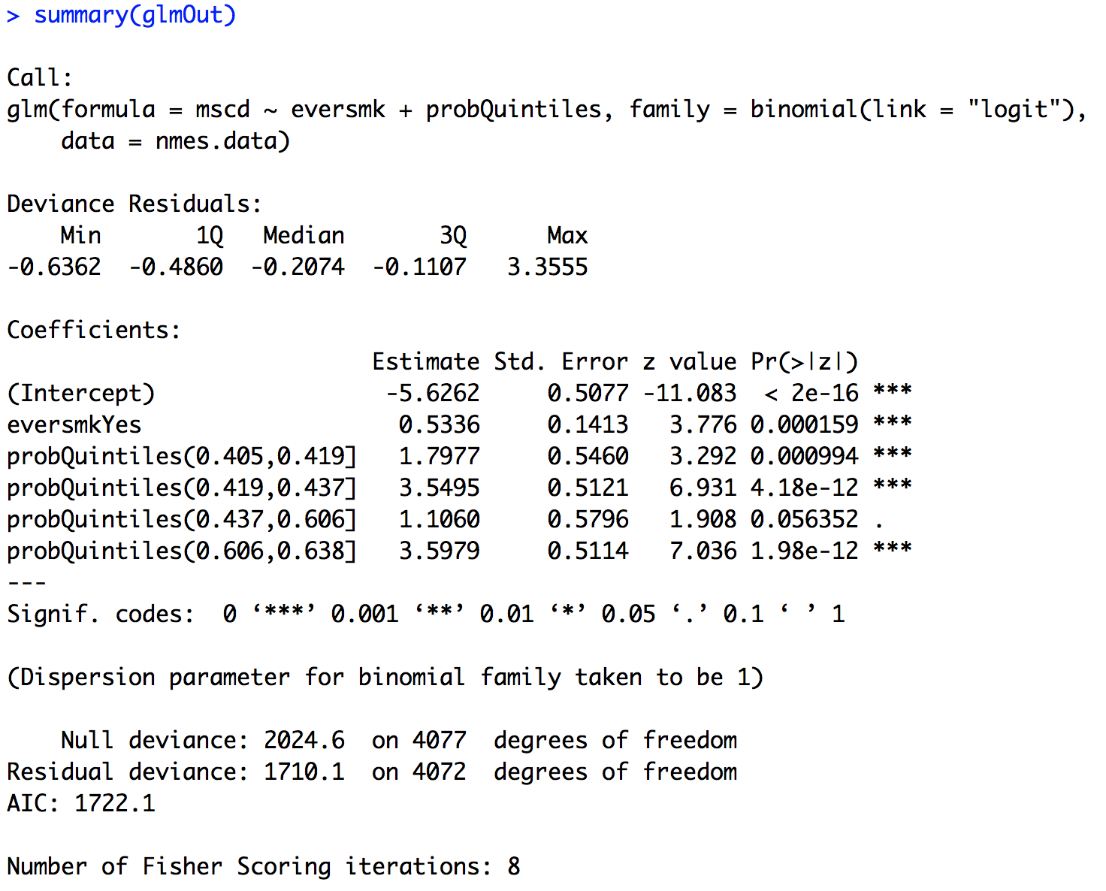
Interpreting propensity score results
We estimate that the log odds of disease
is .53 higher for smokers compared to
non-smokers of similar age and sex.
We would consider the
relationship statistically
significant!
We estimate that the odds of disease
for smokers are 1.71 times the odds for
non-smokers of similar age and sex. The
odds of disease are 71% higher for
smokers compared to non-smokers of
similar age and sex.

Slide 5
Interpreting propensity score results
Don’t need to interpret
these since they are just
for adjustment purposes
and not the relationship
of interest!

Slide 6
Now for Question 1.2
Question 1.2 (Q1.2): Does the contribution of smoking to the risk of disease vary by sex or SES?
Data display?
Statistical analysis?
An effect modification (or interaction) is present when the relationship between a predictor of interest and the outcome varies by the level (subgroup) of another variable
smoking status
disease status
sex, SES

Slide 7
Ways to include effect modification
Do separate analyses for each subgroup; report estimate with confidence interval by subgroup
OR
Include interaction between smoking and indicator of subgroup in second step of propensity score analysis:
glm( mscd ~ eversmk*sex + ps.groups,
family=binomial(link=”logit”))
Be sure subgroup indicator is in propensity model
propModel <- glm( eversmk ~ ??? + sex,
family=binomial(link=”logit”))

Slide 8
Interpreting effect modification results
Analyses separately for males/females:
nmes.female <- nmes.data %>% filter(female=="Female")
nmes.male <- nmes.data %>% filter(female=="Male")
propModel<-glm(eversmk ~ age, data=nmes.female,
family=binomial(link="logit"))
predLogOdds<-predict(propModel)
predProb<-exp(predLogOdds)/(1+exp(predLogOdds))
probCutoffs<-quantile(predProb, probs=c(0,0.2, 0.4, 0.6, 0.8, 1))
probQuintiles<-cut(predProb, probCutoffs, include.lowest = TRUE)
glmOut.female<-glm(mscd ~ eversmk + probQuintiles, data=nmes.female,
family=binomial(link="logit"))
summary(glmOut.female)
confint.default(glmOut.female)
Then repeat the same analyses for males!
don’t include sex here!

Slide 9
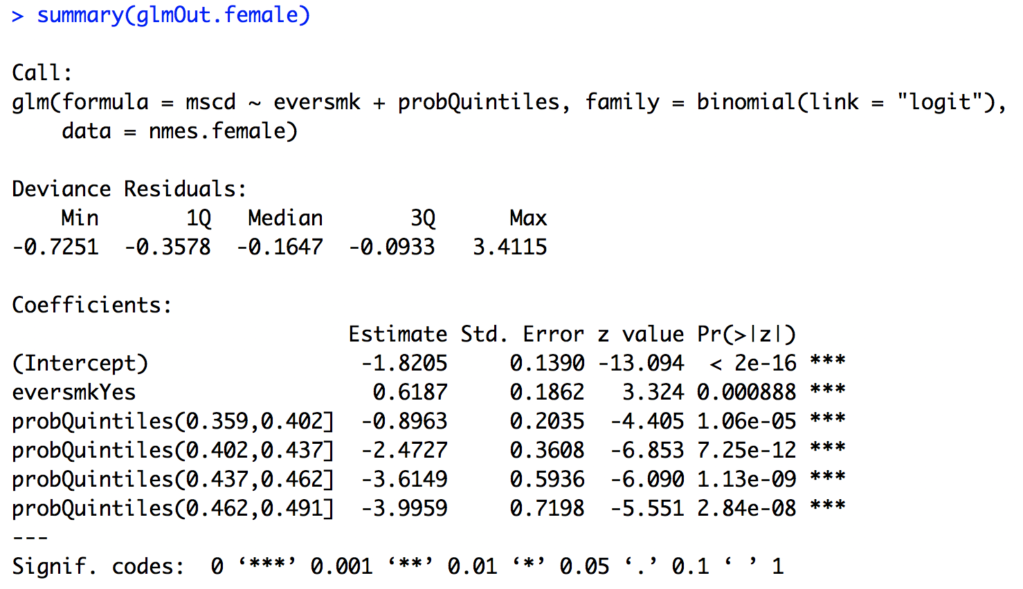
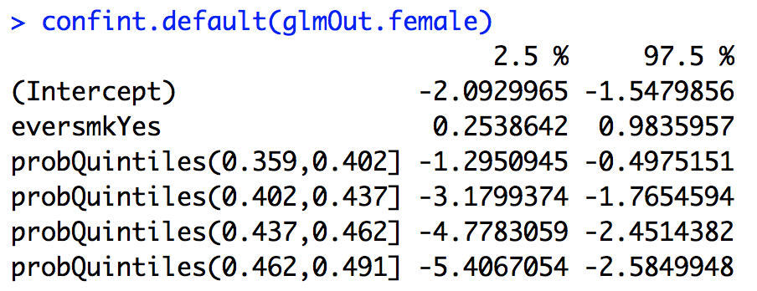
Interpreting effect modification results
exp(.6187) = 1.86
exp(.2539) = 1.29
exp(.9836) = 2.67
We estimate that the odds of disease for
female smokers are 1.86 times the odds for
female non-smokers of similar ages
(95% CI for OR: 1.29 to 2.67).

Slide 10
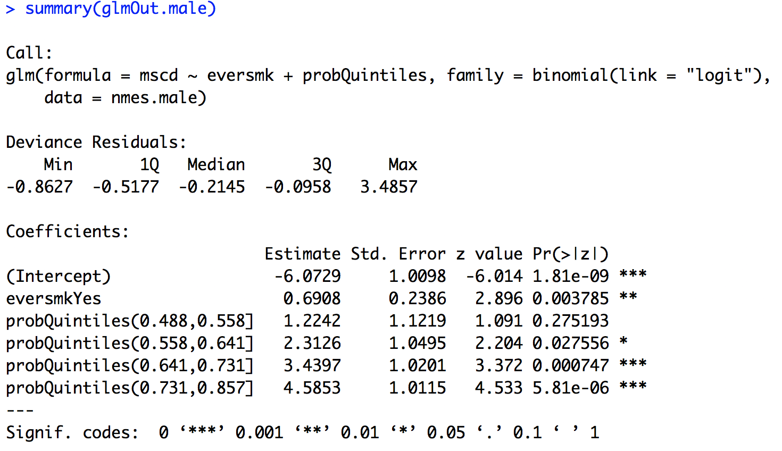
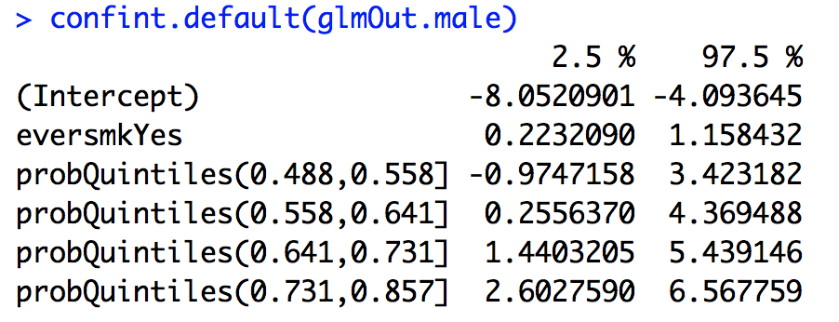
Interpreting effect modification results
exp(.6908) = 2.00
exp(.2232) = 1.25
exp(1.158) = 3.18
We estimate that the odds of disease for
male smokers are 2.0 times the odds for
male non-smokers of similar ages
(95% CI for OR: 1.25 to 3.18).

Slide 11
Interpreting effect modification results
Including interaction term along with propensity adjustment:
propModel<-glm(eversmk ~ age + female, data=nmes.data,
family=binomial(link="logit"))
predLogOdds<-predict(propModel)
predProb<-exp(predLogOdds)/(1+exp(predLogOdds))
probCutoffs<-quantile(predProb, probs=c(0,0.2, 0.4, 0.6, 0.8, 1))
probQuintiles<-cut(predProb, probCutoffs, include.lowest = TRUE)
glmOut<-glm(mscd ~ eversmk*female + probQuintiles, data=nmes.data,
family=binomial(link="logit"))
summary(glmOut)
confint.default(glmOut)
be sure to include sex here!
include interaction with sex here

Slide 12
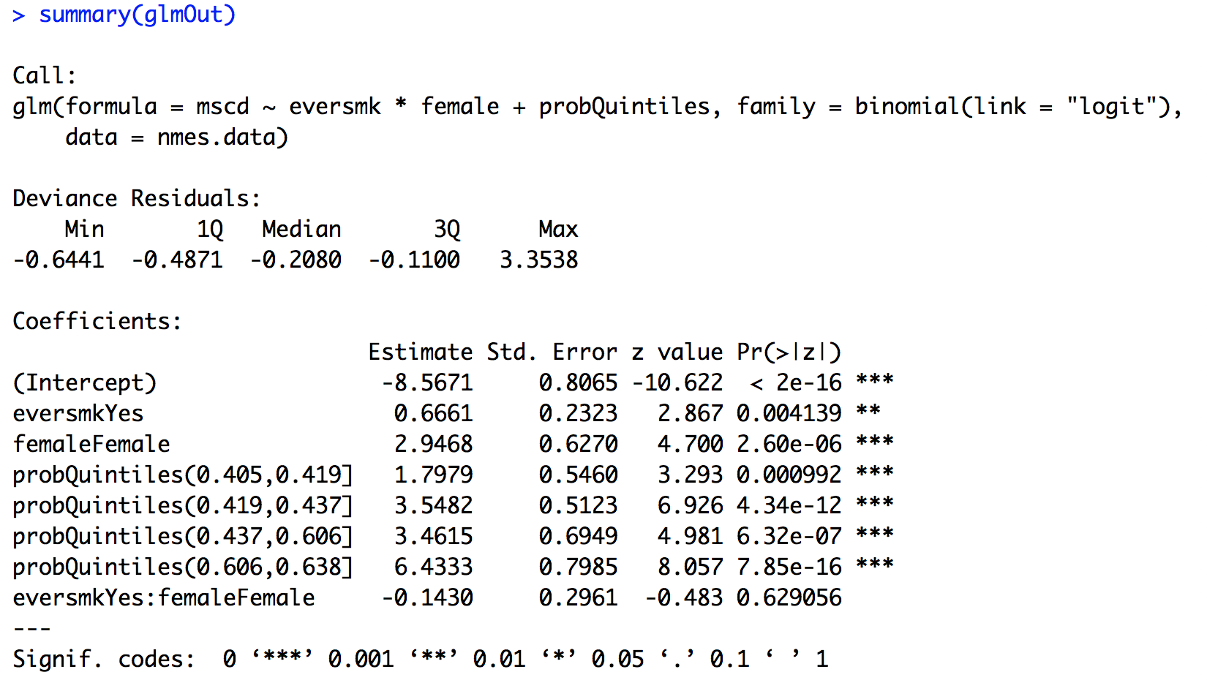
Interpreting effect modification results
No evidence of effect modification
(interaction) between sex and smoking
status because the interaction term is not
statistically significant!

Slide 13
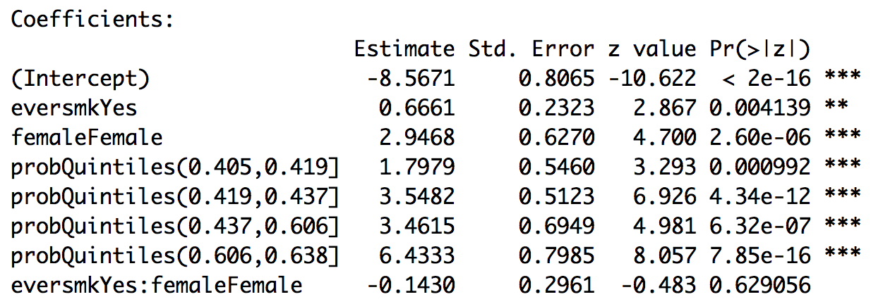
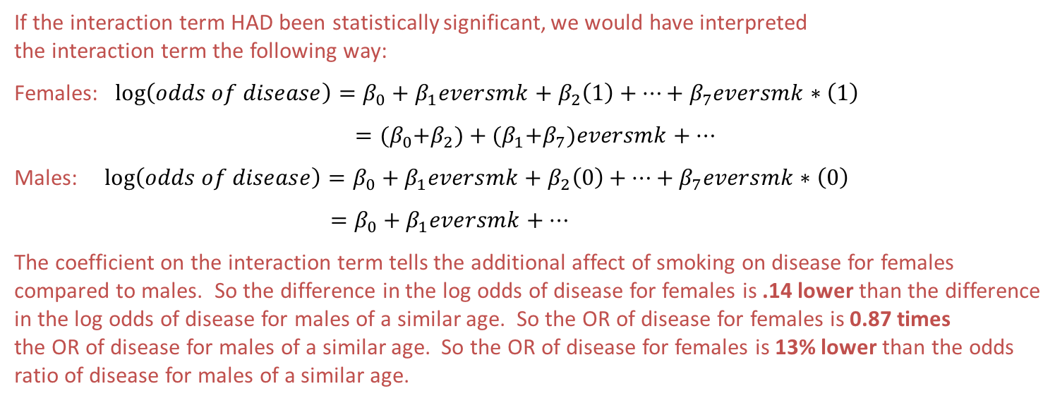
Interpreting effect modification results
If the interaction term HAD been statistically significant, we would have interpreted
the interaction term the following way:
Females: $\log\left(odds of disease\right)=β_{0}+β_{1}eversmk+β_{2}\left(1\right)+…+β_{7}eversmk∗\left(1\right)$
$={(β}_{0}+β_{2})+{(β}_{1}+β_{7})eversmk+…$
Males: $\log\left(odds of disease\right)=β_{0}+β_{1}eversmk+β_{2}\left(0\right)+…+β_{7}eversmk∗\left(0\right)$
$=β_{0}+β_{1}eversmk+…$
The coefficient on the interaction term tells the additional affect of smoking on disease for females
compared to males. So the difference in the log odds of disease for females is .14 lower than the difference
in the log odds of disease for males of a similar age. So the OR of disease for females is 0.87 times
the OR of disease for males of a similar age. So the OR of disease for females is 13% lower than the odds
ratio of disease for males of a similar age.

Slide 14
Assignment 1.4
Finalize your report for Module 1 to answer Q1.1 and Q1.2.
For each question, you should have a data display and a statistical analysis to address the question.
Provide a caption for your data display(s).
(http://abacus.bates.edu/~ganderso/biology/resources/writing/HTWtablefigs.html)
Write up your results in a few paragraphs to answer both questions. In your write-up, you should refer to your data display(s) and your analysis results. Be numerate!
Work together in groups!
Submit your assignment in R markdown through Blackboard by Sunday @ midnight.

