Slide 1
AS.280.347 Class 1.3
Look at data displays & logistic regression models!
Propensity scores
Using R for propensity scores

Slide 2
Module 1: Smoking and risk of disease
Question 1.1 (Q1.1): How does the risk of disease compare for smokers and otherwise similar non-smokers?
Question 1.2 (Q1.2): Does the contribution of smoking to the risk of disease vary by sex or SES?
To address each question, we want:
a data display
a statistical analysis
We will answer these questions using data from the National Medical Expenditures Survey (NMES)

Slide 3
Today’s agenda
Group presentations and critiques Q1.1:
How does the risk of disease compare for smokers and otherwise similar non-smokers?
Updated data displays
Logistic regression models
Plans to improve displays/models
Propensity score approach

Slide 4
Confounding
Goal is to estimate the effect of a “treatment” or “risk factor” (e.g., ever smoking) on an outcome (e.g., major smoking-caused disease) by comparing otherwise similar persons with and without the risk factor.
How could we account for any possible confounding variables in a logistic regression analysis?

Slide 5
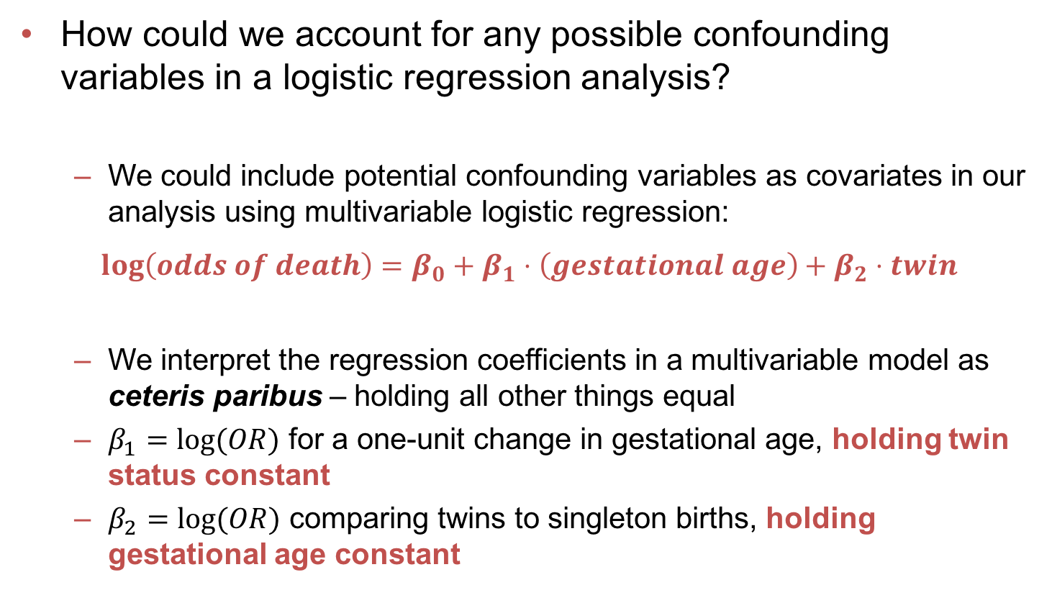
Review of logistic regression
How could we account for any possible confounding variables in a logistic regression analysis?
We could include potential confounding variables as covariates in our analysis using multivariable logistic regression:
$$\log\left(odds of death\right)=β_{0}+β_{1}⋅\left(gestational age\right)+β_{2}⋅twin$$
We interpret the regression coefficients in a multivariable model as ceteris paribus – holding all other things equal
$β_{1}=log⁡(OR)$ for a one-unit change in gestational age, holding twin status constant
$β_{2}=log⁡(OR)$ comparing twins to singleton births, holding gestational age constant

Slide 6
Scenario for today’s discussion
Health response: Y
Major smoking caused disease
Binary treatment or risk factor: Z=1,0
Ever smoker
Potential confounders: X
Age
Gender
SES: poverty, education
Marital status
Etc

Slide 7
Stratification to account for confounding
Stratify by the covariate
Estimate the difference in mean outcome within each covariate stratum
Pool the stratum-specific values

Slide 8
Example: Stratifying by income
Income Level | Probability of MSCD (n) |  | Smoking effect Log OR | Std error | W=1/var | W* Log OR
 | Ever smokers | Never smokers
1 (Poverty) | .158 (677) | .079 (579)
2 | .191 (303) | .120 (292)
3 | .187 (925) | .092 (739)
4 | .131 (2083) | .094 (1548)
5 | .105 (2607) | .073 (1892)
Pooled

Slide 9
Example: Stratifying by income
Income Level | Probability of MSCD (n) |  | Smoking effect Log OR | Std error | W=1/var | W* Log OR
 | Ever smokers | Never smokers
1 (Poverty) | .158 (677) | .079 (579) | .777 | .186
2 | .191 (303) | .120 (292) | .553 | .232
3 | .187 (925) | .092 (739) | .820 | .153
4 | .131 (2083) | .094 (1548) | .370 | .109
5 | .105 (2607) | .073 (1892) | .397 | .109
Pooled

Slide 10
Example: Stratifying by income
Income Level | Probability of MSCD (n) |  | Smoking effect Log OR | Std error | W=1/var | W* Log OR
 | Ever smokers | Never smokers
1 (Poverty) | .158 (677) | .079 (579) | .777 | .186 | .112 | .087
2 | .191 (303) | .120 (292) | .553 | .232 | .072 | .040
3 | .187 (925) | .092 (739) | .820 | .153 | .165 | .135
4 | .131 (2083) | .094 (1548) | .370 | .109 | .326 | .121
5 | .105 (2607) | .073 (1892) | .397 | .109 | .326 | .129
Pooled |  |  |  |  | 1 | .512

Slide 11
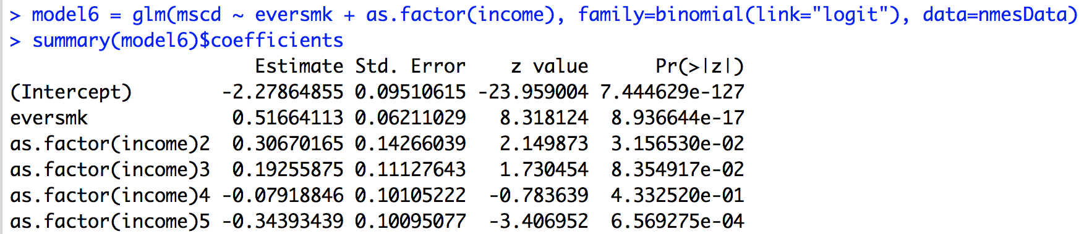
Example: MSCD
Regression of Y on X and indicator variables of the strata is identical to weighting the log ORs inversely related to their variances.
A faster method of pooling the evidence!

Slide 12
What to do with many potential confounders?
Stratify on all confounder combinations
Large number of strata, hard to make tables
Match each smoker to a few “similar” non-smokers
Not bad, but does not use all the data
Stratify on a single derived variable chosen so that the distribution of all the covariates is similar fore the two treatment groups within each stratum of the variable
One such variable is the propensity score

Slide 13
What is a propensity score?
Definition: p(X) = Pr(Z=1|X)
The propensity score is the probability of being “treated” (smoking) as a function of the potential confounders
Fact: The distribution of X given p(X) is the same whether Z=1 or Z=0
The treated (smokers) and untreated (non-smokers) within a propensity score stratum are alike with respect to the covariates (age, gender, SES variables)

Slide 14
Propensity score strategy – idea
Estimate the propensity score using logistic regression (or other classification method)
Estimate probability of being a smoker, given age, sex, SES, etc
Estimate Pr(eversmk = 1 | age, sex, SES, etc)
Stratify by this propensity score (perhaps into 5 groups based on the quintiles of the scores)
Estimate the treatment effect within each stratum
Calculate the log OR (or OR) of MSCD, comparing smokers to non-smokers, within each PS group
Pool the estimates across strata
Use inverse-variance weighting to combine estimates

Slide 15
Propensity score strategy – implementation
Estimate the propensity score using logistic regression (or other classification method)
propModel <- glm( eversmk ~ ??? , family=binomial(link=”logit”))
predLogOdds <- predict(propModel)
predProb <- exp(predLogOdds)/(1+exp(predLogOdds))
propScores <- predProb
Stratify by this propensity score (perhaps into 5 groups based on the quintiles of the scores)
psCutoffs <- quantile(propScores, probs=c(0,0.25, 0.5, 0.75, 1))
ps.groups <- cut(propScores, psCutoffs, include.lowest=TRUE)
Estimate the treatment effect within each stratum and pool the estimates across strata
glm( mscd ~ eversmk + ps.groups , family=binomial(link=”logit”))

Slide 16
Pros and cons of propensity scores
Organizes the analysis into 2 steps
Estimate the probability of treatment given the covariates
Compare treatment groups within strata of this probability
Easy to picture the evidence for the binary treatment effect
Most natural with binary treatment (extensions possible, but awkward)
Not as simple to study effect modifications (interactions)
No method controls for unmeasured confounders, regardless of what is claimed

Slide 17
Assignment 1.3
Improve your data display to answer Q1.1: How does the risk of disease compare for smokers and otherwise similar non-smokers?
Update your logistic regression model to answer Q1.1. What does this model say about Q1.1? Be sure to focus on answering the question being asked!
Estimate propensity scores for the treatment of smoking (eversmk); that is, use logistic regression to estimate the probability of smoking given possible confounders.
Use logistic regression with quintiles of your propensity scores to answer Q1.1. Interpret the results.
Work together in groups!
Submit your assignment in R markdown through Blackboard by Sunday @ midnight.

Slide 18
Thinking ahead…
What statistical analysis will effectively use the NMES data to address Q1.1?
Multiple logistic regression
Propensity scores
What displays and statistical analysis will address Question 1.2 (Q1.2):
Does the contribution of smoking to the risk of disease vary by sex or SES?

Slide 19
References for propensity scores
Rosenbaum and Rubin, 1983. Biometrika, 70: 41-55.
Rubin. 1997. Annals of Internal Medicine, 127: 757-763.

