Slide 1
AS.280.347 Class 2.4
Review your work!
Your projects!

Slide 2
Module 2: Particulate air pollution and mortality
Question 2.1 (Q2.1): How does the daily risk of death depend upon air pollution level in American cities?
Question 2.2 (Q2.2): Is the estimate of the pollution effect sensitive to assumptions about seasonal or weather effects?
Question 2.3 (Q2.3): How do you pool PM effect (log relative rate) estimates from multiple cities taking account of both natural geographic variability in the true effects and statistical errors that might differ among cities?
We will answer these questions using data from the National Morbidity and Mortality Air Pollution Study (NMMAPS)

Slide 3
Assignment 2.3
For each single city:
Update your time series display of PM10, temperature, and total mortality versus date.
Regress mortality on PM10 using a Poisson model with different indicator variables for time: (a) nothing (0 df); (b) season (4-1 df); (c) month (12-1 df); (d) season by year (4x19-1 df); (e) month by year (12x19-1 df)
Repeat the regressions with natural splines to give a smooth relationship between mortality and time using ns(time, df) for df = 0, 3, 11, 75, 227
Display the 10 PM10 coefficients with confidence intervals in a table or graph to see the effect of the method of control for seasonality.
Choose your preferred model from among the 10 above. Explain your choice. Interpret the log relative rate from this chosen model.
Across the cities:
Using your chosen seasonal adjustment – the same for each city – pool the city-specific estimates of log relative rate from your team to estimate an average value taking account of statistical and city-specific variation in the log relative rate estimates.
Write an R function to do the pooling calculation
Work together in groups!
Submit assignment in R markdown through Blackboard by Sunday, March 24th @ midnight.

Slide 4
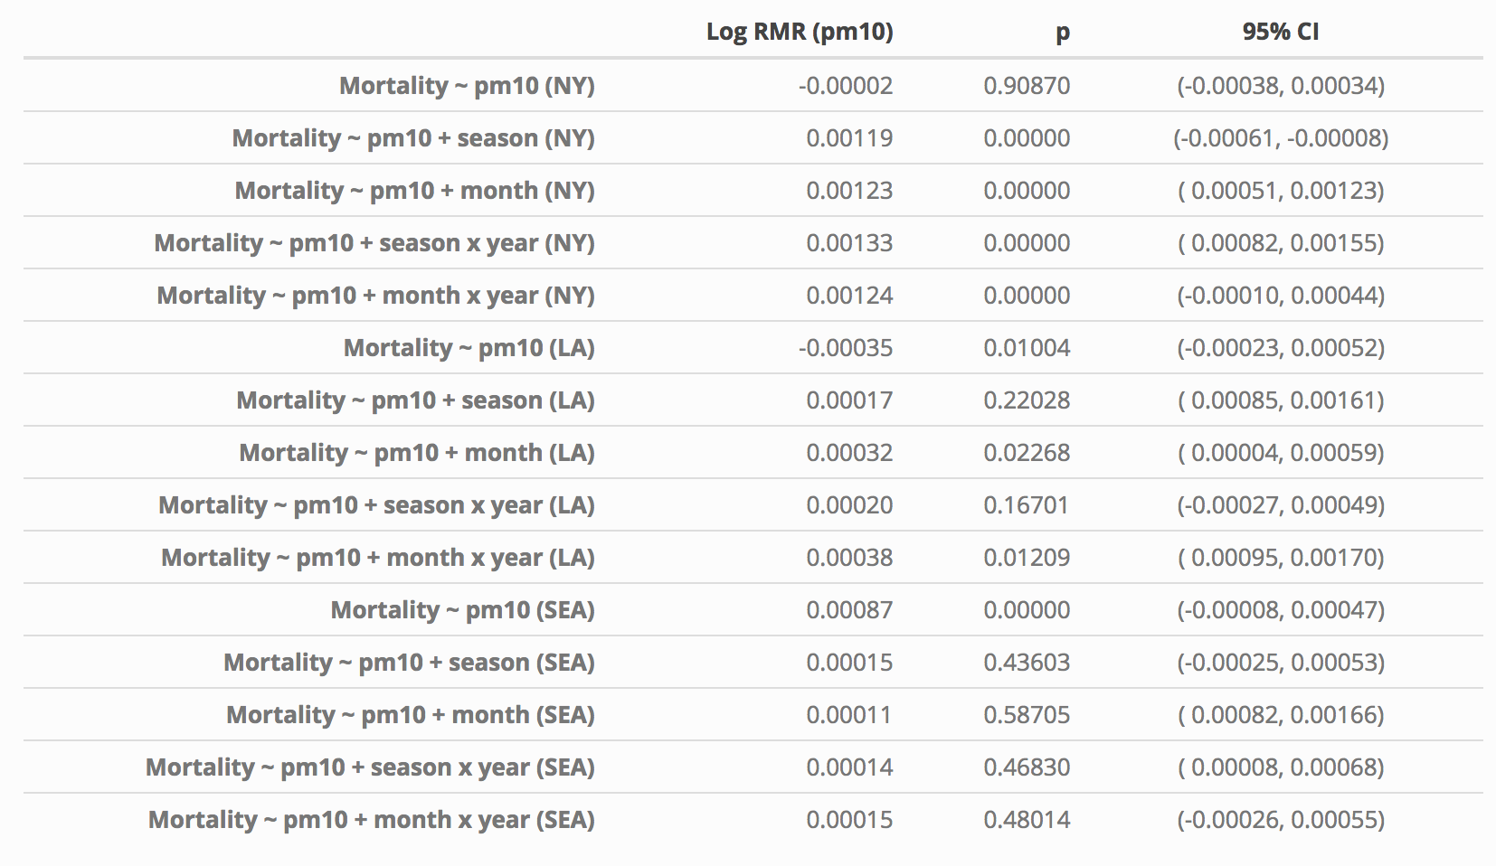

Slide 5
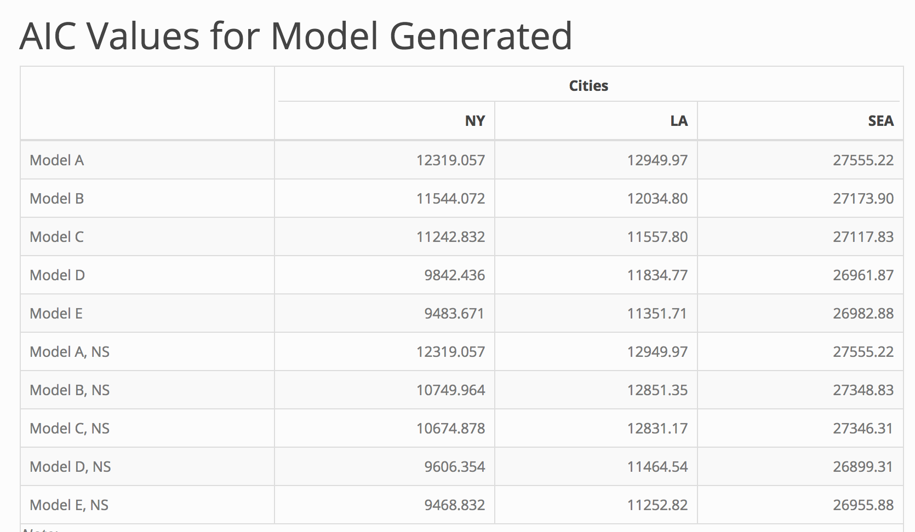

Slide 6
Pooling the City-Specific Estimates
City | Estimate of Log Rel Rate | SE _{Estimate} | Total Variance (V=t²+ SE²) | V⁻¹ | V⁻¹/Sum(V⁻¹) | Weighted Average

Slide 7
Assignment 2.4
Finalize your report for Module 2 to answer Q2.1 – Q2.3.
For each question, you should have a data display and a statistical analysis to address the question.
Provide a caption for your data display(s).
(http://abacus.bates.edu/~ganderso/biology/resources/writing/HTWtablefigs.html)
Write up your results in a few paragraphs to answer these questions. In your write-up, you should refer to your data display(s) and your analysis results. Be numerate!
Work together in groups!
Submit your assignment in R markdown through Blackboard by Sunday @ midnight.

Slide 8
Your Project Design
Question:
Data set and design
Outcome:
Predictor variables of primary interest:
Effect modifiers:
Confounders:
DAG:
Primary analysis to address question:
Communicating results in tables, figures

Slide 9
Your project!
Question:
Data set and design
Outcome:
Predictor variables of primary interest:
Effect modifiers:
Confounders:
Directed Acyclic Graph (DAG):
Primary analysis to address question:
Communicating results in tables and figures:

Slide 10
Your project!
For your final project, you will need:
A research question of interest in public health
A data source that you can use to answer this question
Framing a research question in public health:
Start with a general area of public health in which you have interest, and then narrow to a specific question you’d like to answer.
It can be helpful to frame your question in terms of investigating a relationship between a specific outcome variable (like “disease status” for our Module 1) and one or more primary predictor variables (“smoking status” for our Module 1.)
Later you will need to think about the possibility of effect modifiers and possible confounders, but for now just think about that primary relationship of interest!
Locating data to answer this question:
If you have a specific area of interest in mind, you can Google for data in that area
Or explore the links below to see what type of data is available:
https://www.healthdata.gov/
http://guides.lib.berkeley.edu/publichealth/healthstatistics/rawdata
http://www.datasciencecentral.com/profiles/blogs/10-great-healthcare-data-sets
https://www.cdc.gov/nchs/data_access/ftp_data.htm
https://catalog.data.gov/dataset?_organization_limit=0&organization=hhs-gov#topic=health_navigation

Slide 11
Types of regression analysis
Linear regression
Logistic regression
Poisson regression (log-linear model)

Slide 12
Assignment 3.1
Write a short introduction to your question of interest:
Question
Data source
Outcome variable
Primary predictor variable(s)
If you have it available, read your data into Rstudio
Examine and explore your data:
Summaries of your variables of interest
Is there missing data? Anything unusual or concerning?
Recode from numbers to factors
1 -> “female”, 0 -> “male”, etc
Make a few basic exploratory plots to answer your question
What type of basic analysis could you use to address your question?
Submit assignment in R markdown through Blackboard by Sunday @ midnight.

