Slide 1
Poverty and Disability in Chicago and its Suburbs
Noah Walch

Slide 2
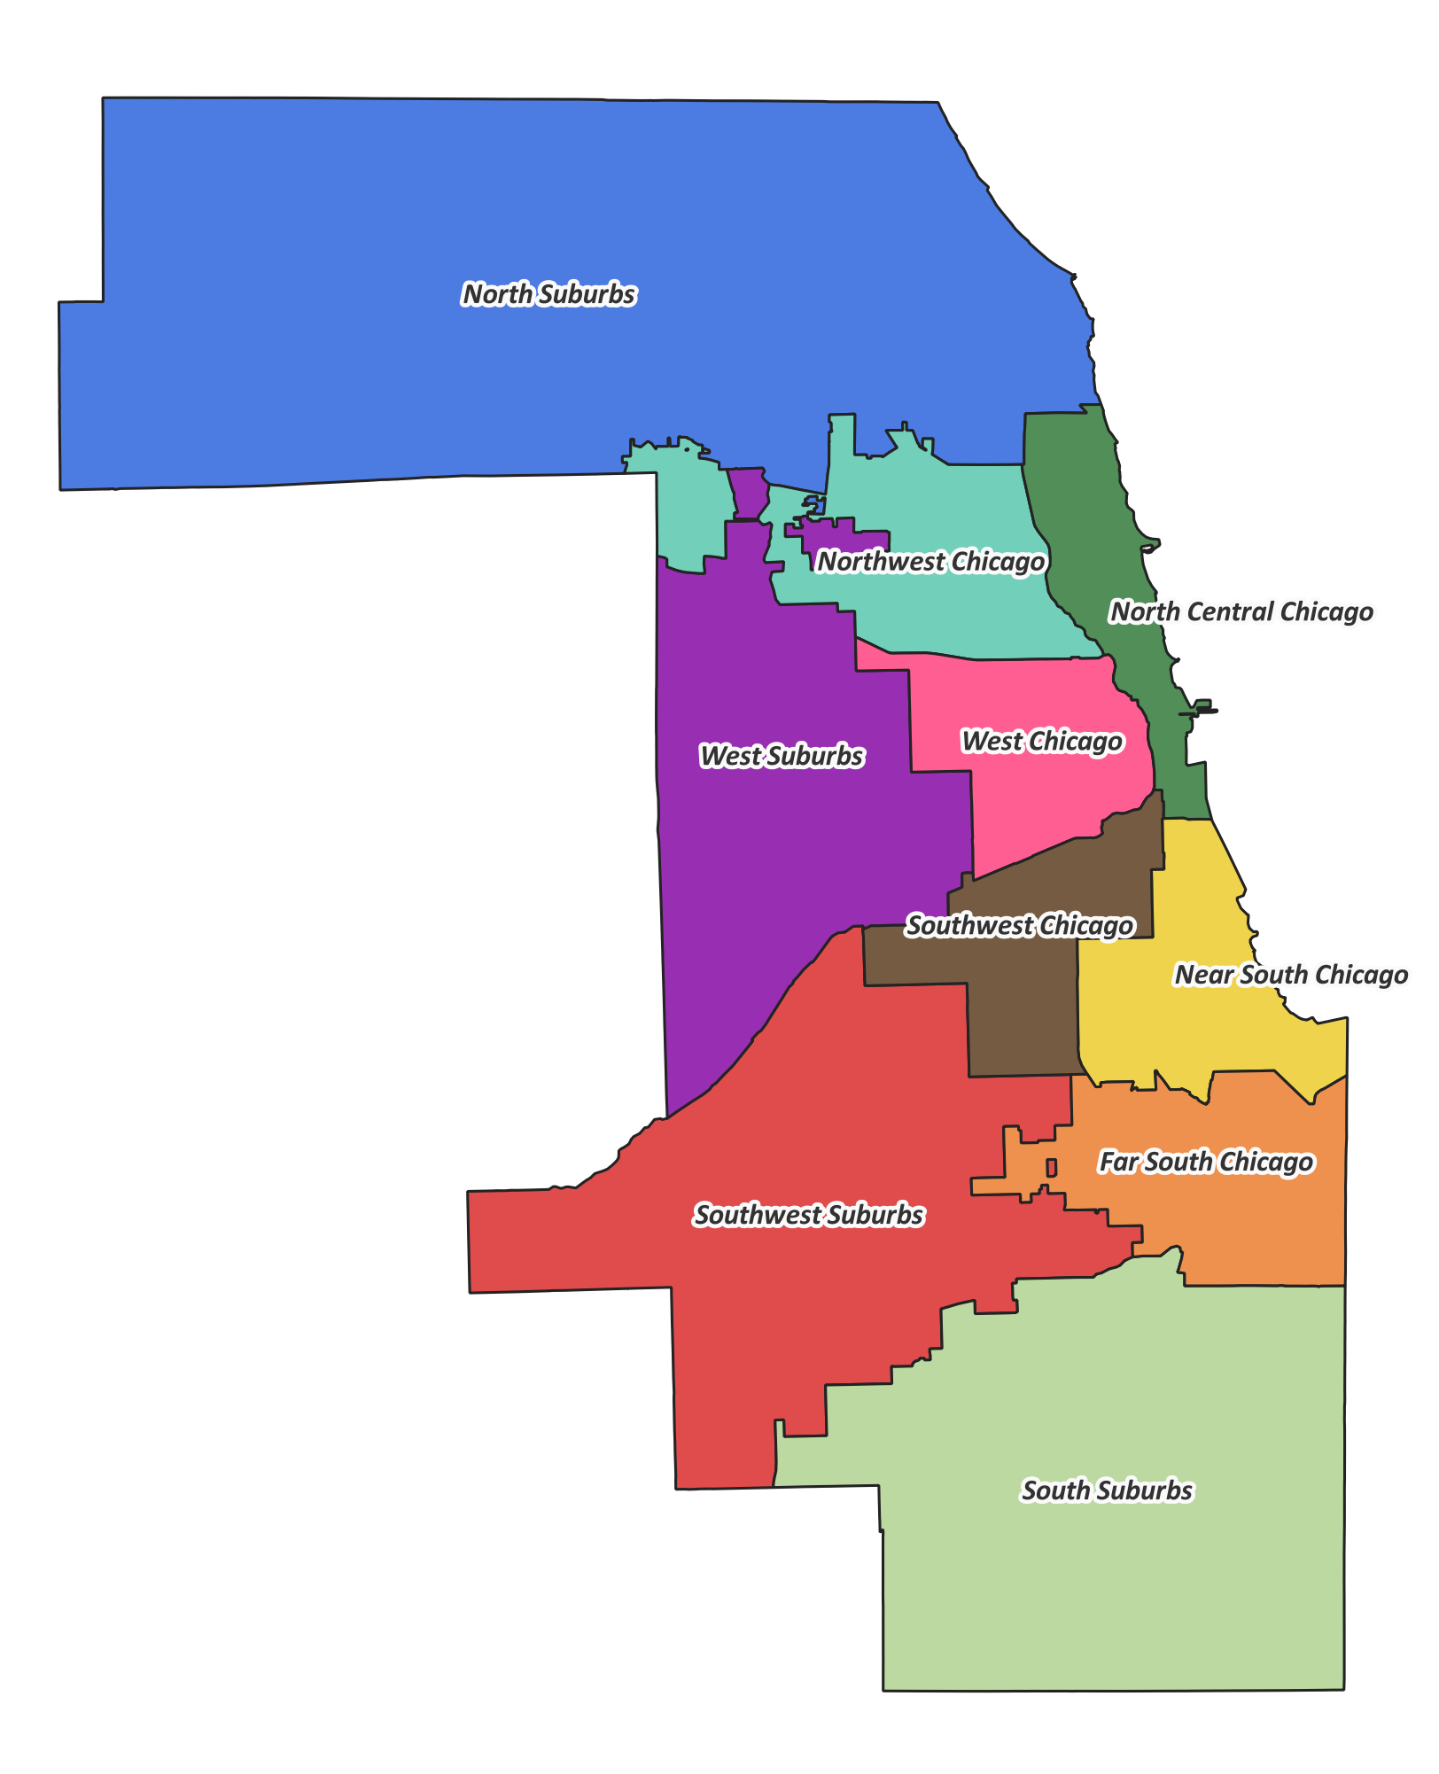
Questions of Interest
How is the poverty rate of a census tract related to its disability rate?
Datasets:
Chicago Health Atlas: Group-level health and demographic data for the city of Chicago
Cook County Health Atlas:
Group-level health and demographic data for suburban Cook County
How does the area of Cook County in which a tract is situated modify the relationship between poverty and disability rates?
Variables of Interest
Outcome variable—
Disability rate
Primary predictor variable—
Poverty rate
Potential confounders—
Percent non-White, Hardship Index, Uninsured Rate
Potential for effect modification—
Area in Cook County

Slide 3
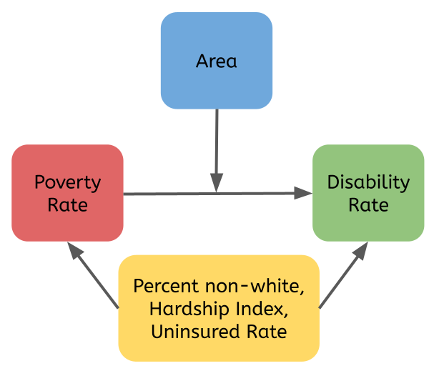
Directed Acyclic Graph

Slide 4
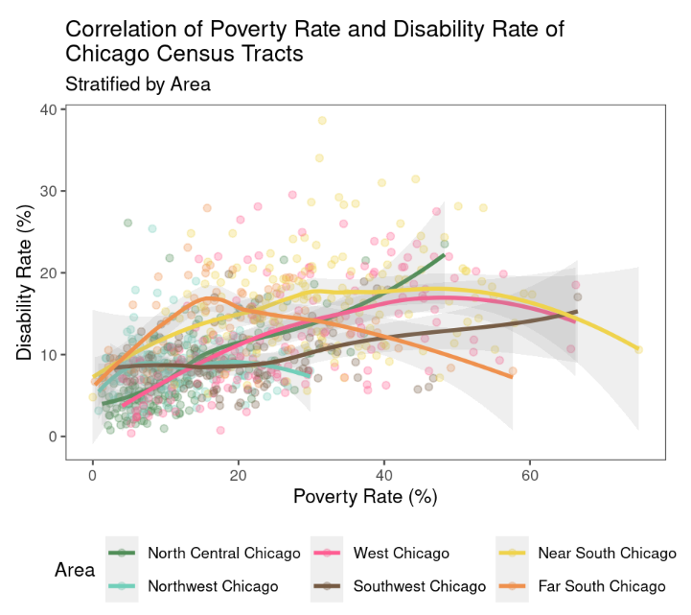
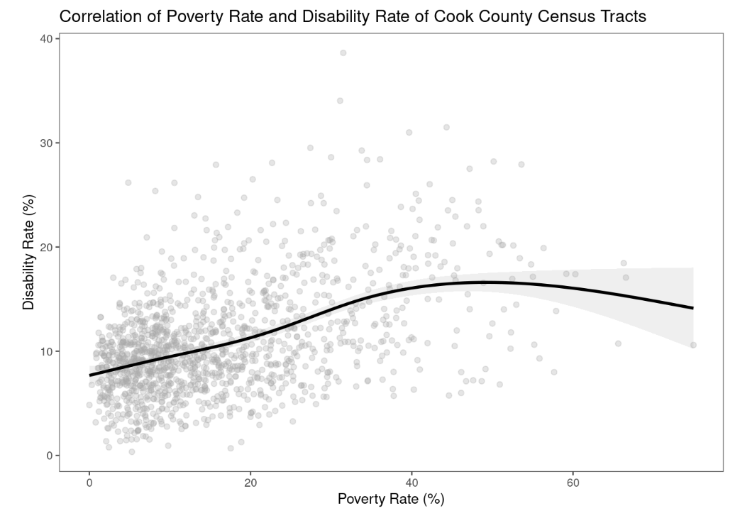
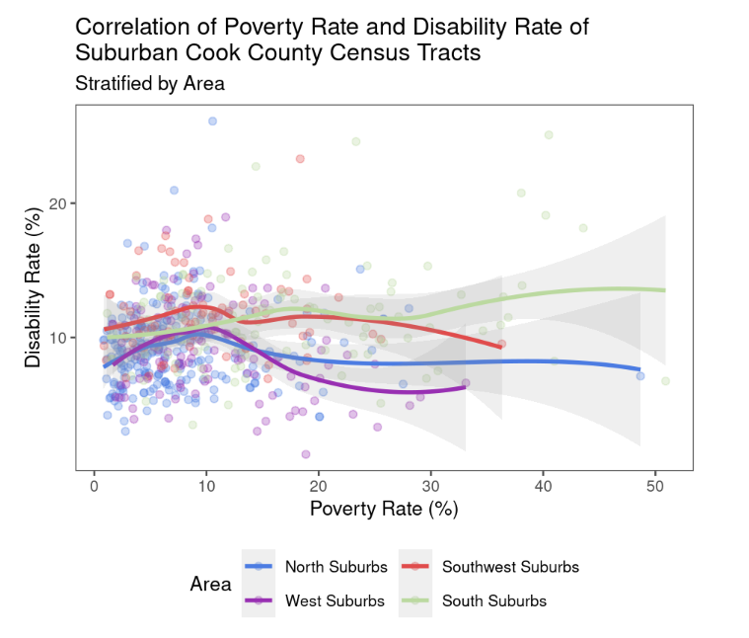
Data Displays

Slide 5
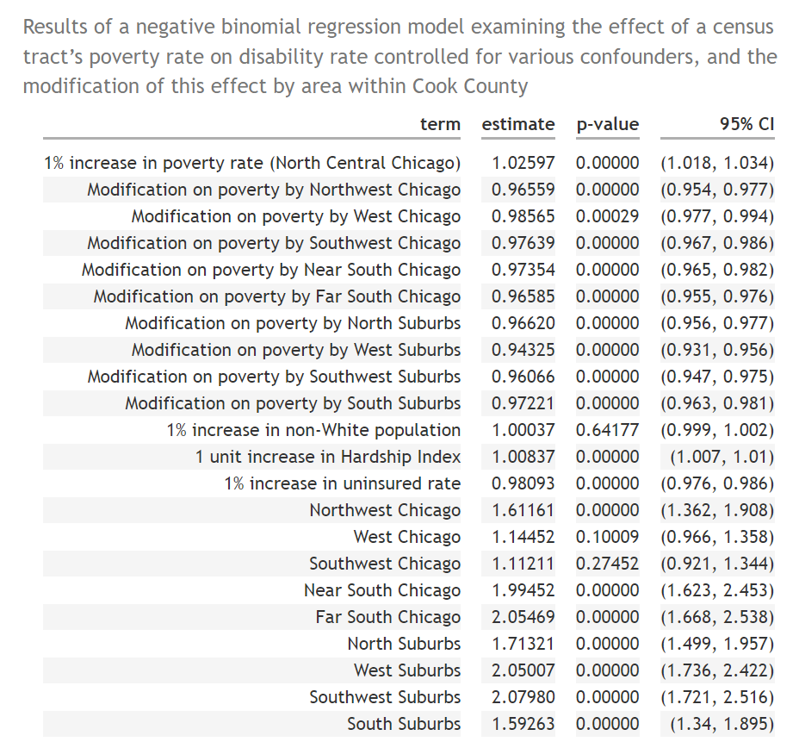
Negative Binomial Regression Analysis
Controlled for confounders:
A 1% increase in poverty rate in a North Central Chicago tract leads to an estimated 2.3% increase (1.8, 3.4) in disability
A tract being in any other area decreases this effect, with the lowest modification being the West Suburbs at -5.67% (-4.4, 6.9)
Non-white % is insignificant

