Slide 1

MODULE-2: PREDICTIVE ANALYTICS
Ahmed Sabit
Department of Biostatistics, Johns Hopkins University

Slide 2
ACKNOWLEDGEMENT
Part of the content has been adapted and modified from work by Dr. Arnold, Dr. Taub, and Dr. Rennie

Slide 3
INTRODUCTION
How is predictive analytics useful?
Mostly supervised learning (regression and classification), some forecasting.
A powerful tool to turn data into action.
Question:
  What’s the difference between a logistic regression model and the one we build for prediction

Slide 4

DIFFERENT KINDS OF ANALYTICS
Past:
  Descriptive Analytics: what happened?
  Diagnostic Analytics: why did it happen?
Future:
  Predictive Analytics: what might happen in the future?
  Prescriptive Analytics: what should we do next?
We'll focus on predictive analytics here.

Slide 5
THE HYPERTENSION EXAMPLE
Descriptive: "25% of our patients have hypertension."
Diagnostic: "Hypertension is 3x higher in patients with high salt intake."
Predictive: "Based on Patient X’s current diet and BMI, there is an 80% chance they will develop hypertension in 2 years."
Prescriptive: "To reduce Patient X's risk from 80% to 20%, the system recommends a 1,500mg daily sodium limit and 30 minutes of cardio 5 days a week."

Slide 6
POWER OF PREDICTIVE MODELING
Medicine: wearable monitor for seizures or falls, detect malaria from blood smears, find effective drug regimens from medical records
Drug Discovery: predict the efficacy of a synthesis plan for a drug
Precision Agriculture: predict effect of micro-climate on plant growth
Urban Planning: forecast resource needs, extreme weather risks, ...
Government: classify feedback from constituents
Retail: predict items in a grocery order
Recommendation systems: Amazon, Netflix, YouTube, ...
User interfaces: gesture typing, autocomplete / autocorrect
and so much more...

Slide 7

THE QUESTION
  Where does the logistic regression model we learned in module-1 fits in?

Slide 8

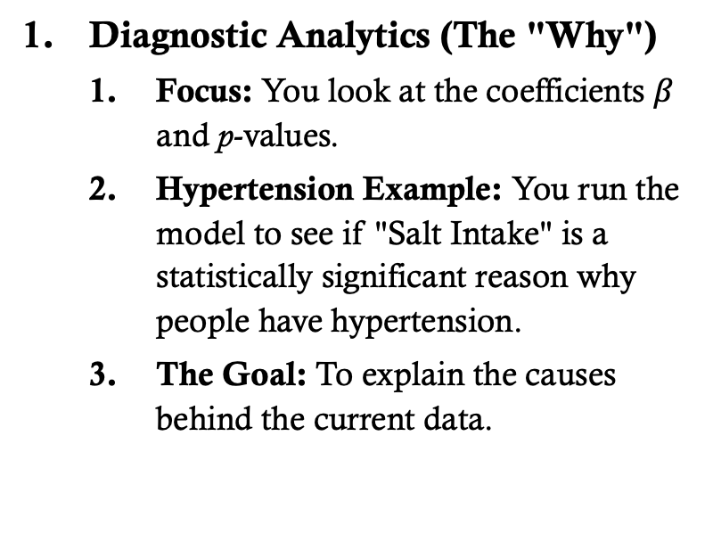
THE QUESTION

Slide 9
THE QUESTION
2. Predictive Analytics (The "What will happen")
When you use a trained logistic regression model to classify new data, you are doing predictive analytics
Focus: You look at the "Probability Score" (e.g., a 78% chance of hypertension) and model accuracy.
Hypertension Example: You input a new patient’s BMI and Age, and the model predicts whether they will develop hypertension in the future.
The Goal: To forecast an outcome for unseen instances.

Slide 10

MOTIVATING PUBLIC HEALTH PROBLEM
Hypertension is one of the most common diseases in the world.
Around 75 million American adults (32%) are estimated to have high blood pressure
It costs the US around $48.6 billion each year.
In this module, we will explore the relationship between hypertension and a variety of risk factors.

Slide 11




THE DATA
NYC HANES
NHANES is a population-based, cross-sectional study with data collected from a physical examination and laboratory tests, as well as a face-to-face interview and an audio computer-assisted self-interview (ACASI).
It is designed to assess the health and nutritional status of adults and children in the United States.
NYC HANES is a local version of NHANES, which implies it mainly focuses on the New York area.

Slide 12
THE DATA
Links to some useful resources available on the website including:
Data Documents: Provides information on how best to analyze the NYC HANES 2013-14 dataset, given its population-based and clustered sampling scheme.
Analytics Guideline: Provides overall guidance on the use of the NYC HANES 2013-14 dataset and statistical weights, as well as other analytic issues pertaining to assessing statistical reliability of estimates.
Variable Codebook: Defines the variables included in the dataset and describes how values for these variables are coded.
Weight Adjustment: Explains how NYC HANES data are weighted in order to compensate for unequal probability of selection and explains how to choose the correct weight for analysis.
Questionnaire: Provides links to the questionnaires that participants in the study completed. Answers from different questionnaires are combined in the data set you will be working with.

Slide 13
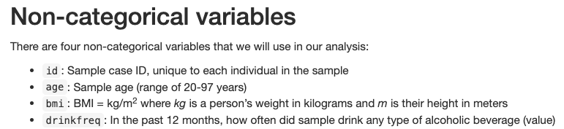
THE DATA

Slide 14
CATEGORICAL VARIABLES
Gender | 1: Male 2: Female | Diet (Self-Reported) | 1: Excellent 2: Very good 3: Good 4: Fair 5: Poor
Born | 1: US born 2: Other country | Diabetes (Medical History) | 1: Yes 2: No 3: Prediabetes
Race | 100: White 110: Black/African American 120: Indian 140: Native Hawaiian/Other Pacific Islander 180: Asian 250: Other race | Cholesterol | 1 = Yes 2 = No

Slide 15
CATEGORICAL VARIABLES
Smoke: Smoking status history | 1= Never smoker 2 = Current smoker 3 = Former smoker | Socioeconomic Status | 1 = Less than $20,000 2 = $20,000 – $39,999 3 = $40,000 – $59,999 4 = $60,000 – $79,999 5 = $80,000 – $99,999 6 = $100,000 or more
Drink unit: Frequency unit for alcoholic beverage consumption in the past 12 months | 1 = per week 2 = per month 3 = per year | Hypertension: Has a doctor/health professional ever said they have hypertension or high blood pressure? | 1 = Yes 2 = No

Slide 16

PREDICTIVE MODELING WORKFLOW
Define the problem: predict what, based on what? What metrics will indicate success? (Measure success in multiple ways!)
Explore your data (EDA): understand its structure, make lots of plots
Pick a model: Which type(s) of models are appropriate for task and data?
Transform the data as needed by the model ("feature engineering", preprocessing", "recipe")
Split the data to allow for validation.
Fit and evaluate the model
Tune: adjust model hyperparameters
Analyze model errors and refine all earlier steps

Slide 17
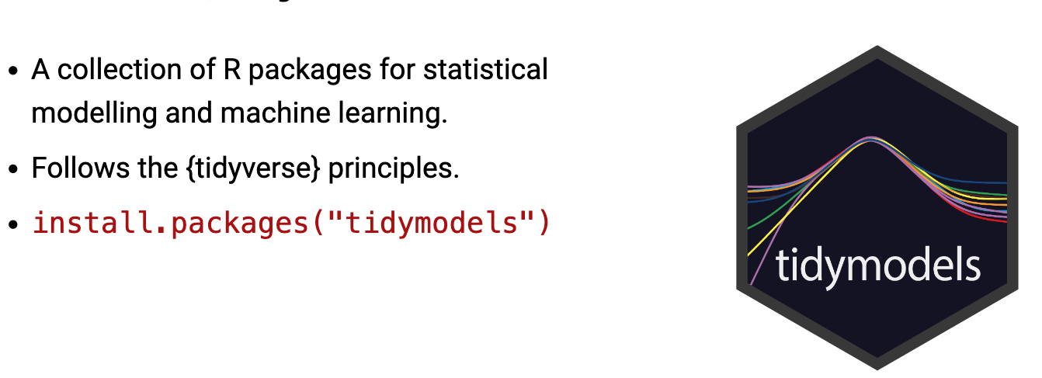
WHAT IS TIDYMODELS?

Slide 18
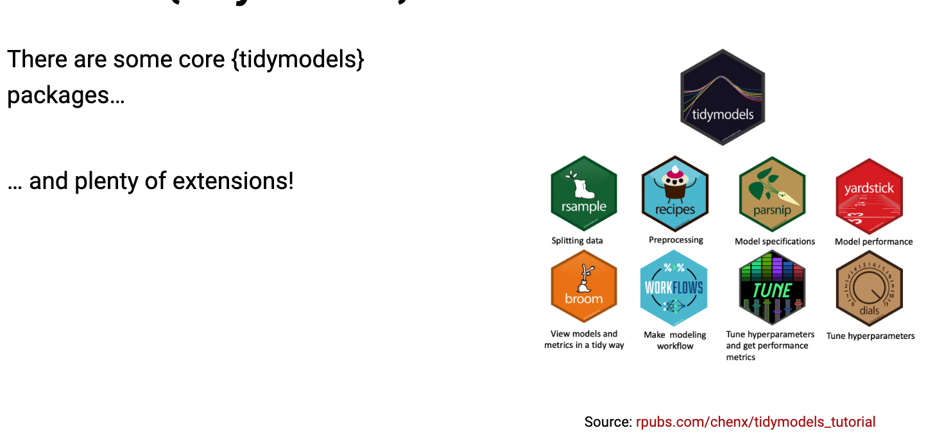
WHAT IS TIDYMODELS?

Slide 19
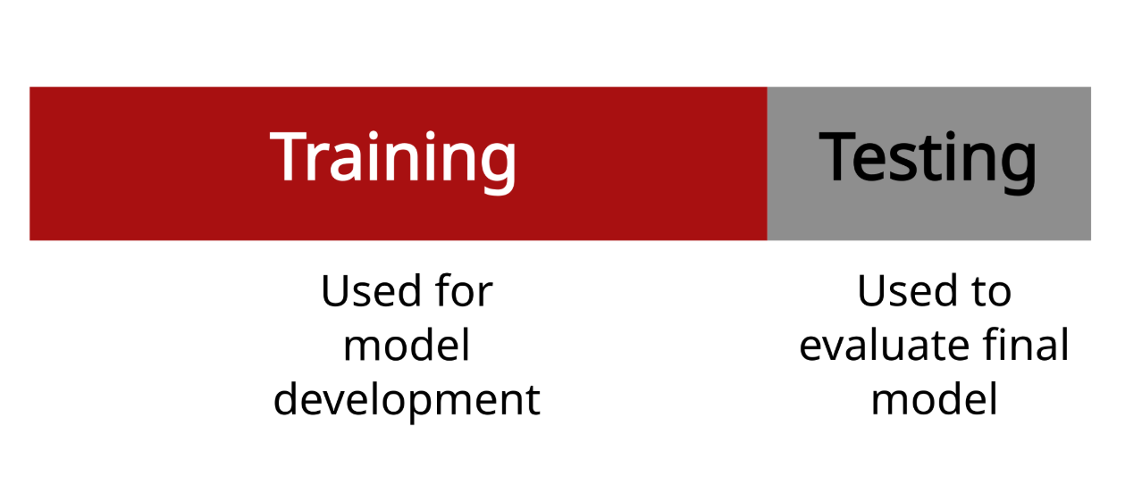
TRAINING AND TESTING DATA

Slide 20
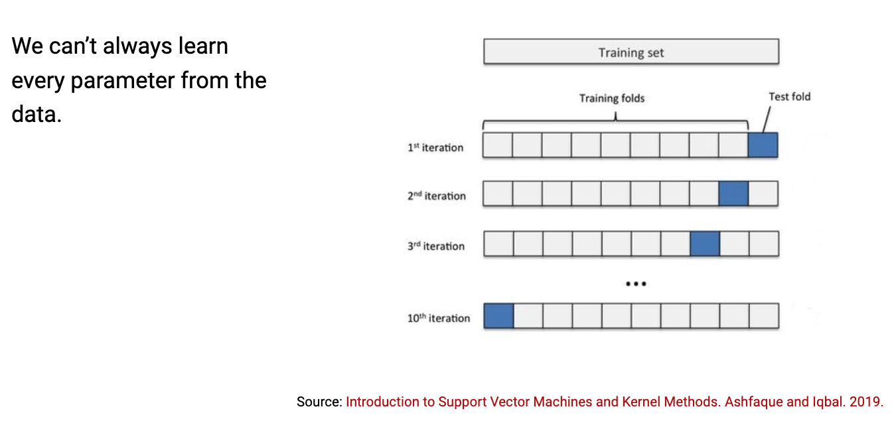
HYPERPARAMETER TUNING

Slide 21
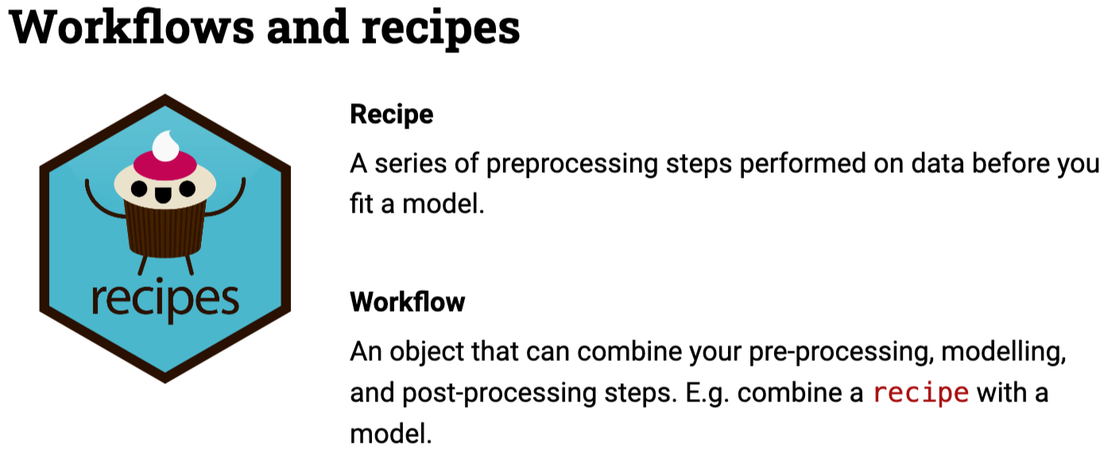
WORKFLOWS AND RECIPES

