Slide 1
WEEK null · TOPIC 4/10
FOODS THAT KEEP YOU FULL LONGEST
"Stop the 3pm hunger crash for good."
Save this for your next grocery run →
healtho · @healtho_10k

Slide 2
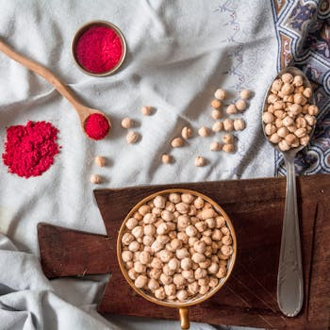
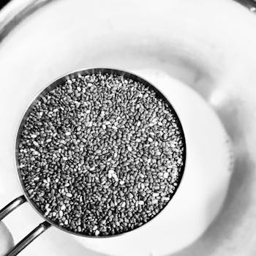
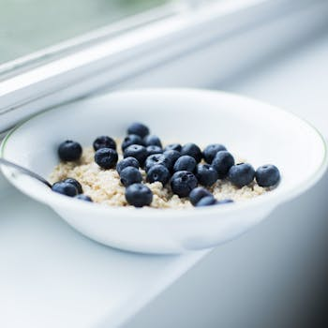
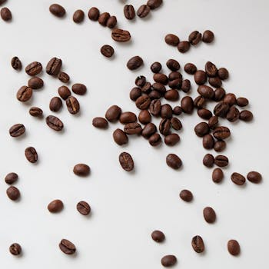
HIGH-FIBER FOODS
slows stomach emptying
Lentils
Chia Seeds
230 kcal · 16g fiber
138 kcal · 10g fiber
Oatmeal
Black Beans
154 kcal · 4g fiber
227 kcal · 15g fiber
2 / 5
healtho · @healtho_10k

Slide 3
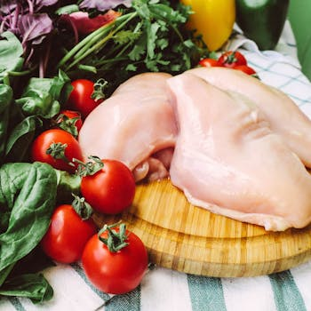
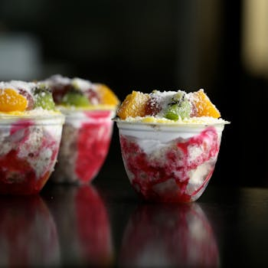
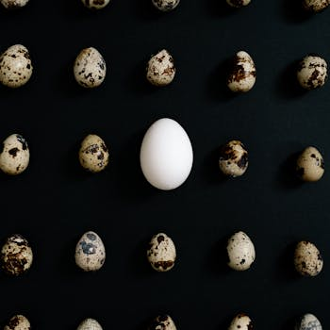
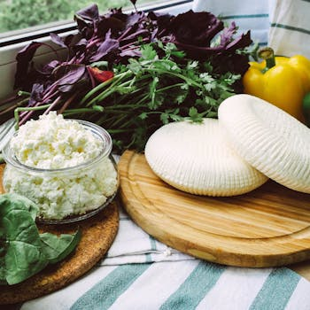
SLOW-DIGESTING PROTEINS
hours of sustained satiety
Chicken Breast
Greek Yogurt
165 kcal · 31g protein
100 kcal · 17g protein
Eggs
Cottage Cheese
144 kcal · 12g protein
98 kcal · 11g protein
3 / 5
healtho · @healtho_10k

Slide 4
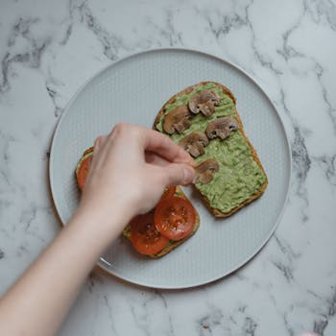
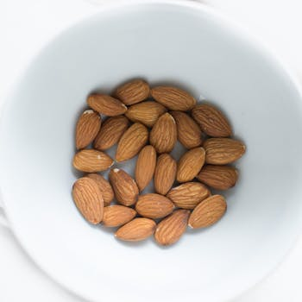
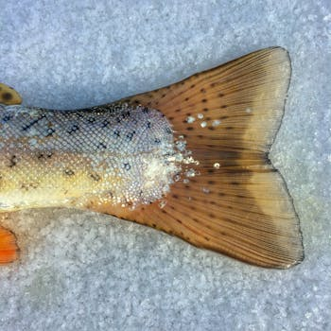
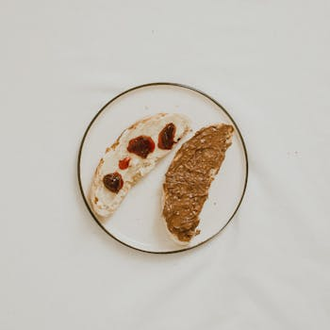
HEALTHY FATS
triggers fullness hormones
Avocado
Almonds
160 kcal · 15g fat
164 kcal · 14g fat
Salmon
Peanut Butter
208 kcal · 13g fat
188 kcal · 16g fat
4 / 5
healtho · @healtho_10k

Slide 5
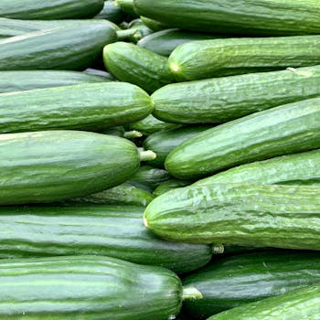
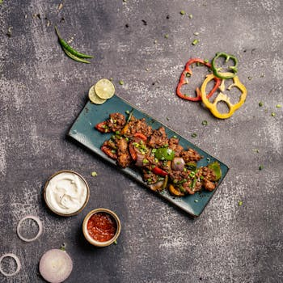

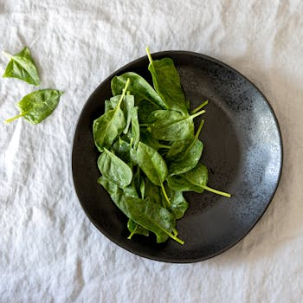
WATER-DENSE VEGETABLES
high volume, low calories
Cucumber
Zucchini
16 kcal · 95% water
17 kcal · 94% water
Celery
Spinach
14 kcal · 95% water
23 kcal · 91% water
5 / 5
healtho · @healtho_10k

