Slide 1
WEEK 37 · TOPIC 7/10
FOODS TO EAT FOR BETTER SLEEP
"Bad sleep is often a nutrition problem in disguise."
Save this for your next grocery run →
healtho · @healtho_10k

Slide 2
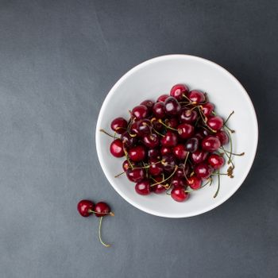
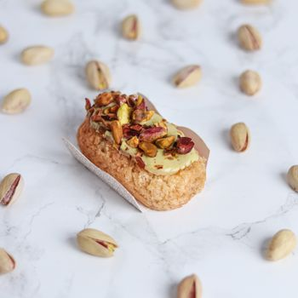
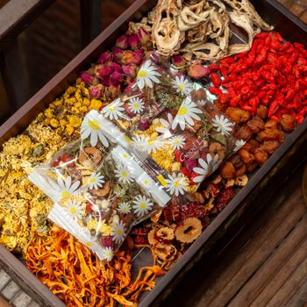
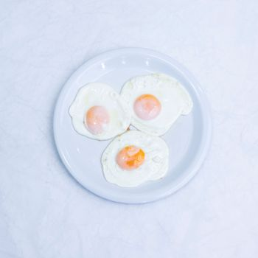
MELATONIN-RICH FOODS
triggers natural sleep signals
Tart Cherries
Pistachios
50 kcal · 13.5µg melatonin
159 kcal · 233µg melatonin
Goji Berries
Eggs
98 kcal · 55µg melatonin
147 kcal · 6.3µg melatonin
2 / 5
healtho · @healtho_10k

Slide 3
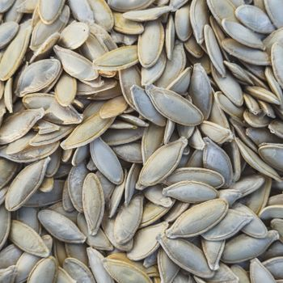
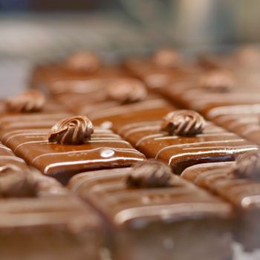
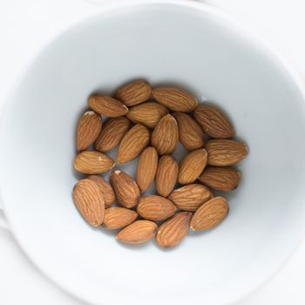
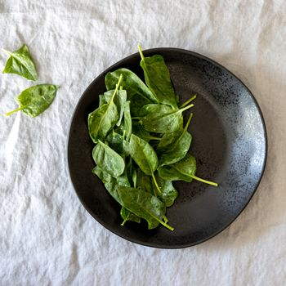
MAGNESIUM-RICH FOODS
relaxes muscles and nerves
Pumpkin Seeds
Dark Chocolate
151 kcal · 156mg magnesium
170 kcal · 64mg magnesium
Almonds
Spinach
164 kcal · 77mg magnesium
23 kcal · 79mg magnesium
3 / 5
healtho · @healtho_10k

Slide 4

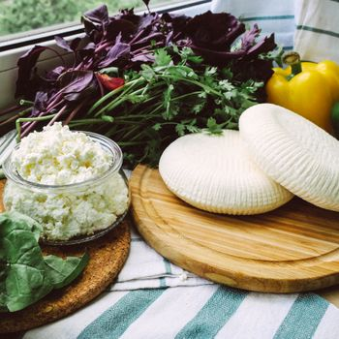

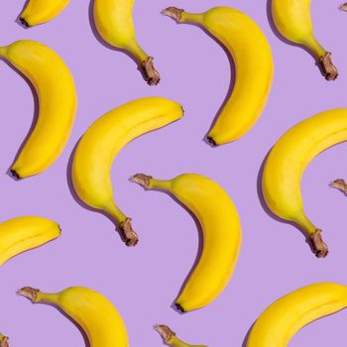
TRYPTOPHAN SOURCES
precursor to sleep hormones
Turkey Breast
Cottage Cheese
135 kcal · 340mg tryptophan
98 kcal · 290mg tryptophan
Oats
Bananas
154 kcal · 182mg tryptophan
89 kcal · 11mg tryptophan
4 / 5
healtho · @healtho_10k

Slide 5

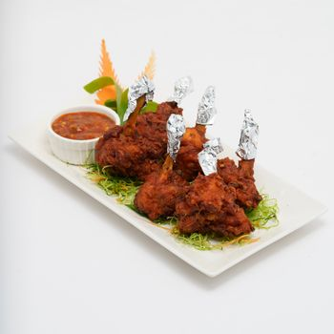
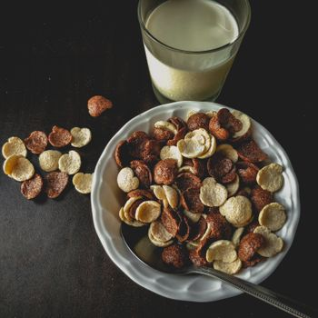
FOODS TO AVOID AT NIGHT
these disrupt deep sleep cycles
Coffee
Dark Chocolate
2 kcal · 95mg caffeine
170 kcal · 43mg caffeine
Spicy Wings
Sugary Cereal
320 kcal · high capsaicin
160 kcal · 18g sugar
5 / 5
healtho · @healtho_10k

