Slide 1
WEEK 22 · TOPIC 2/10
FOODS THAT BOOST YOUR METABOLISM
"Your metabolism is more controllable than you think."
Save this for your next grocery run →
healtho · @healtho_10k

Slide 2



THERMOGENIC FOODS
increases calorie burn through digestion
Chicken Breast
Egg Whites
165 kcal · 31g protein
52 kcal · 11g protein
Salmon
Turkey Breast
208 kcal · 20g protein
135 kcal · 30g protein
2 / 5
healtho · @healtho_10k

Slide 3
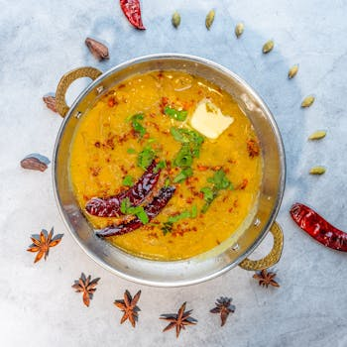
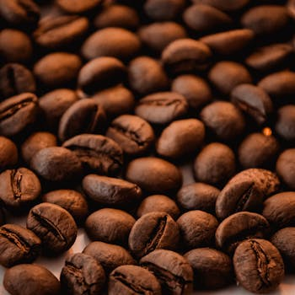

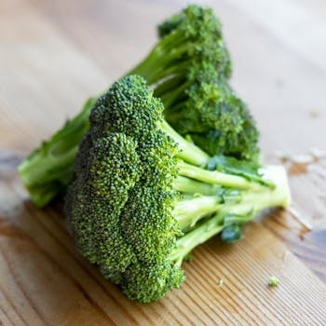
FIBER-RICH FOODS
slows digestion, sustains energy
Lentils
Black Beans
230 kcal · 16g fiber
227 kcal · 15g fiber
Oats
Broccoli
389 kcal · 11g fiber
34 kcal · 2.6g fiber
3 / 5
healtho · @healtho_10k

Slide 4




CAFFEINE SOURCES
natural metabolic stimulants
Black Coffee
Green Tea
2 kcal · 95mg caffeine
2 kcal · 28mg caffeine
Yerba Mate
Dark Chocolate 85%
5 kcal · 85mg caffeine
170 kcal · 43mg caffeine
4 / 5
healtho · @healtho_10k

Slide 5


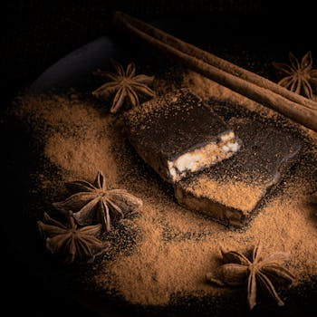
METABOLISM-BOOSTING SPICES
activates fat-burning enzymes
Cayenne Pepper
Ginger Root
17 kcal · 0.6g capsaicin
80 kcal · 2g gingerol
Cinnamon
Turmeric
247 kcal · 53g fiber
312 kcal · 3.3g curcumin
5 / 5
healtho · @healtho_10k

