Slide 1
WEEK 27 · TOPIC 7/10
FOODS TO EAT FOR BETTER SLEEP
"Bad sleep is often a nutrition problem in disguise."
Save this for your next grocery run →
healtho · @healtho_10k

Slide 2
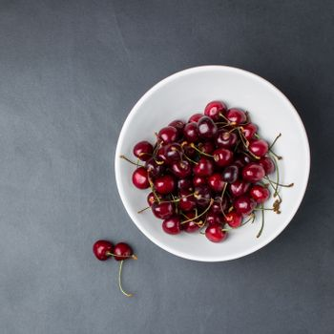
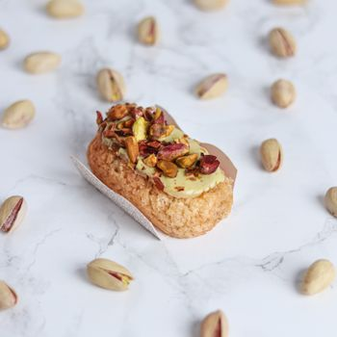
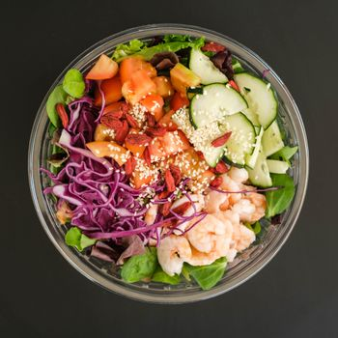

MELATONIN-RICH FOODS
triggers natural sleep signals
Tart Cherries
Pistachios
50 kcal · 13.5mg melatonin/100g
562 kcal · 0.23mg melatonin/g
Goji Berries
Grapes
349 kcal · high melatonin content
69 kcal · 0.01mg melatonin/100g
2 / 5
healtho · @healtho_10k

Slide 3
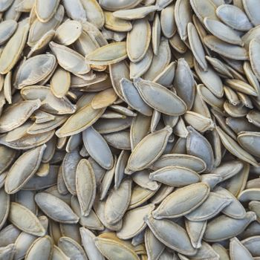
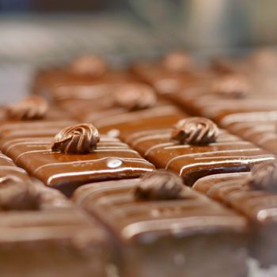
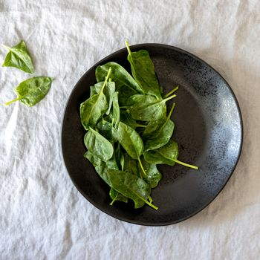
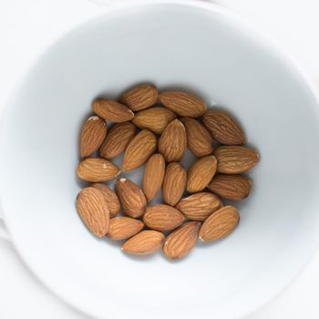
MAGNESIUM-RICH FOODS
relaxes muscles and nerves
Pumpkin Seeds
Dark Chocolate
559 kcal · 550mg magnesium/100g
546 kcal · 228mg magnesium/100g
Spinach
Almonds
23 kcal · 79mg magnesium/100g
579 kcal · 270mg magnesium/100g
3 / 5
healtho · @healtho_10k

Slide 4



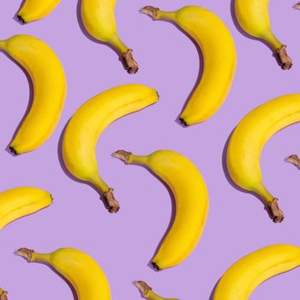
TRYPTOPHAN SOURCES
precursor to sleep hormones
Turkey Breast
Warm Milk
135 kcal · 340mg tryptophan/100g
42 kcal · 75mg tryptophan/100ml
Oats
Bananas
389 kcal · 182mg tryptophan/100g
89 kcal · 11mg tryptophan/100g
4 / 5
healtho · @healtho_10k

Slide 5



FOODS TO AVOID AT NIGHT
these disrupt deep sleep cycles
Coffee
Dark Chocolate
2 kcal · 95mg caffeine/cup
546 kcal · 43mg caffeine/100g
Spicy Foods
Sugary Snacks
raises core body temperature
causes blood sugar spikes
5 / 5
healtho · @healtho_10k

