Slide 1
WEEK 20 · TOPIC 10/10
BREAKFAST FOODS RANKED BY PROTEIN
"Your breakfast is either working for you or against you."
Save this for your next grocery run →
healtho · @healtho_10k

Slide 2
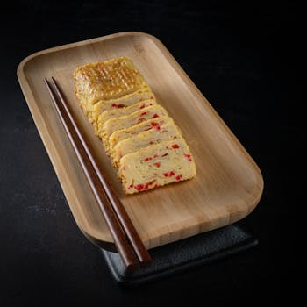
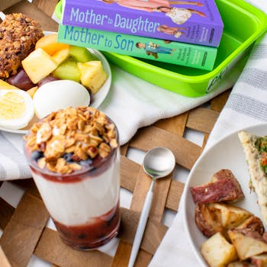
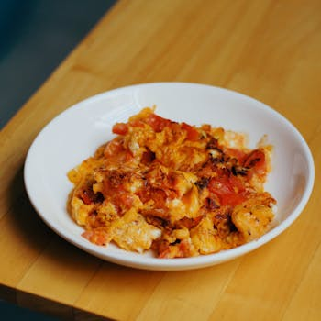
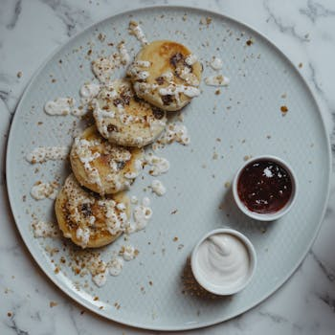
30G+ PROTEIN BREAKFASTS
sets the tone for the whole day
4-Egg Omelette with Cheese
Greek Yogurt Parfait with Protein Granola
450 kcal · 35g protein
380 kcal · 32g protein
Chicken Sausage & Egg Scramble
Protein Pancakes with Cottage Cheese
410 kcal · 38g protein
395 kcal · 34g protein
2 / 5
healtho · @healtho_10k

Slide 3
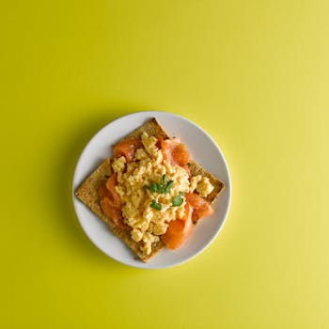
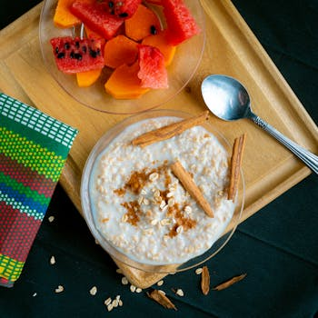
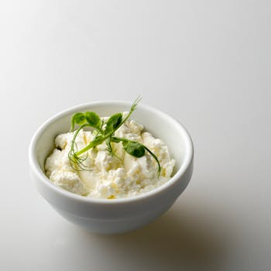
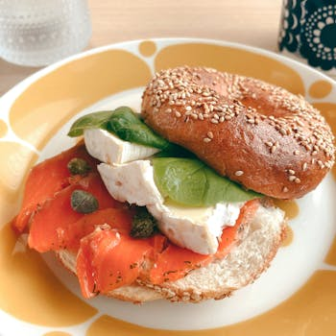
20–30G PROTEIN OPTIONS
solid start, easy to make
3-Egg Scramble with Toast
Overnight Oats with Protein Powder
350 kcal · 24g protein
340 kcal · 28g protein
Cottage Cheese Bowl with Fruit
Smoked Salmon on Whole Wheat Bagel
220 kcal · 25g protein
370 kcal · 22g protein
3 / 5
healtho · @healtho_10k

Slide 4
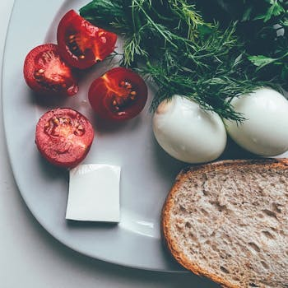
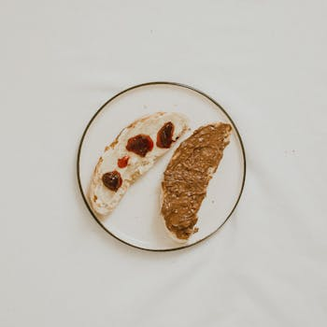

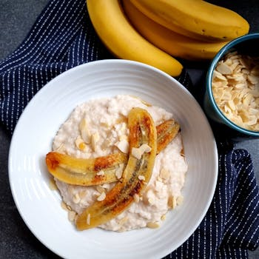
10–20G PROTEIN OPTIONS
better than most who skip it
Two Hard-Boiled Eggs
Peanut Butter on Whole Wheat Toast
155 kcal · 13g protein
270 kcal · 11g protein
Regular Greek Yogurt Cup
Oatmeal with Milk and Almonds
130 kcal · 15g protein
285 kcal · 12g protein
4 / 5
healtho · @healtho_10k

Slide 5
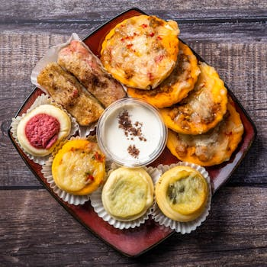
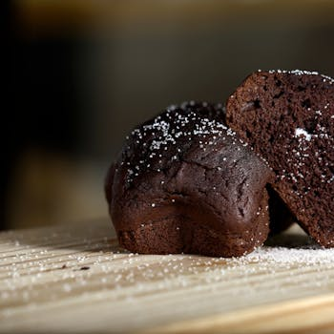
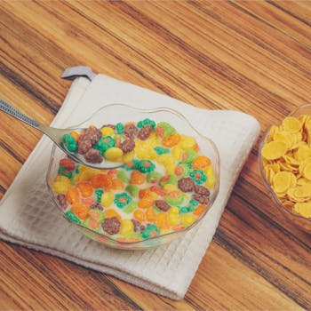
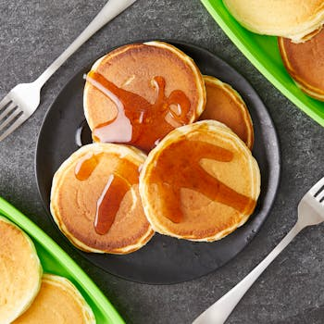
HIGH-SUGAR BREAKFASTS TO AVOID
these spike blood sugar fast
Frosted Pop-Tarts (2 pastries)
Chocolate Chip Muffin
380 kcal · 4g protein
450 kcal · 5g protein
Sugary Cereal with Skim Milk
Pancakes with Maple Syrup
280 kcal · 4g protein
520 kcal · 8g protein
5 / 5
healtho · @healtho_10k

