Slide 1
WEEK 30 · TOPIC 10/10
BREAKFAST FOODS RANKED BY PROTEIN
"Your breakfast is either working for you or against you."
Save this for your next grocery run →
healtho · @healtho_10k

Slide 2
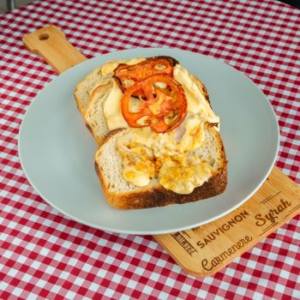
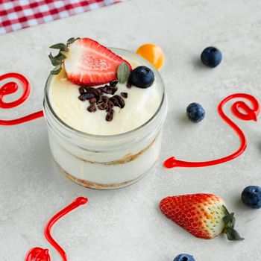

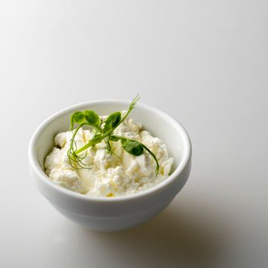
30G+ PROTEIN BREAKFASTS
sets the tone for the whole day
4-Egg Omelette with Cheese
Greek Yogurt Parfait (300g)
450 kcal · 34g protein
380 kcal · 32g protein
Protein Pancakes (3 stack)
Cottage Cheese Bowl with Nuts
420 kcal · 35g protein
350 kcal · 31g protein
2 / 5
healtho · @healtho_10k

Slide 3
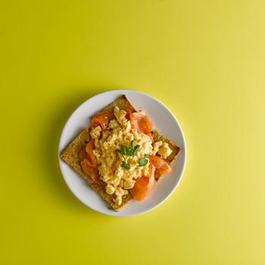
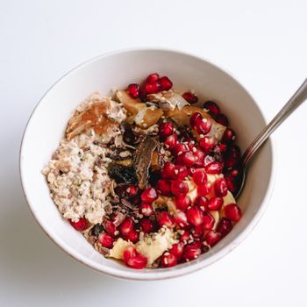
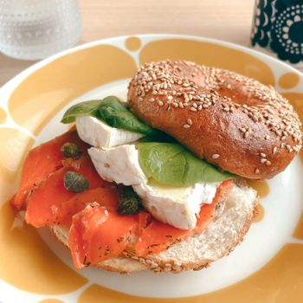
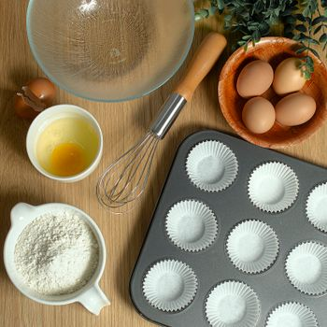
20–30G PROTEIN OPTIONS
solid start, easy to make
3 Scrambled Eggs on Toast
Overnight Oats with Protein
370 kcal · 24g protein
340 kcal · 25g protein
Smoked Salmon Bagel
Turkey Sausage & Egg Muffin
380 kcal · 22g protein
350 kcal · 26g protein
3 / 5
healtho · @healtho_10k

Slide 4
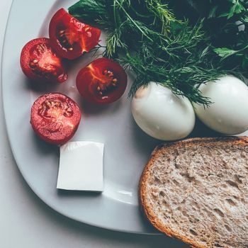
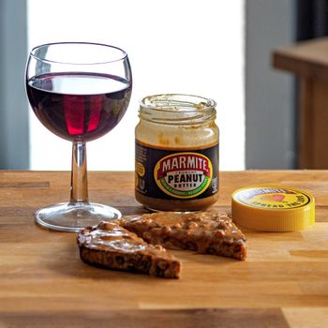
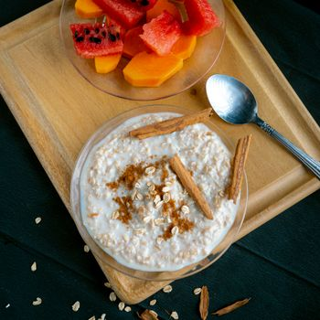
10–20G PROTEIN OPTIONS
better than most who skip it
2 Boiled Eggs
Peanut Butter Toast (2 slices)
155 kcal · 13g protein
320 kcal · 12g protein
Regular Oatmeal with Milk
Avocado Toast with 1 Egg
250 kcal · 11g protein
290 kcal · 10g protein
4 / 5
healtho · @healtho_10k

Slide 5
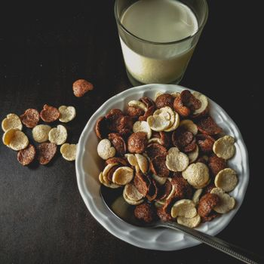

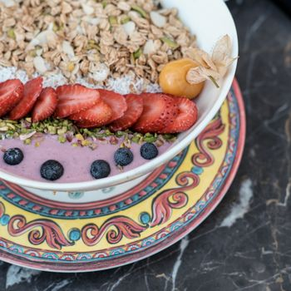
HIGH-SUGAR BREAKFASTS TO AVOID
these spike blood sugar fast
Frosted Cereal with Milk
Chocolate Chip Muffin
310 kcal · 4g protein
450 kcal · 5g protein
Syrup-Loaded Pancakes
Store-Bought Acai Bowl
520 kcal · 6g protein
490 kcal · 3g protein
5 / 5
healtho · @healtho_10k

