Slide 1
WEEK 40 · TOPIC 10/10
BREAKFAST FOODS RANKED BY PROTEIN
"Your breakfast is either working for you or against you."
Save this for your next grocery run →
healtho · @healtho_10k

Slide 2
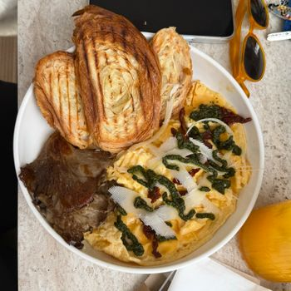
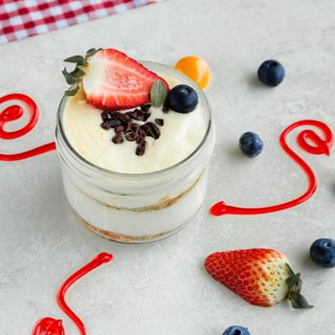

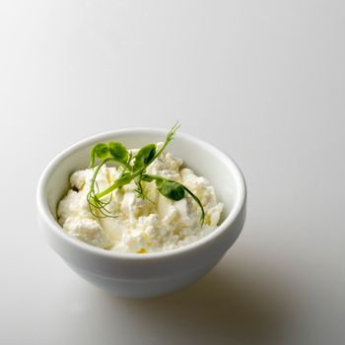
30G+ PROTEIN BREAKFASTS
sets the tone for the whole day
4-Egg Omelette with Cheese
Greek Yogurt Parfait (300g)
450 kcal · 34g protein
350 kcal · 32g protein
Protein Pancakes (3 stack)
Cottage Cheese Bowl with Nuts
380 kcal · 35g protein
340 kcal · 31g protein
2 / 5
healtho · @healtho_10k

Slide 3
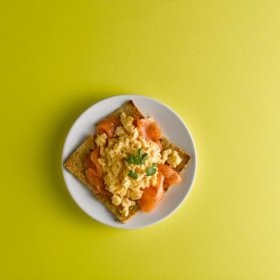
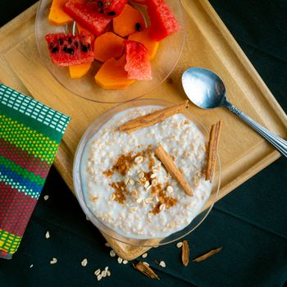
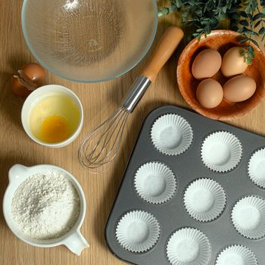
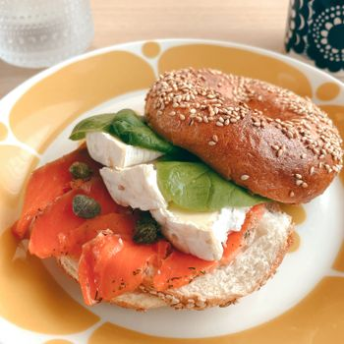
20–30G PROTEIN OPTIONS
solid start, easy to make
3 Scrambled Eggs on Toast
Overnight Oats with Protein Powder
350 kcal · 24g protein
370 kcal · 27g protein
Turkey Sausage & Egg Muffin
Smoked Salmon Bagel
310 kcal · 22g protein
380 kcal · 25g protein
3 / 5
healtho · @healtho_10k

Slide 4
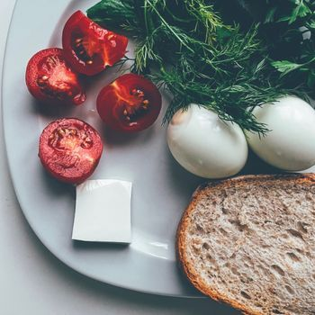
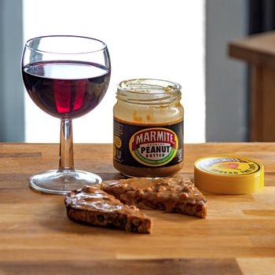
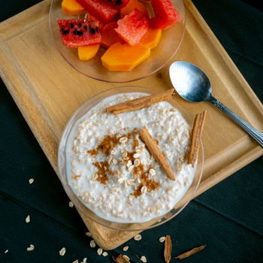
10–20G PROTEIN OPTIONS
better than most who skip it
2 Boiled Eggs
Peanut Butter Toast (2 slices)
140 kcal · 12g protein
320 kcal · 14g protein
Regular Oatmeal with Milk
Avocado Toast with 1 Egg
250 kcal · 11g protein
280 kcal · 13g protein
4 / 5
healtho · @healtho_10k

Slide 5
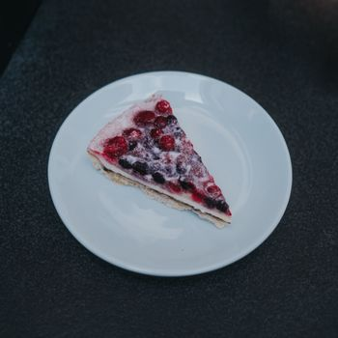
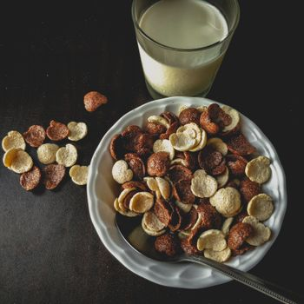
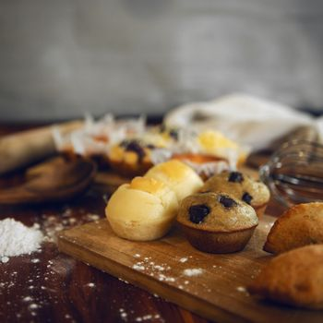
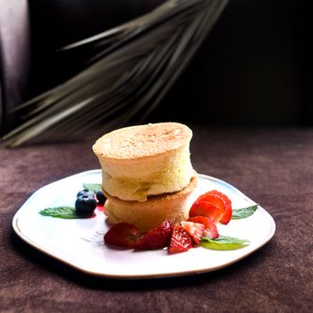
HIGH-SUGAR BREAKFASTS TO AVOID
these spike blood sugar fast
Frosted Pop-Tarts (2 pastries)
Sugary Cereal with Skim Milk
400 kcal · 4g protein
280 kcal · 5g protein
Chocolate Chip Muffin
Pancakes with Syrup (no eggs)
450 kcal · 5g protein
520 kcal · 6g protein
5 / 5
healtho · @healtho_10k

