Slide 1
WEEK 35 · TOPIC 5/10
LOWEST CALORIE FOODS ON THE PLANET
"Eat more, weigh less — these foods make it possible."
Save this for your next grocery run →
healtho · @healtho_10k

Slide 2
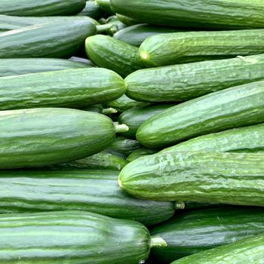
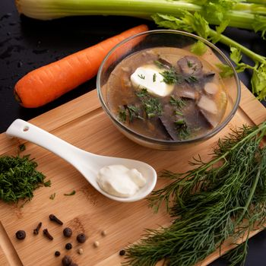
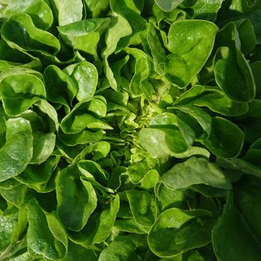
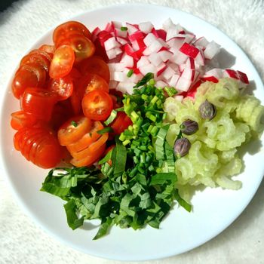
UNDER 20 KCAL PER 100G
virtually zero calorie cost
Cucumber
Celery
15 kcal · 0.7g protein
16 kcal · 0.7g protein
Lettuce
Radishes
15 kcal · 1.4g protein
16 kcal · 0.7g protein
2 / 5
healtho · @healtho_10k

Slide 3
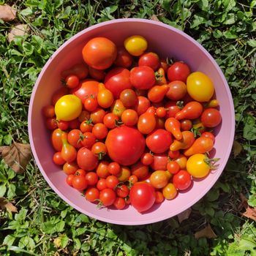

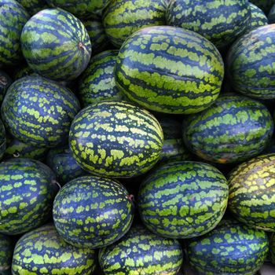
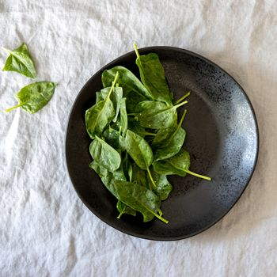
UNDER 30 KCAL PER 100G
high water, high volume
Tomatoes
Zucchini
18 kcal · 0.9g protein
17 kcal · 1.2g protein
Watermelon
Spinach
30 kcal · 0.6g protein
23 kcal · 2.9g protein
3 / 5
healtho · @healtho_10k

Slide 4
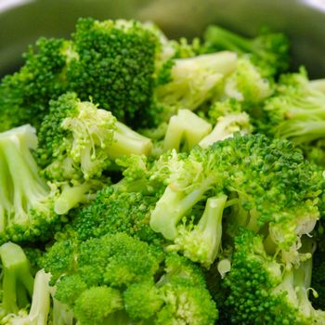
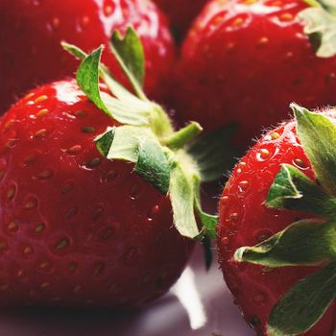
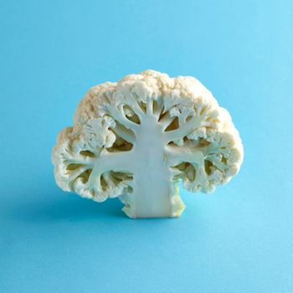
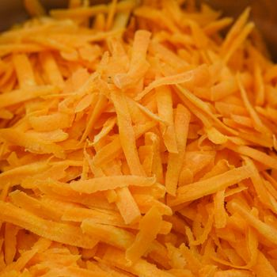
UNDER 50 KCAL PER 100G
nutrient-dense and filling
Broccoli
Strawberries
34 kcal · 2.8g protein
32 kcal · 0.7g protein
Cauliflower
Carrots
25 kcal · 1.9g protein
41 kcal · 0.9g protein
4 / 5
healtho · @healtho_10k

Slide 5

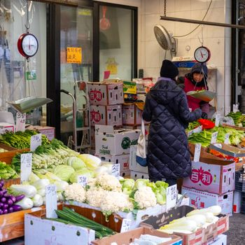
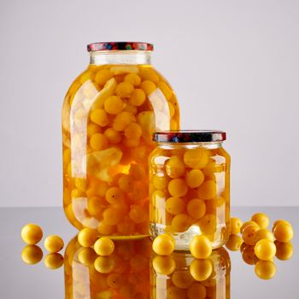
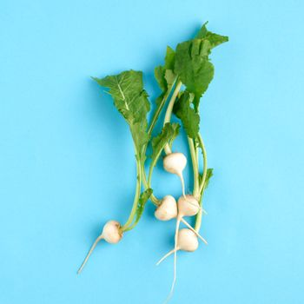
HIGH-VOLUME SNACK OPTIONS
satisfies cravings guilt-free
Air-Popped Popcorn
Sugar Snap Peas
31 kcal · 1.0g protein
42 kcal · 2.8g protein
Pickles
Jicama
11 kcal · 0.3g protein
38 kcal · 0.7g protein
5 / 5
healtho · @healtho_10k

