Slide 1
WEEK 16 · TOPIC 6/10
MUSCLE BUILDING FOODS
"Muscle isn't just built in the gym — it's built in the kitchen."
Save this for your next grocery run →
healtho · @healtho_10k

Slide 2

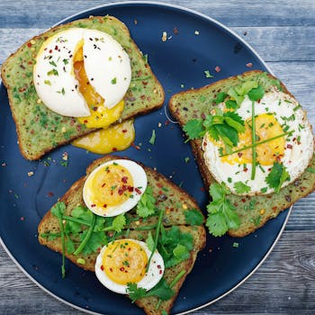
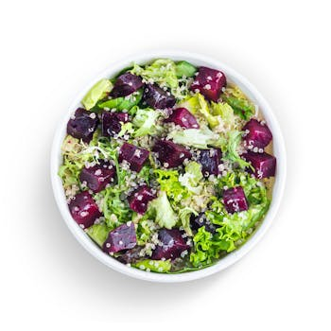
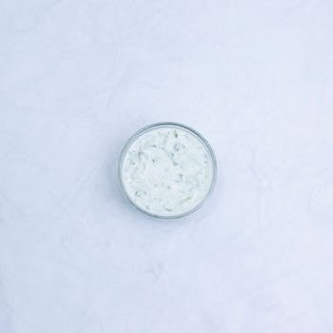
COMPLETE PROTEINS
all 9 essential amino acids in one source
Chicken Breast
Whole Eggs
165 kcal · 31g protein
155 kcal · 13g protein
Quinoa
Greek Yogurt
120 kcal · 4g protein
100 kcal · 17g protein
2 / 5
healtho · @healtho_10k

Slide 3
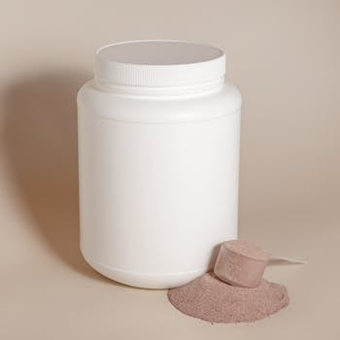

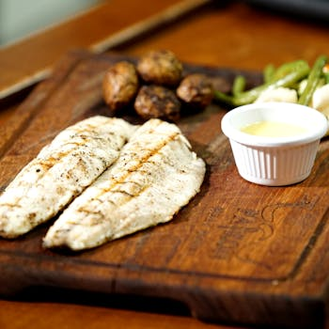
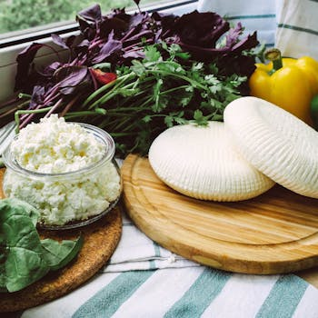
FAST-DIGESTING PROTEINS
ideal for the post-workout window
Whey Protein
Egg Whites
120 kcal · 25g protein
52 kcal · 11g protein
White Fish (Tilapia)
Fat-Free Cottage Cheese
128 kcal · 26g protein
80 kcal · 14g protein
3 / 5
healtho · @healtho_10k

Slide 4
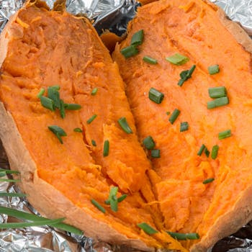
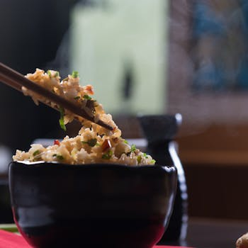
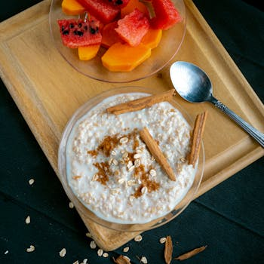
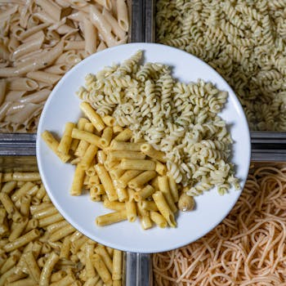
COMPLEX CARB SOURCES
fuels workouts and recovery
Sweet Potato
Brown Rice
103 kcal · 24g carbs
123 kcal · 26g carbs
Oatmeal
Whole Wheat Pasta
154 kcal · 27g carbs
174 kcal · 37g carbs
4 / 5
healtho · @healtho_10k

Slide 5
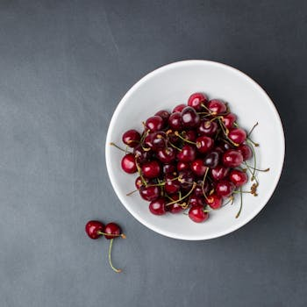
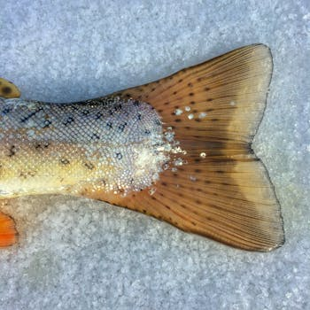
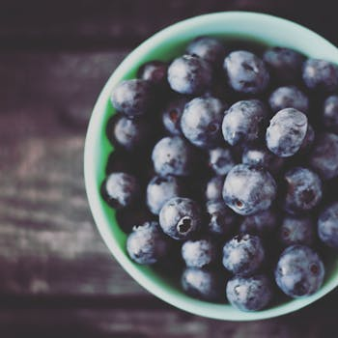
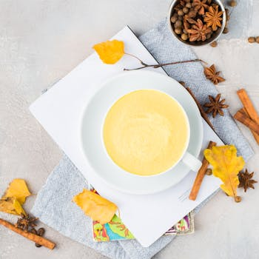
RECOVERY FOODS
reduces soreness and inflammation
Tart Cherry Juice
Salmon
117 kcal · 28g carbs
208 kcal · 20g protein
Blueberries
Turmeric Golden Milk
57 kcal · 14g carbs
75 kcal · 3g protein
5 / 5
healtho · @healtho_10k

