Slide 1
WEEK 39 · TOPIC 9/10
FOODS THAT REDUCE BELLY BLOATING
"Bloating is usually food-related — and totally fixable."
Save this for your next grocery run →
healtho · @healtho_10k

Slide 2
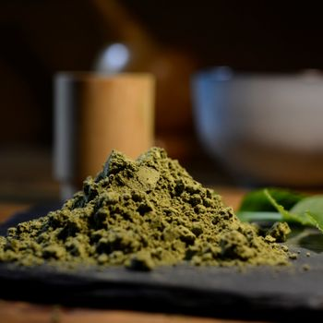
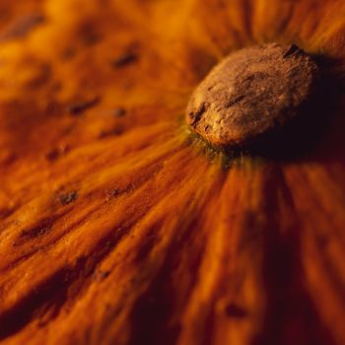
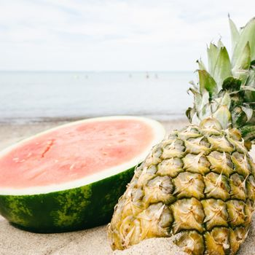
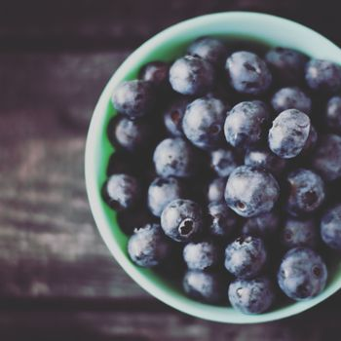
ANTI-INFLAMMATORY FOODS
reduces gut irritation
Turmeric
Ginger
29 kcal · 3g fiber
80 kcal · 2g fiber
Pineapple
Blueberries
50 kcal · 1.4g fiber
57 kcal · 2.4g fiber
2 / 5
healtho · @healtho_10k

Slide 3
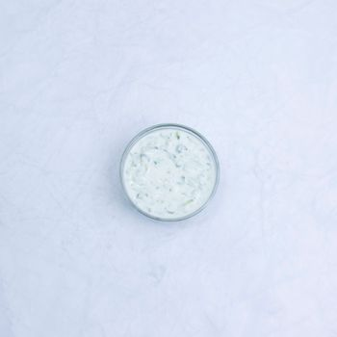
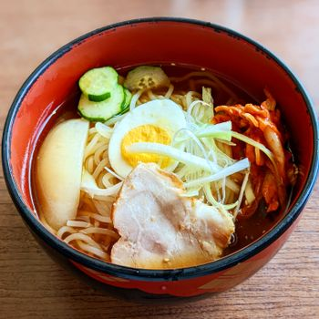
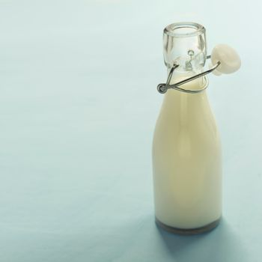
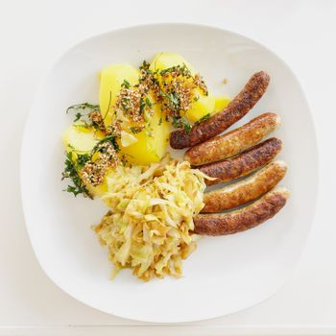
PROBIOTIC FOODS
restores gut bacteria balance
Greek Yogurt
Kimchi
59 kcal · 10g protein
15 kcal · 1.1g fiber
Kefir
Sauerkraut
63 kcal · 3.5g protein
19 kcal · 2.9g fiber
3 / 5
healtho · @healtho_10k

Slide 4
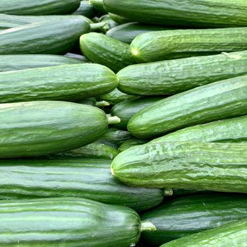
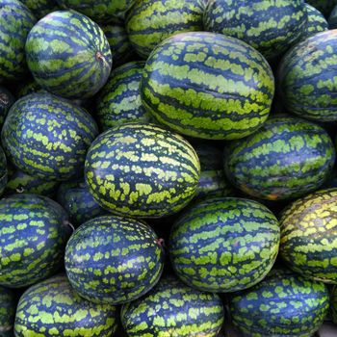
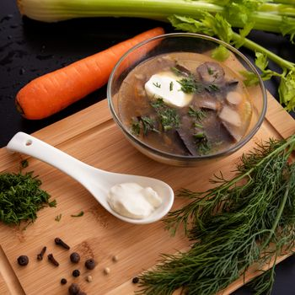
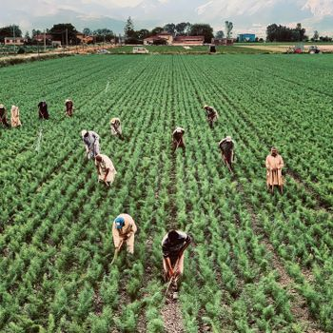
NATURAL DIURETICS
flushes excess water weight
Cucumber
Watermelon
16 kcal · 0.5g fiber
30 kcal · 0.4g fiber
Celery
Asparagus
14 kcal · 1.6g fiber
20 kcal · 2.1g fiber
4 / 5
healtho · @healtho_10k

Slide 5
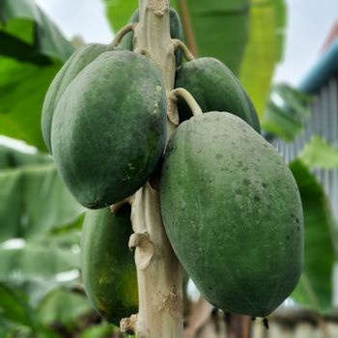
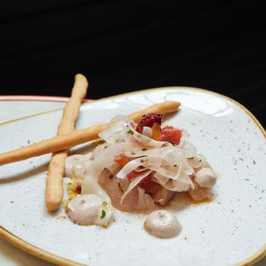
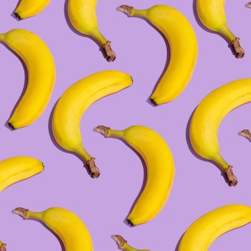
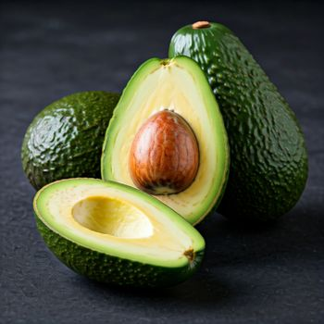
DIGESTIVE AIDS
speeds up slow digestion
Papaya
Fennel
43 kcal · 1.7g fiber
31 kcal · 3.1g fiber
Banana
Avocado
89 kcal · 2.6g fiber
160 kcal · 6.7g fiber
5 / 5
healtho · @healtho_10k

