Slide 1
WEEK 21 · TOPIC 1/10
HIGH PROTEIN FOODS UNDER 200 CALORIES
"You don't need to overeat to hit your protein goals."
Save this for your next grocery run →
healtho · @healtho_10k

Slide 2

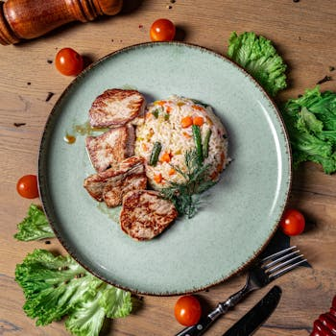
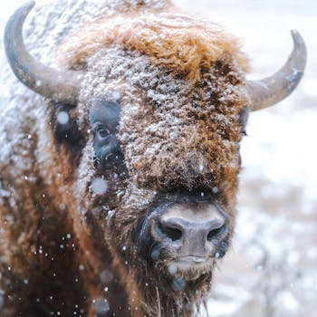
LEAN MEATS
builds muscle, keeps you full
Chicken Breast
Turkey Breast
165 kcal · 31g protein
135 kcal · 30g protein
Pork Tenderloin
Bison Steak
143 kcal · 26g protein
143 kcal · 28g protein
2 / 5
healtho · @healtho_10k

Slide 3
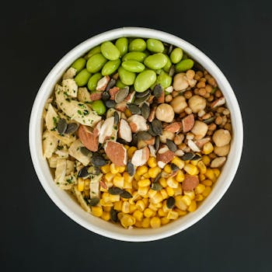

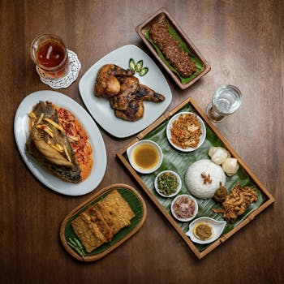
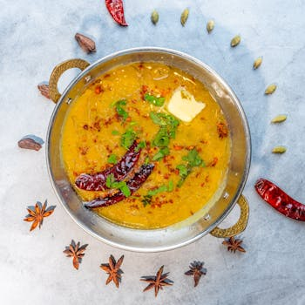
PLANT PROTEINS
fiber-rich and cholesterol-free
Edamame (1 cup)
Black Beans (1 cup)
188 kcal · 18g protein
114 kcal · 8g protein
Tempeh (100g)
Lentils (1 cup cooked)
192 kcal · 20g protein
165 kcal · 12g protein
3 / 5
healtho · @healtho_10k

Slide 4
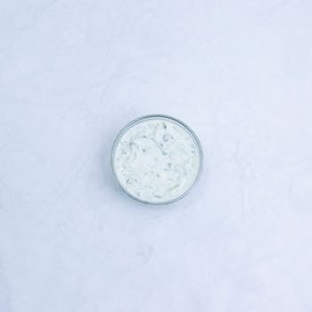
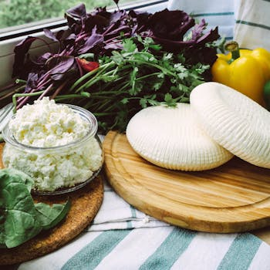
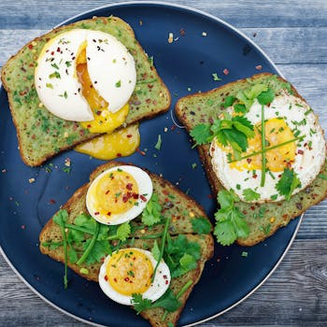
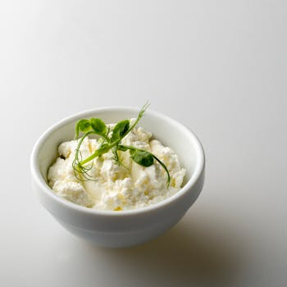
DAIRY & EGGS
complete amino acid profiles
Greek Yogurt (200g)
Cottage Cheese (1 cup)
130 kcal · 20g protein
183 kcal · 24g protein
Whole Eggs (3 large)
Skyr (170g)
198 kcal · 18g protein
110 kcal · 19g protein
4 / 5
healtho · @healtho_10k

Slide 5
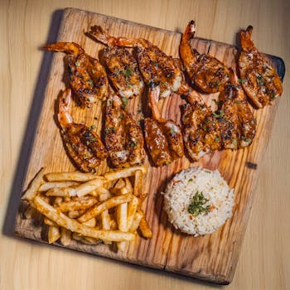
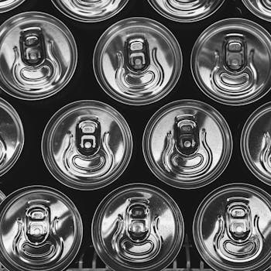
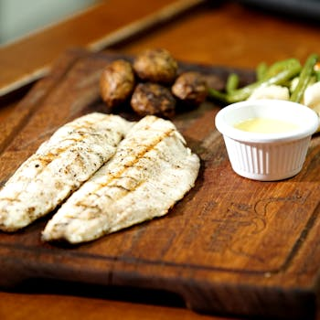
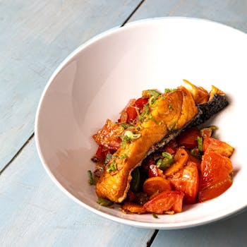
SEAFOOD OPTIONS
omega-3s plus high protein
Shrimp (150g)
Tuna (1 can drained)
150 kcal · 35g protein
179 kcal · 39g protein
Cod Fillet (170g)
Salmon (100g)
140 kcal · 32g protein
182 kcal · 25g protein
5 / 5
healtho · @healtho_10k

