Slide 1
WEEK 32 · TOPIC 2/10
FOODS THAT BOOST YOUR METABOLISM
"Your metabolism is more controllable than you think."
Save this for your next grocery run →
healtho · @healtho_10k

Slide 2


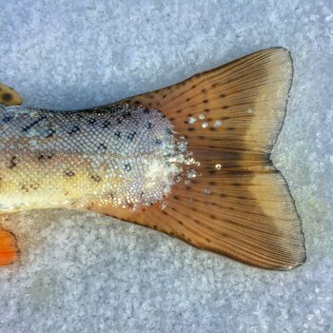
THERMOGENIC FOODS
increases calorie burn through heat production
Chicken Breast
Egg Whites
165 kcal · 31g protein
52 kcal · 11g protein
Salmon
Turkey Breast
208 kcal · 20g protein
135 kcal · 30g protein
2 / 5
healtho · @healtho_10k

Slide 3
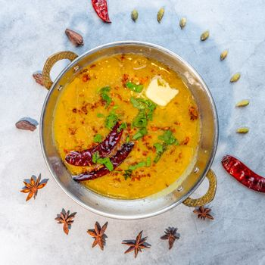

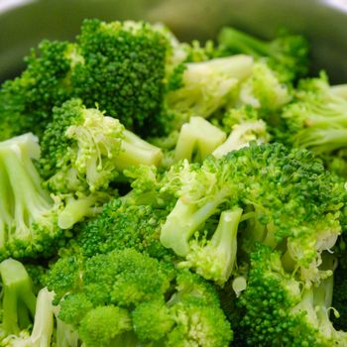
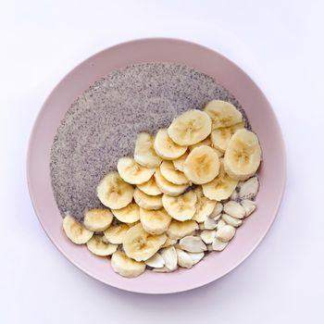
FIBER-RICH FOODS
slows digestion and sustains energy levels
Lentils
Oats
116 kcal · 8g fiber
389 kcal · 11g fiber
Broccoli
Chia Seeds
34 kcal · 3g fiber
486 kcal · 34g fiber
3 / 5
healtho · @healtho_10k

Slide 4
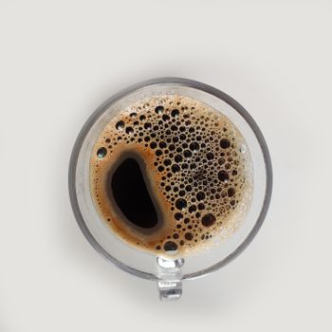



CAFFEINE SOURCES
natural metabolic stimulants that boost energy
Black Coffee
Green Tea
2 kcal · 95mg caffeine
2 kcal · 28mg caffeine
Yerba Mate
Dark Chocolate 85%
5 kcal · 85mg caffeine
170 kcal · 43mg caffeine
4 / 5
healtho · @healtho_10k

Slide 5
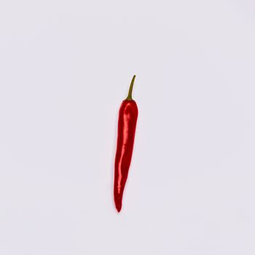
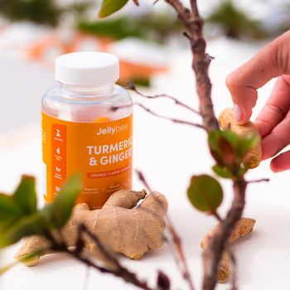
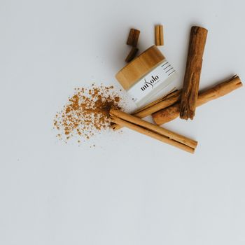
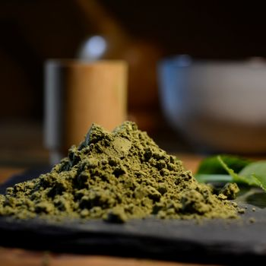
METABOLISM-BOOSTING SPICES
activates fat-burning enzymes naturally
Cayenne Pepper
Ginger Root
17 kcal · 0.6g capsaicin
80 kcal · 2g gingerol
Cinnamon
Turmeric
247 kcal · 53g fiber
312 kcal · 3g curcumin
5 / 5
healtho · @healtho_10k

