Slide 1
WEEK 33 · TOPIC 3/10
BEST FOODS FOR FAT LOSS
"Fat loss isn't about eating less — it's about eating smarter."
Save this for your next grocery run →
healtho · @healtho_10k

Slide 2
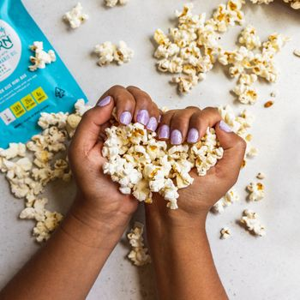
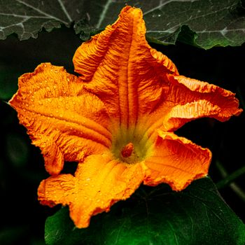

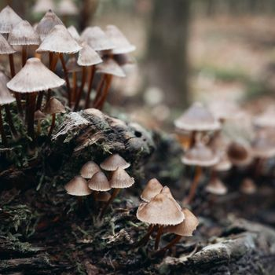
HIGH-VOLUME LOW-CAL FOODS
fills you up on fewer calories
Popcorn (Air-Popped)
Zucchini
31 kcal · 1g fiber per cup
17 kcal · 1g fiber per 100g
Cabbage
Mushrooms
25 kcal · 2g fiber per 100g
22 kcal · 1g fiber per 100g
2 / 5
healtho · @healtho_10k

Slide 3

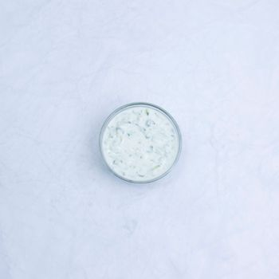
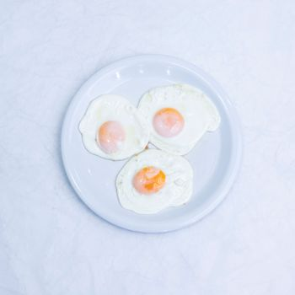
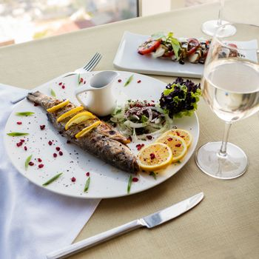
PROTEIN SOURCES
preserves muscle during a deficit
Chicken Breast
Greek Yogurt (0%)
165 kcal · 31g protein per 100g
59 kcal · 10g protein per 100g
Egg Whites
Cod Fillet
52 kcal · 11g protein per 100g
82 kcal · 18g protein per 100g
3 / 5
healtho · @healtho_10k

Slide 4
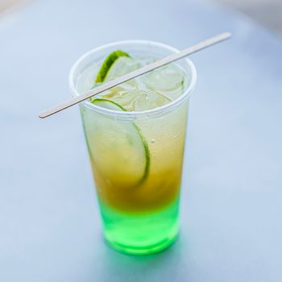
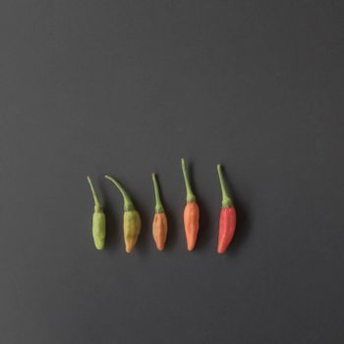
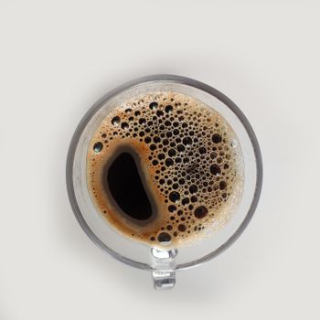
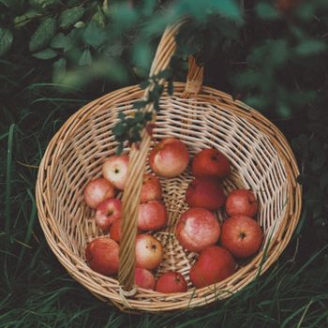
FAT-BURNING FOODS
directly supports fat oxidation
Green Tea
Chili Peppers
2 kcal · 30mg EGCG per cup
40 kcal · 144mg capsaicin per 100g
Coffee (Black)
Apple Cider Vinegar
2 kcal · 95mg caffeine per cup
3 kcal · 5% acetic acid per tbsp
4 / 5
healtho · @healtho_10k

Slide 5
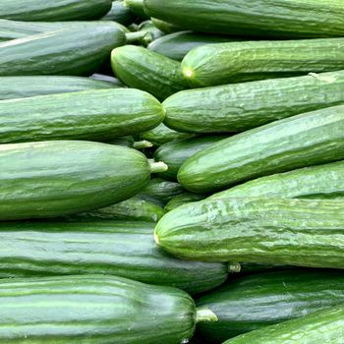
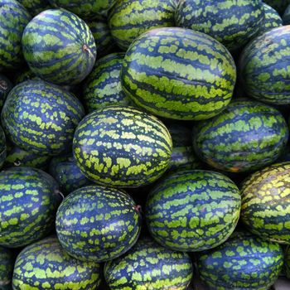
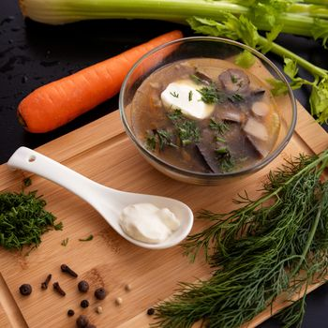
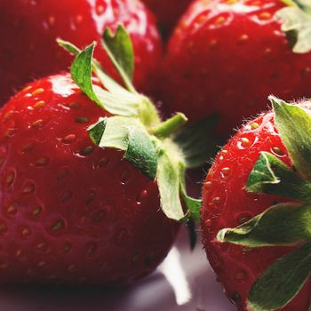
WATER-DENSE FOODS
suppresses appetite naturally
Cucumber
Watermelon
15 kcal · 96% water per 100g
30 kcal · 92% water per 100g
Celery
Strawberries
14 kcal · 95% water per 100g
32 kcal · 91% water per 100g
5 / 5
healtho · @healtho_10k

