Slide 1
WEEK 41 · TOPIC 1/10
HIGH PROTEIN FOODS UNDER 200 CALORIES
"You don't need to overeat to hit your protein goals."
Save this for your next grocery run →
healtho · @healtho_10k

Slide 2
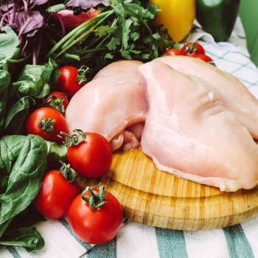
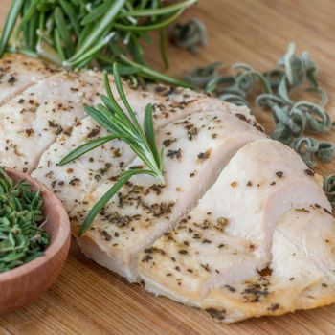
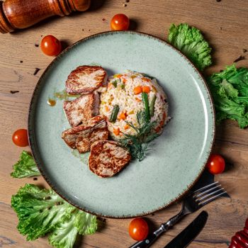
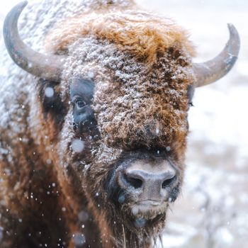
LEAN MEATS
builds muscle, keeps you full
Chicken Breast
Turkey Breast
165 kcal · 31g protein
135 kcal · 30g protein
Pork Tenderloin
Bison Steak
143 kcal · 26g protein
143 kcal · 28g protein
2 / 5
healtho · @healtho_10k

Slide 3
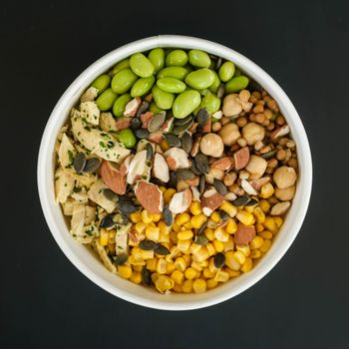
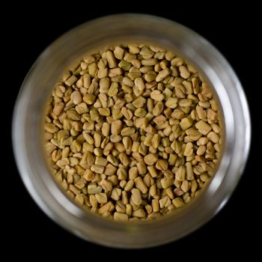
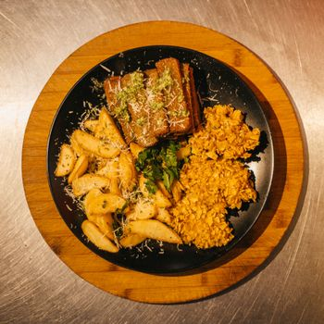
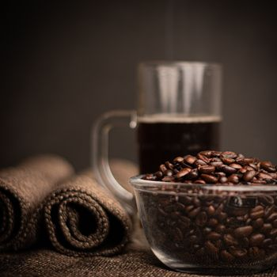
PLANT PROTEINS
fiber-rich and cholesterol-free
Edamame (1 cup)
Lentils (¾ cup)
188 kcal · 18g protein
170 kcal · 13g protein
Tempeh (3 oz)
Black Beans (¾ cup)
162 kcal · 17g protein
170 kcal · 11g protein
3 / 5
healtho · @healtho_10k

Slide 4
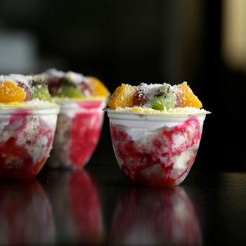
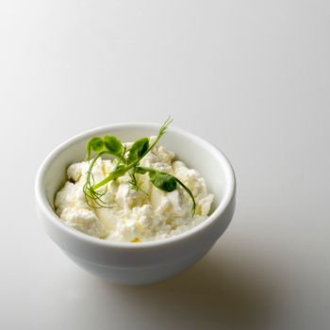
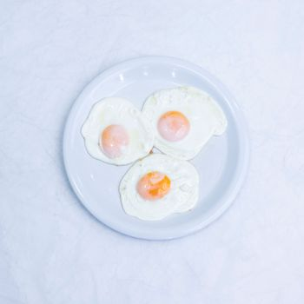
DAIRY & EGGS
complete amino acid profiles
Greek Yogurt (1 cup)
Cottage Cheese (¾ cup)
130 kcal · 22g protein
165 kcal · 24g protein
3 Large Eggs
Skyr (¾ cup)
198 kcal · 18g protein
120 kcal · 17g protein
4 / 5
healtho · @healtho_10k

Slide 5
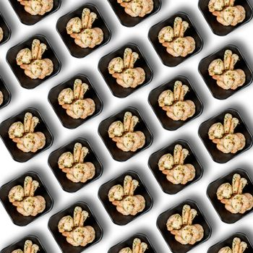
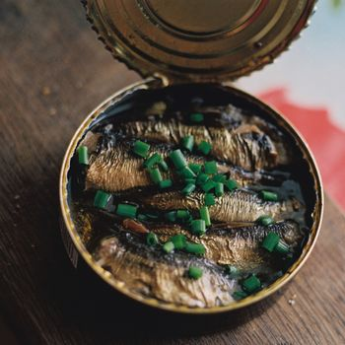
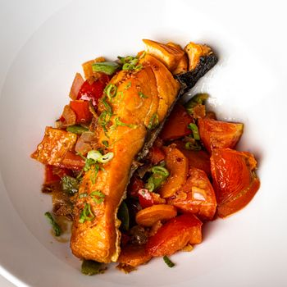
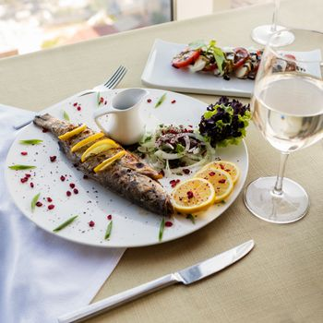
SEAFOOD OPTIONS
omega-3s plus high protein
Shrimp (6 oz)
Tuna (4 oz canned)
170 kcal · 36g protein
120 kcal · 28g protein
Salmon Fillet (3 oz)
Cod Fillet (5 oz)
177 kcal · 25g protein
148 kcal · 32g protein
5 / 5
healtho · @healtho_10k

