Slide 1
WEEK 18 · TOPIC 8/10
HIGH CALORIE HEALTHY FOODS
"Gaining weight the healthy way is harder than it looks."
Save this for your next grocery run →
healtho · @healtho_10k

Slide 2
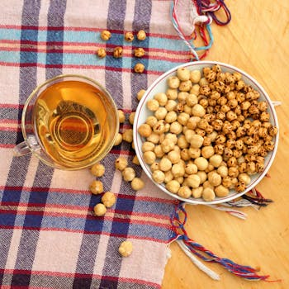
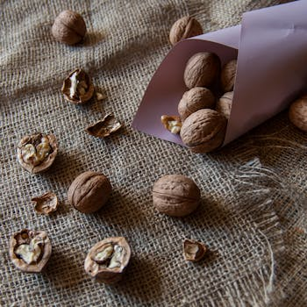

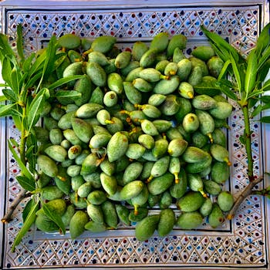
CALORIE-DENSE NUTS & SEEDS
healthy fats and micronutrients
Macadamia Nuts
Walnuts
718 kcal · 76g fat
654 kcal · 65g fat
Sunflower Seeds
Almonds
584 kcal · 51g fat
579 kcal · 50g fat
2 / 5
healtho · @healtho_10k

Slide 3
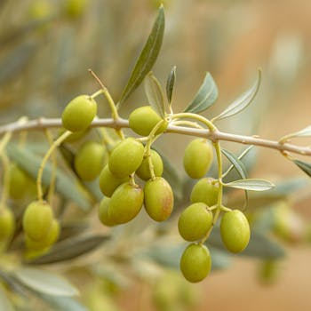
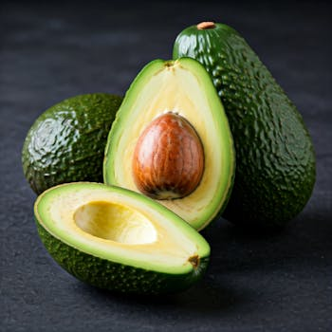
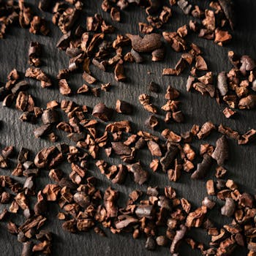
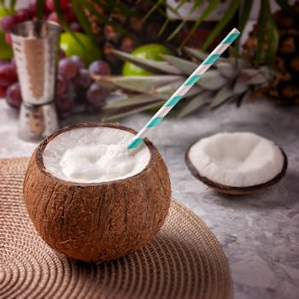
HEALTHY FATS
9 kcal per gram, nutrient-rich
Extra Virgin Olive Oil
Avocado
884 kcal · 100g fat
160 kcal · 15g fat
Dark Chocolate 85%
Coconut Meat
604 kcal · 43g fat
354 kcal · 33g fat
3 / 5
healtho · @healtho_10k

Slide 4

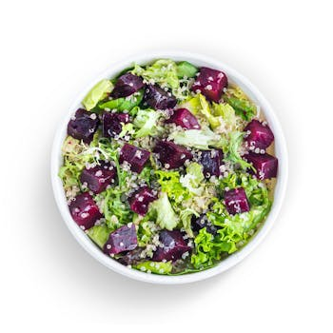
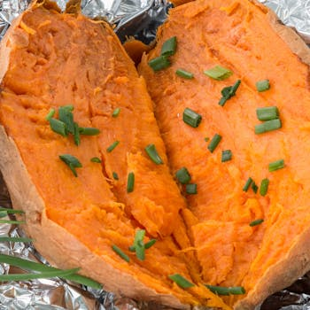

COMPLEX CARBOHYDRATES
sustained energy for training
Oats
Quinoa
389 kcal · 66g carbs
368 kcal · 64g carbs
Sweet Potato
Brown Rice
86 kcal · 20g carbs
362 kcal · 76g carbs
4 / 5
healtho · @healtho_10k

Slide 5
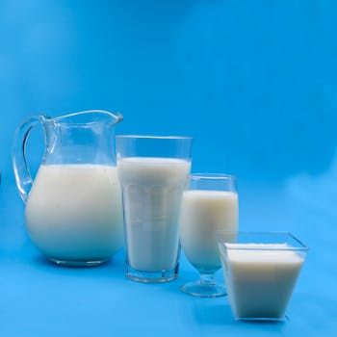
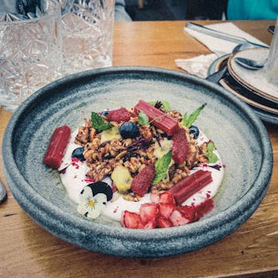

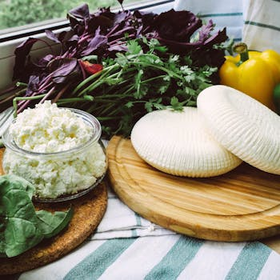
PROTEIN-DENSE DAIRY
calories plus muscle support
Whole Milk
Greek Yogurt (Full Fat)
149 kcal · 8g protein
97 kcal · 9g protein
Cheddar Cheese
Cottage Cheese
403 kcal · 25g protein
98 kcal · 11g protein
5 / 5
healtho · @healtho_10k

