Slide 1
WEEK 36 · TOPIC 6/10
MUSCLE BUILDING FOODS
"Muscle isn't just built in the gym — it's built in the kitchen."
Save this for your next grocery run →
healtho · @healtho_10k

Slide 2

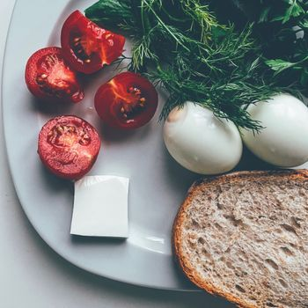
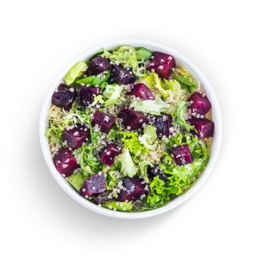
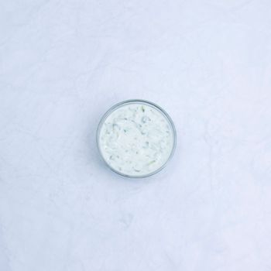
COMPLETE PROTEINS
all 9 essential amino acids in one source
Chicken Breast
Whole Eggs
165 kcal · 31g protein
155 kcal · 13g protein
Quinoa
Greek Yogurt
120 kcal · 4g protein
100 kcal · 17g protein
2 / 5
healtho · @healtho_10k

Slide 3
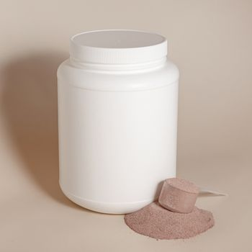

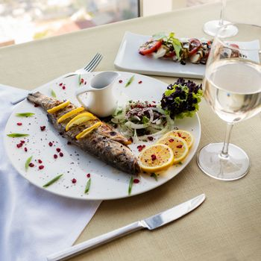
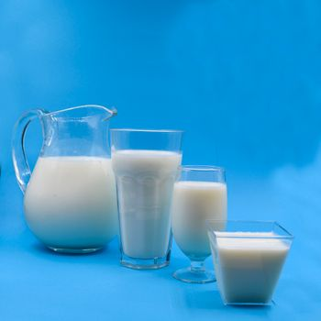
FAST-DIGESTING PROTEINS
ideal for the post-workout anabolic window
Whey Protein Isolate
Egg Whites
120 kcal · 25g protein
52 kcal · 11g protein
White Fish (Tilapia)
Skimmed Milk
128 kcal · 26g protein
83 kcal · 8g protein
3 / 5
healtho · @healtho_10k

Slide 4
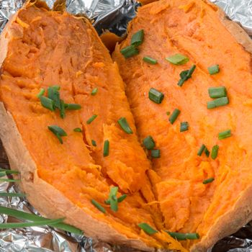
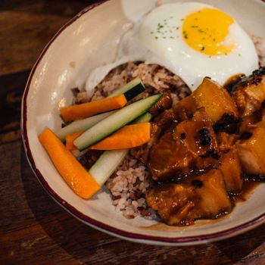

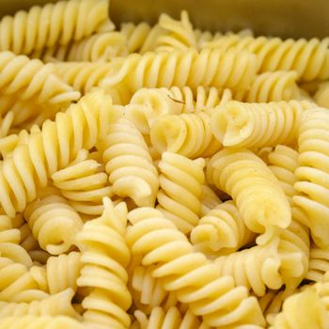
COMPLEX CARB SOURCES
fuels intense workouts and recovery
Sweet Potato
Brown Rice
103 kcal · 24g carbs
123 kcal · 26g carbs
Oats
Whole Wheat Pasta
154 kcal · 27g carbs
174 kcal · 37g carbs
4 / 5
healtho · @healtho_10k

Slide 5
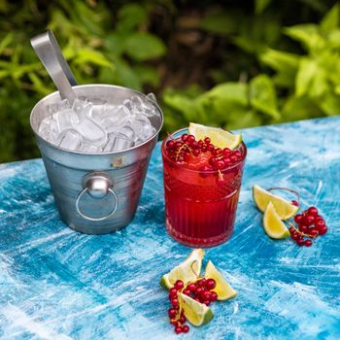
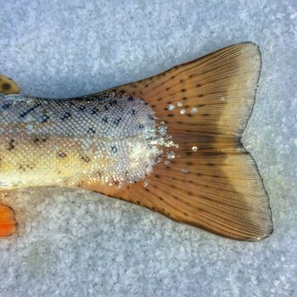
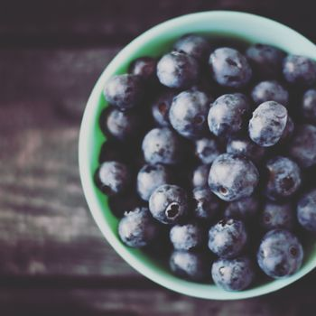
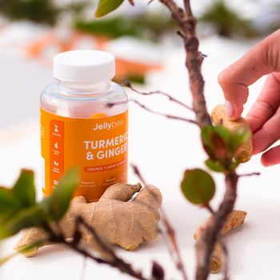
RECOVERY FOODS
reduces soreness and inflammation
Tart Cherry Juice
Salmon
119 kcal · 28g carbs
208 kcal · 20g protein
Blueberries
Turmeric (Ground)
57 kcal · 14g carbs
29 kcal · 2g fiber
5 / 5
healtho · @healtho_10k

