Slide 1
WEEK 38 · TOPIC 8/10
HIGH CALORIE HEALTHY FOODS
"Gaining weight the healthy way is harder than it looks."
Save this for your next grocery run →
healtho · @healtho_10k

Slide 2
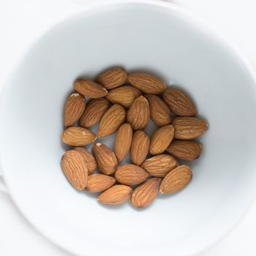
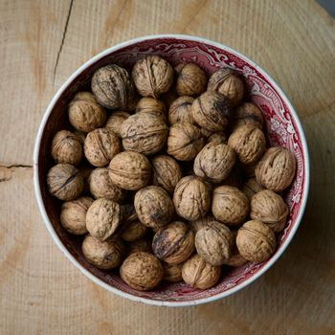

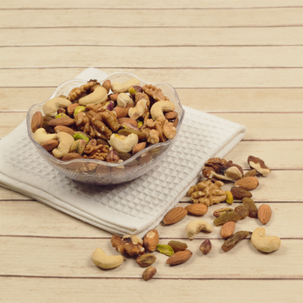
CALORIE-DENSE NUTS & SEEDS
healthy fats and micronutrients
Almonds
Walnuts
579 kcal · 21g protein
654 kcal · 15g protein
Sunflower Seeds
Cashews
584 kcal · 21g protein
553 kcal · 18g protein
2 / 5
healtho · @healtho_10k

Slide 3
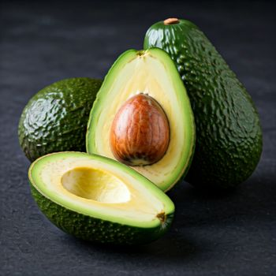
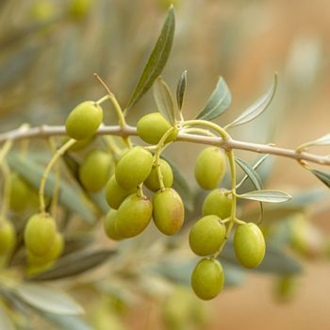

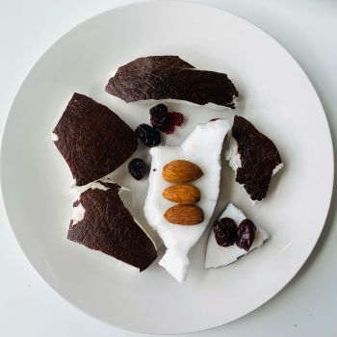
HEALTHY FATS
9 kcal per gram, nutrient-rich
Avocado
Extra Virgin Olive Oil
160 kcal · 15g fat
884 kcal · 100g fat
Dark Chocolate 85%
Coconut Meat
604 kcal · 43g fat
354 kcal · 33g fat
3 / 5
healtho · @healtho_10k

Slide 4

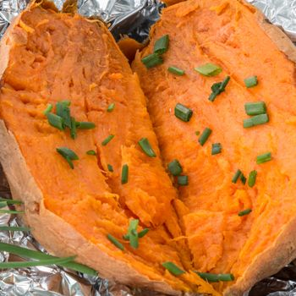
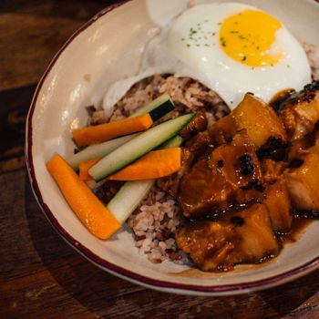
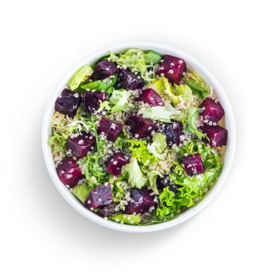
COMPLEX CARBOHYDRATES
sustained energy for training
Oats
Sweet Potato
389 kcal · 66g carbs
86 kcal · 20g carbs
Brown Rice
Quinoa
370 kcal · 77g carbs
368 kcal · 64g carbs
4 / 5
healtho · @healtho_10k

Slide 5
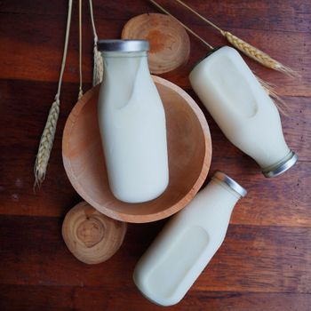
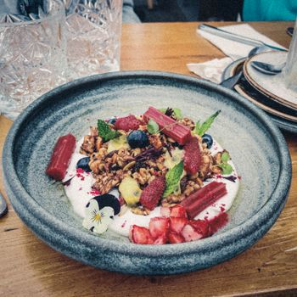
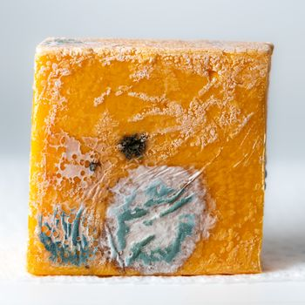
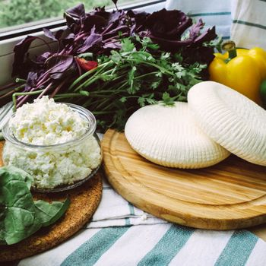
PROTEIN-DENSE DAIRY
calories plus muscle support
Whole Milk
Greek Yogurt (Full Fat)
149 kcal · 8g protein
97 kcal · 9g protein
Cheddar Cheese
Cottage Cheese
403 kcal · 25g protein
98 kcal · 11g protein
5 / 5
healtho · @healtho_10k

