Slide 1
Continuous Integration: Processes and APIs
Kyle S. Healy
December 14, 2016
CPSC 59700

Slide 2
Continuous Integration in Practice
Stepping through a continuous integration

Slide 3
Company X
Baseline that’s a few years old
Some unit tests may exist, but not for all code
Testing is done manually
Some regression tests exist, but may only be run before delivery

Slide 4

A Continuous Integration tool
Automates builds and tests
Run on a separate server
Reports back to the developers successes and failures

Slide 5
Integration Steps
Create build script to build baseline
Download Jenkins onto a server
Configure Jenkins
Poll/Fetch from Source Control Server
Builds baseline with build script
Tests with unit tests
Report procedures
Commit code or kick off build manually

Slide 6
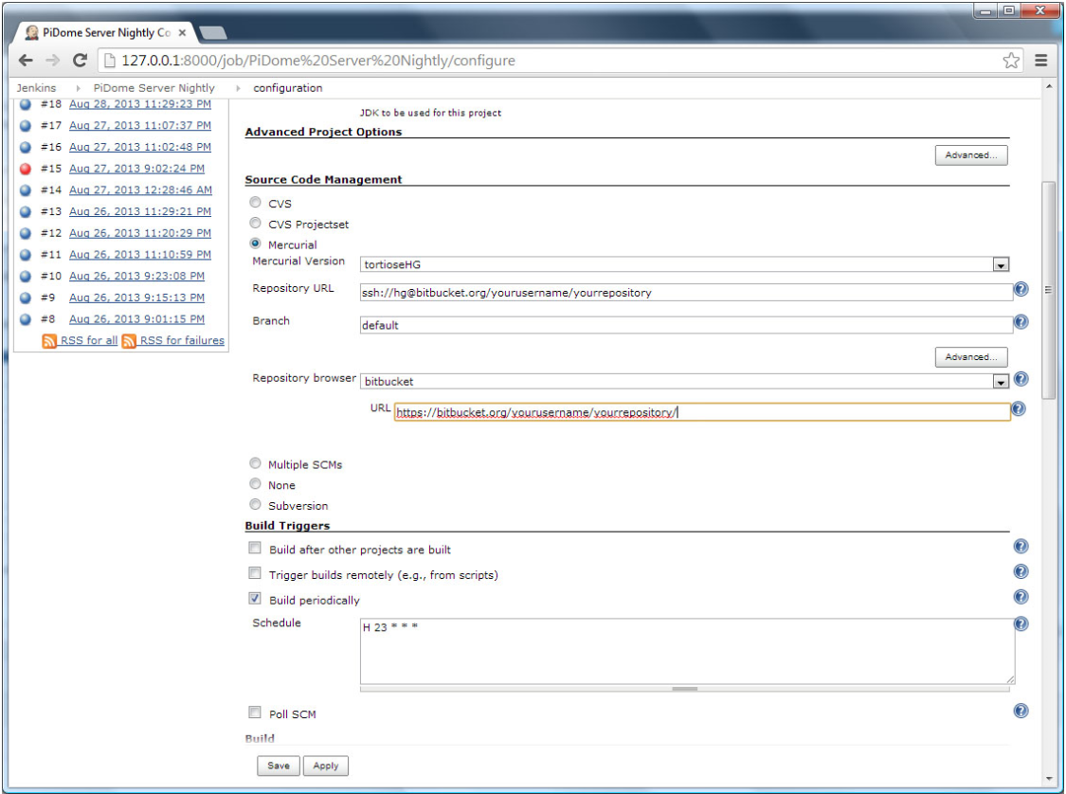
Jenkins Configuration Setup
[16]

Slide 7
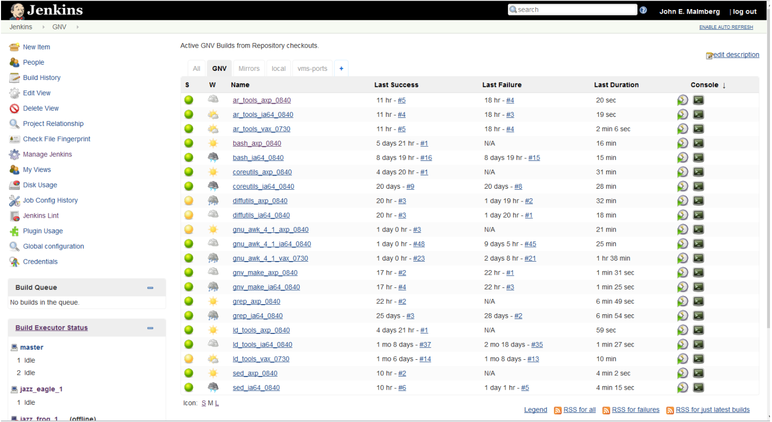
Jenkins Main Page
[11]

Slide 8
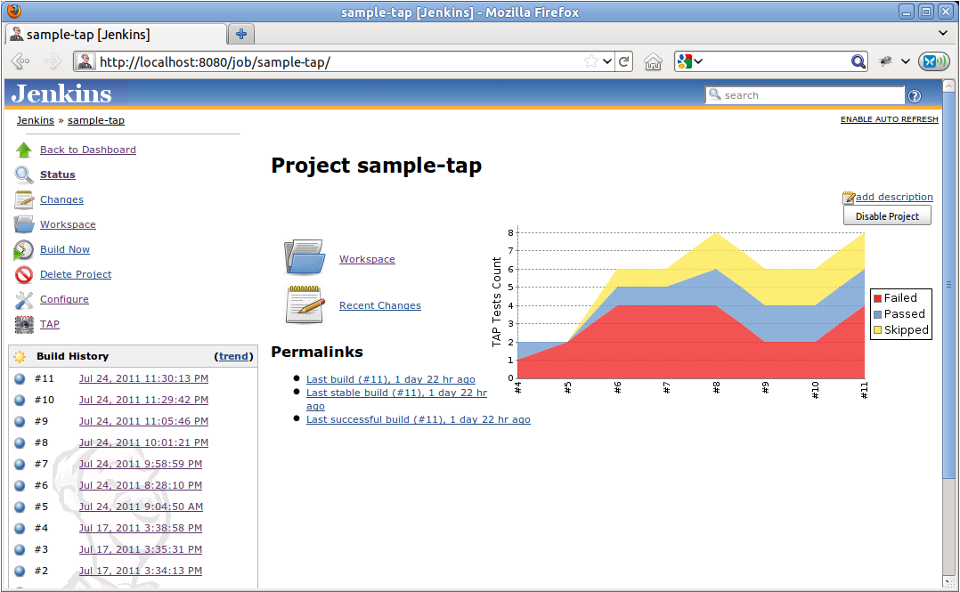
Jenkins Report Page
[12]

Slide 9


Continuous Integration in Industry
Both large corporations
Jenkins incorporated into builds on programs
Multiple unit tests on each build
Nightly builds running integration and regression tests
[5]
[4]

Slide 10
Continuous Integration
High Level Overview

Slide 11
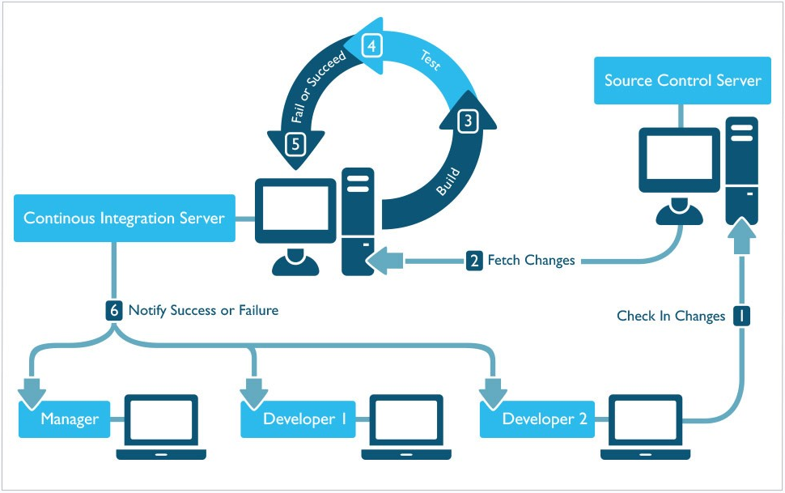
[8]

Slide 12
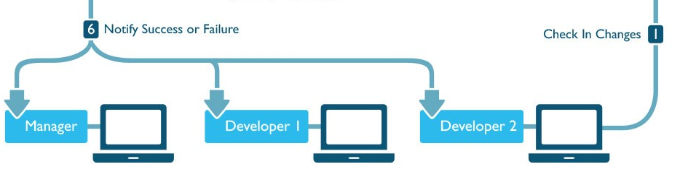
Software Developers
Software developers are the human in the loop portion
Code is developed locally
Tests are developed locally or updated
Developers initiate the process by check ins

Slide 13
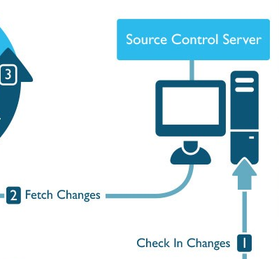
Source Control Server
Source Control Server hosts the repository
Keeps track of all changes and different baselines created

Slide 14
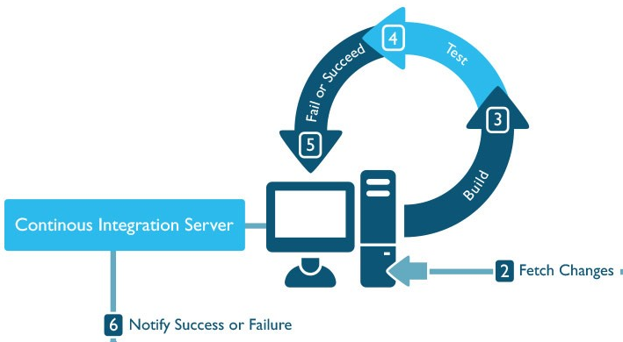
Continuous Integration Server
Continuous Integration Server polls changes from Source Control Server
The Continuous Integration Server fetches changes
Continuous Integration Server builds baseline

Slide 15
Continuous Integration Server Testing
‘Every check in’ tests
Unit Tests
‘Nightly’ tests
Unit Tests
Integration Tests
Regression Tests

Slide 16
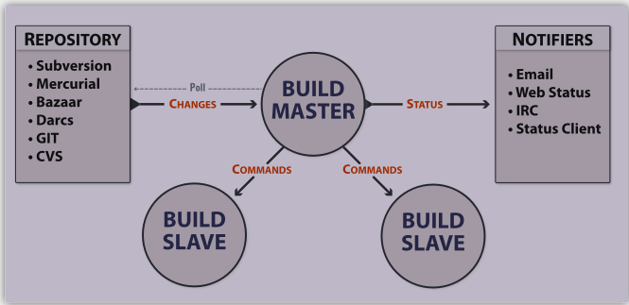
Continuous Integration Server Set ups
Build Master
Manages resources
Monitors Repository
Commands Build Slaves
Sends status updates to developers
Build Slave
Run in multiple languages
Multiple OS instances
Completes heavy processing work
[15]

Slide 17
Benefits
Automated Building
Consistent Testing
Quick Reporting
Easy Traceability
Broken builds
Bugs found in the code

Slide 18
Limitations
Build needs to be automated with a script
Unit tests need to be created by developers
Integration/ Regression tests need to be created
Cultural Adoption
Smaller, frequent commits
Metrics – How to use this information

Slide 19
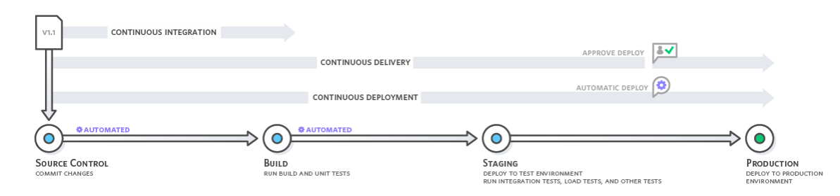
Continuous Ops Life Cycles
[1]

Slide 20
Questions?

