Slide 1
March Madness An Artificial Intelligence Perspective
Kyle Healy, Brogan Joynson, Jayant Sahewal
https://github.com/healykys/MarchMadnessProject

Slide 2
Introduction
March Madness is a single elimination college basketball tournament
Each year people participate in bracket predictions in hopes of predicting the perfect Final Four
For this project, we entered the Kaggle competition, “March Machine Learning Madness 2017” to compete using machine learning algorithms in Python to predict this year’s bracket
Odds of a perfect bracket are 1 in 9.2 quintillion

Slide 3
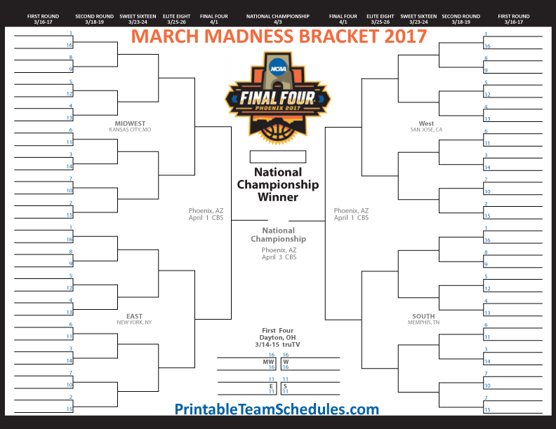

Slide 4
Literature Review
2014: Jared Forsyth and Andrew Wilde produced a bracket with an accuracy of 73.62% using kNN and random forest classification
2015: Students from Old Dominion University produced log loss score of 0.56915 using neural networks
2015:March Machine Learning Madness (Kaggle) Zach Bradshaw came in 1st place using a Bayesian framework. Log loss: 0.438933
2016:March Machine Learning Madness (Kaggle) Miguel Alomar came in 1st place with a logarithmic regression model that used random forest classifiers. Log loss: 0.481310

Slide 5
Methodology
Entered Kaggle competition using Python to implement machine learning techniques
Our implementations include:
Extra Trees Classifier
Logistic Regression
Deep Learning: Keras with TensorFlow
Random Forest
Support Vector Machine (not successful)

Slide 6
Input Data files
Seasons
Teams
TourneySeeds
TourneySlots
RegularSeasonCompactResults
RegularSeasonDetailedResults
TourneyCompactResults
TourneyDetailedResults
Notes:
Show example of one input data file next. All the rest of them put in back up slides.
Back up slides are available for this section that discusses each input file.

Slide 7
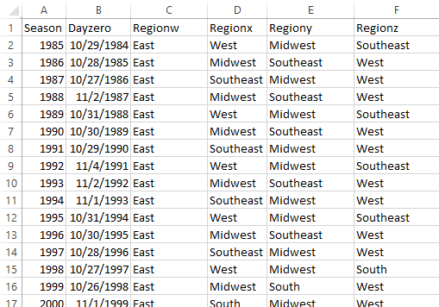
Seasons.csv Screen Shot

Slide 8
Feature Engineering
“When working on a machine learning problem, feature engineering is manually designing what the input x's should be.” - Shayne Miel, (author of “What is the intuitive explanation of feature engineering in machine learning?”)
Deciding what the inputs of the algorithm should be
Requires domain knowledge, subject matter experts (or unsupervised learning)

Slide 9
Feature Engineering
Seed Difference
Difference between the seed of the winning team and the seed of the losing team
Winning and losing teams
Team numbers were re-indexed, starting at 0. This was for Keras, which uses them as vectors

Slide 10
Training the models
Data split using StratifiedShuffleSplit - a scikit-learn library
StratifiedShuffleSplit - a scikit-learn library
Shuffles and then splits data into training and testing data
Stratified - preserves the same percentage for each target class as in the complete set.

Slide 11
GridSearchCV
GridSearchCV is part of the scikit-learn model_selection library
Estimators: C, Kernel, or Gamma - used for scoring models
Exhaustively generates candidates from a grid of parameter values

Slide 12
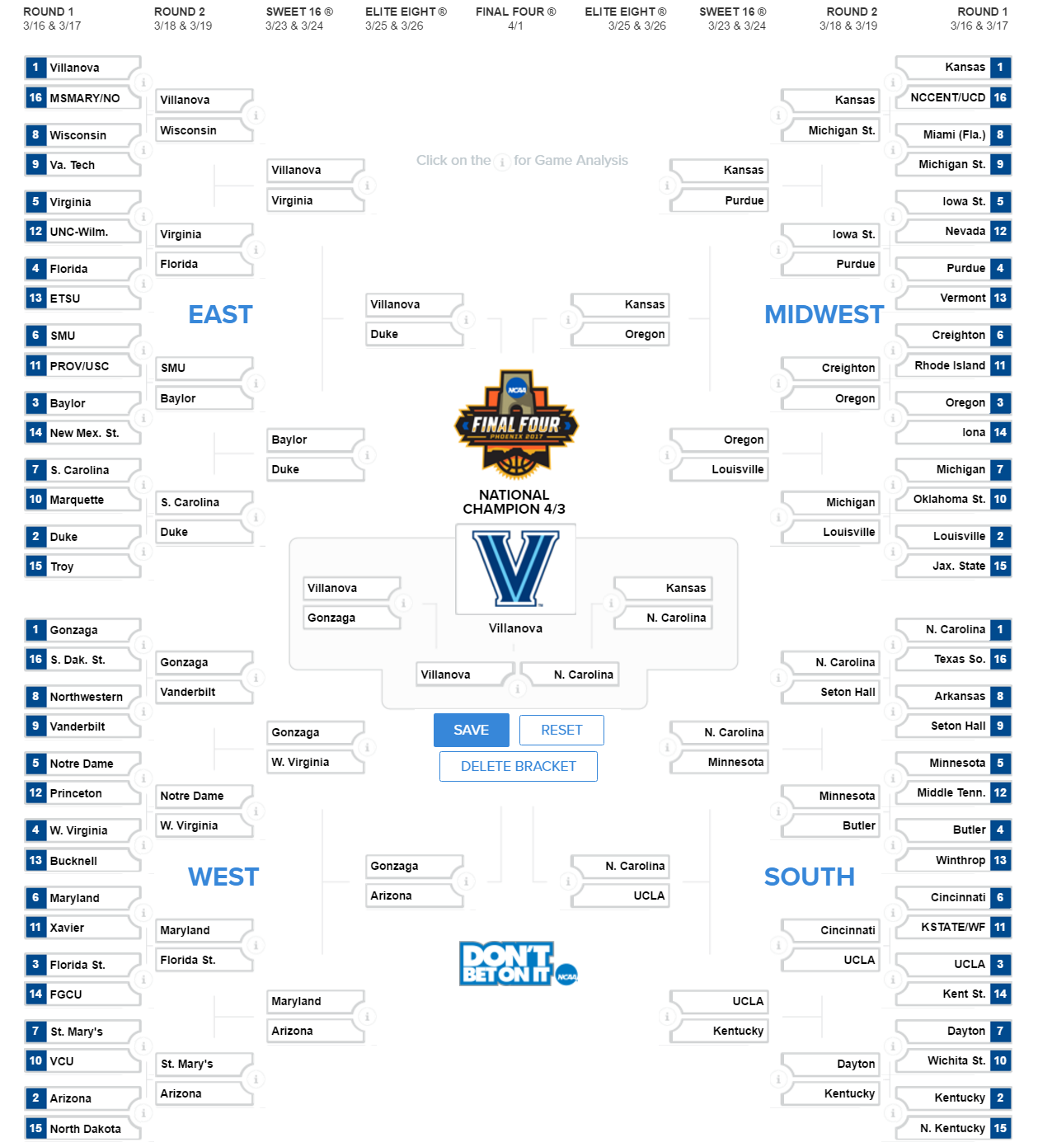
Extra Trees Classifier
Scikit-Learn Ensemble Library
Fits several different randomized decision trees
Improves accuracy through for prediction
Uses averaging to combat overfitting

Slide 13
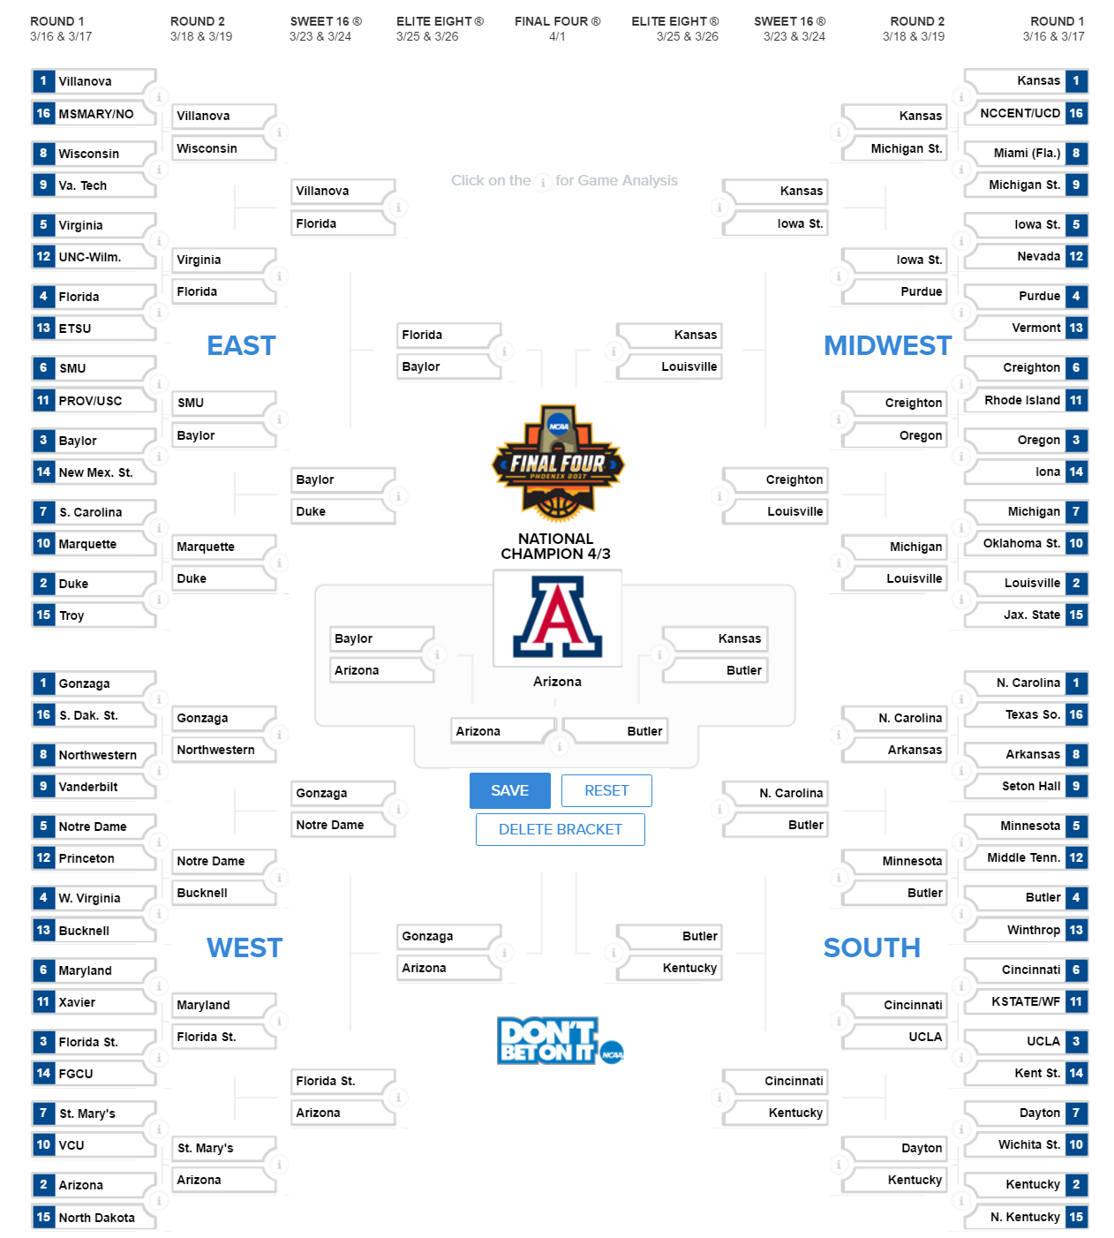
Logistic Regression
Logistic regression is a classifier in the scikit-learn linear model library
Uses training algorithm that compares one-vs-rest to determine a predicted outcome

Slide 14
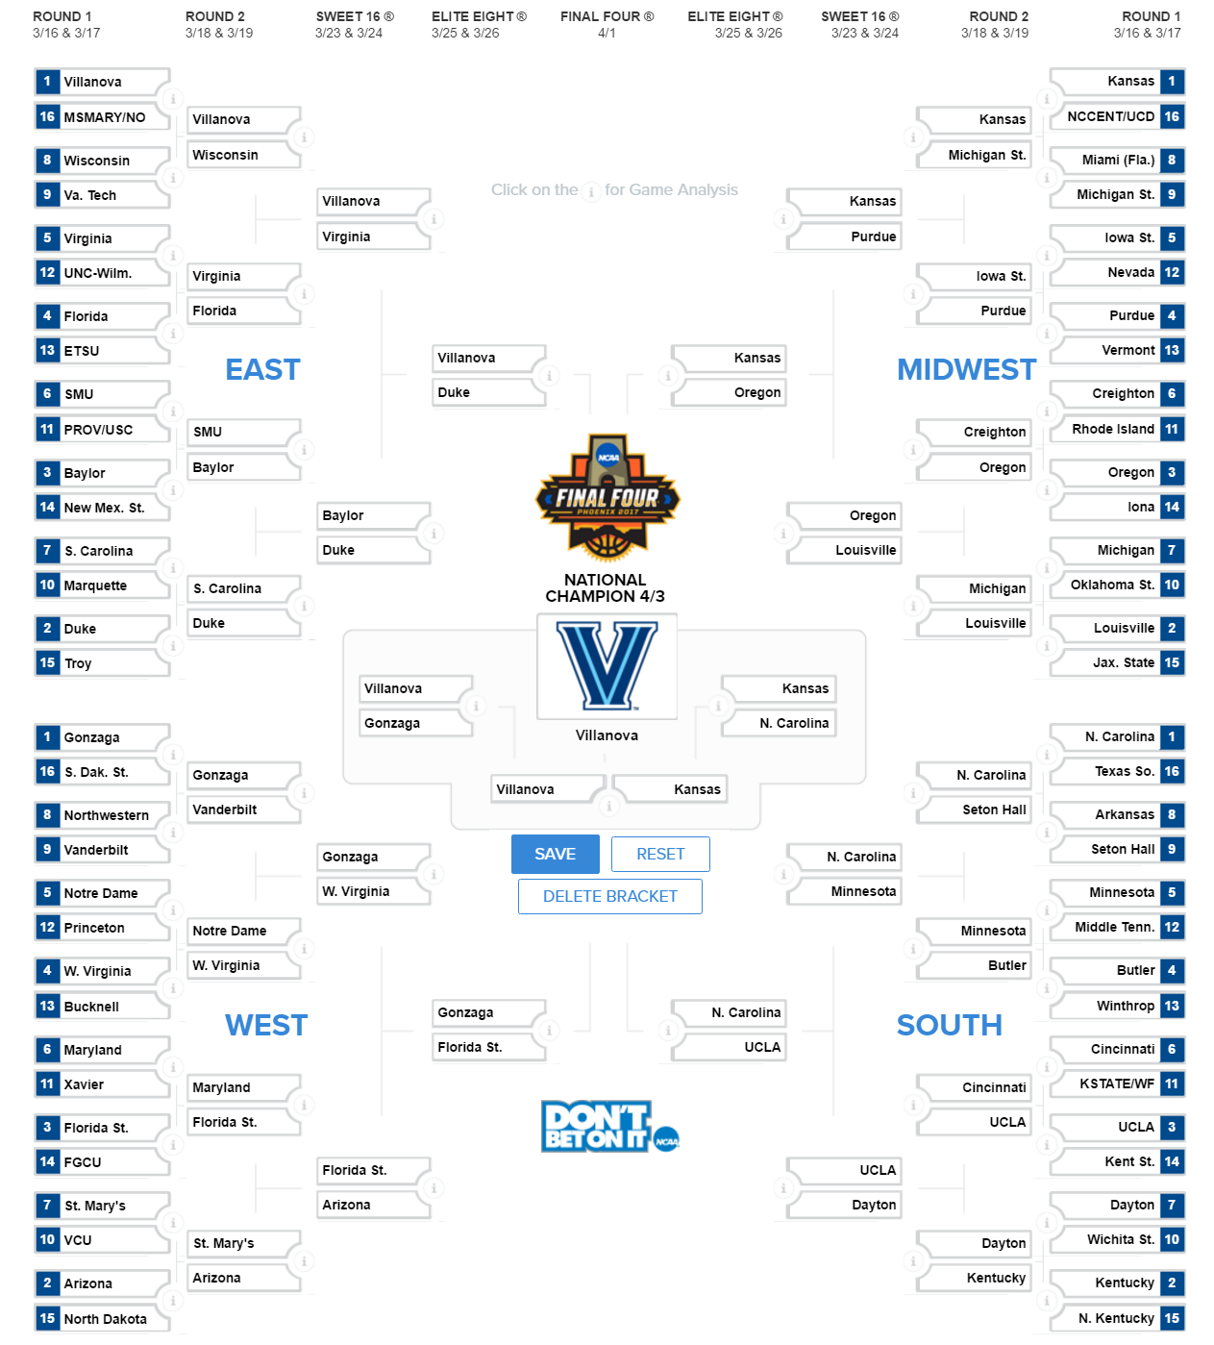
Deep Learning: Keras with TensorFlow
TensorFlow is an open source library for numerical computation
Keras runs on top of TensorFlow to run deep learning models which can be used as classification or regression estimators in scikit-learn

Slide 15
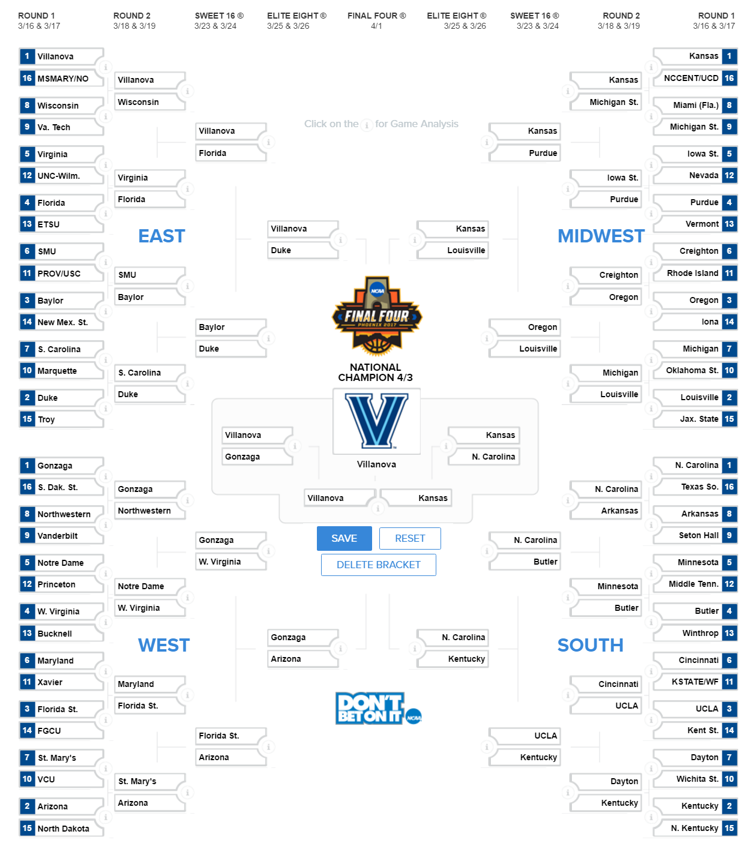
Random Forest
A meta-estimator in the scikit-learn ensemble library
Fits several decision tree classifiers on sub-samples of the data
Uses averaging to improve predictive accuracy and helps to control over-fitting

Slide 16
Support Vector Machine
Set of supervised learning methods used for classification, regression and outliers’ detection
Use subset of training points in the decision function (support vectors)
SVMs do not directly provide probability estimates
they are calculated using five-fold cross-validation which takes a lot of time
Our SVM model did not converge

Slide 17
Results
Algorithm | Log Loss
Extra Trees Classifier | 0.317722
Random Forest Classifier | 0.553033
Logistic Regression | 0.583911
Deep Learning: Keras with TensorFlow | 0.585499
Support Vector Machine | N/A

Slide 18
Conclusion
Kaggle competition closes tomorrow (3/16/2017) - the team is still submitting algorithms to the competition
Kaggle allows only two final submissions of our choice for the competition
Although Extra Trees Classifier was our best model for predicting previous year’s outcomes, we have to wait and see how the games play out this year to determine our best output model
The logistic regression model submitted has more ability to handle randomness; therefore it may be more general and robust, even though it scored worse in previous year outcomes

Slide 19
Conclusion (cont.)
This is a difficult problem to predict due to possible game upsets. Our models with higher accuracies tend to choose the higher seeded team to win almost every time, resulting in all number 1 seeds in the Final Four
Odds of a perfect bracket are 1 in 9.2 quintillion

Slide 20
Recommended Next steps
More feature engineering
Model was not robust enough with current feature engineering.
More features are needed. Examples include: Total wins/losses this season, record against opposing team, home/away/neutral court.
Decrease overfitting
Overfitting occurred in some of the models
Test more algorithms
Test more hyper-parameters

Slide 21
References
Kaggle. (2017). March Machine Learning Mania 2017. [Online]. Available: https://www.kaggle.com/c/march-machine-learning-mania-2017
Scikit-learn Developers. (2017, February 24). [Online]. Available: http://scikit-learn.org/
J. Forsyth and A. Wilde, “A Machine Learning Approach to March Madness”, 2014.
Hao Ji et al. “March Madness Prediction: A Matrix Completion Approach”, Old Dominion University.
Forbes. (2017, February 28). Warren Buffett’s 2017 March Madness Bracket Contest: $1 Million A Year For Life. [Online]. Available: https://www.forbes.com/sites/kurtbadenhausen/2017/02/28/warren-buffets-2017-march-madness-bracket-contest-1-million-a-year-for-life/#1c9841b2fad7tt

Slide 22
Questions?

Slide 23
Back Up Slides

Slide 24
Log Loss function
Negative log-likelihood of the true labels given a probabilistic classifier’s prediction.
Function used to score the algorithm.
Used in classification problems in machine learning and mathematical optimization

Slide 25
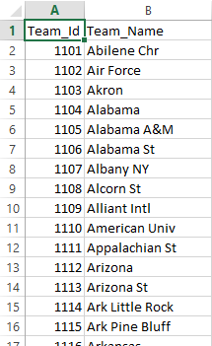
Teams.csv Screen Shot

Slide 26
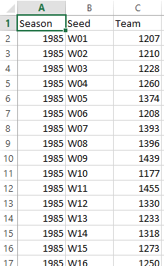
TourneySeeds.csv Screen Shot

Slide 27
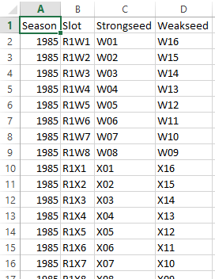
TourneySlots.csv Screen Shot

Slide 28
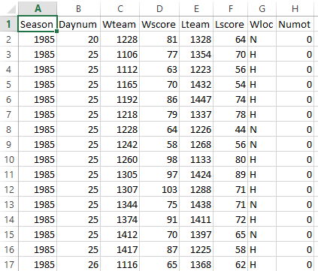
RegularSeasonCompactResults.csv Screen Shot

Slide 29
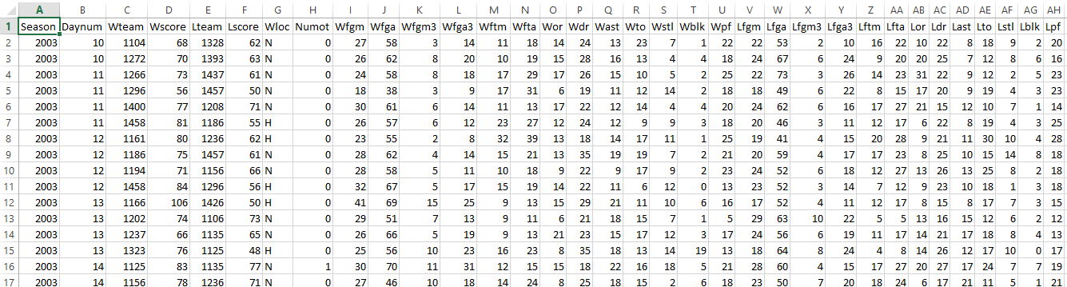
RegularSeasonDetailedResults.csv Screen Shot

Slide 30
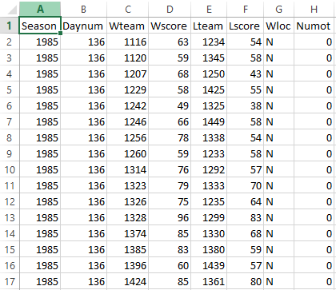
TourneyCompactResults.csv Screen Shot

Slide 31
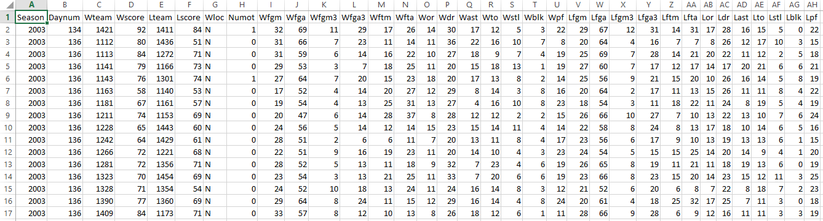
TourneyDetailedResults.csv Screen Shot

Slide 32
Bagging Classifier
Bagging Classifier is a Scikit-learn ensemble classifier
Summation process takes place by voting or averaging across the base classifier (KNeighbors)
Implemented with KNeighborsClassifier
KNeighborsClassifier - Scikit-learn neighbors classifier
Takes the k nearest neighbors’ votes into account to decide how to implement the node

Slide 33
Bagging Results
Bagging Classifier
Log loss: 0.557002

