Slide 1
Tabu Search scheduling algorithm
By Heansuh lee

Slide 2
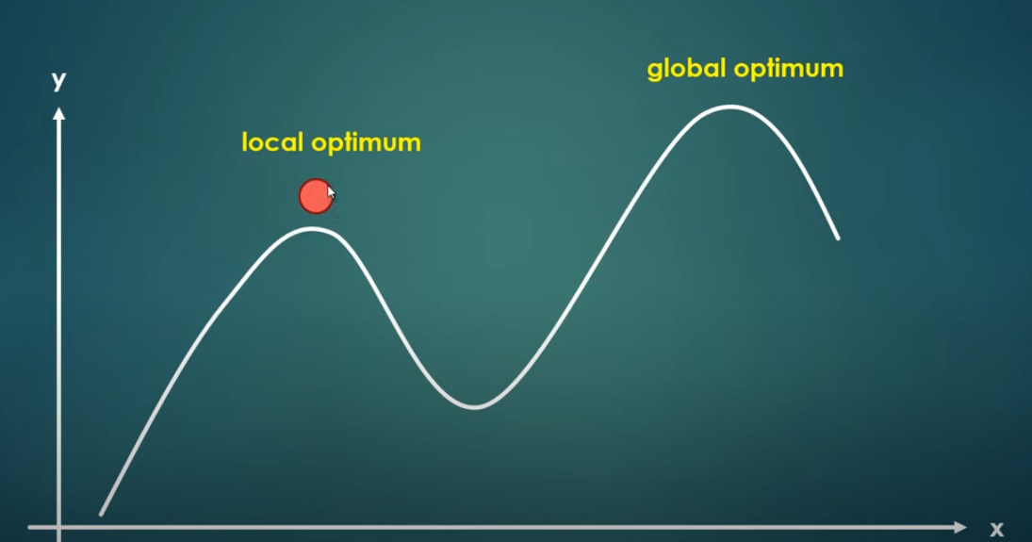
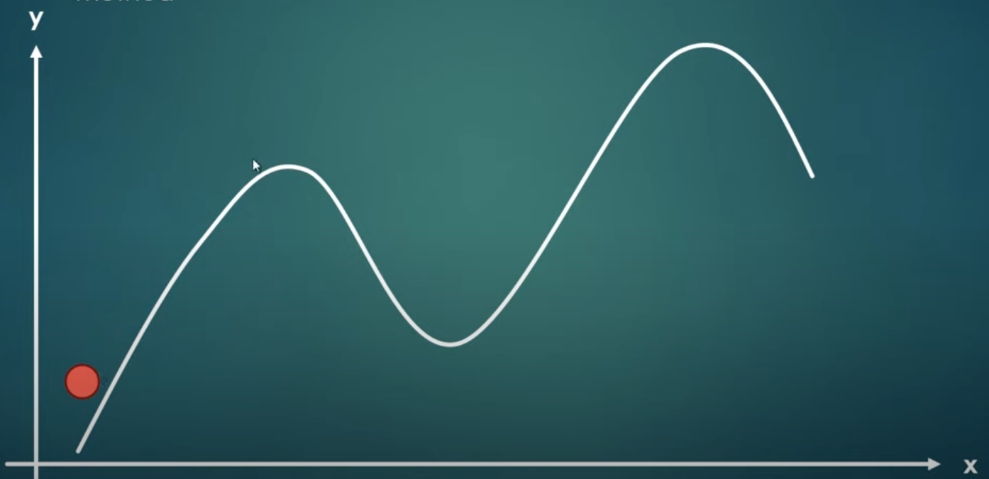
Motivation
[1]
[1] https://www.youtube.com/watch?v=tIDhFPhrCbU

Slide 3
Agenda
What is Tabu Search Scheduling algorithm?
Travelling Salesman Problem (TSP)
Relation to High Level Synthesis (HLS) and HW/SW codesign
Implementation in Python

Slide 4
TABU SEARCH SCHEDULING ALGORITHM
Tabu search is a metaheuristic algorithm for combinatorial optimization problems → efficiently explore and optimize complex combinatorial problems
Introduced by Fred W. Glover [2]
Inspired by the concept of "tabu" (taboo) in game theory, which restricts certain actions
Utilizes a "tabu list" memory structure to guide the search process and avoid local optima
Aim: Find an optimal or near-optimal schedule for tasks/jobs with constraints and objectives
Iteratively explores the search space, moving between solutions
Objective: Improve the objective function value (e.g., minimize makespan or completion time)

Slide 5
Strategies
3 main strategies [3]:
Forbidding strategy: control what enters the tabu list
Freeing strategy: control what exits the tabu list and when
Short-term strategy: manage interplay between the forbidding strategy and freeing strategy to select trial solutions

Slide 6
Concept & terminology
Tabu: a chief way to exploit memory in tabu search is to classify a subset of the moves in a neighborhood as forbidden [4] – forbidding strategy
Neighbourhood: constructed to identify adjacent solutions that can be reached from current solution [5]
The classification depends on the history of the search, and particularly on the recency or frequency that certain move or solution components, called attributes, have participated in generating past solutions [4]

Slide 7
Concept & terminology
Tabu list: records forbidden moves, which are referred to as tabu moves [6].
Aspiration criterion: tabu restrictions are subject to an important exception → When a tabu move has a sufficiently attractive evaluation where it would result in a solution better than any visited so far, then its tabu classification may be overridden → A condition that allows such an override to occur is called an aspiration criterion [4] – freeing strategy
Tabu tenure: when a move is made, tabu is added to tabu list with a certain value, and this value is “tabu tenure” → with each iteration, the tabu is decremented by 1 → when the tabu tenure of a certain move in 0 → the certain move can be accepted

Slide 8
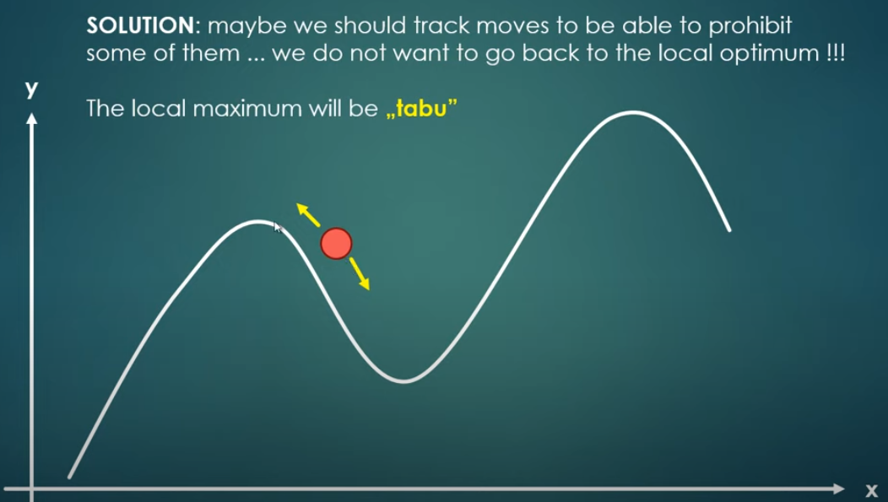
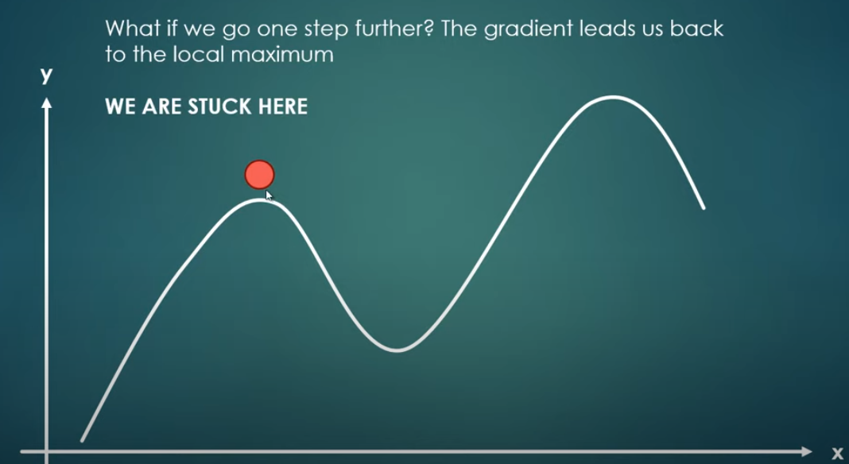
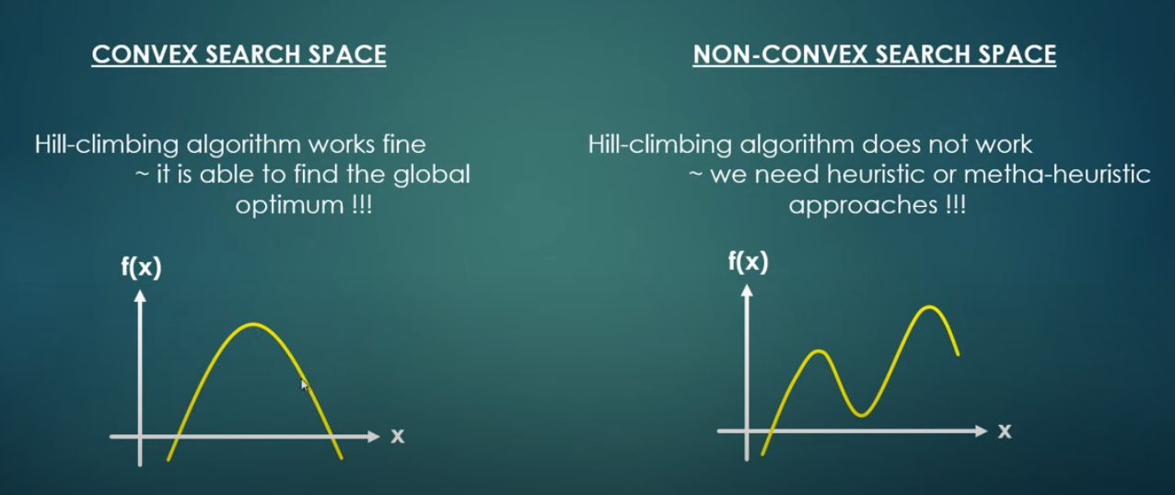
[1]
[1] https://www.youtube.com/watch?v=tIDhFPhrCbU

Slide 9
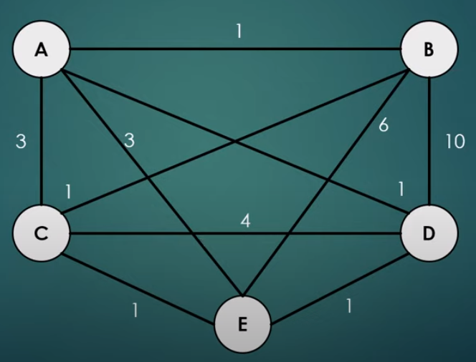
Travelling Salesman Problem (TSP)
[7]
[7] https://www.youtube.com/watch?v=saNk8h2KuVE

Slide 10
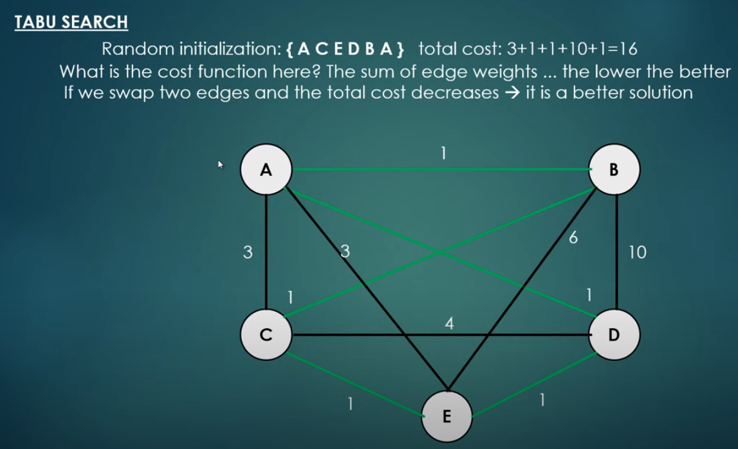
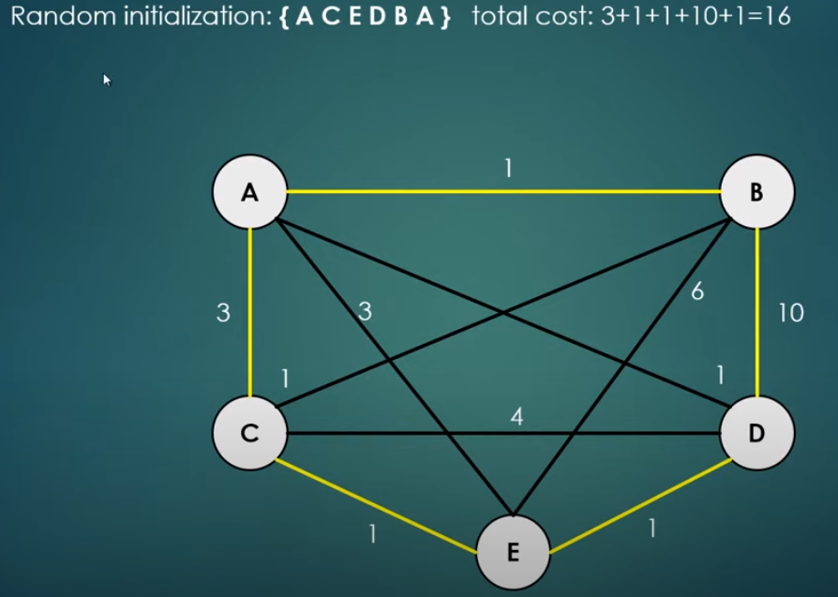
[7]
[7] https://www.youtube.com/watch?v=saNk8h2KuVE

Slide 11
Relation to high level synthesis (HLS) [8]
Used in high-level synthesis (HLS) for optimizing task allocation in hardware designs
HLS transforms high-level descriptions (HLD) (e.g. written in C/C++) into hardware implementations
Tabu search helps determine optimal or near-optimal task allocation to hardware resources
Considers constraints such as resource availability, timing, and power consumption
Tabu search explores different task allocations to optimize performance metrics like latency, throughput, and area

Slide 12
Relation to HW/SW Codesign [8]
Codesign involves designing systems with both hardware and software components
Tabu search aids in allocating tasks between hardware and software components
Considers capabilities and constraints of each component
Optimizes system performance by balancing task allocation and scheduling decisions
Considers factors such as execution time, resource utilization, power consumption, and communication overhead

Slide 13
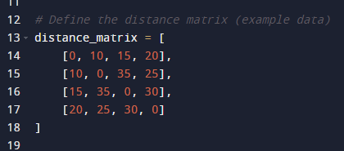
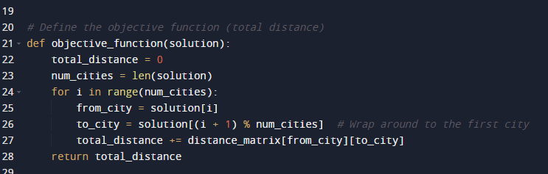
Implementation in python
[9] https://towardsdatascience.com/tabu-search-simply-explained-ee2852339d78
Notes:
The distance_matrix (lines 11-16) represents the distances between each pair of cities. The value at distance_matrix[i][j] is the distance from city i to city j. The diagonal of the matrix is all zeros because the distance from a city to itself is zero.
The objective_function (lines 19-26) calculates the total distance of a solution (a specific order of visiting the cities). It loops over each city in the solution, adds the distance from the current city to the next city to the total distance, and finally returns the total distance.
The generate_neighborhood function (lines 29-37) generates all possible solutions that can be reached by swapping two cities in the current solution. These solutions are called the "neighborhood" of the current solution.
The main loop of the algorithm (lines 47-85) performs the tabu search. In each iteration, it generates the neighborhood of the current solution, evaluates each neighbor using the objective function, and selects the best neighbor that is not in the tabu list as the new solution. If all neighbors are in the tabu list, it clears the tabu list and generates a new random solution.
The "Solution" printed in each iteration (e.g., [0, 1, 3, 2]) represents the order of visiting the cities. In this example, the salesman first visits city 0, then city 1, then city 3, and finally city 2. The "Best value" is the total distance of this route. The "Final Best Solution" and "Best Value" printed at the end are the best solution and its total distance found during all iterations.

Slide 14
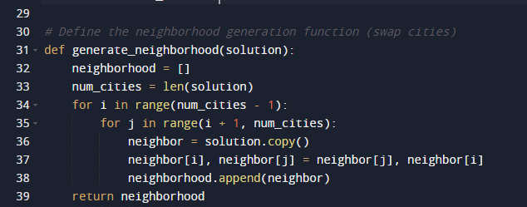
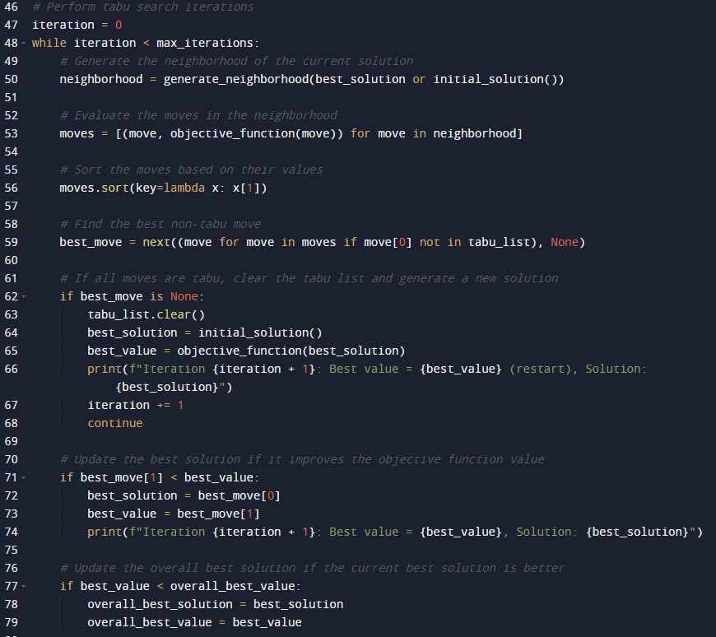
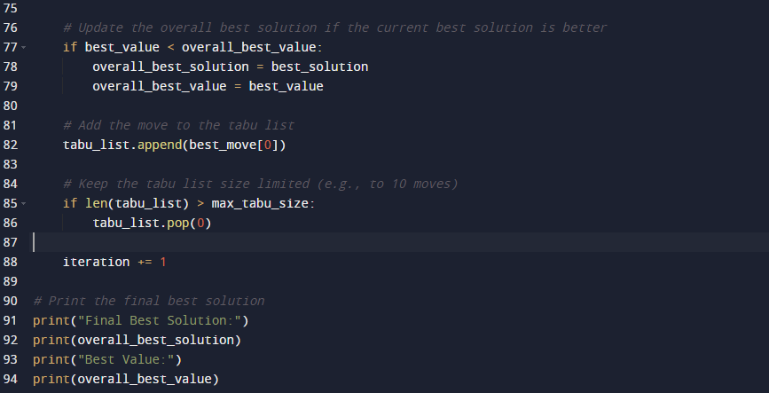
Implementation in python
[9] https://towardsdatascience.com/tabu-search-simply-explained-ee2852339d78
Notes:
The distance_matrix (lines 11-16) represents the distances between each pair of cities. The value at distance_matrix[i][j] is the distance from city i to city j. The diagonal of the matrix is all zeros because the distance from a city to itself is zero.
The objective_function (lines 19-26) calculates the total distance of a solution (a specific order of visiting the cities). It loops over each city in the solution, adds the distance from the current city to the next city to the total distance, and finally returns the total distance.
The generate_neighborhood function (lines 29-37) generates all possible solutions that can be reached by swapping two cities in the current solution. These solutions are called the "neighborhood" of the current solution.
The main loop of the algorithm (lines 47-85) performs the tabu search. In each iteration, it generates the neighborhood of the current solution, evaluates each neighbor using the objective function, and selects the best neighbor that is not in the tabu list as the new solution. If all neighbors are in the tabu list, it clears the tabu list and generates a new random solution.
The "Solution" printed in each iteration (e.g., [0, 1, 3, 2]) represents the order of visiting the cities. In this example, the salesman first visits city 0, then city 1, then city 3, and finally city 2. The "Best value" is the total distance of this route. The "Final Best Solution" and "Best Value" printed at the end are the best solution and its total distance found during all iterations.

Slide 15
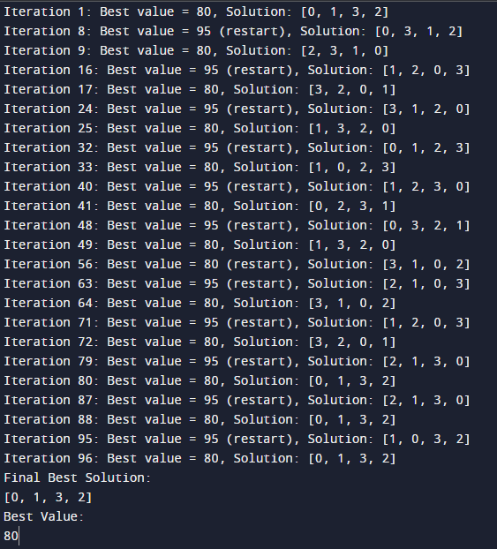
Implementation in python
[9] https://towardsdatascience.com/tabu-search-simply-explained-ee2852339d78
Notes:
The distance_matrix (lines 11-16) represents the distances between each pair of cities. The value at distance_matrix[i][j] is the distance from city i to city j. The diagonal of the matrix is all zeros because the distance from a city to itself is zero.
The objective_function (lines 19-26) calculates the total distance of a solution (a specific order of visiting the cities). It loops over each city in the solution, adds the distance from the current city to the next city to the total distance, and finally returns the total distance.
The generate_neighborhood function (lines 29-37) generates all possible solutions that can be reached by swapping two cities in the current solution. These solutions are called the "neighborhood" of the current solution.
The main loop of the algorithm (lines 47-85) performs the tabu search. In each iteration, it generates the neighborhood of the current solution, evaluates each neighbor using the objective function, and selects the best neighbor that is not in the tabu list as the new solution. If all neighbors are in the tabu list, it clears the tabu list and generates a new random solution.
The "Solution" printed in each iteration (e.g., [0, 1, 3, 2]) represents the order of visiting the cities. In this example, the salesman first visits city 0, then city 1, then city 3, and finally city 2. The "Best value" is the total distance of this route. The "Final Best Solution" and "Best Value" printed at the end are the best solution and its total distance found during all iterations.

Slide 16
Applications of tabu search scheduling [10]
Job Shop Scheduling
In industries where multiple jobs need to be processed on different machines in a specific order
helps in determining the sequence of jobs on each machine and the start time for each job, with the goal of minimizing the total completion time, reducing job tardiness, or balancing the workload across machines
increased efficiency, reduced production time, and improved on-time delivery performance.
Vehicle Routing Problem (VRP)
Logistics and transportation for optimizing vehicle routes
Helps in determining the most efficient routes for a fleet of vehicles to deliver goods to a set of locations, minimizing total distance or cost.
Network Design
Design and optimize the layout of telecommunications networks
It helps in determining the optimal locations for routers and servers, the routing of signals, and other decisions to minimize costs and maximize network performance

Slide 17
[1] 073 Tabu search introduction | Computer Monk. 2023. https://www.youtube.com/watch?v=tIDhFPhrCbU&
[2] Glover, F. 1986. Future Paths for Integer Programming and Links to Artificial Intelligence. Computers and Operations Research. Vol. 13, pp. 533-549.
[3] Pham, D.T. and Karaboga, D. 2000. Intelligent Optimisation Techniques – Genetic Algorithms, Tabu Search, Simulated Annealing and Neural Networks. London: Springer-Verlag.
[4] Glover, F., Kelly, J. P., and Laguna, M. 1995. Genetic Algorithms and Tabu Search: Hybrids for Optimization. Computers and Operations Research. Vol. 22, No. 1, pp. 111 – 134.
[5] Reeves, C.R. 1993. Modern Heuristic Techniques for Combinatorial Problems. John Wiley & Sons, Inc.
[6] Hillier, F.S. and Lieberman, G.J. 2005. Introduction to Operations Research. New York, NY: McGraw-Hill. 8th Ed.
[7] 074 Tabu search introduction II | Computer Monk. 2023. https://www.youtube.com/watch?v=saNk8h2KuVE
[8] Ji, M. and Tang, H. 2004. Global Optimizations and Tabu Search Based on Memory. Applied Mathematics and Computation. Vol. 159, pp. 449 – 457.
[9] https://towardsdatascience.com/tabu-search-simply-explained-ee2852339d78
[10] Gendreau, M., & Potvin, J. Y. (2010). Handbook of Metaheuristics (2nd ed.). Springer. (This book provides a comprehensive overview of different metaheuristic algorithms, including Tabu Search.)

