Slide 1
Facial Recognition
Presenter: Alan Heanue
Supervisor: Dr Martin Kenirons
Module: Research Methods | Nov. 7th 2017

Slide 2
Overview
Social Media
What is Facial Recognition
Conclusion
&
Questions
History & Methods

Slide 3
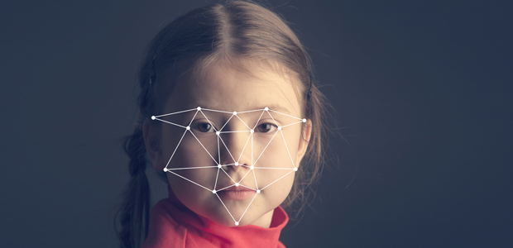
What is Facial Recognition ?
Detection & Recognition
Biometrics
Normalization
Recognizing Patterns
Nodal points
Bunch graph
Face Print

Slide 4
Facial Recognition
There are two types of Comparisons
Verification :
The system compares the given individual who they say they are and given a yes or no decision.
Identification :
The system compares the given individual to all other individuals in the database and gives a ranked list of matches.
All Identifications and authentication technologies operate using the same four stages
Capture
Extraction
Comparison
Match or no match
Accept

Slide 5
Facial recognition timeline
SOCIAL MEDIA & SECURITY
EIGENFACES
Sirovich and Kirby began with applying linear algebra to the problem. It was a low dimensional representation of FR.
MANUAL MEASUREMENTS
The Father of Facial Recognition Woodrow Wilson Bledsoe Using coordinates and electronic pulses .(RAND TABLET)
2010- now
Late 90s
1970s
1960s
Late 1980s early 90s
Increased Accuracy 21 Facial Markers
Goldstein, Harmon and Lesk added more markers, hair color and lip thickness.
NEURAL NETWORK
Super Bowl (2002)
Vendor tests
L
Notes:
https://www.facefirst.com/blog/brief-history-of-face-recognition-software/

Slide 6
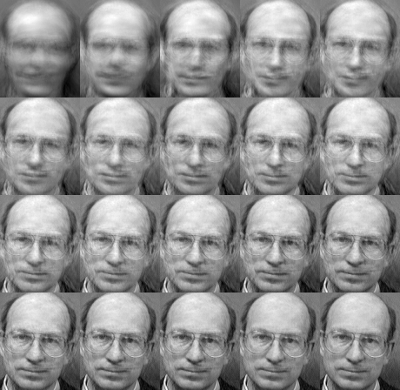
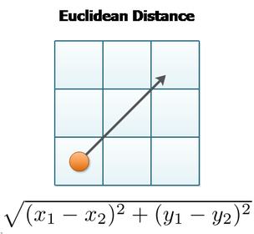
EigenFaces Overview
Principal component Analysis(PCA) is generally referred to as the use of Eigenface.
Uses PCA to reduce high-dimensionality 2D image into a smaller set of directions with largest variances. Eg. images 92x112pixels=10304 dimensions of image space (breaks down to 300 subset)
Advantages: smaller and simple search space. DisAdvantages: PCA searches greatest variances in the data which may sometimes be caused by lighting & illumination or objects

Slide 7
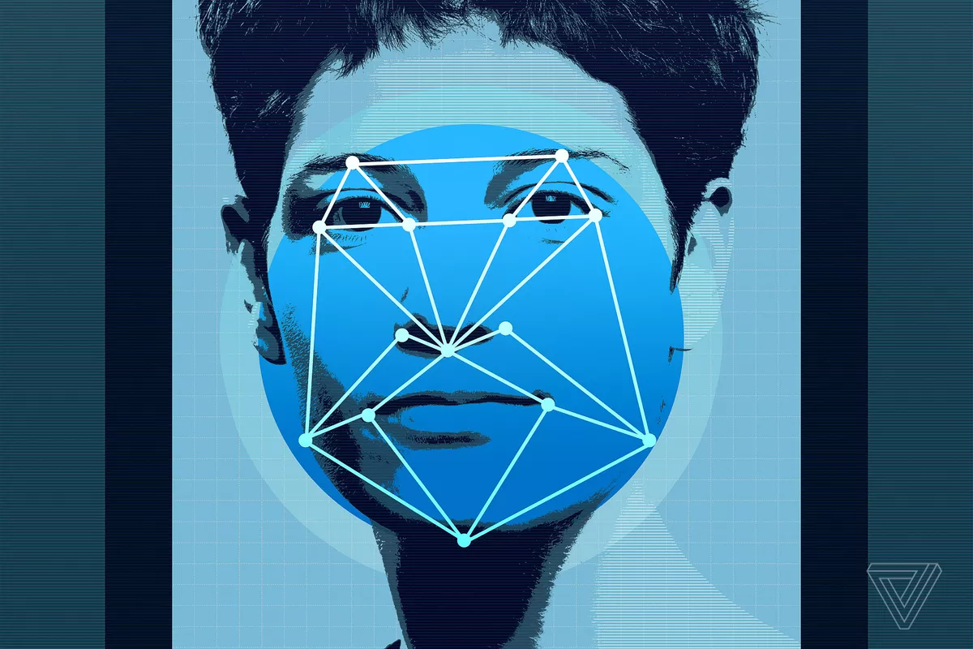
Other Algorithms
FisherFaces Algorithm
Neural networks
Binary Pattern Histograms
Describes local features of an object
2D texture Analysis each pixel is compared against its neighbour to create a pattern

Slide 8

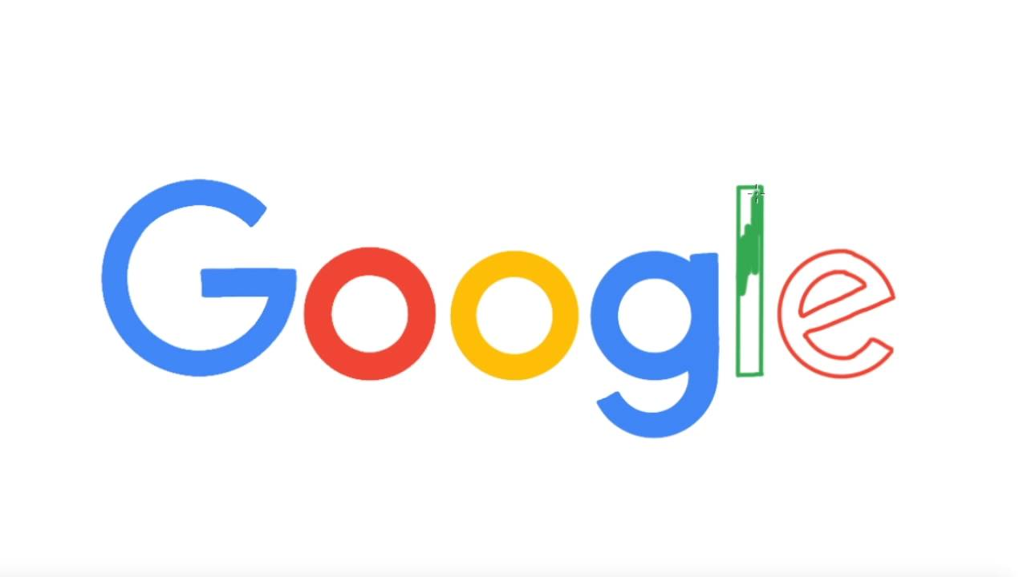


Social Media
DeepFace 97% acc
3d Model
Neural Networks
Datasets
Google Photos
Opensource
Google Glass
FaceNet 86% acc
73.45%
Quick search
Good Accuracy
Not private

Slide 9



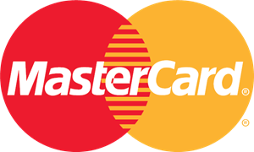
What's coming & Conclusion

Slide 10
References
http://fortune.com/2015/03/17/google-facenet-artificial-intelligence/
https://www.google.com/url?q=https://www.cs.toronto.edu/~ranzato/publications/taigman_cvpr14.pdf&sa=D&ust=1509625663642000&usg=AFQjCNFW2mq8wgHhuWr0tUkUaA6NMxN_og
https://www.google.com/url?q=http://www.vcl.fer.hr/papers_pdf/Appearance-based%2520Statistical%2520Methods%2520for%2520Face%2520Recognition.pdf&sa=D&ust=1509625663644000&usg=AFQjCNH-WI9ldjJsCxO4VHgfMlTpKcDeLA
https://www.researchgate.net/publication/233864740_Face_Recognition_A_Literature_Review
https://www.cs.toronto.edu/~ranzato/publications/taigman_cvpr14.pdf

Slide 11

QUESTIONS ???
Thank you

