Slide 1

HeApp
Health Platform For Everyone

Slide 2

Mission: Efficient communication between caregiver and patient

Slide 3
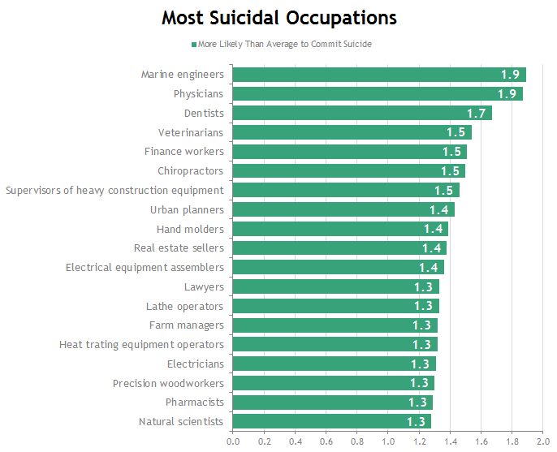
Problem
tight agenda for caregivers
high risk for burn-out and suicide
source: https://www.researchgate.net/post/Medscape_National_Physician_Burnout_Depression_Suicide_Report_2019_a_point_to_ponder
20XX | 20XX | 20XX | 20XX
Notes:
delays because calls during consultations

Slide 4

Solution
Less phone calls
Centralize communication
Request prescriptions
Chatbot interaction
Notes:
demotivating patients to use app when not urgent
prescriptions lost or renewal with doctors approval, request via app

Slide 5
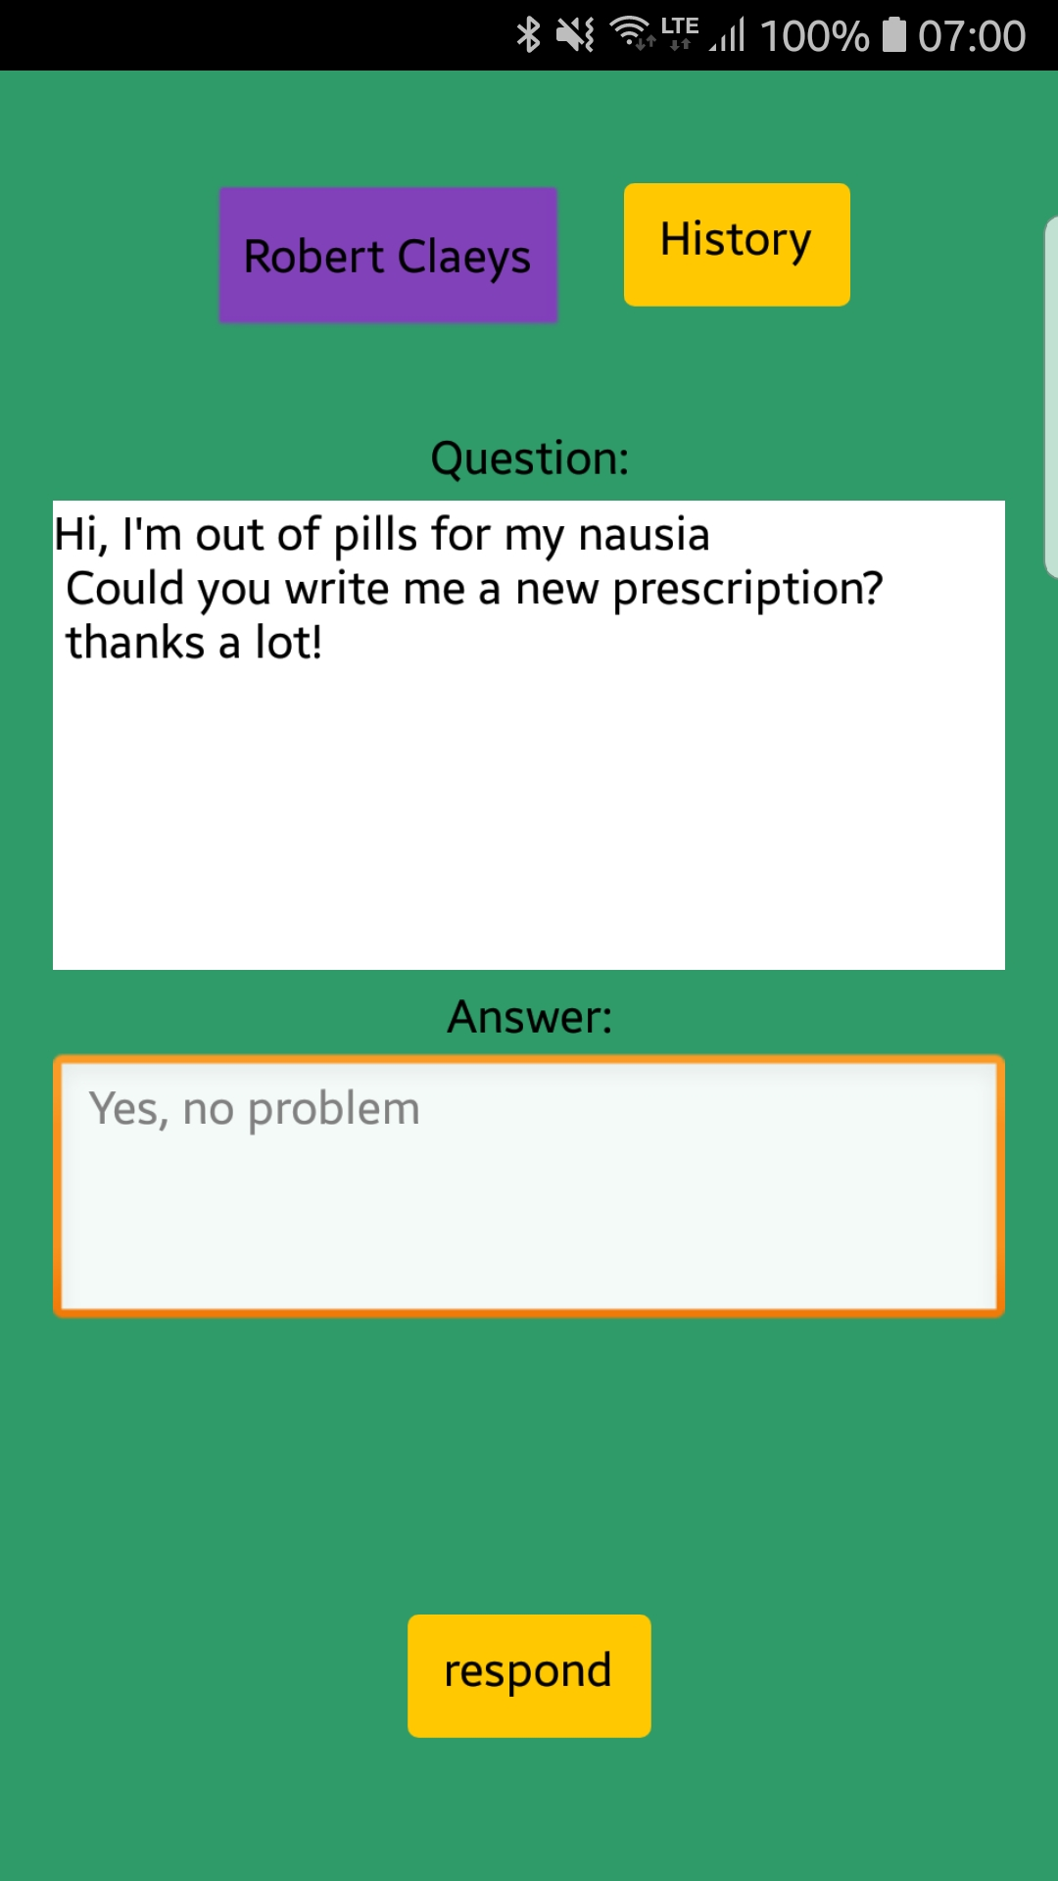
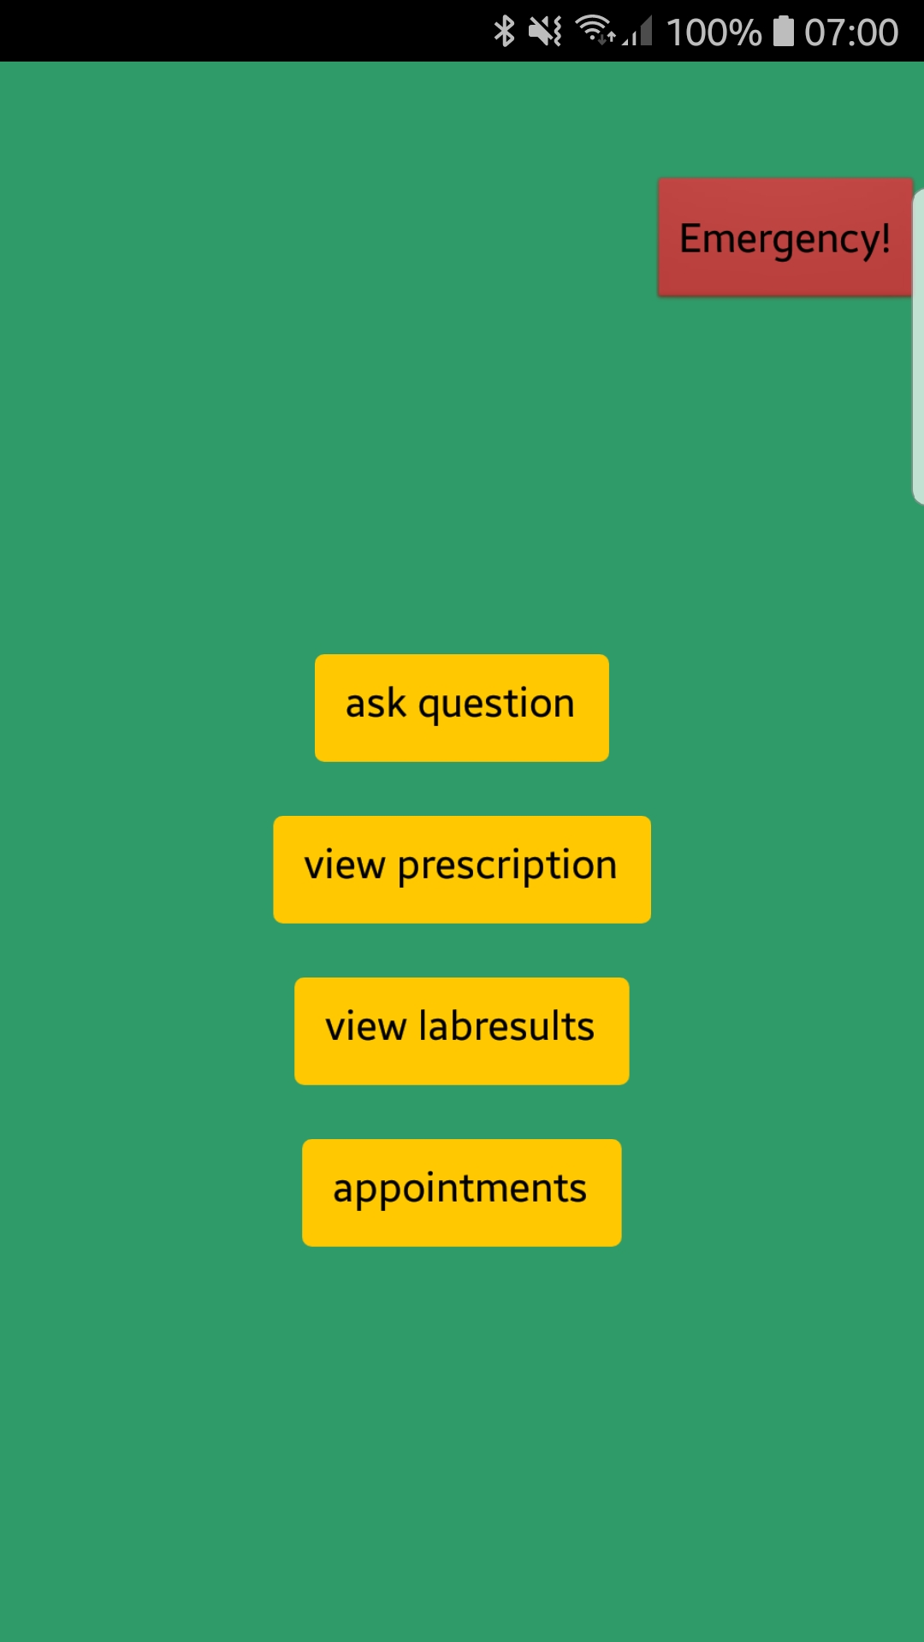

How it works:
Patient
Want to see a demo video?
Also check out heapp.carrd.co!

Slide 6
Used technologies
Webserver
Node.js backend
RESTful API
MongoDB
Client
Native mobile app
Universal web app
Other tools
VoIP
App Inventor for mockups

Slide 7
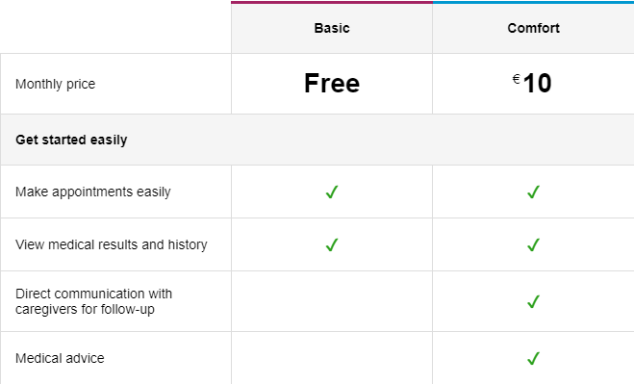
Business model
Patient
HeApp
Caregiver
Estimated development cost: €100K
Caregiver receives compensation for medical advice
Notes:
make customers familiar with app via free tier caregiver fixed entry cost

Slide 8
WhatTheHack: HealthTech
Team #3:
De Boever Rob
Onderbeke Sven
Martens Ward
Tielemans Jorim
Vanspauwen Laura

