Slide 1
One Way Functions

Slide 2
Alice and Bob

Slide 3


Slide 4

Alice: I solved it!

Slide 5
Bob: Prove it!
Alice and Bob
Compete on Crosswords

Slide 6
Bob: Tell me the answer to 87

Slide 7
Alice knows the answer but does not want to give it away

Slide 8
How does Alice prove she knows the solution without giving it away?

Slide 9
Alice proposes the following
Lets assume the word is “FOLIO”

Slide 10
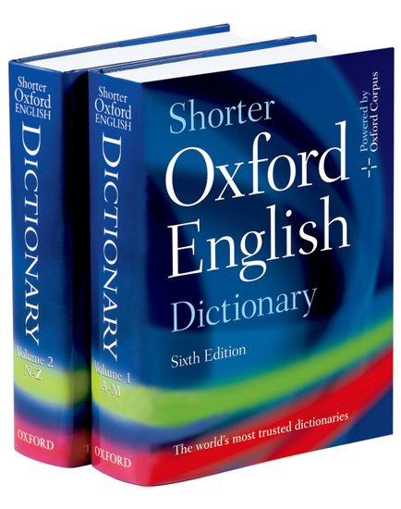

Slide 11
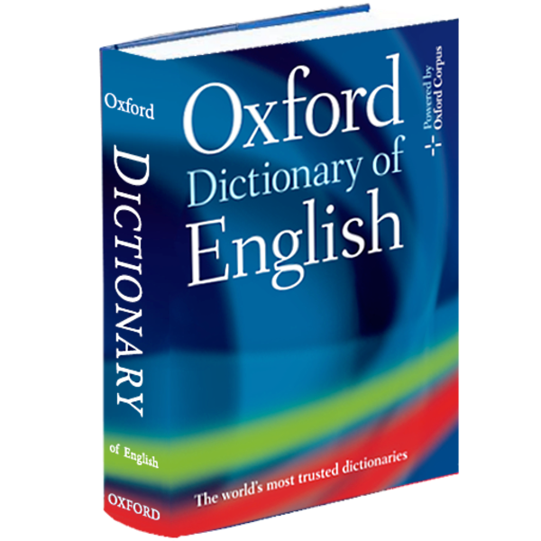
1st word
FOLIO
An individual leaf of paper or parchment …
2nd word
A single human being …
3rd word
Relating to or characteristic of people …
4th word
Used to link alternatives ...
5th word
One of two or more available possibilities

Slide 12
Alice tells Bob the word “MORE”

Slide 13
3rd word
Ample
enough or more than enough; plentiful.

Slide 14
Alice and Bob
Another Example

Slide 15

Boston
Phonebook
Boston
Phonebook

Slide 16
Foley, Valery → 617-253-8859
Olsen, Barry → 617-894-5248
Larson, Anne → 798-577-9833
Ingalls, Olivia → 578-621-5622
Obrien, Mark → 857-299-1147
FOLIO
617-253-8859617-894-5248578-621-5622857-299-1147

