Slide 1
1.125 – Software Engineering and Architecting
Lectures 2-3
JavaScript and the Dynamic Web

Slide 2
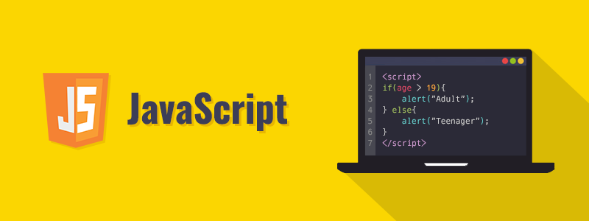
JavaScript
Created in 1995 to allow non-programmers to program in the web
Brendan Eich at Netscape was given 10 days to create a new language
JavaScript and Java have nothing in common*
JavaScript is a scripting language
Weakly typed
Notes:
Java was the king of all server-side development back in the 90’s.
At Netscape they wanted to have an alternative language to be more lightweight alternative.
Eich was given the task of making a new language in 10 days.
Originally this was called lightscript, but since there was an upcoming merger with Sun Microsystems (developer of Java) they called it JavaScript so that it would be the scripting, web language for Sun Microsystems.
The opensource language is actually ECMAscript, JavaScript is based on this as are all of the decendants.

Slide 3





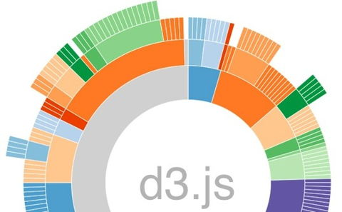


JavaScript - Frameworks
Notes:
https://insights.stackoverflow.com/survey/2018#technology Shows the demand for JavaScript and the amount of people working with it
Also look at these website and go over what they do and link to JS as a language being able to unlock all of these abilities

Slide 4
JavaScript
Introduction to basics of JavaScript programming
Variables
Types of variables in JS
Arrays
Simple arrays
Objects
Traversing Objects, creating them, using them
Functions
Definitions, scope
Callbacks
What are they, array callbacks

Slide 5
JavaScript in the Browser
Programming in the developer console
Controlling webpages with JavaScript

Slide 6
JavaScript in the Browser
Programming in the developer console
Controlling webpages with javascript
In class activity – Solve problems in the console by writing code using the html+script format
-------------------------End of Lecture----------------------------------------

Slide 7
Async
What is it and why is it
How does it work
JavaScript Asnyc, promises, async await

Slide 8
Putting it all together
HTML + JS + Asnyc

Slide 9
Second weeks homework overview

