Slide 1
Wednesday
Abel Sanchez

Slide 2
Data Collection
Collaborative Wall
Today’s question: What problems could patterns help solve in the real world?
Take photo at end of day
Document via photos & video
Document via photos & video with your phone. Specifically, try to capture times when learning is being demonstrated: the students giving explanations of their solutions, describing applications of algorithms, or presenting their projects. Upload to Dropbox, link to follow.

Slide 3
Create Teams – 10 mins
First activity of day
Create teams yourself
Other strategies for forming groups
http://www.supportrealteachers.org/techniques-for-forming-groups.html

Slide 4
Activity: Encoding information
5x5

Slide 5
Add extra row and column
Your Row
6x6
Your Column

Slide 6
Go outside – class changes one cell
Guess change

Slide 7
Make row/column sum even
Your Row
6x6
Your Column

Slide 8
Step out of the room, ask class to make change
Changed row/column no longer event
Your Row
Your Column

Slide 9
Activity – ask teams to demonstrate

Slide 10
Optional: ISBN verification
ISBN number verification
1101980133
= (1*10)+(1*9)+(0*8)+(1*7)+(9*6)+(8*5)+(0*4)+(1*3)+(3*2)
= 10+9+0+7+54+40+0+3+6
= 129
= 129/11
= 11 remainder 8
= 11-8
= 3

Slide 11
Search for number (20 mins) – unordered search
Make cards with numbers 1-to-15
- Shuffle cards
- Select 15 students from class
- Have them come up to the board
- Give a each student a shuffled card
- Ask each group to make a guess
- They are trying to find a number we selected
When done, ask teams what was their strategy

Slide 12
Search for number - Linear (20 mins)
- this time numbers are in order
- do not tell class numbers in order
When done, ask teams what was their strategy

Slide 13
Activity - minimum guesses to find a number between 1 and X
Given the numbers 1 to 1000, what is the minimum numbers guesses needed to find a specific number if you are given the hint "higher" or "lower" for each guess you make. Number of guesses to 10, 100, 1000, 10000
Solution
Log₂ 10 ≈ 3.3
Log₂ 100 ≈ 6.6
Log₂ 1000 ≈ 10
Log₂ 10000 ≈ 13.3
Log₂ 100000 ≈ 16.6
Log₂ 100000 ≈ 19.9

Slide 14
Ask groups to provide answers
Ask groups to explain their approach in coming up with a solution

Slide 15
Announce – Tomorrow strategies for sorting
Note difference in approaches depending on information structure

Slide 16
Cypher competitions

Slide 17
Cypher Activity – ask class to discover cypher (hash) function
Hash
Function
hello
52

Slide 18
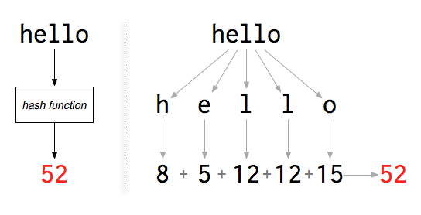
Hash
http://www.filosophy.org/post/8/what_is_a_password_anyway/

Slide 19
Cyphers activity
fachada bella, 6-1-3-8-1-4-1 2-5-12-12-1
mama bella, 13-1-13-1 2-5-12-12-1
medalla, 13-5-4-1-12-12-1
medicina bella, 13-5-4-9-3-9-14-1 2-5-12-12-1
angel, 1-14-7-5-12
camello, 3-1-13-5-12-12-15
cadena bella, 3-1-4-5-14-1 2-5-12-12-1
chile, 3-8-9-12-5
fabula, 6-1-2-21-12-1
hacienda bella, 8-1-3-9-5-14-4-1 2-5-12-12-1
anemia, 1-14-5-13-9-1
bella, 2-5-12-12-1

Slide 20
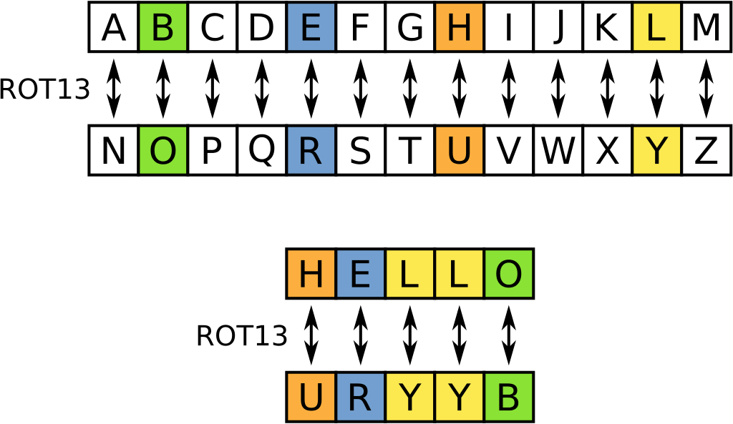

Slide 21
Cyphers Activity – ROT13
fachada bella, snpunqn oryyn
mama bella, znzn oryyn
Medalla, zrqnyyn
medicina bella, zrqnyyn
angel, natry
camello, pnzryyb
cadena bella, pnqran oryyn
chile, puvyr
fabula, snohyn
hacienda bella, unpvraqn oryyn
anemia, narzvn
bella, oryyn

Slide 22
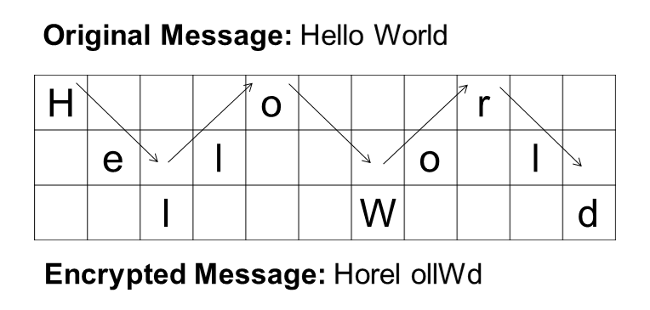
Rail fence cypher

Slide 23
Cyphers Activity – Rail Fence
fachadabella, faeahdblacal
mamabella, mbaaaelml
medalla, mlealda
medicinabella, mcbaeiiaeldnl
angel, alneg
camello, claelmo
cadenabella, cnlaeaeldba
chile, cehli
fabula, flauab
haciendabella, hebaainaelcdl
anemia, ainmae
bella, baell

Slide 24
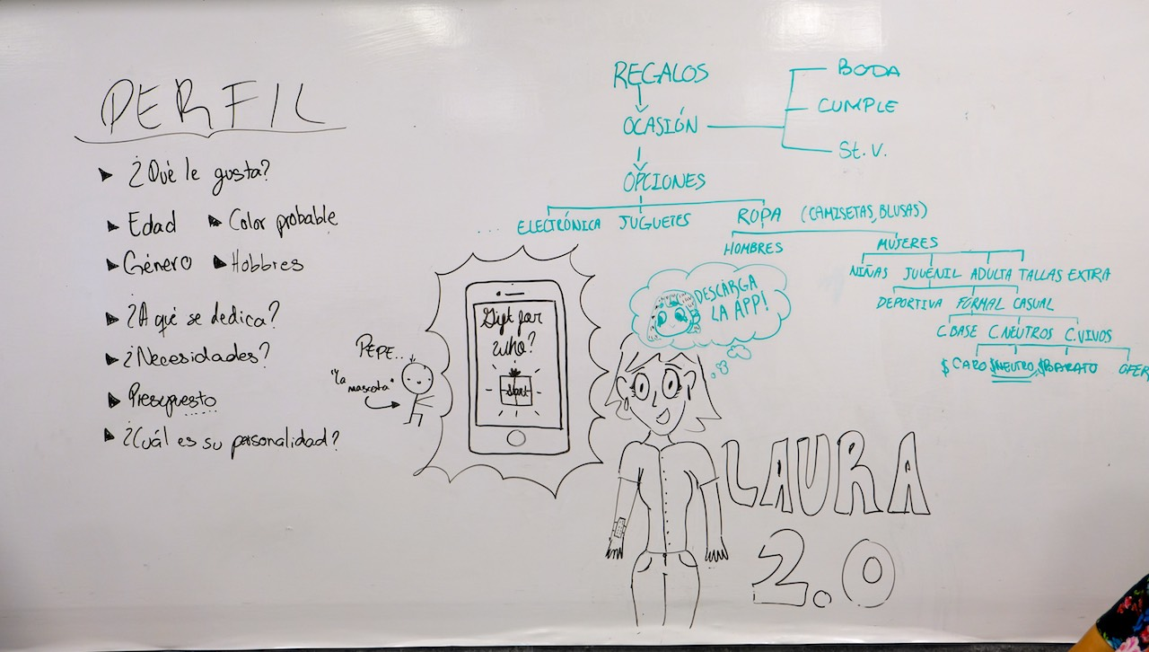
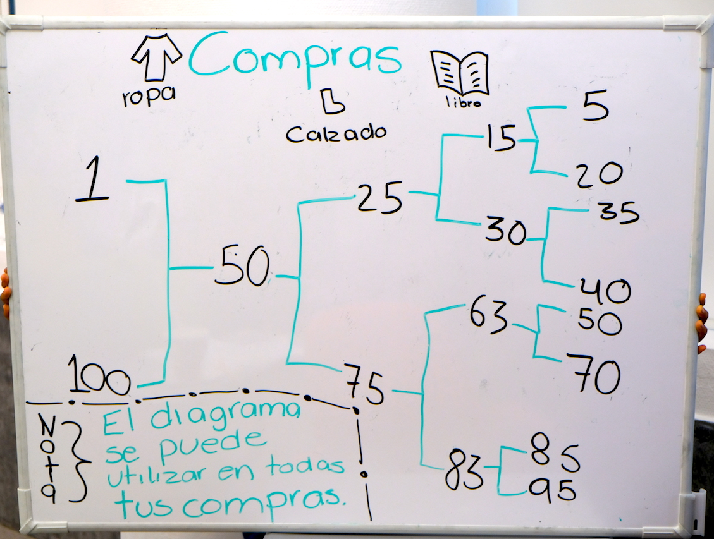
Activity: Binary Decision Trees

Slide 25
AFTERNOON

Slide 26
Topics covered
Timers
Coordinate systems
Computational geometry
Simulation
Moving in time
Moving in space

Slide 27
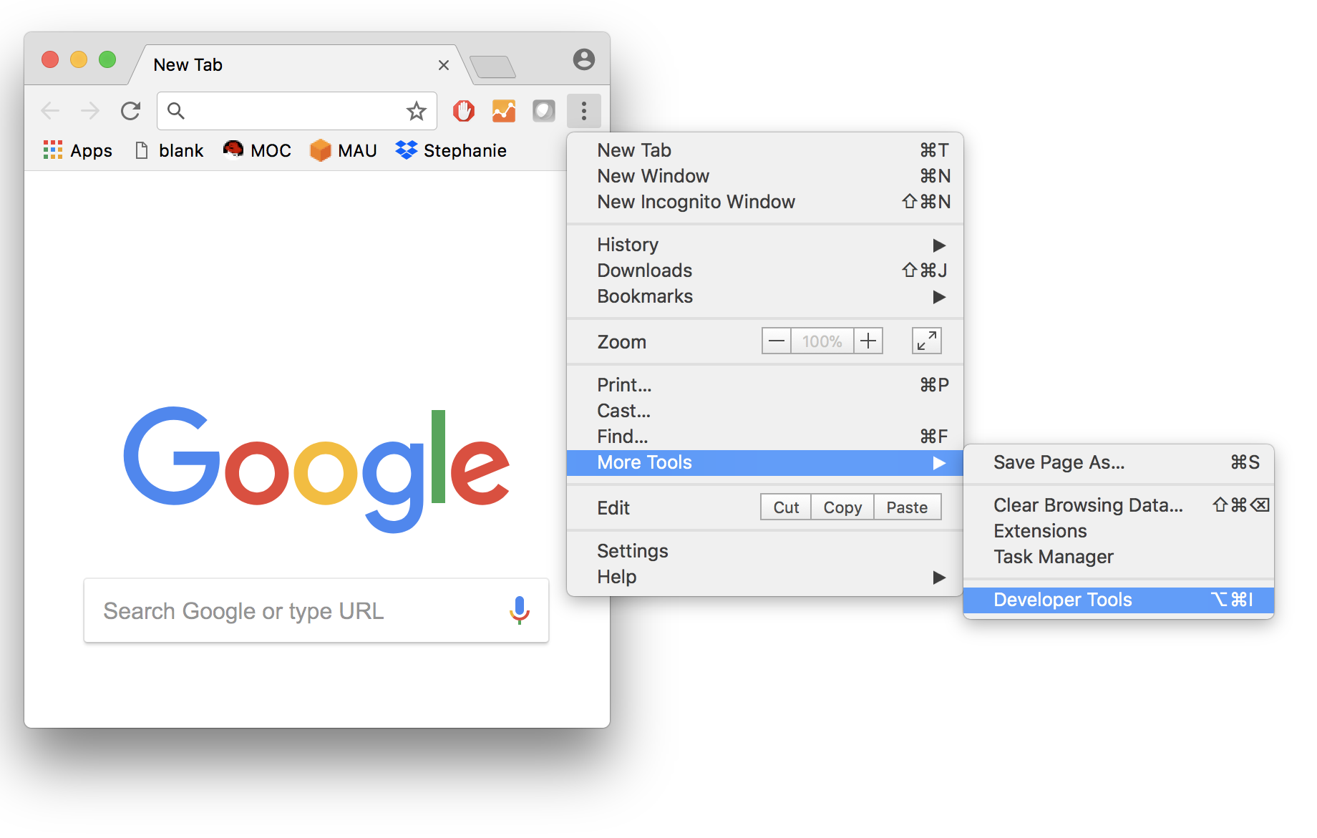
Browser console

Slide 28
Timers
var counter = 0;
setInterval(function(){
counter++;
console.log(counter);
}, 500);

Slide 29
Move ball in horizontal access using timer

Slide 30
Moving in time/space
var velocity = 5;
var position = 0;
var ball = document.getElementById('ball');
setInterval(function(){
position = position + velocity;
ball.style.left = position + 'px';
},100);

Slide 31
Edge detection
var velocity = 5;
var position = 0;
var ball = document.getElementById('ball');
setInterval(function(){
if(position > 200 || position < 0){
velocity = -1*velocity;
}
position = position + velocity;
ball.style.left = position + 'px';
},100);

Slide 32
Bonus - 2D
Same but for X and Y

Slide 33
Bonus
Change speed on bounce
Change color on bounce
Change color depending on x direction
Change color depending on y direction
Change size on bounce
Multiple balls moving at different speeds
Collision detection, detect when one ball collides against another

Slide 34
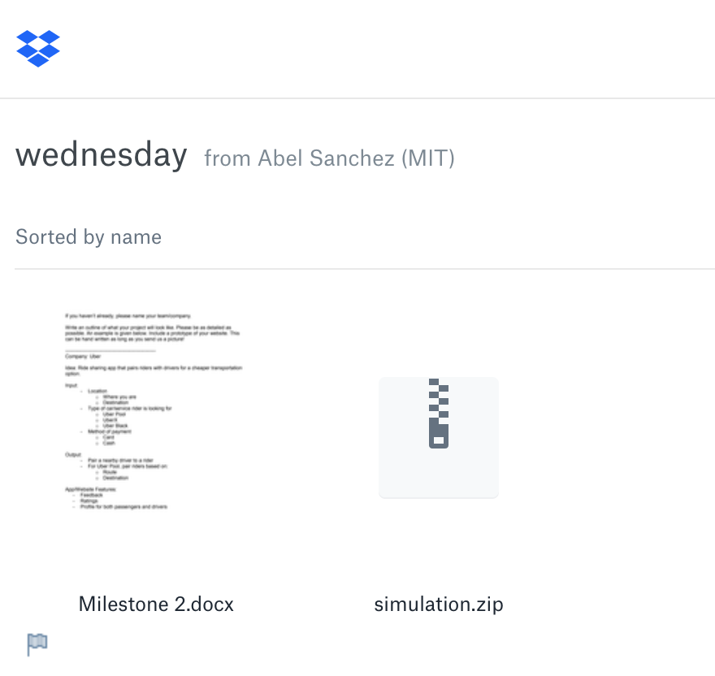
Project Time – http://bit.ly/patronx
Milestones
Document

Slide 35
END OF THE DAY TASKS

Slide 36
Instructor – Submit Reflection
Upload to
TBD

Slide 37
TA – Submit Reflection
Upload to
TBD

Slide 38
Students – Submit Reflection
Upload to
TBD

