Slide 1
Tuesday
Abel Sanchez

Slide 2
Data Collection
Collaborative Wall
Today’s question: What are you nervous about this week?
Take photo at end of day
Document via photos & video
Document via photos & video with your phone. Specifically, try to capture times when learning is being demonstrated: the students giving explanations of their solutions, describing applications of algorithms, or presenting their projects. Upload to Dropbox, link to follow.

Slide 3
Create Teams – 10 mins
First activity of day
Create teams yourself
Other strategies for forming groups
http://www.supportrealteachers.org/techniques-for-forming-groups.html

Slide 4
Magician – Binary search
Solution
Sixteenth card at start
Eight of hearts
Must choose from 16th to 32nd cannot choose sixteenth or thirty two
Throw closed
Down up
Throw away downs
Important: spread deck right-to-left

Slide 5
Students: how does work?
Let them try …

Slide 6
Give them the answer
Ask them to demonstrate …
Demo
https://youtu.be/AexEv32fLz0
Solution
https://youtu.be/nfwJW0N2Ds8

Slide 7
Competition
Teams select representative
Teams compete against each other

Slide 8
Teach Binary counting
THERE ARE ONLY 10 TYPES
OF PEOPLE IN THE WORLD:
THOSE WHO UNDERSTAND BINARY
AND THOSE WHO DON'T

Slide 9
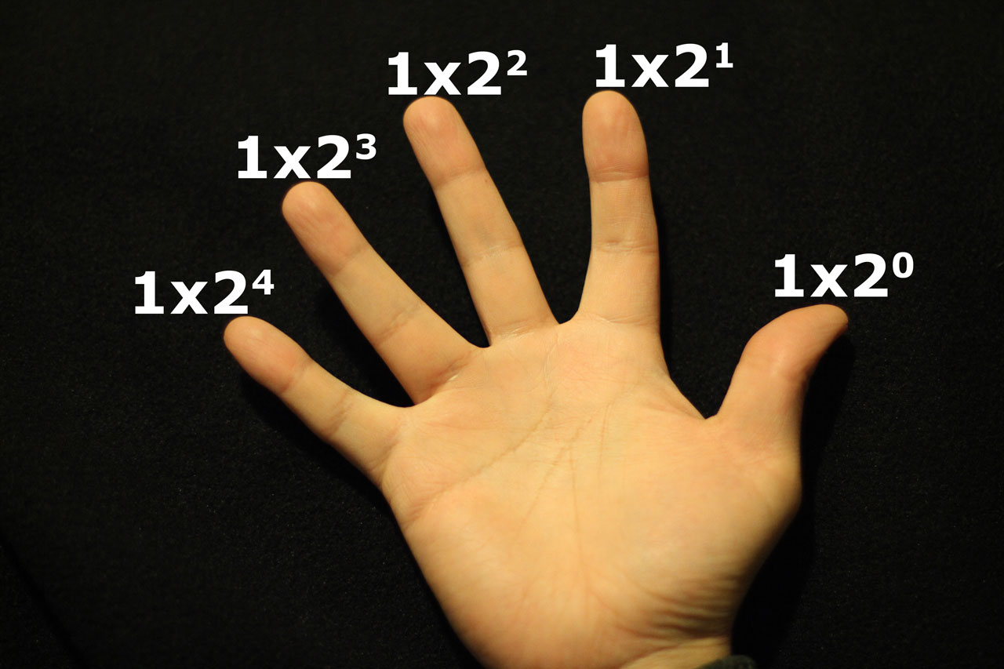

Slide 10
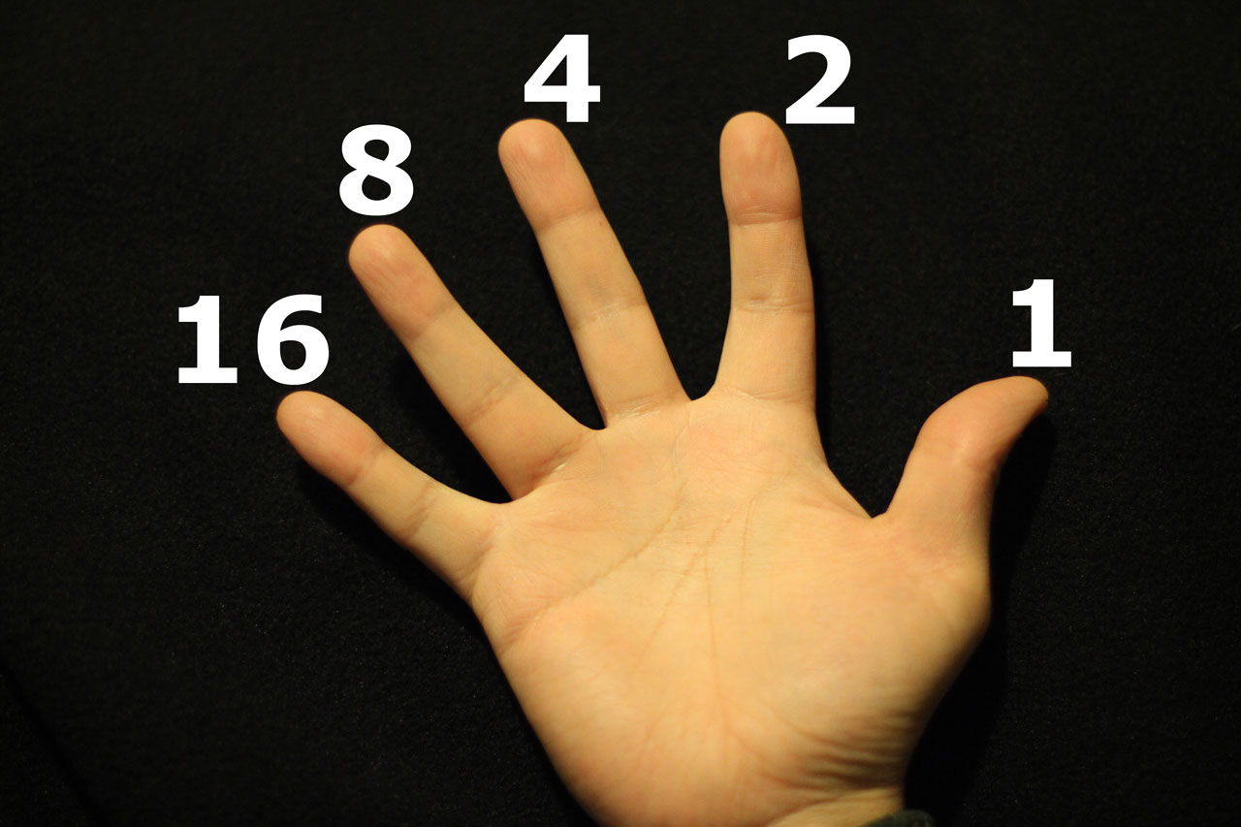

Slide 11
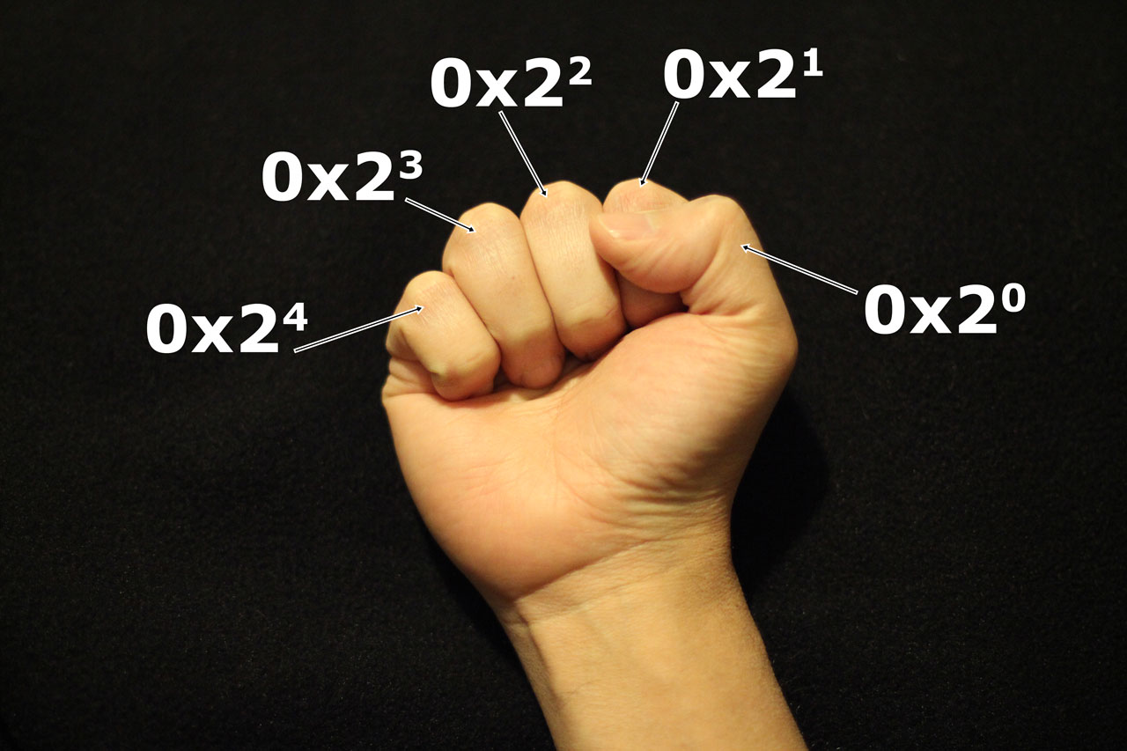

Slide 12
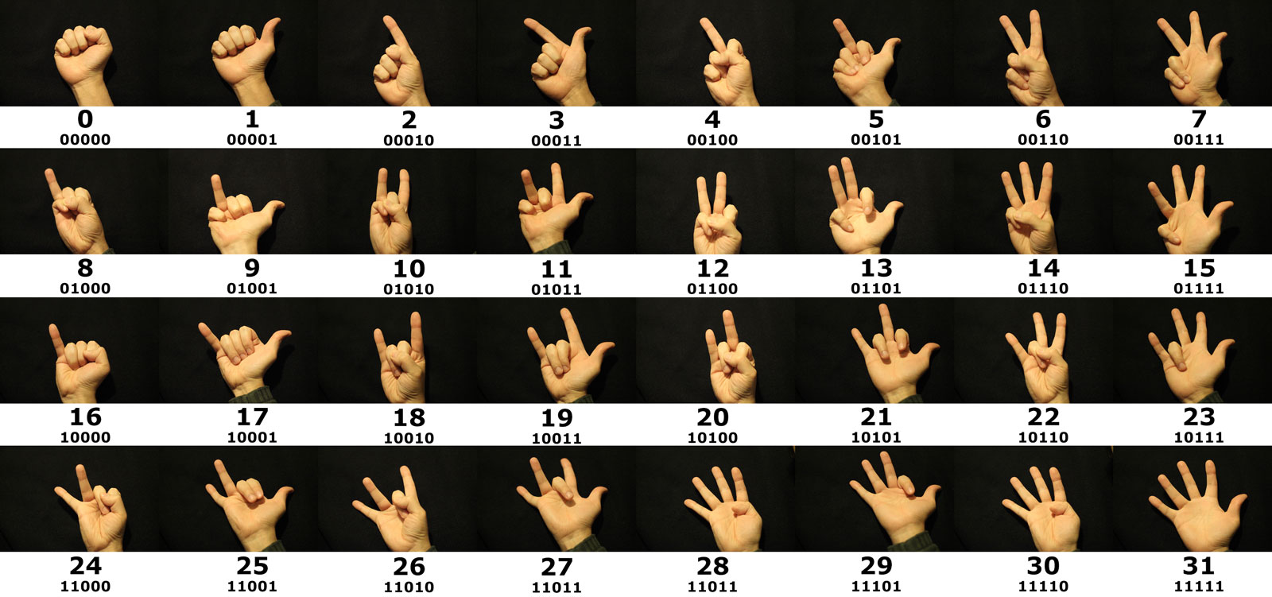

Slide 13
Binary counting activity
Practice binary counting
Optional: consider increasing to both hands

Slide 14
Class competition – Individual, not teams
Fun …

Slide 15
Binary clock activity
Explain problem
Have every team create a binary clock
Every team presents solution

Slide 16
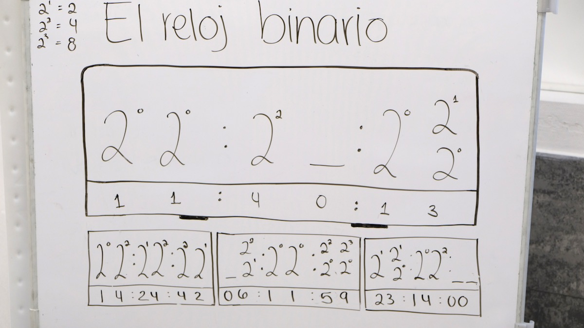
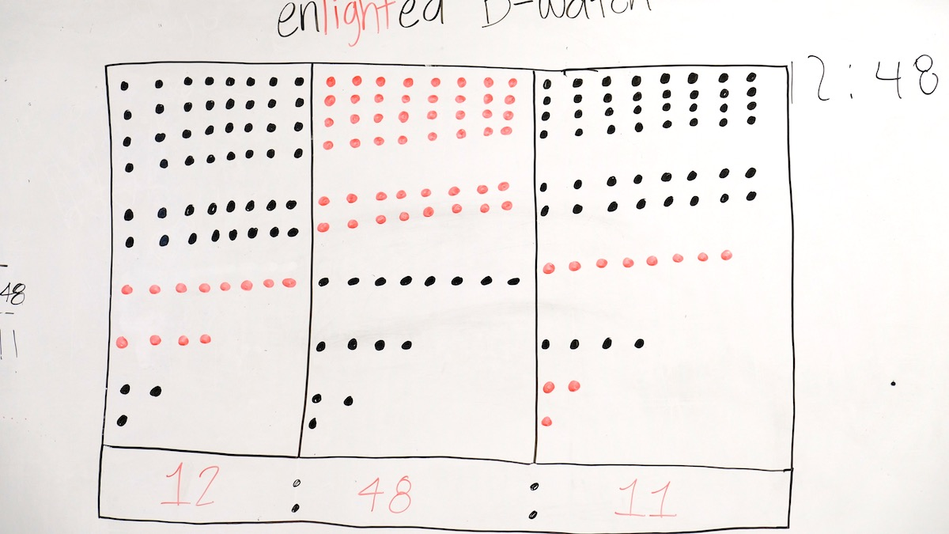
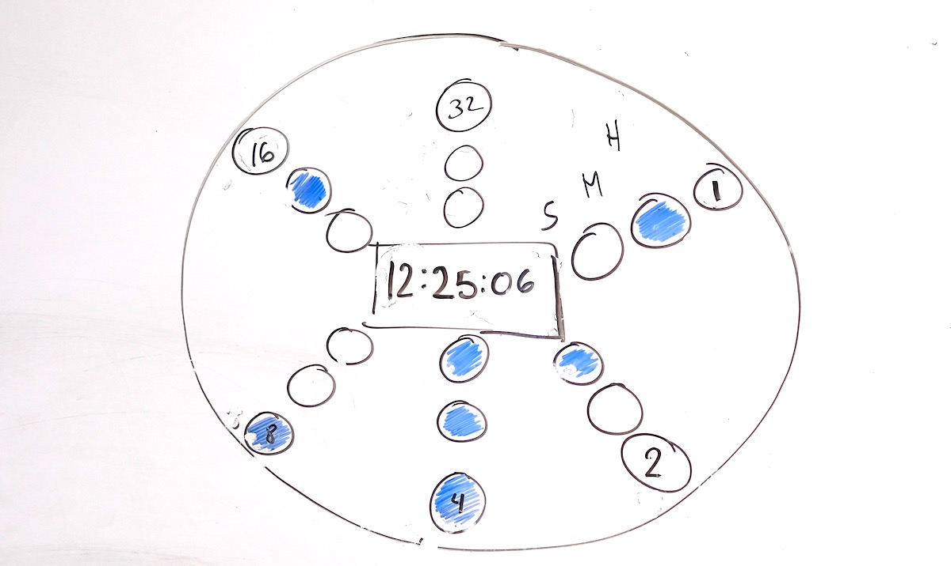
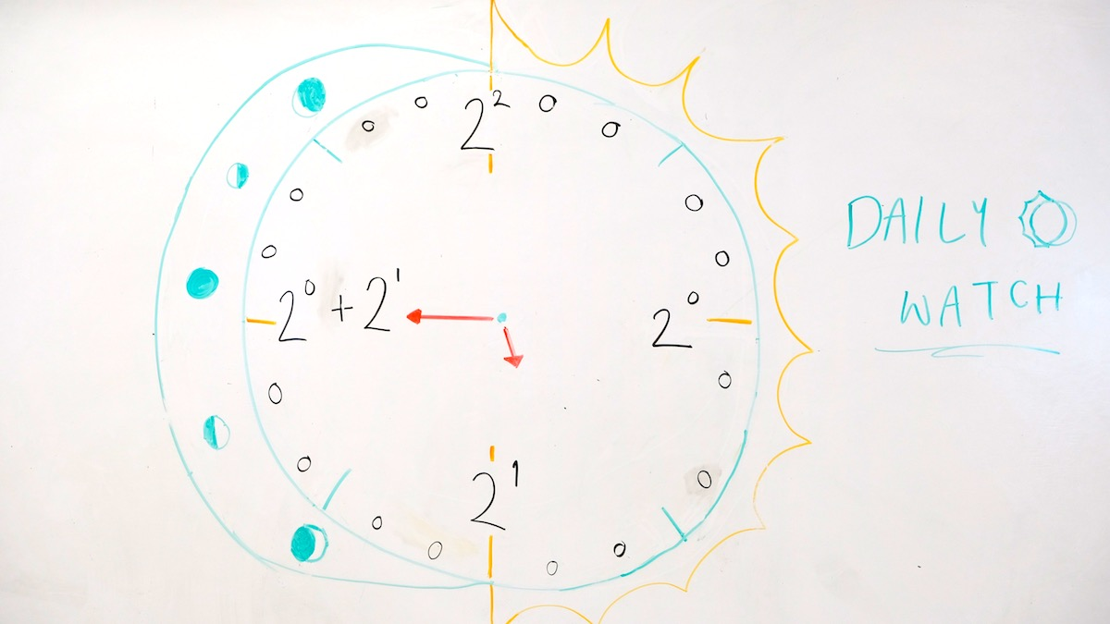
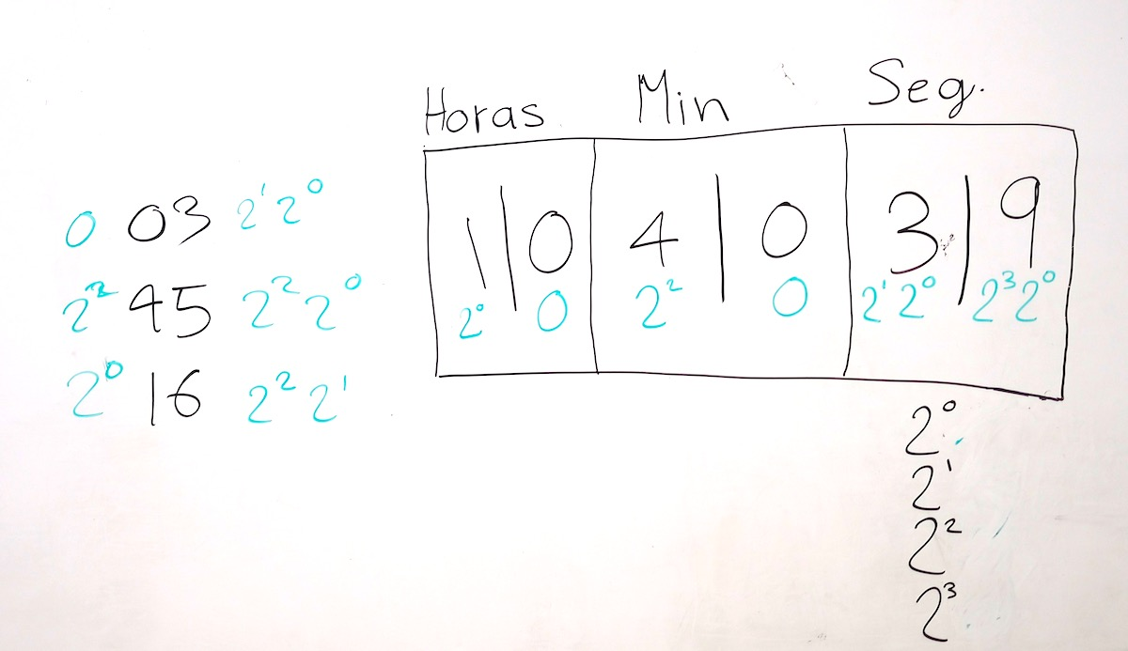
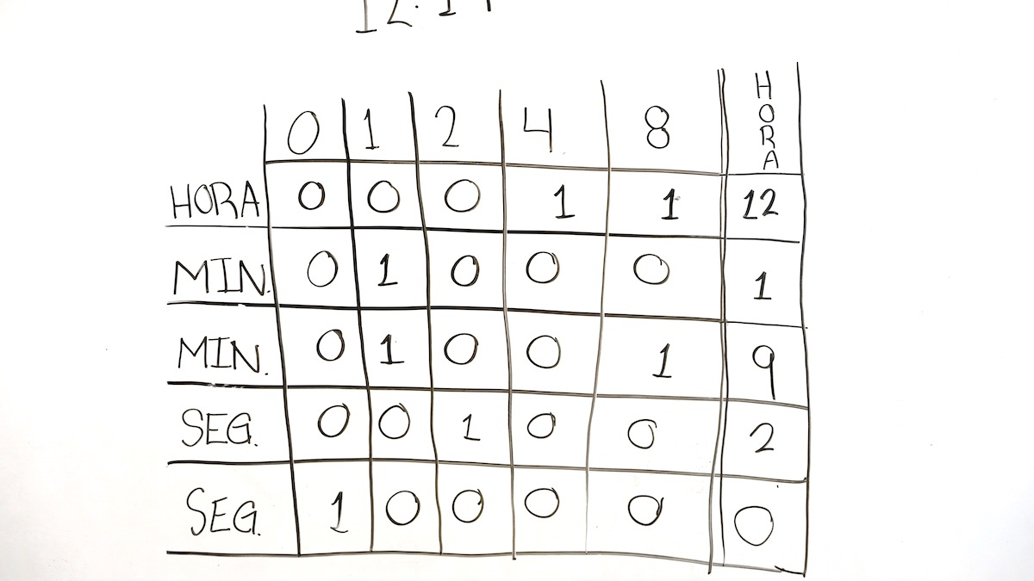
Samples

Slide 17
AFTERNOON

Slide 18
Topics covered
Variables
Arrays
Conditional statements
Loops
Functions

Slide 19
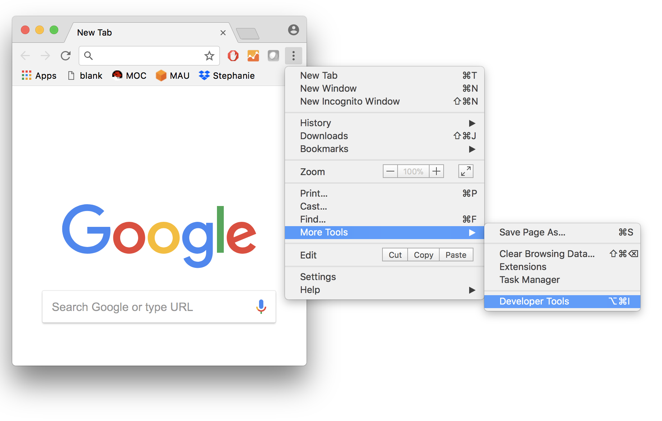
Browser console

Slide 20
Create a variable
var ball;

Slide 21
Calling functions
// function calls
ball = create();
size(ball,200,200);
color(ball,255,0,0);
move(ball,50,50);
colorRandom(ball);
zIndex(ball,5);
repeatMove(ball, 10, 10, 5);

Slide 22
Loops
// loop exercise
var counter = 0;
while (counter < 10) {
create();
counter++;
}

Slide 23
Arrays
// arrays exercise
var list = [];
list.push(create());
list.push(create());
list.push(create());
list.push(create());
// change color of balls in array
var i=0;
var length = list.length;
while (i < length) {
var ball = list[i];
colorRandom(ball);
i++;
}

Slide 24
Painting
// length of array with painting information
var length = data.length;
// create a ball for each color
for (var i = 0; i < length; i++) {
var ball = data[i];
create(ball.x,ball.y,ball.color);
}

Slide 25
Bonus
// create(0,0,painting[400]);
// create(15,0,painting[401]);
// create(30,0,painting[402]);
// create(45,0,painting[403]);
// create(60,0,painting[404]);
// create(75,0,painting[405]);
// create(90,0,painting[406]);
// create(105,0,painting[407]);
for(var j=0; j<81; j++){
y = j*15;
for(var i=0; i<53; i++){
x = i*15;
//create(x,y,painting[counter]);
data.push({x:x,y:y,color:painting[counter]});
counter++;
}
}

Slide 26
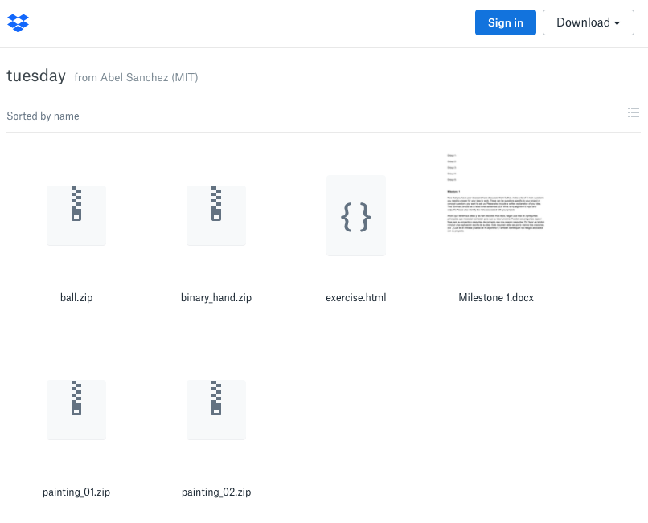
Project Time – http://bit.ly/patronx
Milestones
Document

Slide 27
END OF THE DAY TASKS

Slide 28
Instructor – Submit Reflection
Upload to
TBD

Slide 29
TA – Submit Reflection
Upload to
TBD

Slide 30
Students – Submit Reflection
Upload to
TBD

