Slide 1

Simulation

Slide 2
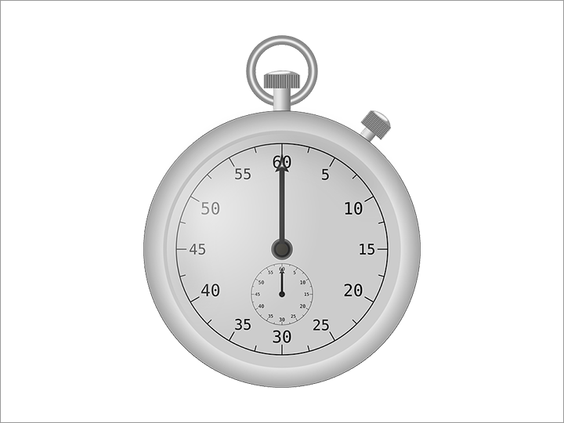
Topics covered
Timers
Coordinate systems
Computational geometry
Simulation
Moving in time
Moving in space

Slide 3
Schedule execution in the future
The name of the
function to execute
command
time to wait
setTimeout(functionName,2000);

Slide 4
Example
function sayHello(){
console.log('Hello World');
}
setTimeout(sayHello,2000);
command
The name of the
function to execute
time to wait

Slide 5
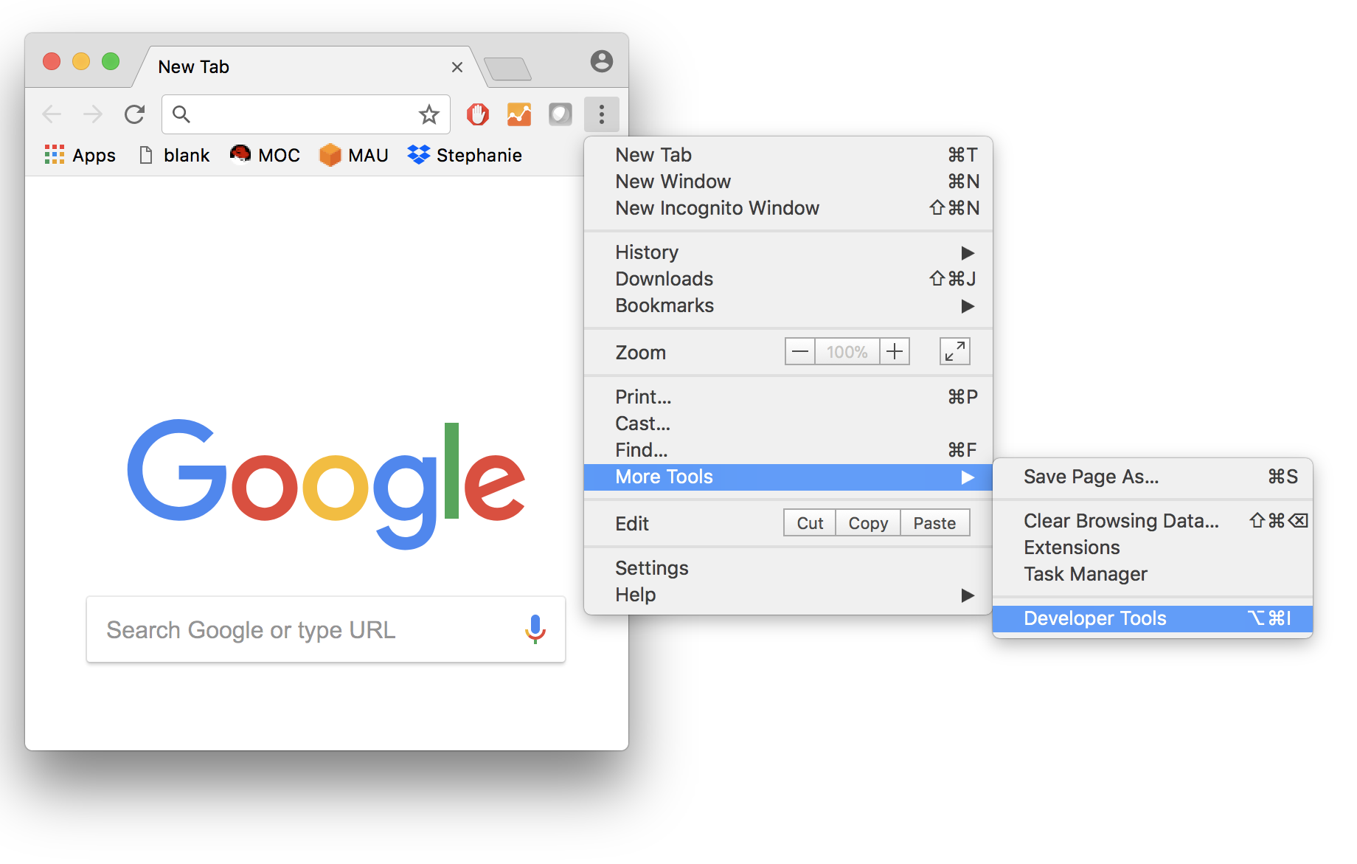
Browser console

Slide 6
Different notation
setTimeout(function(){
console.log('Hello World!');
},2000);
command
function to execute
time to wait

Slide 7
Active learning
Schedule computation into the future

Slide 8
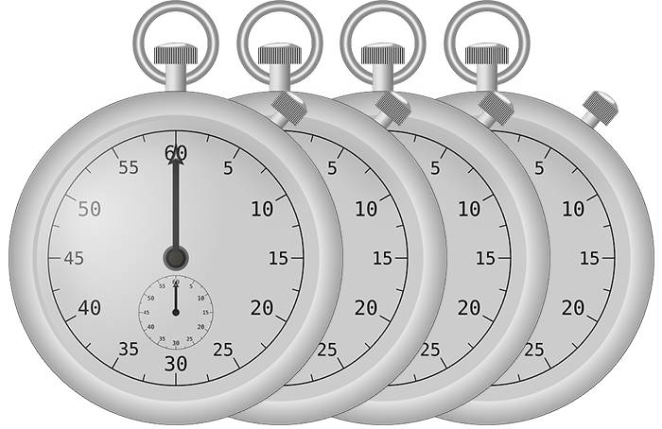
Schedule repeating execution
The name of the
function to execute
command
time to wait
setInterval(functionName,2000);

Slide 9
Example
function sayHello(){
console.log('Hello World');
}
setInterval(sayHello,2000);
command
The name of the
function to execute
time to wait

Slide 10
Different notation
setInterval(function(){
console.log('Hello World!');
},2000);
command
function to execute
time to wait

Slide 11
Active learning
Schedule repeating computation into the future

Slide 12
Active Learning – what will the following do?
var counter = 0;
function myFunction(){
counter++;
console.log(counter); }
setInterval(myFunction,3000);

Slide 13
Active Learning
Can you explain what is happening?
Can you modify the function to increase by 5 on each console write?
Can you create exponential growth?

Slide 14
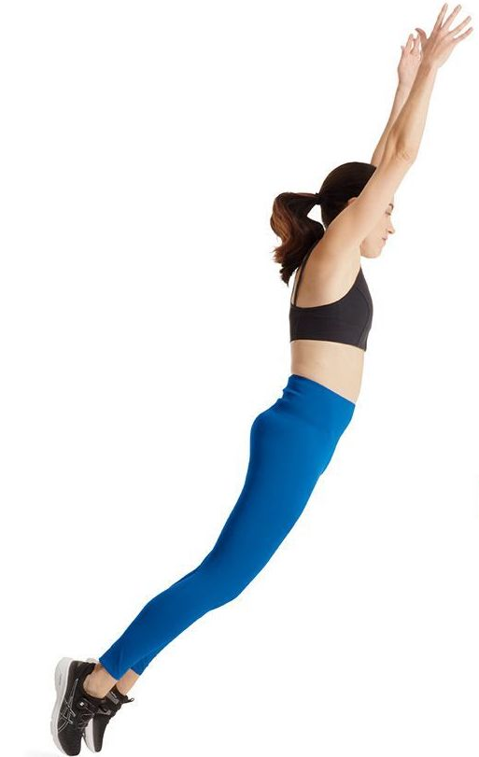
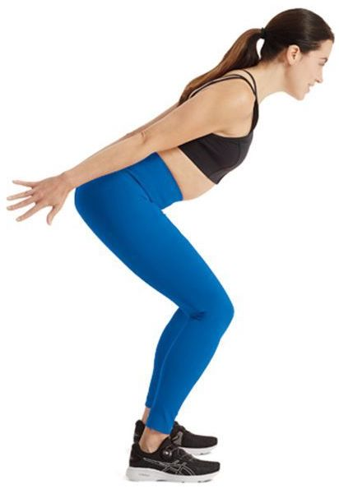
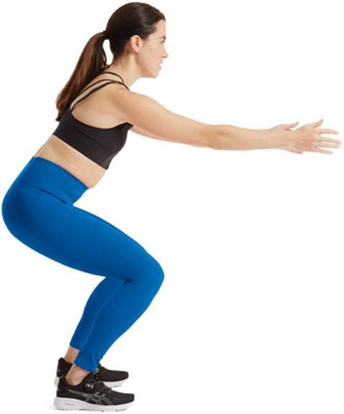
Time
Position

Slide 15
Time: move every 3000 ms
Position: move 5 units

Slide 16
3000
3000
3000
3000
3000
Time
5
10
15
20
25
Position

Slide 17
Active Learning – what will the following do?
var time = 3000;
var position = 0;
var velocity = 5;
function myFunction(){
position = position + velocity;
console.log(position); }
setInterval(myFunction,time);

Slide 18
Active Learning
Can you explain what is happening?
What is happening with “position”?
Could you use this approach to model the physical world?

Slide 19
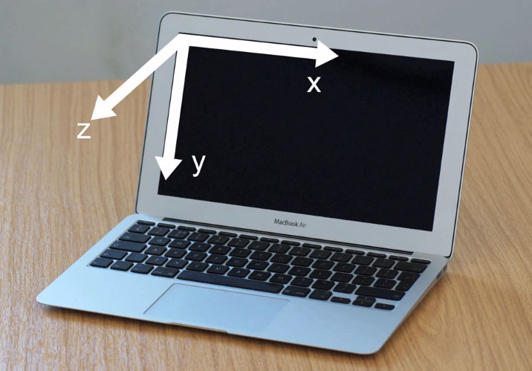
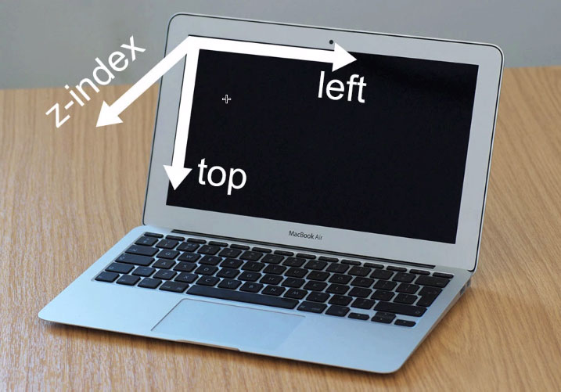
The horizontal axis is called “left”

Slide 20
<div id="ball" style="
z-index:5;
position:absolute;
left:0px;
top:200px;
width:100px;
height:100px;
border-radius:50%;
background:black">
</div>
<script>
var velocity = 20;
var position = 0;
var ball = document.getElementById('ball');
// move ball
position = position + velocity;
ball.style.left = position + 'px';
</script>
Solid Circle id is “ball”
Get “ball”
Set “ball” position

Slide 21
Demo

Slide 22
Active Learning: Your turn, Move ball in horizontal axis

Slide 23
Active Learning: Move ball in horizontal axis using timer

Slide 24
Active Learning: starter code
<div id="ball" style="
z-index:5;
position:absolute;
left:0px;
top:0px;
width:50px;
height:50px;
border-radius:50%;
background:green"></div>
<script>
var velocity = 5;
var position = 0;
var ball = document.getElementById('ball');
// YOUR CODE
// ----------------
</script>

Slide 25
Demo

Slide 26
Active Learning: edge detection
edge
edge

Slide 27
Demo

Slide 28
Bonus, 2D – do the same for X and Y
edge
edge
edge
edge

Slide 29
Active Learning: starter code
<div id="ball" style="
z-index:5;
position:absolute;
left:0px;
top:0px;
width:50px;
height:50px;
border-radius:50%;
background:green"></div>
<script>
var velocityX = 5;
var velocityY = 3;
var positionX = 0;
var positionY = 0;
var ball = document.getElementById('ball');
// YOUR CODE
// ----------------
</script>

Slide 30
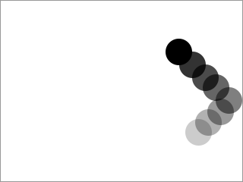
Demo

Slide 31
Bonus
Change speed on bounce
Change color on bounce
Change color depending on x direction
Change color depending on y direction
Change size on bounce
Multiple balls moving at different speeds
Collision detection, detect when one ball collides against another

Slide 32
Demo

Slide 33
How to play a sound
<input type="button" value="PLAY" onclick="play()">
<audio id="audio" src="sound.wav"></audio>
<script>
function play(){
var audio = document.getElementById("audio");
audio.play();
}
</script>

Slide 35
Active Learning: edge detection

