Slide 1
Monday
Abel Sanchez

Slide 2
Create Teams – 10 mins
First activity of day – don’t explain
Number 1-to-5
1s together
2s together
3s together
…
Opportunity to talk about patterns later on

Slide 3
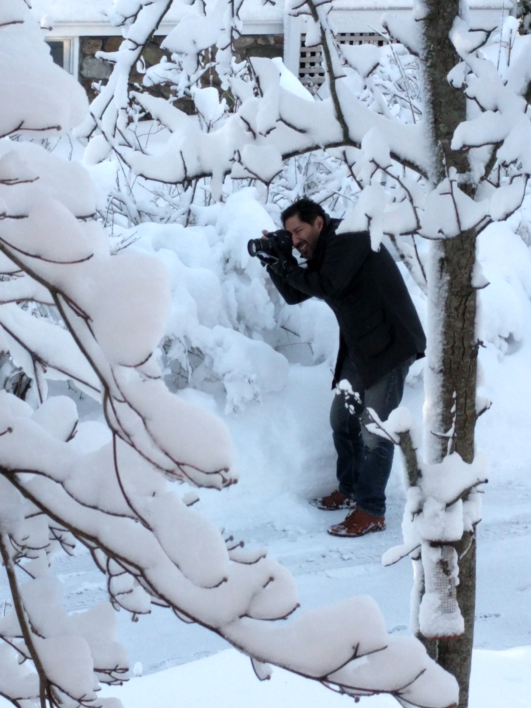
Instructor: Introduce yourself – 5 mins
Make it fun!
Who are you?
Where are you from?
What do you do for fun
Let them see you as a scientist
Let them see you as a person

Slide 4
Students: Introduce Yourself – 15 mins
Name
Why are you taking the class
DO NOT ASK where are you from (home address)?
City is okay
Hobbies
Instruments
Sports
Most common hobby was dance in 2017

Slide 5
Ice breaker - Draw a scientist – 15 mins
Hand-out Index cards
Collect
Group by patterns
Tape to wall

Slide 6
TA Task - Take photos of each index card
Upload to
TBD

Slide 7
Introduction – Beautiful Patterns – 15 mins
What were the patterns in scientist drawings?
What is a pattern?
Everyday patterns
User patterns derived from of students hobbies
Restaurant as a computer analogy
Emphasis: every academic field is a set of patterns
(Practicing professionals: apply domain patterns)

Slide 8
Maximize Happiness – 30 mins

Slide 9
Maximizing the happiness of a dating group
Explain the problem connecting to real life
The classic problem
You might like him/her, he/she may not like you
Levels of like
A fun discussion to have

Slide 10
Distribute materials
Provide students with cards
Provide students with card configuration
Ask them to maximize happiness
Scoring system
1st choice: 4 pts
2nd choice: 3 pts
3rd choice: 2 pts
4th choice: 1 pts

Slide 11
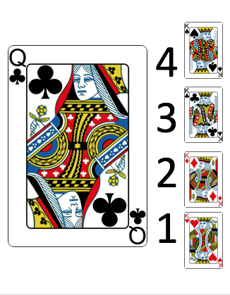
Sample Setup Image – Show one by one

Slide 12
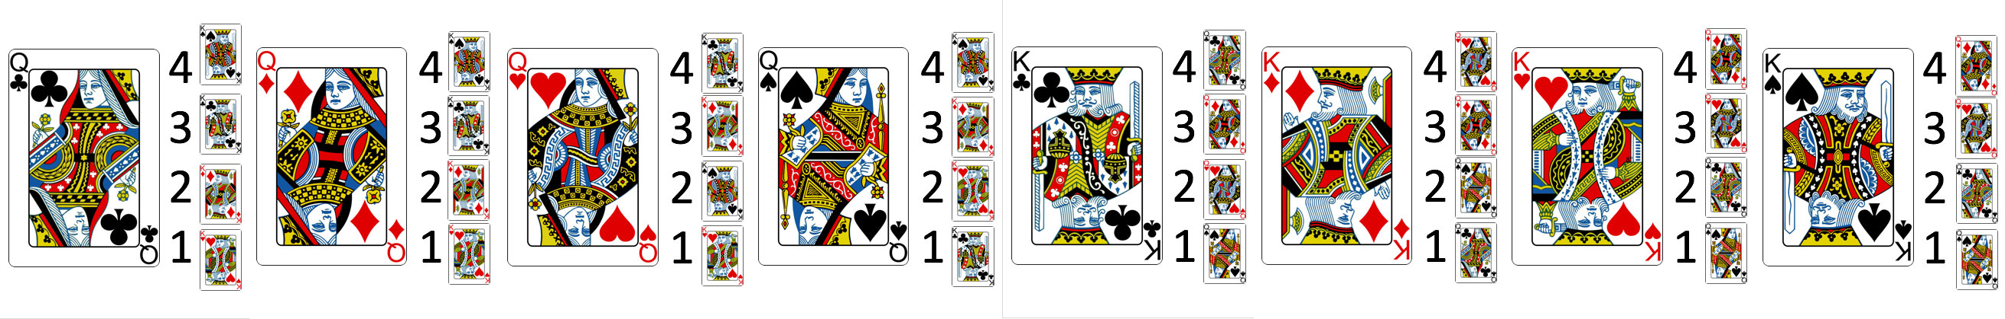
The complete list – PPT deck in git repo

Slide 13
Students compete for highest score

Slide 14
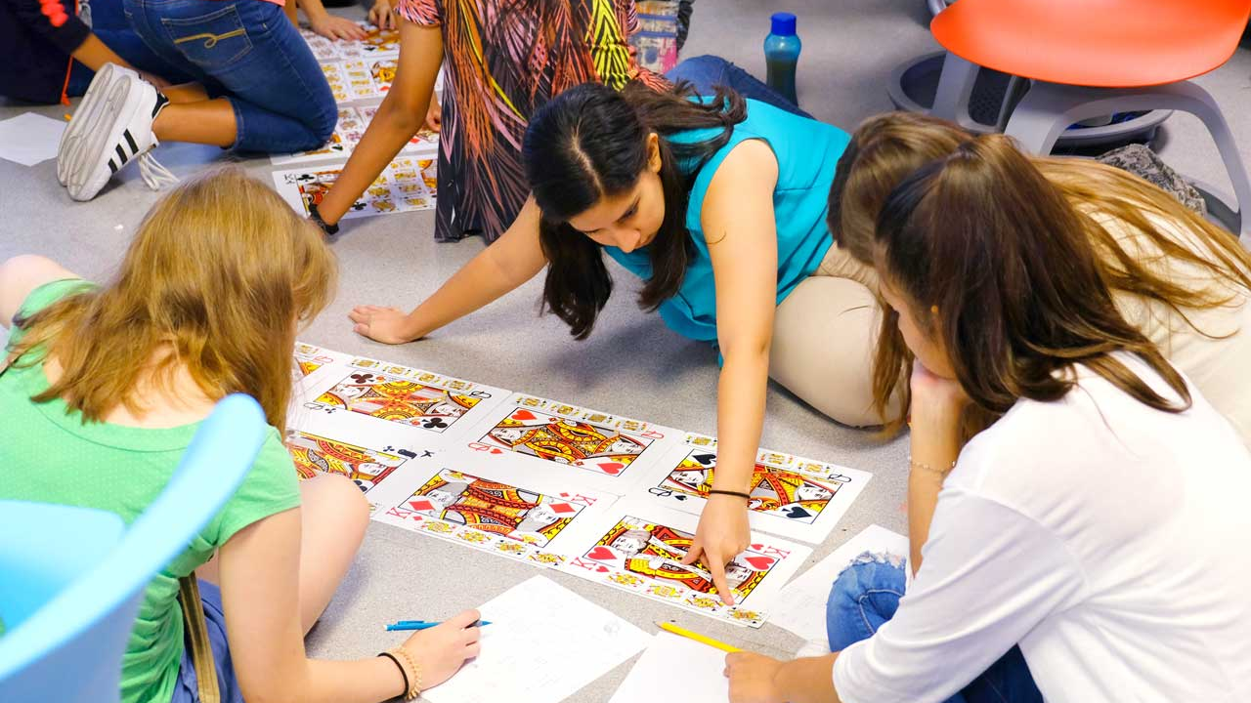
Student work – 30 mins

Slide 15
Gale-Shapley – phase 1 – 15 mins

Slide 16
With Algorithm – Round 1
Queens select their top 4 choices
Queens make proposals to their top choice (first paring)
King consider offers
King selects top offer (rejects others)
Rejected queens top choice is removed

Slide 17
With Algorithm – Round 2
Queens select their next top choice
King consider offers
King selects top offer (rejects others)
Rejected queens top choice is removed

Slide 18
Gale-Shapley – phase 2 – 1 hour

Slide 19
Apply Gale-Shapley to something of their own choosing
Explain problem
Support application
Every team presents

Slide 20
AFTERNOON

Slide 21
High level description of a computer
The restaurant analogy
Explain that we will write instructions
The computer will interpret them

Slide 22
Topics covered – Code for day is declarative
HTML
CSS
Screen coordinate system
Z-Index
DIV properties

Slide 23


<div style="
z-index:5;
position:absolute;
left:100px;
top:200px;
width:100px;
height:100px;
border-radius:50%;
background:black">
</div>
<div style="
z-index:5;
position:absolute;
left:100px;
top:200px;
width:100px;
height:100px;
border-radius:50%;
border: 3px solid">
</div>

Slide 24
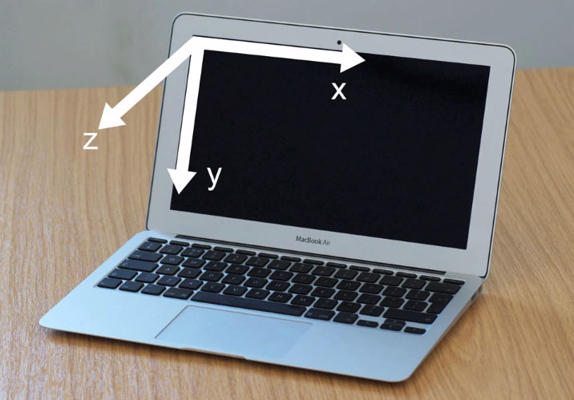
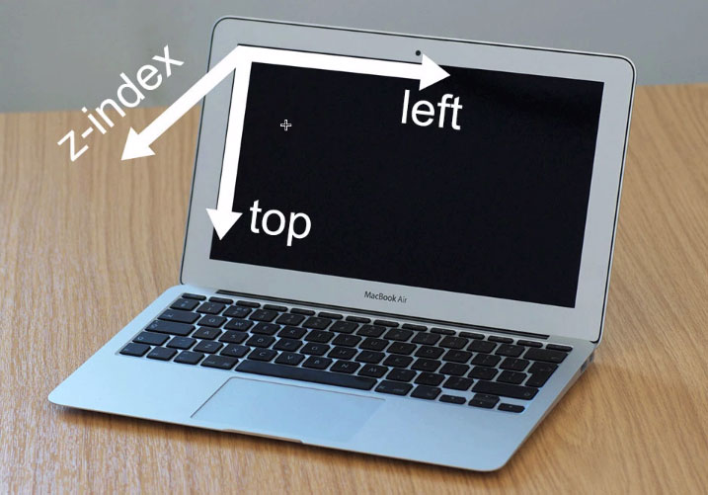
Coordinates

Slide 25


Slide 26
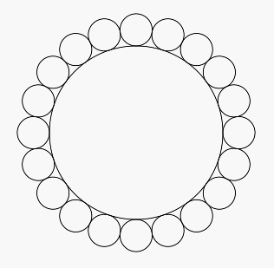

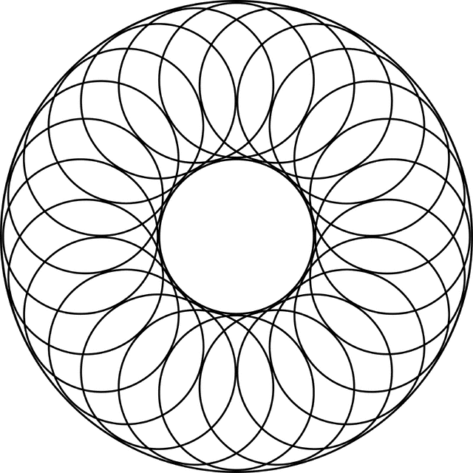
https://css-tricks.com/examples/ShapesOfCSS/

Slide 27
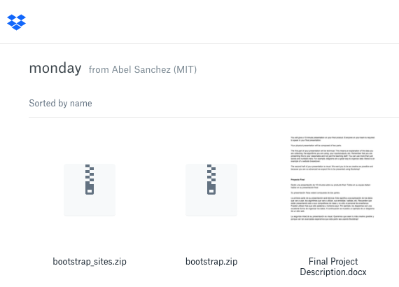
Bootstrap – http://bit.ly/patronx

Slide 28
Project – http://bit.ly/patronx

Slide 29
END OF THE DAY TASKS

Slide 30
Instructor – Submit Reflection
Upload to
TBD

Slide 31
TA – Submit Reflection
Upload to
TBD

Slide 32
Students – Submit Reflection
Upload to
TBD

